Slide 1
MAS Project - Task 1
Design of the Multi-Agent System

Slide 2


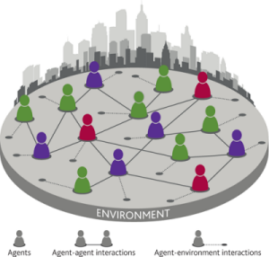

Introduction to the Project
Use of a Multi-Agent System
UCI’s Audit dataset
Firm Fraudulent or not Fraudulent
Notes:
Anne

Slide 3
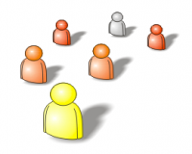
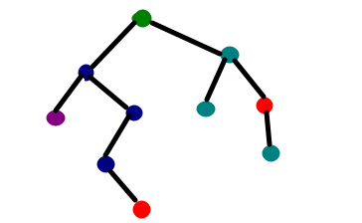
Requirements to fulfil
10 or more classifier agents
Classifiers trained using Weka + decision tree model
Notes:
Anne

Slide 4
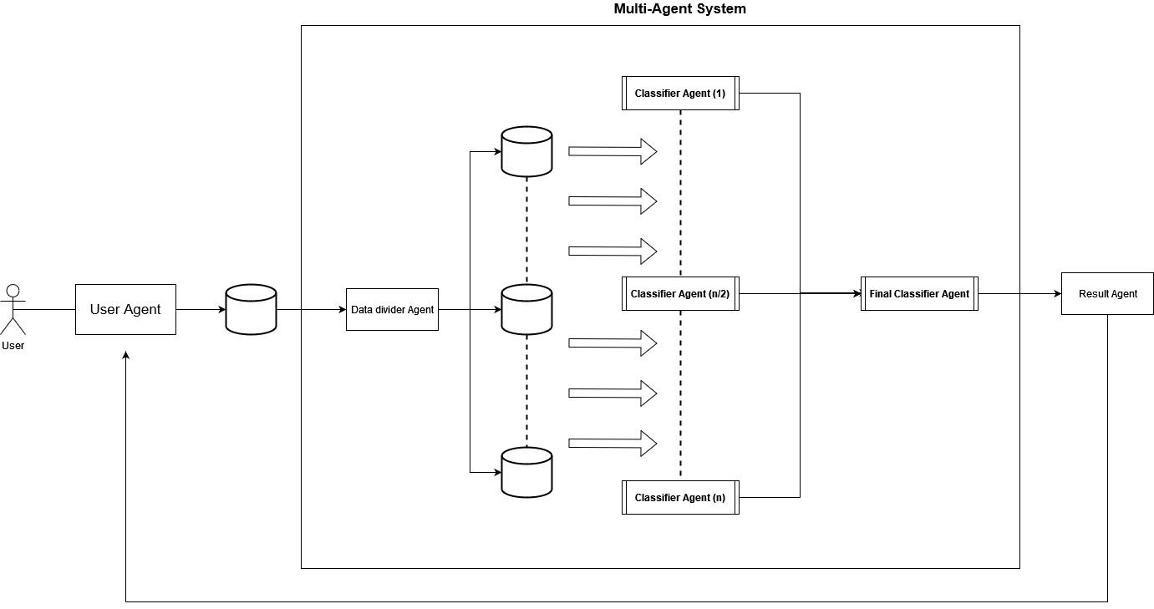
Design
Notes:
Anne

Slide 5
User Agent
Type: Interface agent
Properties:
Reactive
Social Ability
Rational
Autonomous
Function/ Behavior:
Interact with the user
Receive the data set
Display the system’s prediction
Notes:
Genevieve
Reactive: We are considering a static environment where we only have the agents that conform our system, and the human agent that wants to use the system. Given that this is the only agent that communicates with the human agent, it is the one from whom we must assure a continuous interaction with the environment, and a fast response time.
Social Ability: This agent interacts with the human agent, the Data Divider Agent, and the Result Agent, hence this property. The interaction with the human agent might require a different language to the one used with the software agents.
Rational: This agent will only act towards handling the user queries, and it will never act against it, nor will it give fake results.
Autonomous: This agent will perform its tasks without user interaction or guidance, only restricted by the user configuration.

Slide 6
Data Divider Agent
Type: Broker
Properties:
Reactive
Social Ability
Rational
Autonomous
Function/ Behavior:
Divides training data in subsets of 300 instances and 6 attributes
Creates new data sets passing them to the classifiers
Passes the test instances to a classifier if the instance contains the classifier attributes
Notes:
Shivani
Architecture: Reactive
Properties:
Reactive: The agent can receive different datasets given by the User Agent. The agent interacts with the said agent, and passes the processed data to the next agent, maintaining the interaction between them.
Social Ability: The agent interacts with different agents within the system.
Rational: Applies a set of rules while dividing the data and allocating them to different classifier agents. The agent will try to archive at any moment its task and will not act off of its delegated purpose within the system.
Autonomous: This agent has autonomy as it does not need the user interaction to perform its designated tasks.

Slide 7
Classifier Agent
Type: Wrapper
Properties:
Learning
Proactive
Reasoning
Autonomous
Rational
Social Ability
Function/ Behavior:
Trains a decision tree model
Validates model with performance metrics (e.g. accuracy)
Classifies new data into fraudulent or normal
Outputs test predictions and performance metrics to the coordination mechanism
Notes:
Joaquim
Learning: The agent learns a model that is able to distinguish at some extent normal and altered data from a firm. Selecting the best feature at each step, the cutting point for each feature, the post-pruning it does with the validation set, can result in different trees with different performances. However, once the model has been built, it will not learn more if it does not receive more data outside the initial dataset to refine the resulting trees.
Proactive: As a classifier, these agents have a goal-directed behavior (computing predictions for a subset of data). While learning, it takes initiative, when necessary, to ensure the best classification performance.
Reasoning: We can consider that this agent reasons, given that it uses its knowledge-base (e.g. the model) to infer the predictions for each queried instance.
Autonomous: This agent is autonomous because it builds, and later traverses the model on its own to give predictions, without the help of the user.
Rational: This agent is rational, as it will never give a prediction that is contrary to what its model says. It can happen that the model is not good enough and the prediction is incorrect. However, the agent is still rational.
Social Ability: This agent needs to interact with the Data Divider as well as the Final Classifier.

Slide 8
Final Classifier Agent
Type: Wrapper (collaborative)
Properties:
Learning
Proactive
Social ability
Reactive
Autonomous
Rational
Function/ Behavior:
Builds a model/function that weights each classifier using their performance metrics
Obtains a final prediction for each instance
Passes the final predictions to the Result agent
Notes:
Ruben
Learning: Given that it learns a set of weights for each intermediate classifier, it will try to learn those that give the best performance when obtaining the final prediction.
Proactive: Has the goal of learning a model that best classifies instances, so it proactively tries to learn the model with the best performance.
Social ability: Works in a coordinated way with all previous classifier agents, as well as with the result agent.
Reactive: Maintains an ongoing interaction with its environment and responds to changes that occur.
Autonomous: Has agency to make decisions, decide on which weight to give to the predictions of a specific agent, to achieve its goal efficiently, and the best possible performance metrics.
Rational: It always gives a prediction using the learned model, so it will never give one contrary to its objective of classifying firm instances.

Slide 9
Result Agent
Type: Information agent
Properties:
Social ability
Rational
Autonomous
Function/ Behavior:
Retrieves output information from final Classifier Agent
Sends the final prediction to the User Agent
Notes:
Anne
Social ability: Interacts with the Final Classifier Agent to gather relevant information.
Rational: Once it acquires the relevant information, it will give it to the User Agent.
Autonomous: Self-regulated, makes decisions about actions to take to fulfill its goal, which is to gather information from the Final Classifier Agent.

