Slide 1
IMAS Project
Agent-based Decision Support System (A-DSS) for Fraud Classification

Slide 2


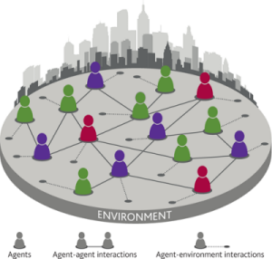

Introduction to the Project
Use of a Multi-Agent System
UCI’s Audit dataset
Firm Fraudulent or not Fraudulent

Slide 3

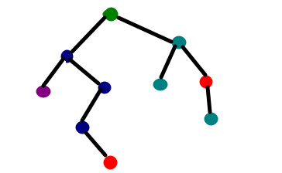
Requirements to fulfil
10 or more classifier agents
Classifiers trained using Weka + decision tree model

Slide 4
System Design

Slide 5
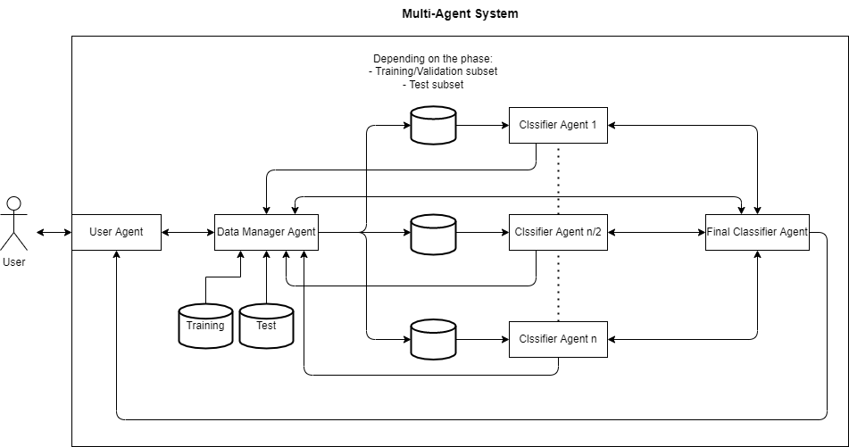
Final design

Slide 6
User Agent
Type: Interface agent
Properties:
Reactive
Social Ability
Rational
Autonomous
Temporal Continuity
Architecture: Reactive
Function/ Behavior:
Interact with the user
Receive the system configuration
Receive test queries
Pass them to the Data Manager Agent
Display the system’s predictions

Slide 7
Data Manager Agent
Type: Broker
Properties:
Reactive
Social Ability
Rational
Autonomous
Temporal Continuity
Architecture: Reactive
Function/ Behavior:
Divides training data in subsets of 300 instances and 6 attributes
Creates new data sets passing them to the classifiers
Passes the test instances to a classifier if the instance contains the classifier attributes

Slide 8
Classifier Agent
Type: Wrapper
Properties:
Learning
Proactive
Reasoning
Autonomous
Rational
Social Ability
Temporal Continuity
Reactive
Architecture: Hybrid
Function/ Behavior:
Trains a decision tree model
Validates model with performance metrics (i.e. F1-score)
Classifies new data into fraudulent or normal
Outputs test predictions and performance metrics to the coordination mechanism

Slide 9
Final Classifier Agent
Type: Collaborative
Properties:
Reactive
Social Interaction
Rational
Autonomous
Temporal Continuity
Architecture: Reactive
Function/ Behavior:
Combines predictions using a weighted Plurality Voting (weights given by the F1-scores)
Obtains a final prediction for each test instance rounding the average to either 0 or 1
Passes the final predictions to the User Agent

Slide 10
Implementation

Slide 11
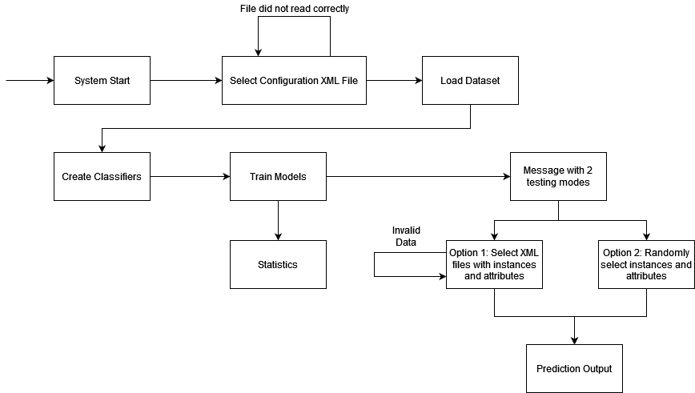
General Functionality of the System

Slide 12
User Agent States
State | Initialised by | Ends on
InitSystem | NA; on system start up | Config file selection by user
WaitForTraining | Config file selection by user | INFORM training completion by Data Manager Agent
PerformTestQueries | INFORM training completion by Data Manager Agent REFUSE by Data Manager Agent on query provision Previous query completion | Query provision by user
WaitForQueriesAcceptance | Query provision by user | AGREE by Data Manager Agent on query validation
WaitForQueriesResults | AGREE by Data Manager Agent on query validation | INFORM by Final Classifier Agent regarding query results

Slide 13
Data Manager Agent States (I)
State | Initialised by | Ends on
WaitingForSystemConfiguration | NA; on system start up | Configuration received Datasets read Number of classifiers sent to Final Classifier Agent
WaitingForFinalClassifierAck | Number of classifiers sent to Final Classifier Agent | INFORM by Final Classifier Agent about receiving the number
CreateClassifiers | INFORM by Final Classifier Agent | Classifier Agents are created and the train and validation datasets are passed
WaitingForClassifiersToTrain | Classifier Agents created | All the Classifier Agent finish training INFORM is sent to the User Agent about finishing the training phase

Slide 14
Data Manager Agent States (II)
State | Initialised by | Ends on
WaitingForQueries | Training phase ends | Receiving the test query to process Validating the test query If invalid, a REFUSE is sent to the User Agent Otherwise: Test instances are preprocessed INFORM sent to Final Classifier with the number of involved classifiers
WaitingForClassifiersToPredict | INFORM from Final Classifier Agent regarding the number of involved Classifier Agents | All the Classifier Agents end predicting

Slide 15
Classifier Agent
J48 decision tree
Metric: F1-score

Slide 16
Classifier Agent States
State | Initialised by | Ends on
PendingToTrain | Being created by the Data Manager Agent | Training and validation data received from Data Manager Agent Training the J48 Sending F1-score to Final Classifier Agent
WaitForMetricsAck | Sends metrics (F1 score) to Final Classifier Agent with a FIPA INFORM message | Confirmation from Final Classifier Agent that the metrics (F1 score) were received
Trained | Confirmation from Final Classifier Agent that the predictions were received | Inform Data Manager Agent that the training phase is complete
WaitForQueries | End of training | Received test queries to predict Predict instances Send predictions to Final Classifier Agent
WaitForPredictionAck | Sends classified instances to Final Classifier Agent | Receives confirmation from Final Classifier Agent Informs the Data Manager that the instances have been predicted

Slide 17

Final Classifier Agent
Voting Protocol: Plurality (Most voted)
Use of F1-scores as weights for the vote value

Slide 18
Final Classifier Agent States
State | Initialised by | Ends on
ReceiveNumOfClassifier | NA; on system start up | Receiving the number of classifiers created
ReceiveMetrics | Receiving the number of classifiers created | Receiving all the metrics from the Classifier Agents, sending an INFORM back
ReceiveNumOfClassifying | Receiving all the metrics from the Classifier Agents, sending an INFORM back | Receive from the Data Manager Agent the number of classifiers that will predict the test query, sending an INFORM back
ReceivePredictions | Receive from the Data Manager Agent the number of classifiers that will predict the test query, sending an INFORM back | Receive the predictions from the Classifier Agents and combining the results
ReturnCombinedPredictions | Receive the predictions from the Classifier Agents and combining the results | Sending the final predictions to the User Agent

Slide 19
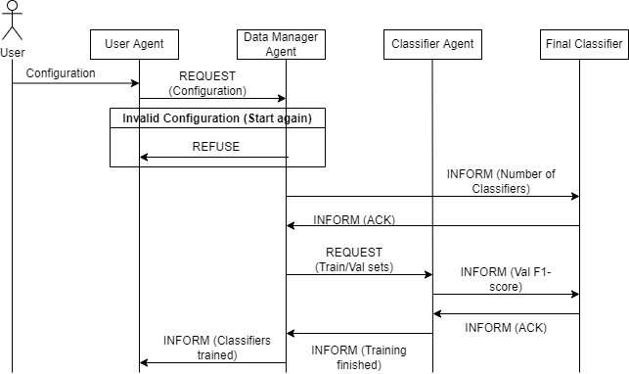
Communication [Training]

Slide 20
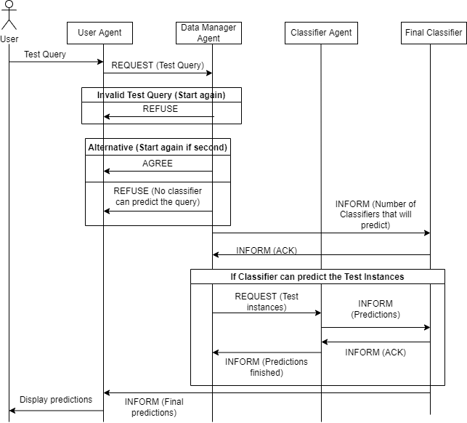
Communication
[Testing]

Slide 21


Cooperation and Coordination
FIPA messages are sent between the Agents to coordinate their actions
Every Agents is ready to help other Agents upon a request to achieve the same goal

Slide 22
Results

Slide 23
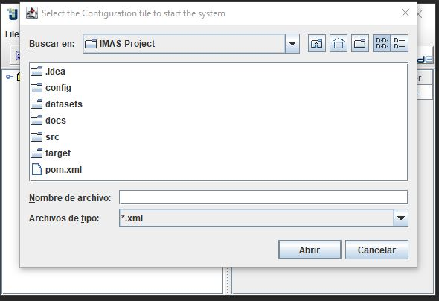
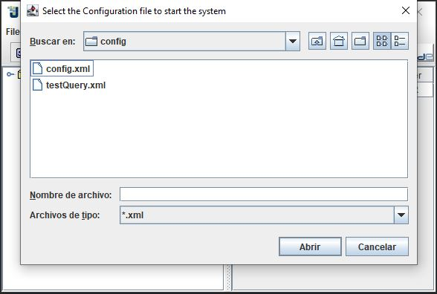
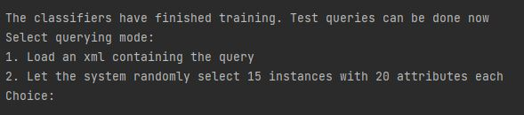

Initialization and Testing Query selection

Slide 24
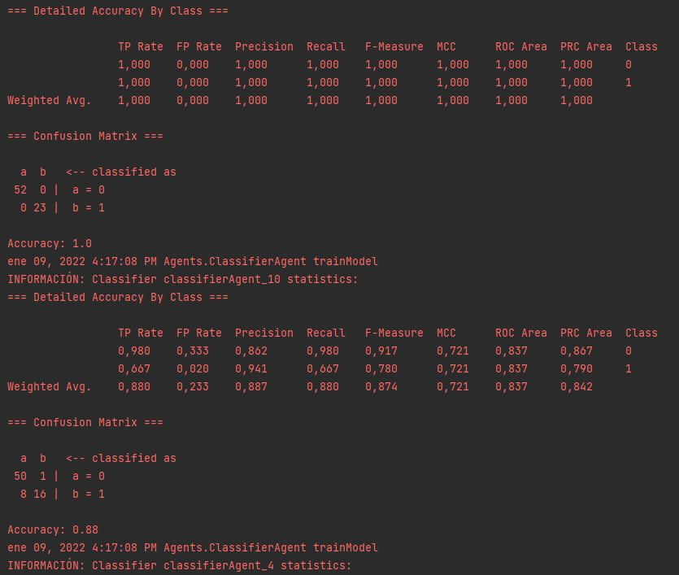
Training Metrics

Slide 25
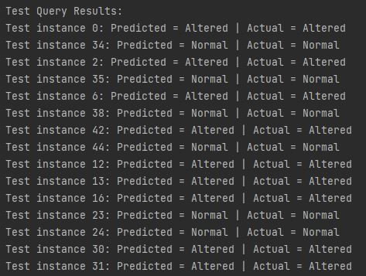
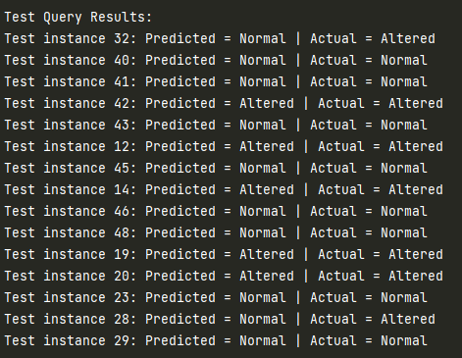
Prediction Results

Slide 26
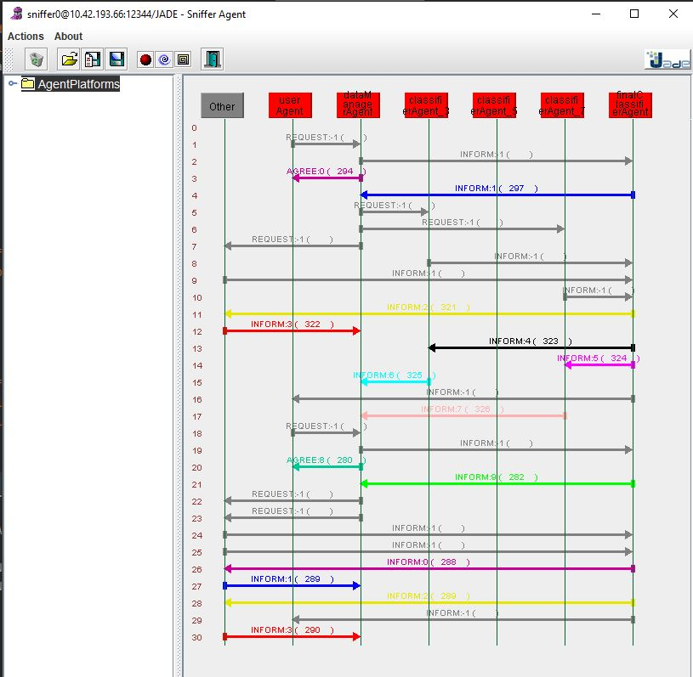
Sniffer
Through the sniffer, we can see the communication between the agents

Slide 27
Conclusion

Slide 28
Final remarks
Developed an end-to-end multiagent system
JADE as an efficient framework for simple systems (FIPA)
Questioning the pertinence of the Final Classifier Agent
Convoluted communications
Merge with Data Manager Agent

