Slide 1
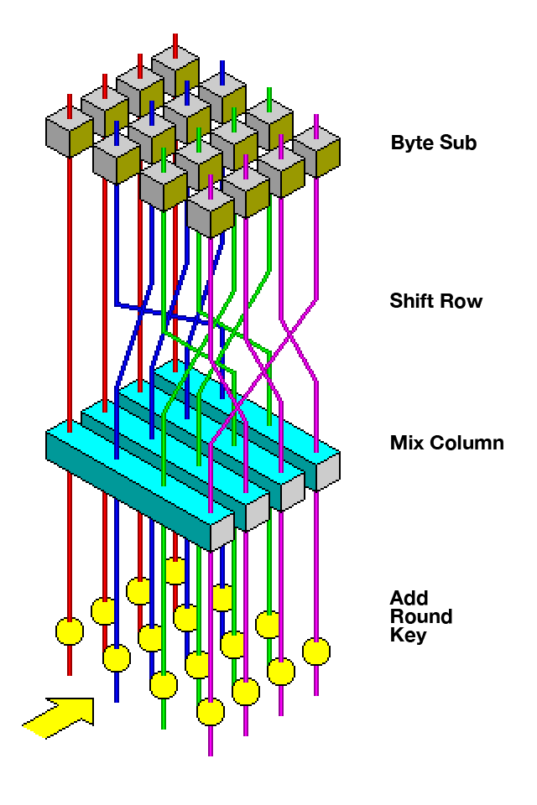
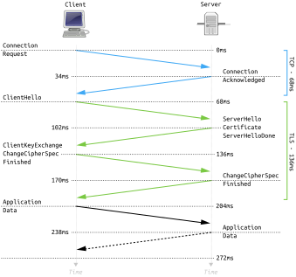
Navigating Cryptography: A Gateway to Network Protocol Security

Slide 2
Overview
The Fundamental Principles of a Secure Network Protocol (Most of them)
  Confidentiality
  Integrity
  Authentication
The Math and Methods to Achieve These Principles
  Asymmetric Key Cryptography
    Fermat’s Little Theorem
    Euler’s Formula and Other Results
    RSA Public Key Cryptosystem
    Digital Signatures
  Symmetric Key Cryptography
    Rings and Fields
    Quotient Rings and Irreducible Polynomials
    Addition and Multiplication in GF(2⁸)
    AES Block Cipher
  Secure Key Exchange
    The Discrete Logarithm Problem
    Diffie-Hellman Key Exchange
  Hash Functions
A Look at TLS
References
Code Demonstration and Walkthrough

Slide 3
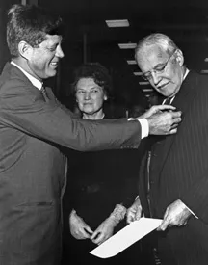
“Hey Allen, you got a little CIA on your shirt...doink!”
C: Confidentiality
I: Integrity
A: Authentication

Slide 4
Confidentiality
When information is transmitted from one node to another, it may be eavesdropped or intercepted. Confidentiality is a security feature to assure that information can only be recevied by elligible communication parties.
I
(kIJ)
J
(kIJ)
C=E(kIJ, P)
C
P=D(kIJ, C)

Slide 5

Integrity
Integrity is to assure that the information is not tampered with by a non-eligible party or through a transmission or storage error.
I
(kIJ)
J
(kIJ)
tag = MAC(kIJ, M)
M, tag
tag' = MAC(kIJ, M)
tag == tag'

Slide 6
Authentication
Authentication is to assure that the originator of the information appearing to the receiver is the actual originator.
I
(pkI, skI)
J
(pkI)
SigI(M)=Sig(skI, M)
M, SigI(M)
V=Veri(pkI, M, SigI(M))
V = “valid” or “invalid”

Slide 7
The Math and Methods to Acheive These Principles

Slide 8
Asymmetric Key Cryptography
Public Keys
pkI pkJ
I
J
skI
skJ
C
C = E(m, pkJ)
m = D(C, skJ)

Slide 9
Fermat’s Little Theorem
∀a ∈ Z: a ≢ 0 (mod p) ⇒ a^{p−1}≡ 1 (mod p)
Example:
Let p =11 and let a = 3. Then
a^{p−1} = 3¹¹ ⁻ ¹
= 3¹⁰
= 59049
= (5368) ⋅ 11 + 1
≡ 1 (mod p).
But does p have to be prime?

Slide 10
Euler’s Formula
Let p and q be distinct primes and let
g = gcd(p − 1, q − 1).
Then
a^{(p−1)(q−1)/g} ≡ 1 (mod pq)
for all a satisfying gcd(a, pq) = 1. In particular, if p and q are odd primes then
a^{(p−1)(q−1)/2} ≡ 1 (mod pq)
for all a satisfying gcd(a, pq) = 1.

Slide 11
Other Results
Let p and q be distinct primes and let e ≥ 1 satisfy
1 = gcd(e, (p − 1)( q − 1)).
Then e has an inverse modulo (p−1)(q−1), say
de≡ 1 (mod (p−1)(q−1)),
and the congruence
x^{e} ≡ c (mod pq)
has the unique solution x≡ c^{d}(mod pq).

Slide 12
RSA Public Key Cryptosystem
Computer A
    Secret primes p and q are selected.
    An encryption exponent e, is selected, such that gcd(e, (p−1)(q−1)) = 1.
    The modulus N = pq and the exponent e is published (made public).
Computer B
    A plaintext message m is selected.
    The public values N and e are used to compute c≡ m^{e}(mod N).
    The ciphertext c is sent to Computer A.
Computer A
    The value d satisfying ed≡ 1 (mod(p−1)(q−1)) is computed.
    *NOTE: Only possible if you know p and q
    The ciphertext is decrypted using m≡c^{d}(mod N).

Slide 13
RSA Digital Signatures
Computer A
    Secret primes p and q are selected.
    An verification exponent e, is selected, such that gcd(e, (p−1)(q−1)) = 1.
    The modulus N = pq and the exponent e is published (made public).
    The value d satisfying ed ≡ 1 (mod(p−1)(q−1)) is computed.
    The document D is signed by computing S ≡ D^{d}(mod N).
    The document D and its signature S are sent to Computer B.
Computer B
    Using the public values N and e, compute D' ≡ S^{e}(mod N) where S is the signature sent by Computer A.
    Verify the authenticity of the signature by comparing D = D'.

Slide 14
Symmetric Key Cryptography
Known Only to I and J
kIJ
I
(kIJ)
J
(kIJ)
C=E(kIJ, P)
C
P =D(kIJ, C)

Slide 15
Rings
Commutative Rings
Integral Domains
U.F.D.
P.I.D.
Euclidean Domain
Field

Slide 16
Rings and Fields
Definitions
A ring is a set R together with two binary operations + and × satisfying the following axioms:
  (R, +) is an abelian group.
  × is associative: (a × b) × c = a × (b × c) for all a, b, c, ∈ R.
  The distributive law holds in R : for all a, b, c ∈ R
  (a+b)× c = (a× c)+(b× c) and a×(b+c) = (a× b)+(a× c)
A field is a set F together with two commutative binary operations + and × on F such that (F, +) is an abelian group (call its identity 0) and (F − {0}, ×) is also an abelian group and the following distributive law holds:
a×(b+c) = (a× b)+(a× c),
for all a, b, c ∈ F .

Slide 17
Consider the following polynomial ring
Z2[x] = {∑i=0 ^{n} ai x^{i} : ai∈ Z2, n ∈ Z}.
Now consider the irreducible polynomial g(x) = x⁸+x⁴+x³+x+1 ∈ Z2[x] and the ideal it generates
I = { f(x)⋅ g(x) : f(x) ∈ Z2[x] }
Combining these two sets into a quotient ring
Z2[x] / I = { h(x) + I : h(x) ∈ Z2[x] }
Gives us a finite field with 256 elements. A field isomorphic to GF(2⁸).

Slide 18
Consider the following polynomial ring
Z2[x] = {∑i=0 ^{n} ai x^{i} : ai∈ Z2, n ∈ Z}.
Now consider the irreducible polynomial g(x) = x⁸+x⁴+x³+x+1 ∈ Z2[x] and the ideal it generates
I = { f(x)⋅ g(x) : f(x) ∈ Z2[x] }
Combining these two sets into a quotient ring
Z2[x] / I = { h(x) + I : h(x) ∈ Z2[x] }
Gives us a field which is isomorphic (same algebraic structure) to GF(2⁸)!

Slide 19
Addition in GF(2⁸)
Consider the byte values 0x57 and 0x83 then
0x57 ⊕ 0x83 = 01010111 ⊕ 10000011
= 11010100
= 0xd4.
Which is supported by the following polynomial addition
(x⁶+x⁴+x²+x+1)+(x⁷+x+1) = x⁷+x⁶+x⁴+x².
The additive structure of GF(2⁸) is what underpins the addition in AES.

Slide 20
Multiplication in GF(2⁸)
Consider the byte values 0x57 and 0x13 then the corresponding polynomial representations in GF(2⁸) are h(x)=x⁶+x⁴+x²+x+1 and g(x)=x⁴+x+1 . To compute the product of 0x57 and 0x13 we compute h(x)⋅ g(x).
h(x)⋅ g(x) = (x⁶+x⁴+x²+x+1)(x⁴+x+1)
= x⁷+x⁶+x⁵+x⁴+x³+x²+x.
Thus 0x57⋅0x13 = 0xfe.
The multiplicative structure of GF(2⁸) is what underpins multiplication in AES.

Slide 21
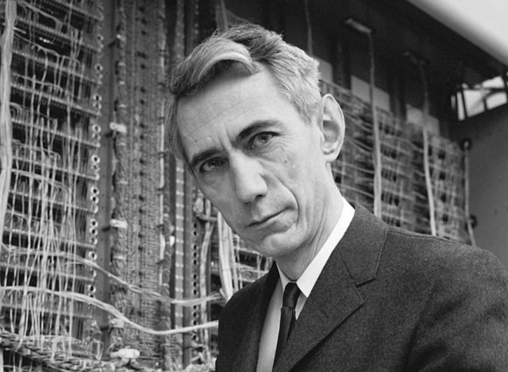

Confusion and Diffusion
Given a secret key, a plaintext message, and the cipher of the plaintext, confusion is meant to make the relationship between the key and ciphertext as complex as possible.
By diffusion, is meant that small changes in the input should result in large changes in the output. A property also known as the Avalanche effect.
The mixColumns operation in AES is the primary source of diffusion. Where byte-byte multiplication takes place modulo x⁸+x⁴+x³+x+1.

Slide 22
Hello!
Input
Convert to bytes
Pad the bytes
Convert to “state”
Multiply columns by fixed matrix
48
65
6c
6c
6f
21
48
65
6c
6c
6f
21
00
00
...
00
48
6f
00
00
65
21
00
00
6c
00
00
00
6c
00
00
00
02 | 03 | 01 | 01
01 | 02 | 03 | 01
01 | 01 | 02 | 03
03 | 01 | 01 | 02
48
65
6c
6c
⋅

Slide 23

Secure Key Exchange
In the context of symmetric key cryptography, we assume both parties are in posession of a secret key.
I need to tell you something secret, but they’re always listening ...
But how can a secret like this be established over a public communication channel?

Slide 24
Definition
Given a prime p, any element g ∈ F* p whose powers give every element of F* p is called a primitive root of F* p . That is
F* p = {1, g, g², g³, ..., g^{p−1}}.
Example
The number 2 is a primitive root of F11 * since
2⁰=1 | 2¹=2 | 2²=4 | 2³=8 | 2⁴=5
2⁵=10 | 2⁶=9 | 2⁷=7 | 2⁸=3 | 2⁹=6

Slide 25
Let g be a primitive root for Fp and let h be a nonzero element of Fp. The Discrete Logarithm Problem (DLP) is the problem of finding an exponent x such that
g^{x} ≡ h (mod p).
The number x is called the discrete logarithm of h to the base g and is denoted by logg(h).

Slide 26
Diffie-Hellman Key Exchange
A trusted party generates and publishes a large prime p and integer g with large prime order in Fp * accessible to both Computer X and Y.
Computer X
    Choose a secret integer a and compute A≡ gª(mod p), then send A to Y.
Computer Y
    Choose a secret integer b and compute B ≡ g^{b}(mod p), then send B to X.
Both Computer X and Y compute their shared secret key
K ≡ Bª ≡ (g^{b})ª ≡ (gª)^{b} ≡ A^{b}(mod p)

Slide 27
Hash Functions
Definition
A hash funciton is a function h:A→ B where A={a∈{0, 1}^{j} : j∈N} is the set of all bit sequences of arbitrary length and B={0, 1}^{k} is the set of all bit sequences of fixed length k∈N. Inputs to hash functions are called messges and outputs are called digests.
Properties
Designed to be computed efficiently and quickly.
Provides an approximately unique signature for each of its input.
Output is uniformly formatted across all input.

Slide 28
A Look at TLS

Slide 29
References
Chen, L., & Gong, G. (2012). Communication system security. CRC Press.
HOFFSTEIN, J. (2016). Introduction to mathematical cryptography. SPRINGER-VERLAG NEW YORK.
Dummit, D. S., & Foote, R. M. (2004). Abstract algebra. John Wiley & Sons.

