Slide 1
Counterflow sCO₂ heat-exchanger model
Code audit • smooth baseline testing • dimpled HTC calibration
What changed, what improved,
and what remains unresolved
38 smooth cases | 40 dimpled cases | HEOS properties
Research review • October 13, 2026
All e/D matches are conditional on stated operating assumptions.
Spencer thesis + technical note; repository snapshot da28165
1
Notes:
Sources: Spencer thesis + technical note; repository snapshot da28165
Repository: https://github.com/QuinAcchione52/counterflow-hx-model
Model-results snapshot: da28165; prepared October 13, 2026.

Slide 2
The main result: improvement with clear limits
Question | Result
Did real code errors exist? | Yes: profiles, property handling, friction and local wall closure.
Did those fixes explain the HTC gap? | No: representative smooth friction change is only about 1%.
Did smooth calibration help prediction? | Held-out mean absolute HTC error: 46.73% → 14.22%.
Can bounded e/D match more dimples? | 24/40 matched within 0–0.05; 16 remain unfitted.
Is the physical mismatch fully solved? | No: heat flux, boundary conditions and applicability remain issues.
A calibrated HTC match is not independent validation of roughness, duty or pressure drop.
Repository results; code snapshot da28165
2
Notes:
Sources: Repository results; code snapshot da28165
Repository: https://github.com/QuinAcchione52/counterflow-hx-model
Model-results snapshot: da28165; prepared October 13, 2026.

Slide 3
Starting problem and the analysis sequence
Historical observations are not a controlled before/after comparison.
• Initial May27 result: roughly 543 versus experimental HTC around 2600 W/(m²·K).
• Changing guessed inlet temperature and allowing very large e/D could fit HTC, but interpretation was unclear.
• First compare smooth tubes at e/D=0; then audit the code; then test a separate smooth baseline correction.
• Hold the smooth-trained correction fixed while fitting individual dimpled e/D.
The experimental observations were not edited to improve agreement.
Repository results; code snapshot da28165
3
Notes:
Sources: Repository results; code snapshot da28165
Repository: https://github.com/QuinAcchione52/counterflow-hx-model
Model-results snapshot: da28165; prepared October 13, 2026.

Slide 4
What data were used—and what was assumed
Input / target | Treatment
38 smooth + 40 dimpled cases | Pressure, CO₂ flow, mean temperature and HTC from source tables.
CO₂ inlet / outlet temperatures | Inlet inferred to reproduce the reported endpoint mean; not measured inputs.
Water inlet / flow | Shared assumptions: 20.7 °C and 0.087 kg/s.
Geometry / properties | ID 13.3858 mm; length 1 m; wall 1.2446 mm; HEOS backend.
Nominal heat flux / uncertainty | 2 or 3 kW/m² group; retain source HTC uncertainty unchanged.
Nominal flux group ≠ exact measured per-case duty; constant water conditions ≠ exact rig reproduction.
Spencer thesis Tables 12–13, printed pp.55–56; Smooth_cases.csv; Dimpled_cases.csv
4
Notes:
Sources: Spencer thesis Tables 12–13, printed pp.55–56; Smooth_cases.csv; Dimpled_cases.csv
Repository: https://github.com/QuinAcchione52/counterflow-hx-model
Model-results snapshot: da28165; prepared October 13, 2026.

Slide 5
Compare the same HTC definition
The endpoint metric and the mean of local HTC values answer different questions.
• Reported comparison metric: h = Q / (Aᵢ × ΔTₗₘ,bulk–inner wall).
• This LMTD is the CO₂ bulk-to-wall difference at the two tube ends—not CO₂-to-water LMTD.
• The CO₂ inlet is solved jointly so (Tᵢₙ + Tₒᵤₜ)/2 matches the reported mean.
• The output also preserves local HTC, wall temperatures, duty and energy residuals.
For nonuniform e/D, endpoint HTC and length-mean local HTC can differ substantially.
hx_metrics.py; CounterHX_full.py; Spencer experimental definition
5
Notes:
Sources: hx_metrics.py; CounterHX_full.py; Spencer experimental definition
Repository: https://github.com/QuinAcchione52/counterflow-hx-model
Model-results snapshot: da28165; prepared October 13, 2026.

Slide 6
Code changes 1/3: roughness and DH baseline
Before | After
Step with n=1 produced zero e/D | One step applies the requested constant e/D.
Custom arrays reduced to first value | Each axial node retains its supplied roughness value.
Step boundaries depended on node partition | Profiles use normalized physical position x/L.
Direct Colebrook replaced smooth DH friction | Original smooth DH recovered exactly at e/D=0.
Ambiguous rough-tube DH interpretation | Relative Colebrook enhancement explicitly labeled empirical.
roughness.py; Correlations.py; validation/correlation_audit.md
6
Notes:
Sources: roughness.py; Correlations.py; validation/correlation_audit.md
Repository: https://github.com/QuinAcchione52/counterflow-hx-model
Model-results snapshot: da28165; prepared October 13, 2026.

Slide 7
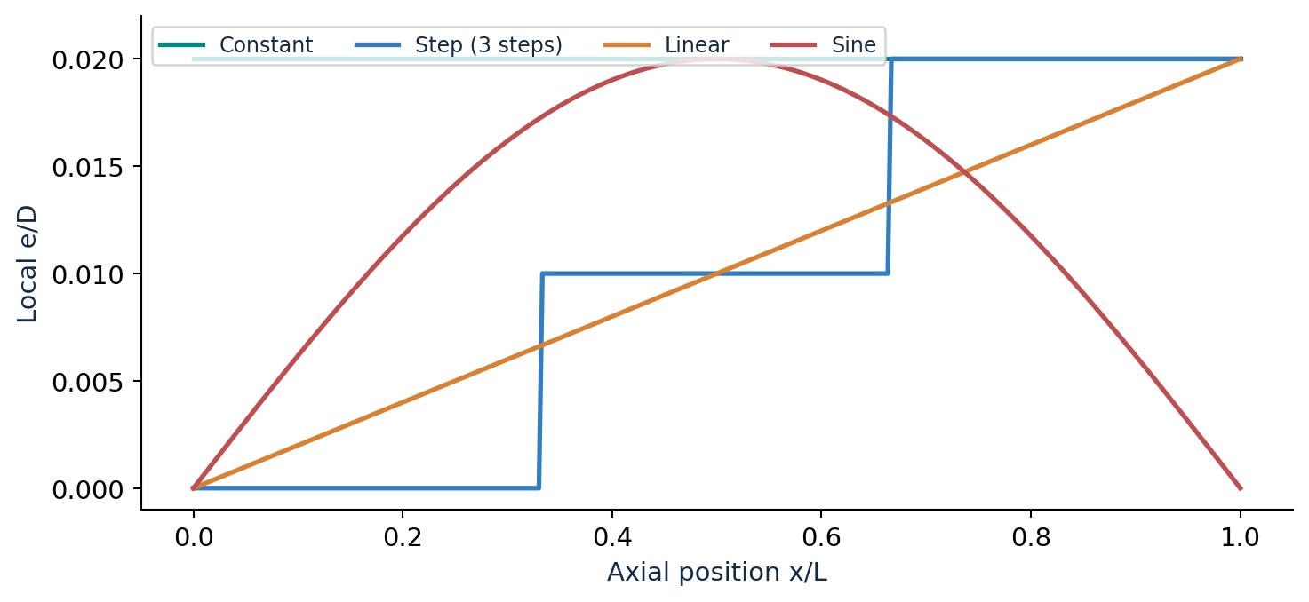
Local roughness profiles now behave as requested
Validated behavior
One Step = Constant.
Custom arrays preserved.
Negative / malformed inputs rejected.
Profile comparison is illustrative; not an experimentally validated dimple geometry model.
roughness.py; illustration: maximum e/D=0.02
7
Notes:
Sources: roughness.py; illustration: maximum e/D=0.02
Repository: https://github.com/QuinAcchione52/counterflow-hx-model
Model-results snapshot: da28165; prepared October 13, 2026.

Slide 8
Code changes 2/3: properties and wall iteration
• Removed silent clipping of CO₂ and wall temperatures; invalid states produce explicit errors.
• Water pressure is supplied in Pa to the correlation; no unit guessing based on magnitude.
• Water-wall iteration now converges to a tolerance instead of stopping after three iterations.
• Coupled solver starts at zero duty rather than an arbitrary 3 kW/m² seed that could create a false freezing state.
• CoolProp named phase constants replace incorrect numerical labels.
Correlations.py; Counterflow_HX_4.py
8
Notes:
Sources: Correlations.py; Counterflow_HX_4.py
Repository: https://github.com/QuinAcchione52/counterflow-hx-model
Model-results snapshot: da28165; prepared October 13, 2026.

Slide 9
Code changes 3/3: balances and pressure bookkeeping
• Node heat flux now follows local conductance and bulk temperature difference. Segment duty remains integrated separately.
• Convergence checks include local water-wall heat-flux closure; both wall-flux and conduction residuals are exported.
• Thermal friction uses film Reynolds number; mechanical Darcy friction uses bulk Reynolds number.
• Added diagnostics: selected Prandtl branch, Cp averaging, film conductivity, phase and separate friction factors.
Corrected pressure bookkeeping is not an experimental pressure-drop calibration.
Counterflow_HX_4.py; tests/test_correlations_profiles.py
9
Notes:
Sources: Counterflow_HX_4.py; tests/test_correlations_profiles.py
Repository: https://github.com/QuinAcchione52/counterflow-hx-model
Model-results snapshot: da28165; prepared October 13, 2026.

Slide 10
Dang–Hihara remains the baseline
Equation audit uses Spencer’s transcription; original article was not independently verified.
Smooth thermal friction
fDH = [1.82 log₁₀(Refilm) − 1.64]⁻²
Local roughness extension
fheat = fDH × fColebrook(Refilm, e/D) / fColebrook(Refilm, 0)
Optional empirical baseline
Nucorrected = Csmooth × NuDH,roughness
The roughness ratio and smooth multiplier are empirical additions; defaults keep Csmooth = 1.
Spencer thesis Eqs.4–10, printed pp.9–10; Correlations.py
10
Notes:
Sources: Spencer thesis Eqs.4–10, printed pp.9–10; Correlations.py
Repository: https://github.com/QuinAcchione52/counterflow-hx-model
Model-results snapshot: da28165; prepared October 13, 2026.

Slide 11
Fixing the smooth friction expression is a small change
Case | e/D | Direct Colebrook HTC | DH-based HTC | Change
May27_10 | 0.00 | 731.98 | 740.46 | +1.16%
May27_10 | 0.05 | 1291.30 | 1304.15 | +0.99%
May19_3 | 0.00 | 698.53 | 705.64 | +1.02%
Units: W/(m²·K). This isolates thermal friction choices within the corrected solver; it is not a replay of the initial 543 result.
The large HTC gap cannot be attributed to this friction-expression difference alone.
validation/Correlation_audit_first_pass_HEOS.csv; 40 segments, shared water assumptions
11
Notes:
Sources: validation/Correlation_audit_first_pass_HEOS.csv; 40 segments, shared water assumptions
Repository: https://github.com/QuinAcchione52/counterflow-hx-model
Model-results snapshot: da28165; prepared October 13, 2026.

Slide 12
Why a baseline mismatch can persist
• The cited DH database uses smaller smooth tubes (1–6 mm) and substantially higher mass flux (~200 kg/m²·s).
• Spencer’s modeled tube is 13.4 mm ID; smooth-case mass flux is about 21–35 kg/m²·s.
• Buoyancy, thermal entrance effects and dimple-induced secondary flows are not independently modeled by the roughness ratio.
• The source procedure adjusts or prechills water; shared 20.7 °C water inputs are an approximation.
• Smooth-tube mismatch exists before adding dimples. This does not establish experimental error.
Spencer thesis §7.2 / Table 8, printed pp.38–39; procedure printed p.29; correlation_audit.md
12
Notes:
Sources: Spencer thesis §7.2 / Table 8, printed pp.38–39; procedure printed p.29; correlation_audit.md
Repository: https://github.com/QuinAcchione52/counterflow-hx-model
Model-results snapshot: da28165; prepared October 13, 2026.

Slide 13
How the optional smooth correction was tested
• Fit one positive multiplier per smooth case at e/D=0 inside the coupled solver.
• Fit log(multiplier) using temperature relative to the pseudocritical point, its square, log(mass flux) and log(nominal flux group).
• For each held-out case, exclude its fitted factor; train on the other 37; predict its multiplier and run the HX solver.
• Then train on all 38 smooth cases for transfer to dimples. No dimple HTC is used to train the smooth baseline.
Nominal flux is a predictor, not imposed heat duty. Related campaign cases limit generalization claims.
train_smooth_baseline.py; smooth_baseline.py; model.json
13
Notes:
Sources: train_smooth_baseline.py; smooth_baseline.py; model.json
Repository: https://github.com/QuinAcchione52/counterflow-hx-model
Model-results snapshot: da28165; prepared October 13, 2026.

Slide 14
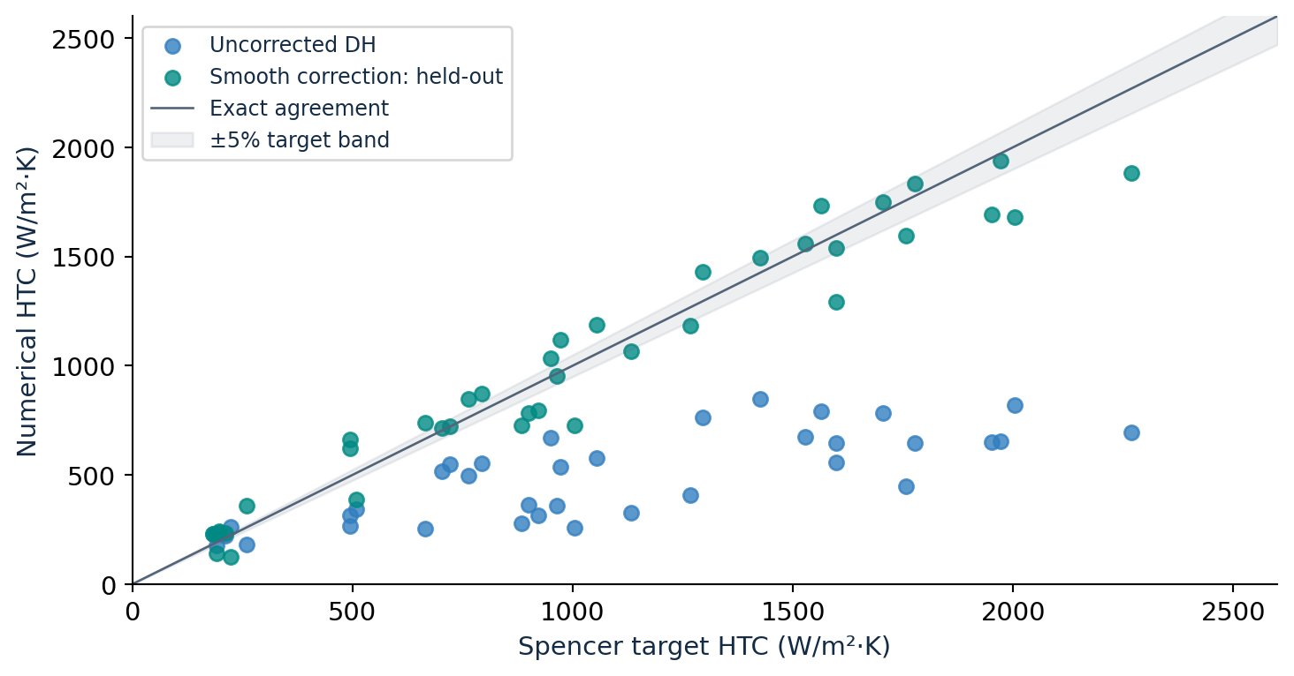
Smooth predictions improve, but are not all within 5%
Mean absolute error
46.73% → 14.22%
Within ±5%
9 / 38 cases
Worst held-out error
43.46%
results/smooth_baseline/heldout_predictions.csv; 38 cases, 20 segments
14
Notes:
Sources: results/smooth_baseline/heldout_predictions.csv; 38 cases, 20 segments
Repository: https://github.com/QuinAcchione52/counterflow-hx-model
Model-results snapshot: da28165; prepared October 13, 2026.

Slide 15
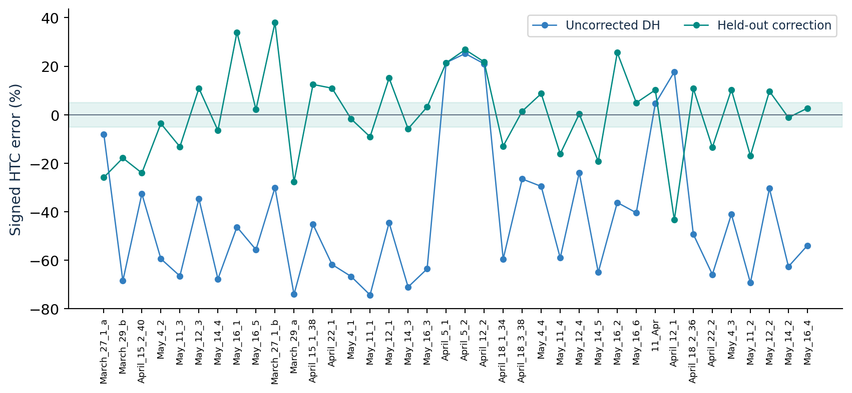
All 38 smooth cases: signed error comparison
Percentage prediction error is distinct from Spencer’s reported experimental uncertainty.
results/smooth_baseline/heldout_predictions.csv; shaded region: ±5% target error
15
Notes:
Sources: results/smooth_baseline/heldout_predictions.csv; shaded region: ±5% target error
Repository: https://github.com/QuinAcchione52/counterflow-hx-model
Model-results snapshot: da28165; prepared October 13, 2026.

Slide 16
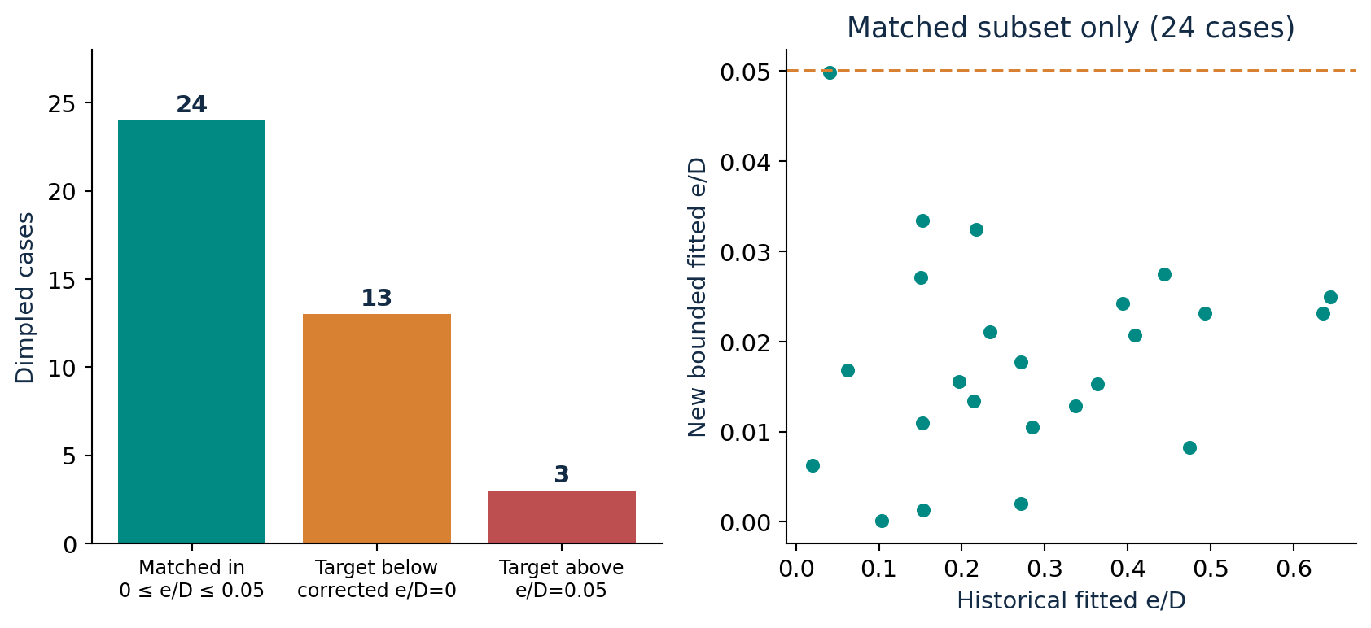
Dimpled transfer: 24 matches within the tested e/D bound
Historical: 4/40 within 0–0.05. Current: 24/40. Different formulation; neither count proves physical roughness.
Dimpled-transfer.summary.csv; historical all-40-case CSV; 20-segment screen
16
Notes:
Sources: Dimpled-transfer.summary.csv; historical all-40-case CSV; 20-segment screen
Repository: https://github.com/QuinAcchione52/counterflow-hx-model
Model-results snapshot: da28165; prepared October 13, 2026.

Slide 17
Two example fits confirmed at 100 segments
Case | Historical e/D¹ | New e/D | Target HTC | Numerical HTC
May19_3 | 0.284824 | 0.0105245 | 1862 | 1862.00
May27_10 | 0.363686 | 0.0153195 | 2642 | 2642.00
¹ Historical 20-segment calibrated table; current example fits use 100 segments.
HTC units: W/(m²·K). These are fitted targets, not held-out dimple predictions.
A smaller fitted e/D reflects the added baseline correction; it is not an independent roughness measurement.
Dimpled_fine_grid_checks.csv; historical all-40-case CSV
17
Notes:
Sources: Dimpled_fine_grid_checks.csv; historical all-40-case CSV
Repository: https://github.com/QuinAcchione52/counterflow-hx-model
Model-results snapshot: da28165; prepared October 13, 2026.

Slide 18
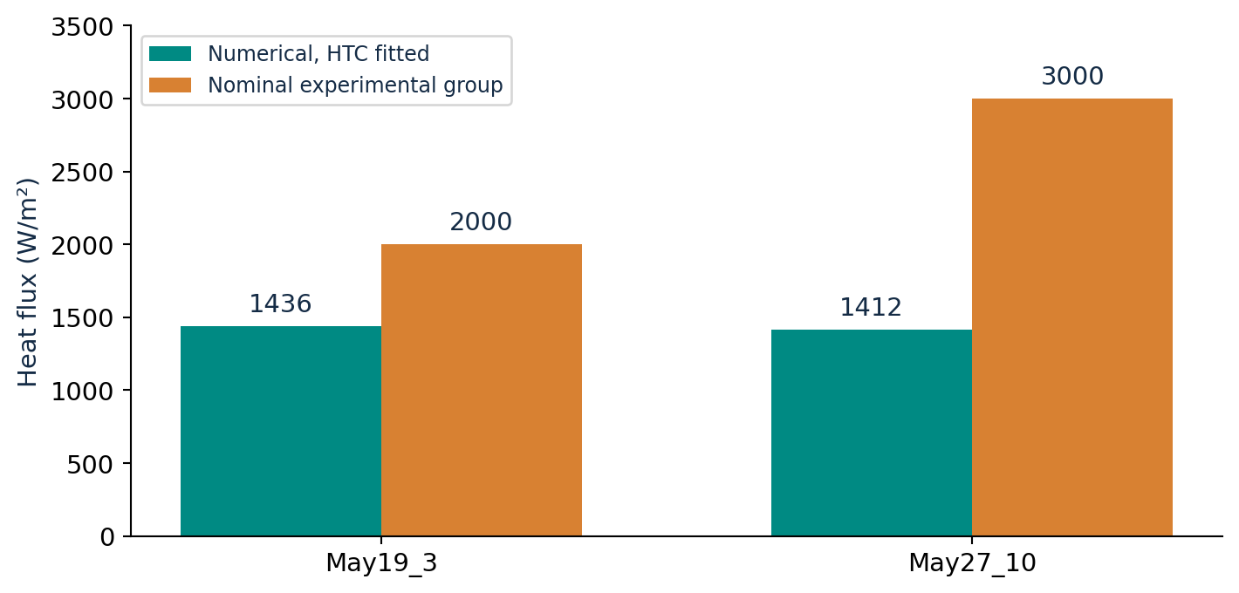
Matching HTC still does not match heat flux
May19_3
1436 vs 2000 W/m²
≈ −28.2%
May27_10
1412 vs 3000 W/m²
≈ −52.9%
These are differences from nominal groups; exact measured per-case duty is needed for a definitive comparison.
Dimpled-transfer.summary.csv; matched 20-segment solutions
18
Notes:
Sources: Dimpled-transfer.summary.csv; matched 20-segment solutions
Repository: https://github.com/QuinAcchione52/counterflow-hx-model
Model-results snapshot: da28165; prepared October 13, 2026.

Slide 19
How the data workflow improved
• Experimental target HTC, reported uncertainty and nominal flux remain separate from numerical outputs.
• Measured CO₂ pressure/flow/mean temperature are distinguished from assumed water conditions and inferred inlet temperature.
• All-case outputs preserve unfitted status, baseline extrapolation flags and local diagnostics.
• Historical tables remain archived; new formulation results are saved separately.
• Prediction errors and fitted target agreement are labeled separately. No experimental uncertainty was reduced.
Better traceability and prediction—not modification of the experimental data.
Repository results; code snapshot da28165
19
Notes:
Sources: Repository results; code snapshot da28165
Repository: https://github.com/QuinAcchione52/counterflow-hx-model
Model-results snapshot: da28165; prepared October 13, 2026.

Slide 20
Verification completed—and its practical limits
• 17 tests pass: profile semantics, Colebrook reference, DH smooth limit, invalid-state guards, wall and energy balances, and calibration-domain checks.
• Three representative corrected smooth cases: 20 → 100 segments changed HTC by less than 0.002%.
• May19_3 and May27_10 dimple fits confirmed at 100 segments.
• Held-out smooth energy residuals are below 6 × 10⁻⁸ W; fitted dimple CO₂ residuals below 3.3 × 10⁻⁶ W.
• May24_1 is flagged outside a smooth-training range. No pressure-drop agreement is established.
Numerical convergence and energy closure do not establish physical validity.
tests/test_correlations_profiles.py; Smooth_grid_checks.csv; Dimpled_fine_grid_checks.csv
20
Notes:
Sources: tests/test_correlations_profiles.py; Smooth_grid_checks.csv; Dimpled_fine_grid_checks.csv
Repository: https://github.com/QuinAcchione52/counterflow-hx-model
Model-results snapshot: da28165; prepared October 13, 2026.

Slide 21
Recommended discussion with your professor
• “We corrected identifiable implementation errors while retaining Dang–Hihara.”
• “Those fixes do not explain the full gap; a separate smooth-trained correction improves held-out HTC predictions.”
• “Bounded dimple fits increase to 24/40, but these are empirical calibrations and heat flux still disagrees.”
• Next: recover per-case inlet/outlet, water flow/temperature, measured duty and wall-temperature data.
• Then test entrance / mixed-convection physics and validate on an independent campaign before interpreting e/D as roughness.
The evidence supports model-development progress, not a claim that the rig or correlation has been disproved.
Repository results; code snapshot da28165
21
Notes:
Sources: Repository results; code snapshot da28165
Repository: https://github.com/QuinAcchione52/counterflow-hx-model
Model-results snapshot: da28165; prepared October 13, 2026.

Slide 22
Appendix: dimpled cases 1–10 of 40
HTC in W/(m²·K). Unfitted cases show endpoint predictions; no forced match.
Case | Target | e/D=0 HTC | e/D=.05 HTC | Fitted HTC | Fitted e/D | Status
May19_3 | 1862 | 1528 | 2491 | 1862 | 0.010524 | Matched
May21_5 | 2190 | 1753 | 2833 | 2190 | 0.012867 | Matched
May21_6 | 2465 | 1754 | 2934 | 2465 | 0.023158 | Matched
May22_4 | 1276 | 973 | 1633 | 1276 | 0.015582 | Matched
May22_8 | 983 | 633 | 1087 | 983 | 0.033412 | Matched
May24_3 | 349 | 270 | 452 | 349 | 0.016803 | Matched
May24_7 | 761 | 797 | 1330 | — | — | Below baseline
May27_3 | 365 | 447 | 749 | — | — | Below baseline
May27_7 | 1059 | 1009 | 1685 | 1059 | 0.002036 | Matched
June1_3 | 906 | 962 | 1608 | — | — | Below baseline
* May24_1: smooth-baseline range extrapolation. A tested e/D bound is not a validated physical limit.
results/smooth_baseline/Dimpled-transfer.summary.csv; 20 segments
22
Notes:
Sources: results/smooth_baseline/Dimpled-transfer.summary.csv; 20 segments
Repository: https://github.com/QuinAcchione52/counterflow-hx-model
Model-results snapshot: da28165; prepared October 13, 2026.

Slide 23
Appendix: dimpled cases 11–20 of 40
HTC in W/(m²·K). Unfitted cases show endpoint predictions; no forced match.
Case | Target | e/D=0 HTC | e/D=.05 HTC | Fitted HTC | Fitted e/D | Status
June1_4 | 971 | 1013 | 1683 | — | — | Below baseline
May19_1 | 2819 | 2012 | 3343 | 2819 | 0.023136 | Matched
May21_3 | 3039 | 2159 | 3537 | 3039 | 0.024924 | Matched
May22_2 | 1883 | 1360 | 2288 | 1883 | 0.020736 | Matched
May22_6 | 1119 | 710 | 1251 | 1119 | 0.032408 | Matched
May24_1 | 379 | 151 | 254 | — | — | Above cap *
May24_5 | 459 | 531 | 890 | — | — | Below baseline
May27_1 | 416 | 505 | 851 | — | — | Below baseline
May27_5 | 694 | 877 | 1468 | — | — | Below baseline
May27_9 | 2326 | 1959 | 3273 | 2326 | 0.008231 | Matched
* May24_1: smooth-baseline range extrapolation. A tested e/D bound is not a validated physical limit.
results/smooth_baseline/Dimpled-transfer.summary.csv; 20 segments
23
Notes:
Sources: results/smooth_baseline/Dimpled-transfer.summary.csv; 20 segments
Repository: https://github.com/QuinAcchione52/counterflow-hx-model
Model-results snapshot: da28165; prepared October 13, 2026.

Slide 24
Appendix: dimpled cases 21–30 of 40
HTC in W/(m²·K). Unfitted cases show endpoint predictions; no forced match.
Case | Target | e/D=0 HTC | e/D=.05 HTC | Fitted HTC | Fitted e/D | Status
June1_1 | 754 | 952 | 1601 | — | — | Below baseline
May19_4 | 1865 | 1497 | 2486 | 1865 | 0.010943 | Matched
May21_7 | 2343 | 1828 | 3026 | 2343 | 0.013417 | Matched
May22_5 | 1325 | 885 | 1533 | 1325 | 0.027118 | Matched
May22_9 | 994 | 537 | 954 | — | — | Above cap
May24_4 | 332 | 290 | 504 | 332 | 0.006247 | Matched
May24_8 | 776 | 774 | 1342 | 776 | 0.000095 | Matched
May27_4 | 369 | 473 | 824 | — | — | Below baseline
May27_8 | 1651 | 1210 | 2097 | 1651 | 0.017717 | Matched
June1_5 | 1025 | 989 | 1699 | 1025 | 0.001290 | Matched
* May24_1: smooth-baseline range extrapolation. A tested e/D bound is not a validated physical limit.
results/smooth_baseline/Dimpled-transfer.summary.csv; 20 segments
24
Notes:
Sources: results/smooth_baseline/Dimpled-transfer.summary.csv; 20 segments
Repository: https://github.com/QuinAcchione52/counterflow-hx-model
Model-results snapshot: da28165; prepared October 13, 2026.

Slide 25
Appendix: dimpled cases 31–40 of 40
HTC in W/(m²·K). Unfitted cases show endpoint predictions; no forced match.
Case | Target | e/D=0 HTC | e/D=.05 HTC | Fitted HTC | Fitted e/D | Status
May19_2 | 2964 | 2001 | 3394 | 2964 | 0.027511 | Matched
May21_4 | 3027 | 2113 | 3544 | 3027 | 0.024223 | Matched
May22_3 | 1725 | 1206 | 2103 | 1725 | 0.021064 | Matched
May22_7 | 1094 | 594 | 1090 | — | — | Above cap
May24_2 | 370 | 213 | 370 | 370 | 0.049887 | Matched
May24_6 | 545 | 702 | 1219 | — | — | Below baseline
May27_2 | 420 | 575 | 1006 | — | — | Below baseline
May27_6 | 859 | 978 | 1693 | — | — | Below baseline
May27_10 | 2642 | 1971 | 3421 | 2642 | 0.015321 | Matched
June1_2 | 924 | 1049 | 1812 | — | — | Below baseline
* May24_1: smooth-baseline range extrapolation. A tested e/D bound is not a validated physical limit.
results/smooth_baseline/Dimpled-transfer.summary.csv; 20 segments
25
Notes:
Sources: results/smooth_baseline/Dimpled-transfer.summary.csv; 20 segments
Repository: https://github.com/QuinAcchione52/counterflow-hx-model
Model-results snapshot: da28165; prepared October 13, 2026.

Slide 26
Appendix: smooth cases 1–10 of 38
HTC in W/(m²·K); correction predicted with this case withheld; e/D=0.
Case | Target | Uncorrected | Held-out HTC | Error | Within 5%
March_27_1_a | 191 | 175.6 | 141.5 | -25.9% | No
March_29_b | 884 | 277.6 | 725.7 | -17.9% | No
April_15_2_40 | 509 | 342.7 | 386.5 | -24.1% | No
May_4_2 | 1599 | 647.8 | 1540.0 | -3.7% | Yes
May_11_3 | 1952 | 652.1 | 1693.0 | -13.3% | No
May_12_3 | 763 | 498.0 | 846.1 | +10.9% | No
May_14_4 | 1268 | 408.3 | 1184.9 | -6.6% | No
May_16_1 | 494 | 265.0 | 662.0 | +34.0% | No
May_16_5 | 1527 | 675.8 | 1559.3 | +2.1% | Yes
March_27_1_b | 260 | 181.7 | 358.7 | +38.0% | No
results/smooth_baseline/heldout_predictions.csv; 20 segments
26
Notes:
Sources: results/smooth_baseline/heldout_predictions.csv; 20 segments
Repository: https://github.com/QuinAcchione52/counterflow-hx-model
Model-results snapshot: da28165; prepared October 13, 2026.

Slide 27
Appendix: smooth cases 11–20 of 38
HTC in W/(m²·K); correction predicted with this case withheld; e/D=0.
Case | Target | Uncorrected | Held-out HTC | Error | Within 5%
March_29_a | 1004 | 259.3 | 725.4 | -27.8% | No
April_15_1_38 | 1055 | 577.1 | 1186.5 | +12.5% | No
April_22_1 | 666 | 254.1 | 738.7 | +10.9% | No
May_4_1 | 1972 | 655.4 | 1937.7 | -1.7% | Yes
May_11_1 | 1757 | 449.7 | 1596.3 | -9.1% | No
May_12_1 | 972 | 538.7 | 1118.9 | +15.1% | No
May_14_3 | 1133 | 327.0 | 1066.8 | -5.8% | No
May_16_3 | 1776 | 645.6 | 1832.5 | +3.2% | Yes
April_5_1 | 189 | 229.5 | 229.4 | +21.4% | No
April_5_2 | 183 | 229.2 | 232.1 | +26.8% | No
results/smooth_baseline/heldout_predictions.csv; 20 segments
27
Notes:
Sources: results/smooth_baseline/heldout_predictions.csv; 20 segments
Repository: https://github.com/QuinAcchione52/counterflow-hx-model
Model-results snapshot: da28165; prepared October 13, 2026.

Slide 28
Appendix: smooth cases 21–30 of 38
HTC in W/(m²·K); correction predicted with this case withheld; e/D=0.
Case | Target | Uncorrected | Held-out HTC | Error | Within 5%
April_12_2 | 198 | 239.6 | 241.1 | +21.8% | No
April_18_1_34 | 900 | 363.7 | 783.2 | -13.0% | No
April_18_3_38 | 704 | 517.1 | 713.9 | +1.4% | Yes
May_4_4 | 951 | 669.5 | 1033.6 | +8.7% | No
May_11_4 | 2004 | 819.3 | 1679.5 | -16.2% | No
May_12_4 | 722 | 548.9 | 724.0 | +0.3% | Yes
May_14_5 | 1599 | 558.7 | 1291.2 | -19.3% | No
May_16_2 | 495 | 315.5 | 621.7 | +25.6% | No
May_16_6 | 1425 | 847.8 | 1494.9 | +4.9% | Yes
11_Apr | 212 | 221.7 | 233.6 | +10.2% | No
results/smooth_baseline/heldout_predictions.csv; 20 segments
28
Notes:
Sources: results/smooth_baseline/heldout_predictions.csv; 20 segments
Repository: https://github.com/QuinAcchione52/counterflow-hx-model
Model-results snapshot: da28165; prepared October 13, 2026.

Slide 29
Appendix: smooth cases 31–38 of 38
HTC in W/(m²·K); correction predicted with this case withheld; e/D=0.
Case | Target | Uncorrected | Held-out HTC | Error | Within 5%
April_12_1 | 223 | 262.5 | 126.1 | -43.5% | No
April_18_2_36 | 1564 | 791.6 | 1732.0 | +10.7% | No
April_22_2 | 921 | 313.5 | 796.5 | -13.5% | No
May_4_3 | 1296 | 763.0 | 1429.4 | +10.3% | No
May_11_2 | 2268 | 694.1 | 1883.5 | -17.0% | No
May_12_2 | 794 | 552.1 | 870.8 | +9.7% | No
May_14_2 | 964 | 359.5 | 952.4 | -1.2% | Yes
May_16_4 | 1704 | 784.1 | 1749.5 | +2.7% | Yes
results/smooth_baseline/heldout_predictions.csv; 20 segments
29
Notes:
Sources: results/smooth_baseline/heldout_predictions.csv; 20 segments
Repository: https://github.com/QuinAcchione52/counterflow-hx-model
Model-results snapshot: da28165; prepared October 13, 2026.

Slide 30
Sources, reproducibility and files
• Spencer thesis: Eqs.4–10 (pp.9–10), procedure (p.29), correlation comparison (pp.38–39), Tables 12–13 (pp.55–56); supplied technical note as companion reference.
• Code audit: validation/correlation_audit.md. Implementation: Correlations.py, Counterflow_HX_4.py, roughness.py.
• Results: results/smooth_baseline/heldout_predictions.xlsx and Dimpled-transfer.xlsx.
• Reproduce correction: train_smooth_baseline.py. Transfer fitting: calibrate_dimpled.py --smooth-baseline-model results/smooth_baseline/model.json --ep-max .05.
• See repository README for full Windows commands, explicit baseline-extrapolation flag and HEOS requirements.
Primary Dang–Hihara article not independently verified; equation audit relies on Spencer’s transcription.
GitHub: QuinAcchione52/counterflow-hx-model; model-results snapshot da28165
30
Notes:
Sources: GitHub: QuinAcchione52/counterflow-hx-model; model-results snapshot da28165
Repository: https://github.com/QuinAcchione52/counterflow-hx-model
Model-results snapshot: da28165; prepared October 13, 2026.

