Slide 1
Kinematics and Dynamics of Robots
Spring Semester 2021
Lecturer: Yoav Golan

Slide 2
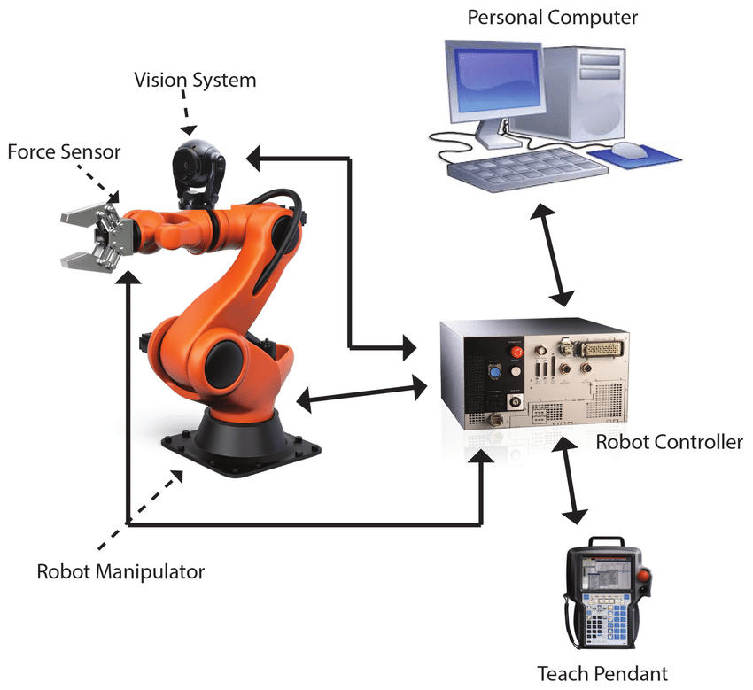
Industrial Robotic Arms

Slide 3
Internal and External Sensors
Robots use sensors to gain information about themselves and their environment
Internal sensors: Information about the robot
External sensors: Robot-Environment interaction, or just environment

Slide 4
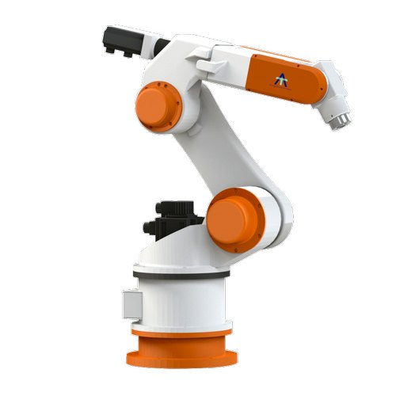
Internal Sensors
Robot joint position
Robot joint velocity
Robot joint torque
Component temperature

Slide 5
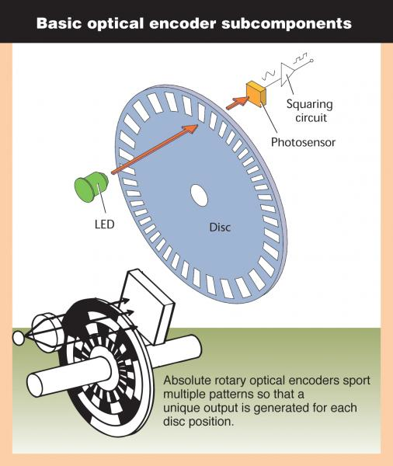
Joint Position/Velocity
Rotary Encoders

Slide 6
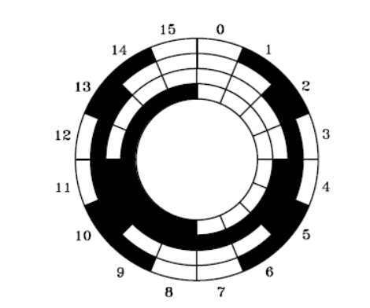
Joint Position/Velocity
Absolute encoder: gives true position

Slide 7
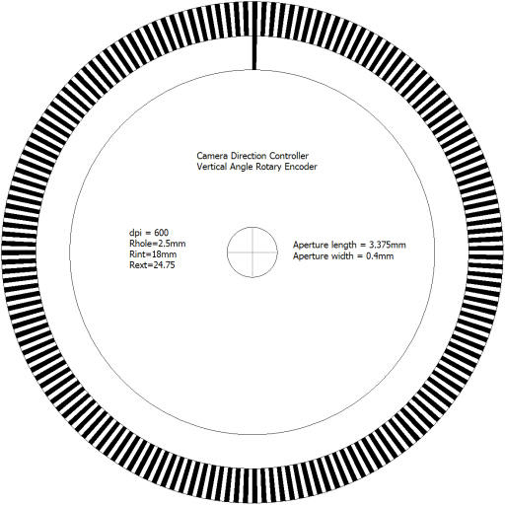
Joint Position/Velocity
Relative encoder: more increments

Slide 8
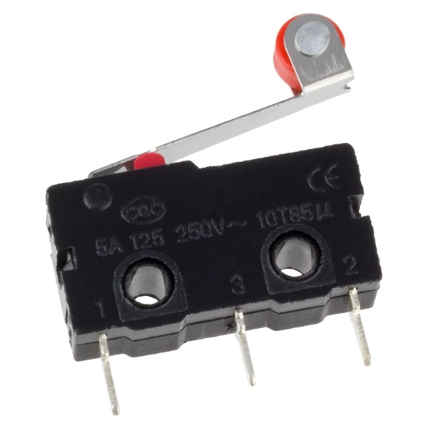
Joint Position/Velocity
Rotary Encoders
Limit switches

Slide 9
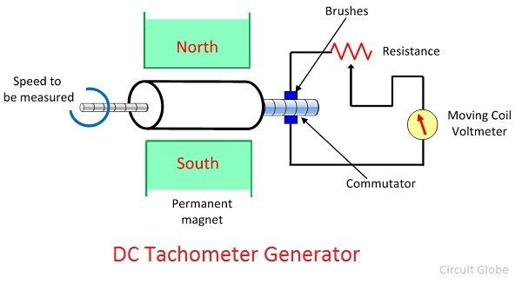
Joint Velocity
Tachometer
Similar to a DC generator

Slide 10
Joint Torque
How much torque is too much?
Let’s solve a Static problem
Let’s solve a Dynamic problem

Slide 11
Joint Torque
What does a high acceleration robot look like?
The problem with high acceleration

Slide 12
Joint Torque
The Jacobian matrix can be modified for accelerations
If we know what torques to expect, why have sensors?
Uncertainty
Collision detection

Slide 13
Joint Torque
Can torque sensors solve all collisions?
If Joint torque > (expected+uncertainty), stop all motors.
Inertial system! Video

Slide 14
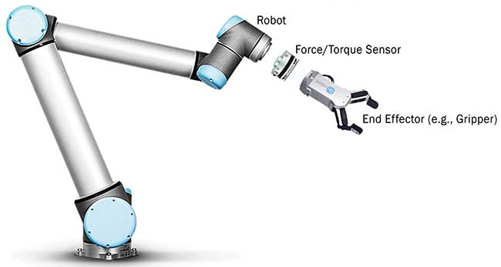
End-Effector Force/Torque
The end-effector is the only member in direct contact with the environment

Slide 15
End-Effector Force/Torque
Force/torque can be used to perform tasks

Slide 16
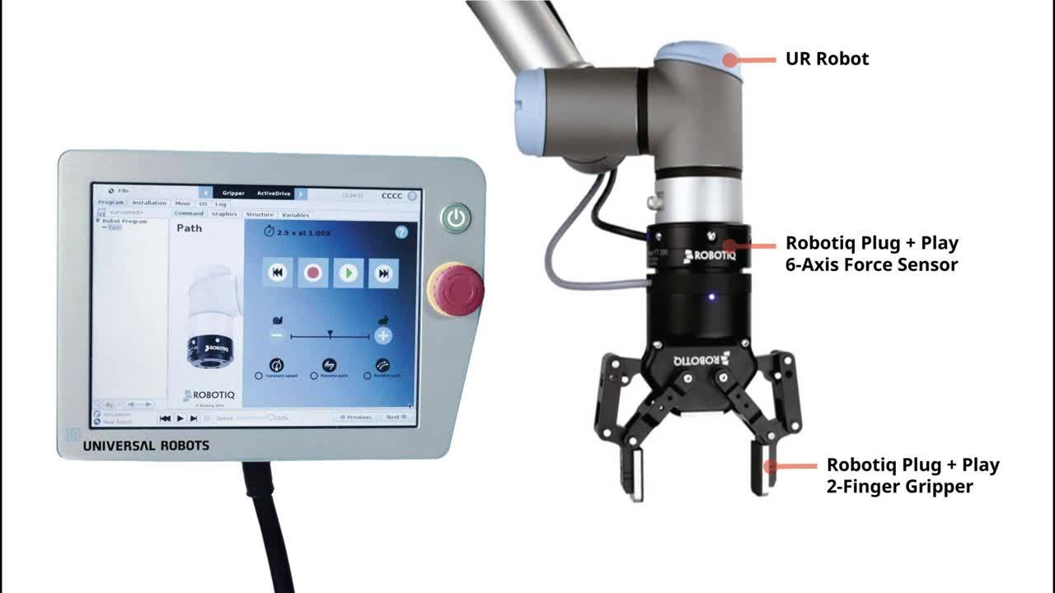
End-Effector Force/Torque
Common, usually integrates well with controller and end effector

Slide 17
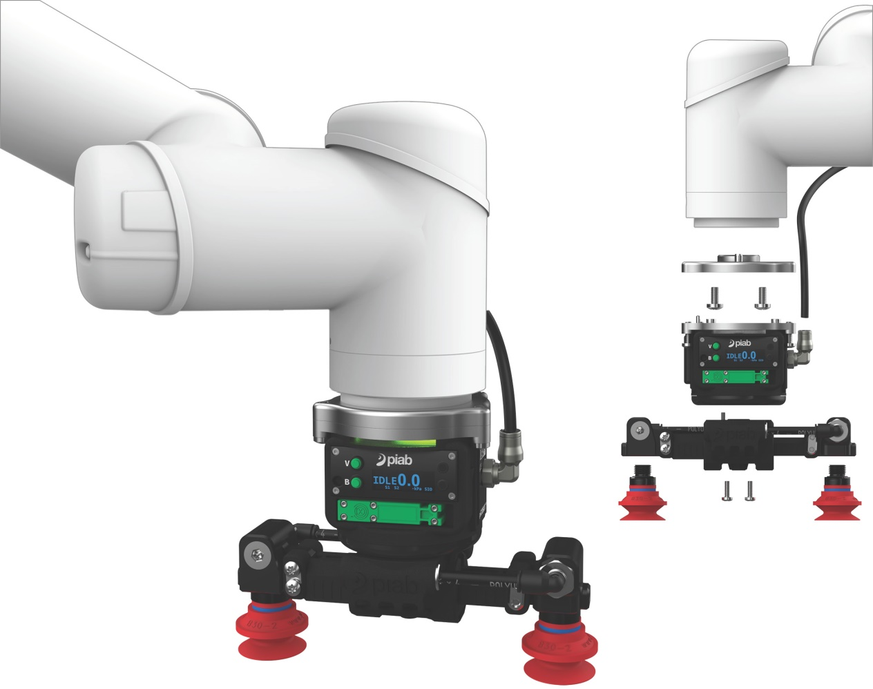
End-Effector Sensors
End effectors have their own sensor suite, depending on their use

Slide 18
Electrical and Pneumatic Routing
Power, communication and pneumatics are transferred from the base to the end effector
Internal or external

Slide 19
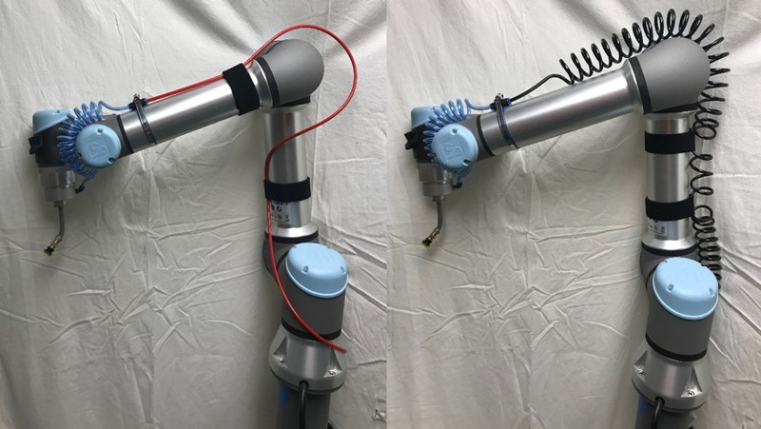
Electrical and Pneumatic Routing
External routing:

Slide 20
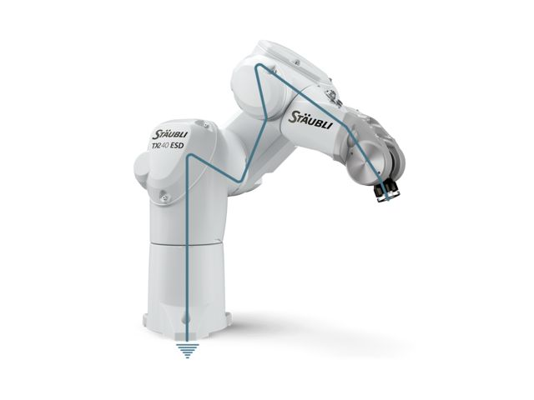
Electrical and Pneumatic Routing
Internal routing:

Slide 21
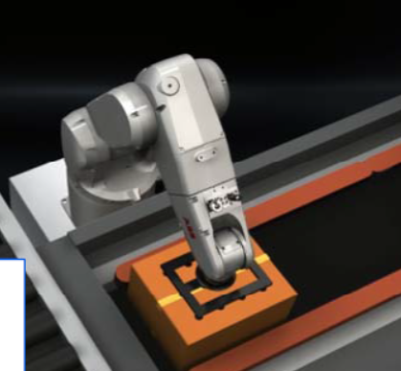
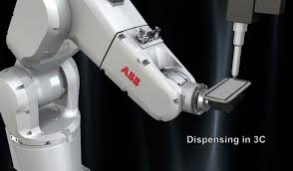
Electrical and Pneumatic Routing
Internal routing:

Slide 22
Cameras
Most advanced sensors
2D or 3D
Arm-Mounted or Static
Requires a PC for image processing

Slide 23
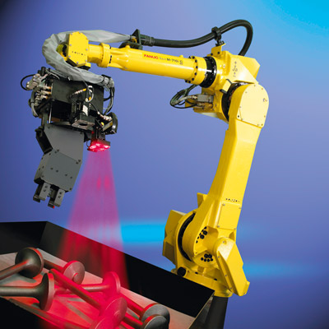
Arm Mounted Cameras
Allow multiple points of view
Can get close to objects
Never occluded by arm

Slide 24
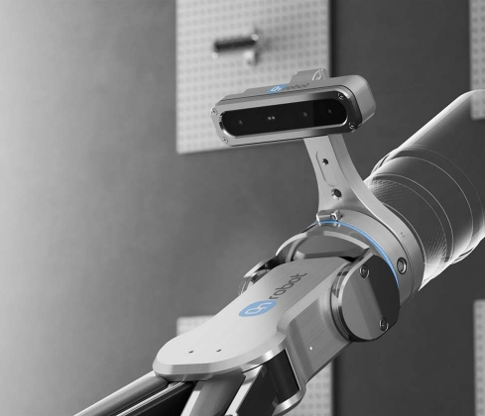
Arm Mounted Cameras
Requires cabling
More difficult to control (accuracy)
Weight and size limitations

Slide 25
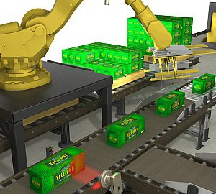
Static Cameras
Accurate, stable
Can be used to calibrate robot
No weight or size limitations
Multiple cameras can be used

Slide 26
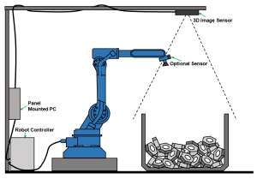
Static Cameras
Can be occluded by the robot
Often far from objects
Requires more space in the factory

Slide 27
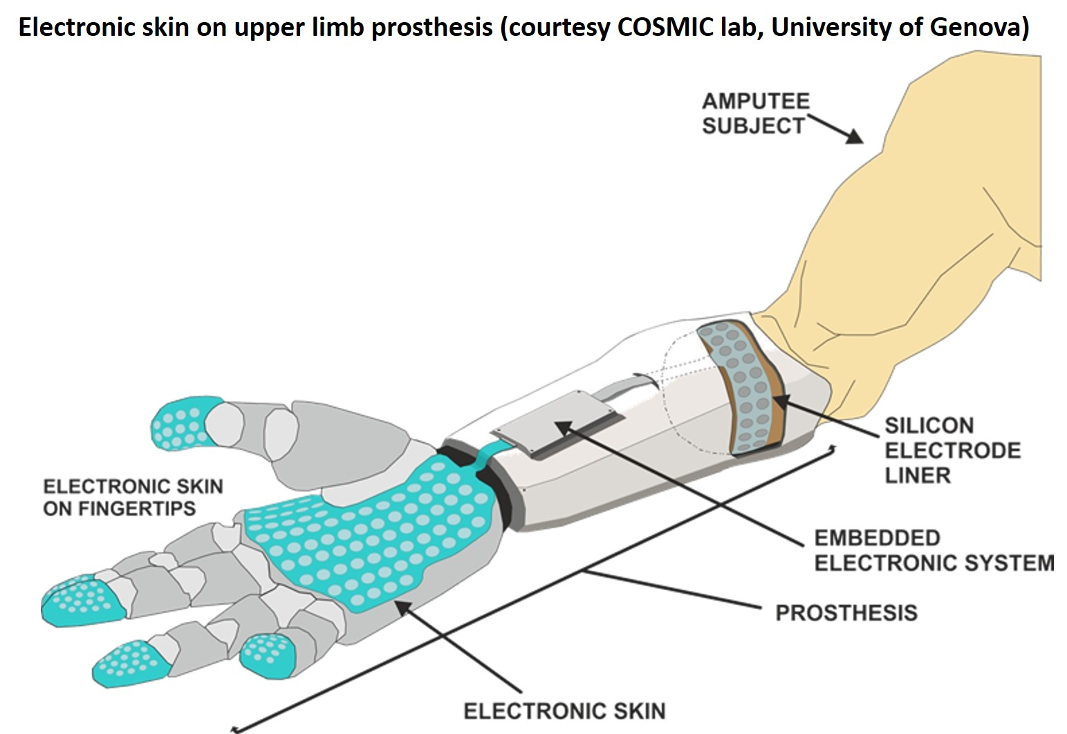
Tactile Sensors
On a robot tool or arm (but rarely)
For sensing touch
Advanced, dense sensory

Slide 28
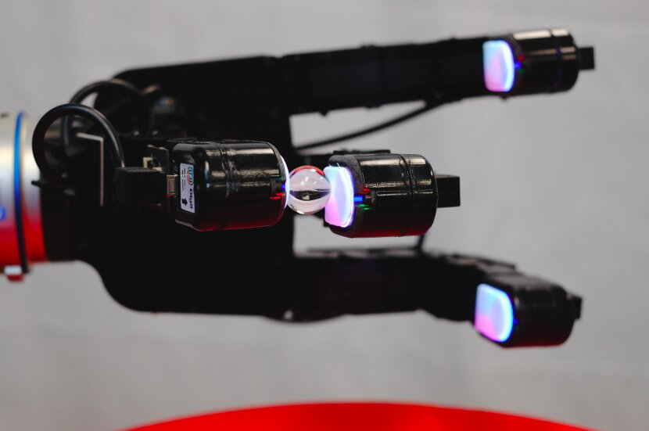
Tactile Sensors
On a robot tool or arm (but rarely)
For sensing touch
Advanced, dense sensory

Slide 29
Misc. Sensors
Accelerometers – Detect shock
Proximity sensors – Prevent collision
Temperature sensors (internal)
Vibration sensors – Detect malfunctions
Current sensors – Indirectly infer torque

Slide 30
Cobots
Weak robot
+
Highly sensitive sensors
+
Design for compliance
+
Easy to control
=
Cobot

Slide 31
Assignment #3

