Slide 1


Racial Wage Gap
CIS361
Spring 2021
M00287717
Developing Analytics Applications in R
Quincy Troutman

Slide 2
Overview
Racial Wage gap
What, and Why
My data
Where I got it
How I analyzed it.
Ultimately, I will try to use the data to answer:
Does a Racial Wage gap Exist in the Technology sector?

Slide 3
Introduction
Racial Wage Gap – What is it?
The racial wage gap (RWG), or in other words a comparison of pay between white people and people of color who have the same job and qualifications (PayScale, 2020). (
Scale, 2020)
Racial Wage Gap – Why is it important?
Racism is illegal in the workplace.
Could affect Many people
Lost wage
EX: African American men make about $73,000 a year and white men make around $74,500 a year (PayScale, 2020)
Loss in workplace motivation.
According to the article Contributions of Skills to The Racial Wage Gap, “Studying wage gaps has become more important than ever since The United States is shifting racial composition towards historical minorities. (Petre, 2019)”

Slide 4
Literature Review
Tukey HSD : (honest significant difference) test is a statistical tool used to determine if the relationship between two sets of data is statistically significant. (Beck, 2020)
Racial Compositions Shift: The majority race in a country slowly becomes less of a majority until another ethnicity surpasses it (Petre, 2019).
composition shift is creating a grater awareness towards the wage gap making studying them even more important as time goes on (Petre, 2019).
Relentless urge for Equal Pay for Equal work
If a result is statistically significant, that means it’s unlikely to be explained solely by chance or random factors.

Slide 5
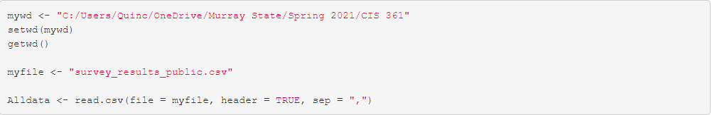
Data
The developer survey results from 2019
located on Stack Overflows website
This data shows survey results of 90,000 different developers.
computer language preferences to life outside of work.

Slide 6
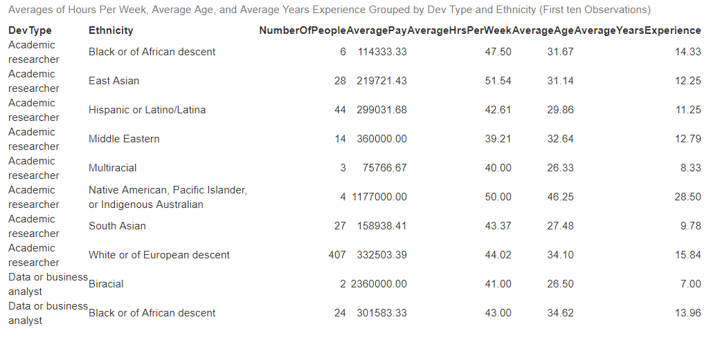
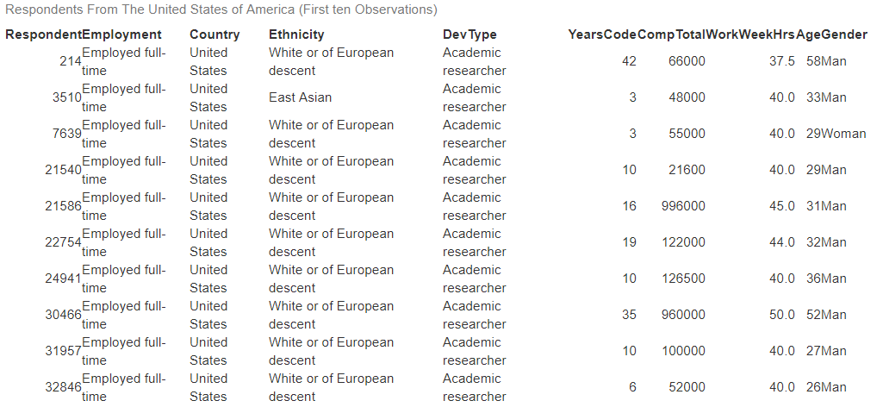
Data cont.
DevTypeVsEthnicity
After I pulled in my data, I created two tables to show what I want.
FromUSA
DevType
Ethnicity
Yearscode
Work week Hours
Age
Gender
DevTypeVsEthnicity
Grouped by DevType and Ethnicity
FromUSA

Slide 7
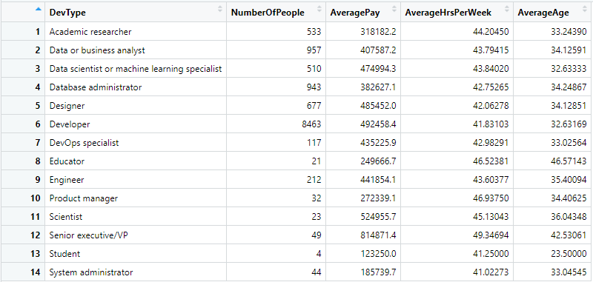
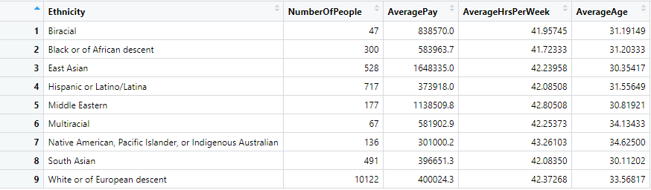
Data cont.
Average of Sorted Date

Slide 8
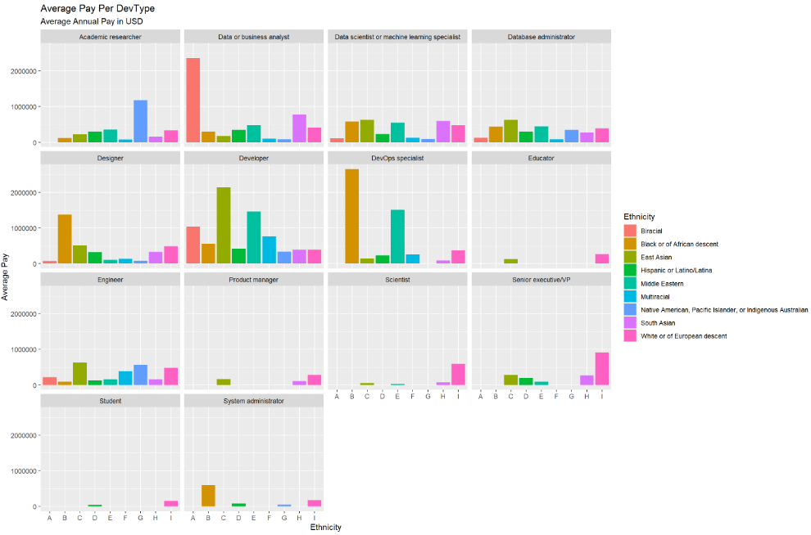
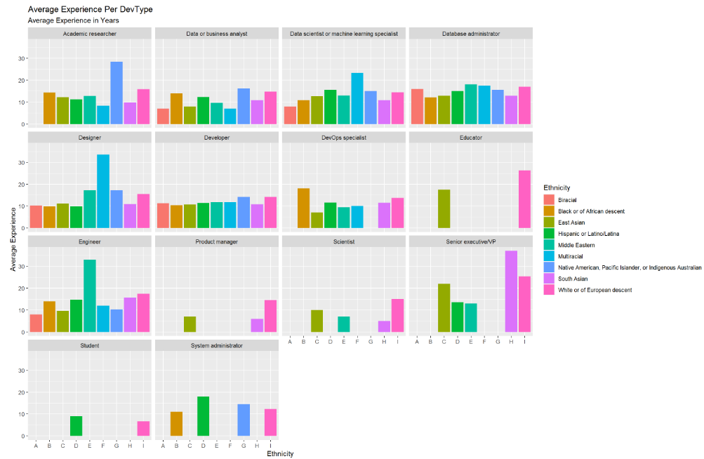

Slide 9
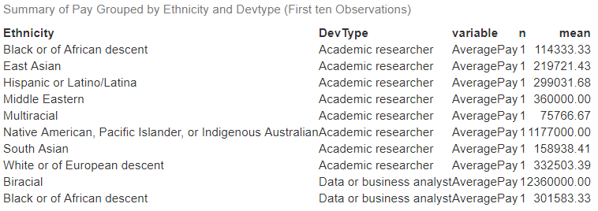
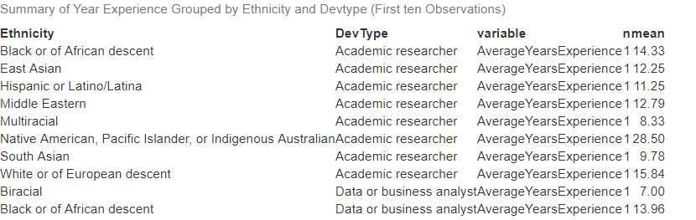
Methodology
Tukey model
Must have summaries of data to be analyzed

Slide 10

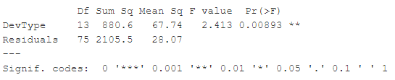


Methodology cont.
Now that I created my data to be analyzed I Started with my Anova Model.
I made four models.
Pay And DevType.
Experience and DevType.
Pay and Ethnicity.
Experience and Ethnicity.

Slide 11
Result
If a result is statistically significant, that means it’s unlikely to be explained solely by chance or random factors.
Pay And DevType.
P-value = 0.273
Not Significant
Experience and DevType.
P-value = 0.28
Not Significant
Pay and Ethnicity.
P-value = 0.339
Not Significant
Experience and Ethnicity.
P-value = .00893
Significant

Slide 12
Implications
Based on my study
Pay to Ethnicity is not significant.
I would recommend
Equal out the data for each group
gather correct annual pay.

Slide 13
In Conclusion
The technology sector in terms of a Pay gap can be explained solely by chance or random factors.
Equal pay for equal work

Slide 14
Citation
Beck, K. (2020, December 21). What is the tukey hsd test? Retrieved May 02, 2021, from https://sciencing.com/what-is-the-tukey-hsd-test-12751748.html
Peffers, K., Tuunanen, T., Rothenberger, M. A., & Chatterjee, S. (2007). A design science research methodology for information systems research. Journal of management information systems, 24(3), 45-77.
Perez, T. (2019, January 7). The state of wage inequality in tech in 2018. PayScale. https://www.payscale.com/data/racial-wage-gap-in-tech
Petre, M. (2019). Contributions of Skills to the Racial Wage Gap. Journal of Human Capital, 13(3), 479–518. https://doi-org.ezproxy.waterfield.murraystate.edu/10.1086/704322
2020 Racial Wage Gap - Compensation Research from PayScale. PayScale. (2021). Retrieved 24 February 2021, from https://www.payscale.com/data/racial-wage-gap#:~:text=The%20controlled%20racial%20wage%20gap%20(RWG)%20is%20a,is%20alive%20and%20well%20in%20the%20U.S.%20workforce.

