Slide 1
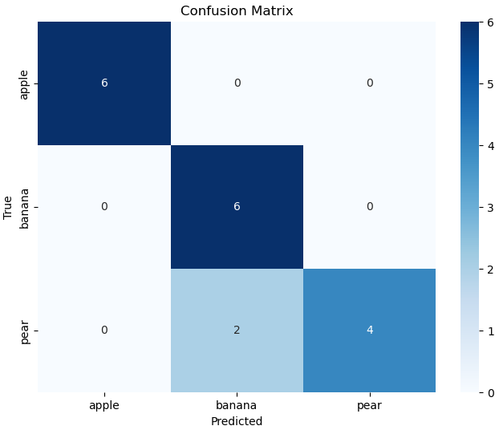
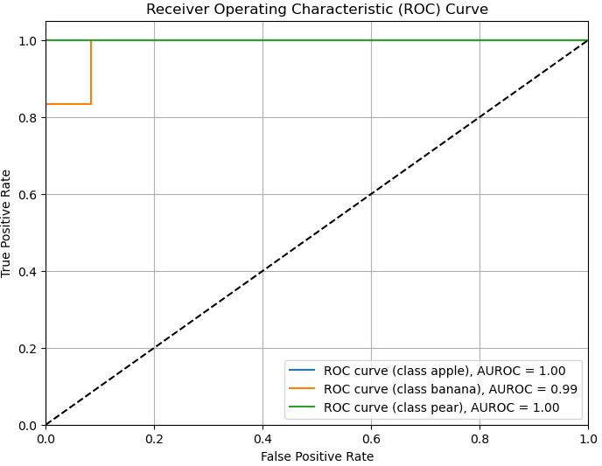
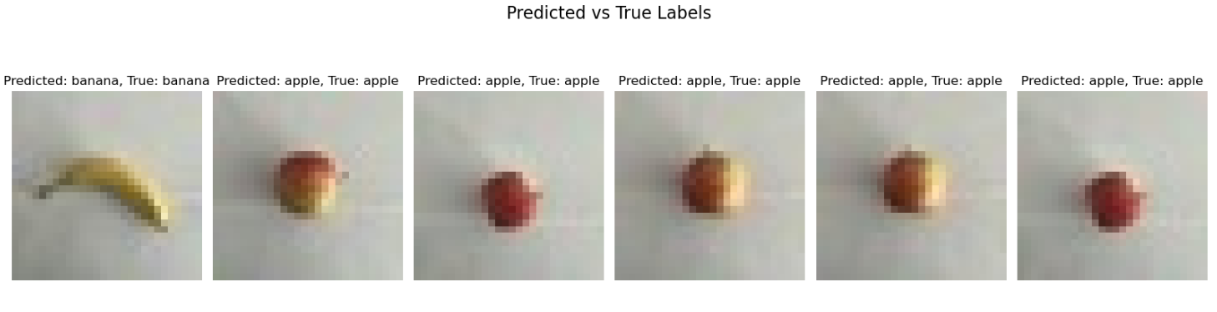
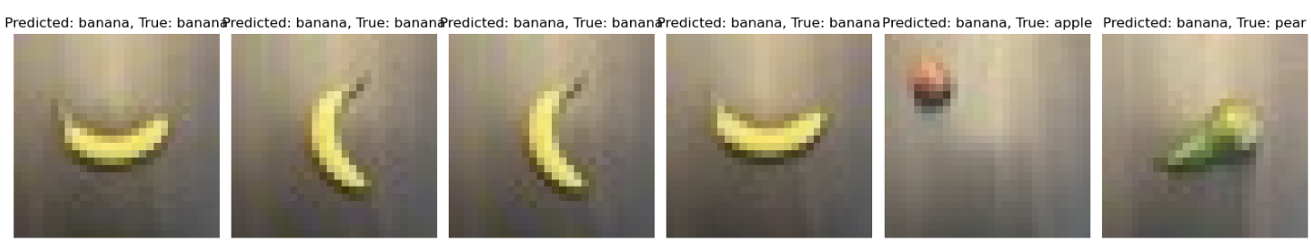
Technieken (AI):
Tensorflow (Machine learning library)
Keras (Neural network layers)
Matplotlib (plotten data in grafieken)
Sklearn (verwarringsmatrix)
AUROC (Modelprestaties meten)
Uitdagingen:
Overfitting
Optimaliseren Accuracy & Loss
Resultaten:
Model loss: 0.24345503747463226
Model Accuracy: 0.9375 (~94%)
AUROC: 0.9953703703703703

