Slide 1
Part 1: Matrix Math
Matrix notation
Matrix math (addition, multiplication)
Inverses and determinants
Part 2: Covariance & Correlation
Concepts
Sample data
Modern pollen data

Slide 2
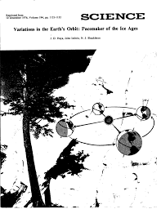
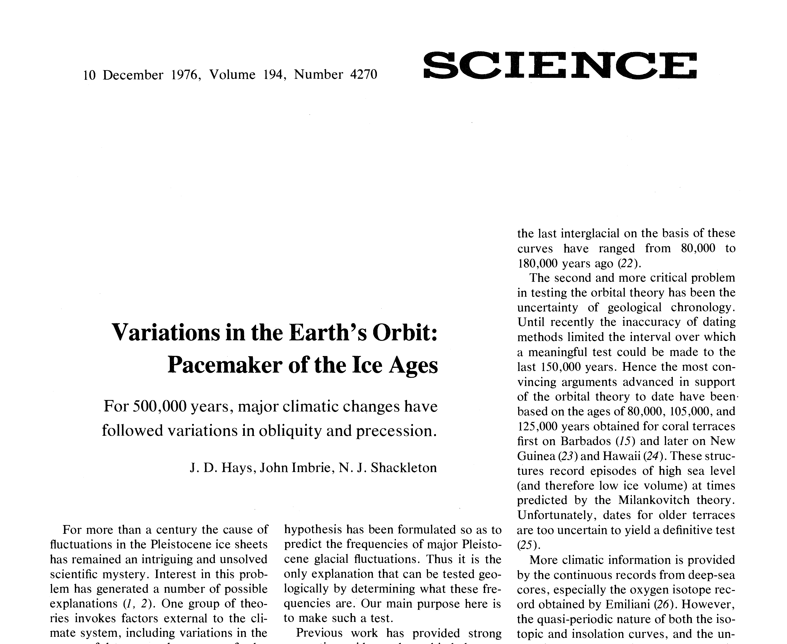
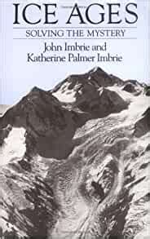

Part II: Imbrie Worksheet

Slide 3
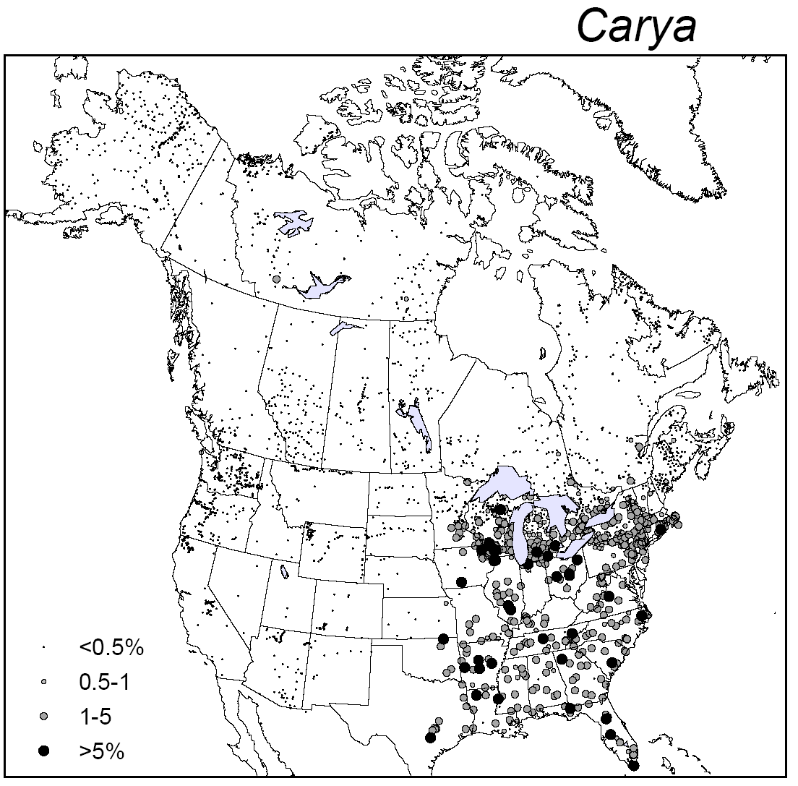
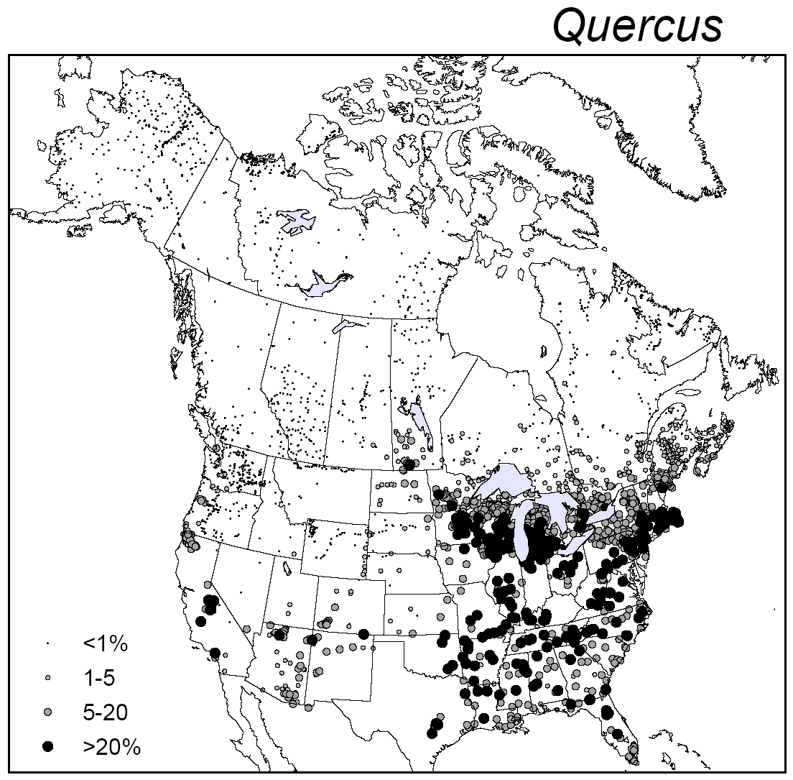
Part III: Correlations in Modern Pollen Dataset
CORRS | CARYA
Acer | 0.021
Alnus | -0.230
ARTEMISIA | -0.179
ASTEROTH | 0.005
BETULA | -0.286
CARYA | 1.000
CASTANEA | -0.046
Fraxinus | 0.155
Juglans | 0.511
Larix | -0.126
LIQUIDAM | 0.234
OSTRYCAR | 0.151
PICEATOT | -0.199
Pinus | -0.354
PLATANUS | 0.250
POACEAE | 0.184
POPULUS | -0.096
QUERCUS | 0.559
SALIX | -0.014
TILIA | 0.054
ULMUS | 0.215
Whitmore et al. 2005 Quaternary Science Reviews
Williams et al. 2006 AASP Atlas

