Slide 1
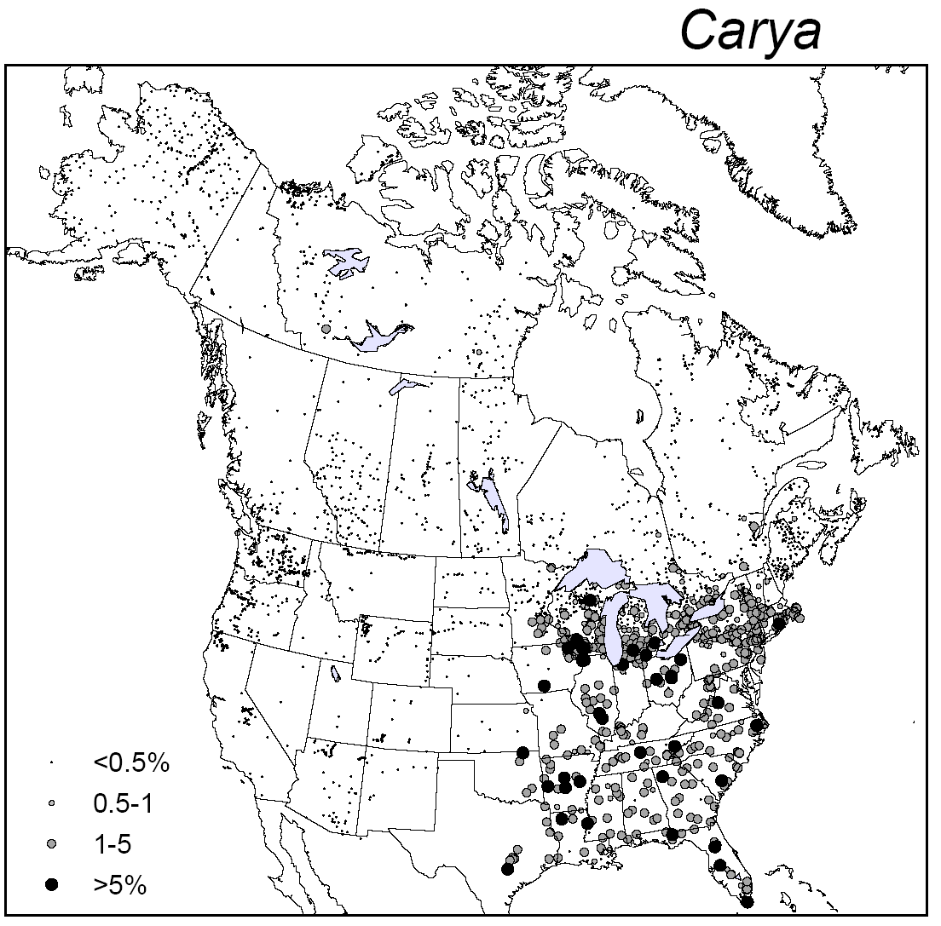
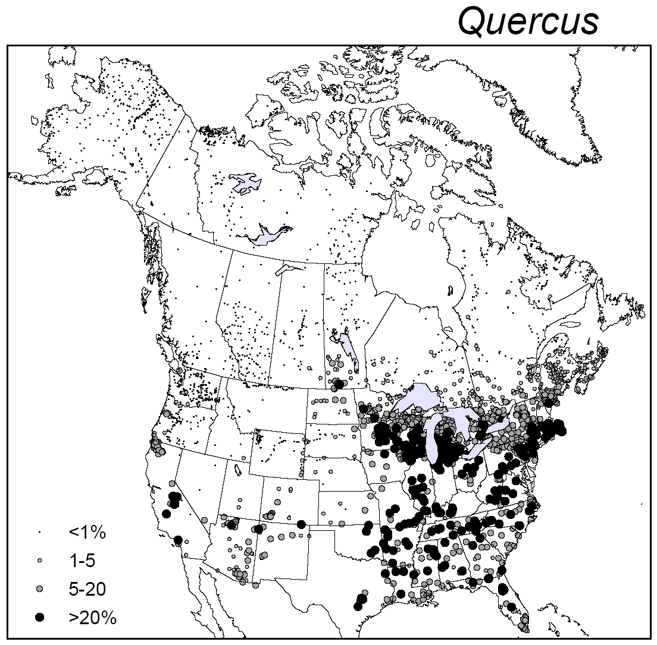
Challenge
CORRS | CARYA
Acer | 0.021
Alnus | -0.230
ARTEMISIA | -0.179
ASTEROTH | 0.005
BETULA | -0.286
CARYA | 1.000
CASTANEA | -0.046
Fraxinus | 0.155
Juglans | 0.511
Larix | -0.126
LIQUIDAM | 0.234
OSTRYCAR | 0.151
PICEATOT | -0.199
Pinus | -0.354
PLATANUS | 0.250
POACEAE | 0.184
POPULUS | -0.096
QUERCUS | 0.559
SALIX | -0.014
TILIA | 0.054
ULMUS | 0.215
Many datasets contain many correlated variables
What variable(s) best summarizes the underlying variance in the data?

Slide 2
Principal Components Analysis:
Summary
The first principal component (PC) is oriented to explain the maximum amount of variance in the data
Each additional PC explains the maximum amount of residual variance
All PCs are orthogonal to each other, i.e. they are fully independent.
The PCs also provide new coordinate axes for the data
PCA assumes data linearity and normality

Slide 3
Principal Components Analysis:
More information
Principal components are based on eigenvectors & eigenvalues
  Eigenvectors describe the orientation of the each PC
  Eigenvalues describe the importance of each PC, in terms of variance explained
The loadings describe the correlations of the original variables to the PCs
The scores describe the position of each sample in the new coordinate axes

Slide 4
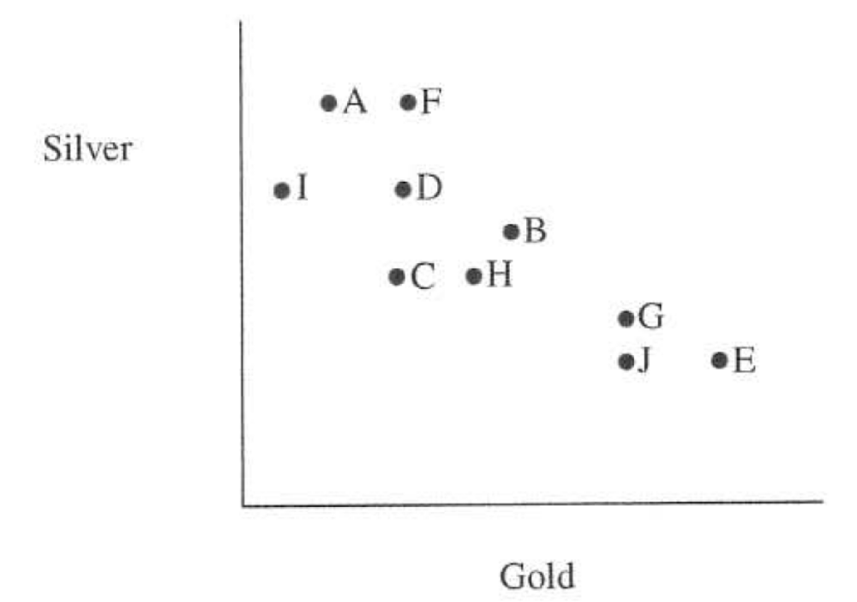
Principal Components Analysis: a graphical example
Silver & gold are highly anti-correlated
If we were to draw a line through this data, what line would maximally explain variance in data?
McKillup & Dyer 2010

Slide 5
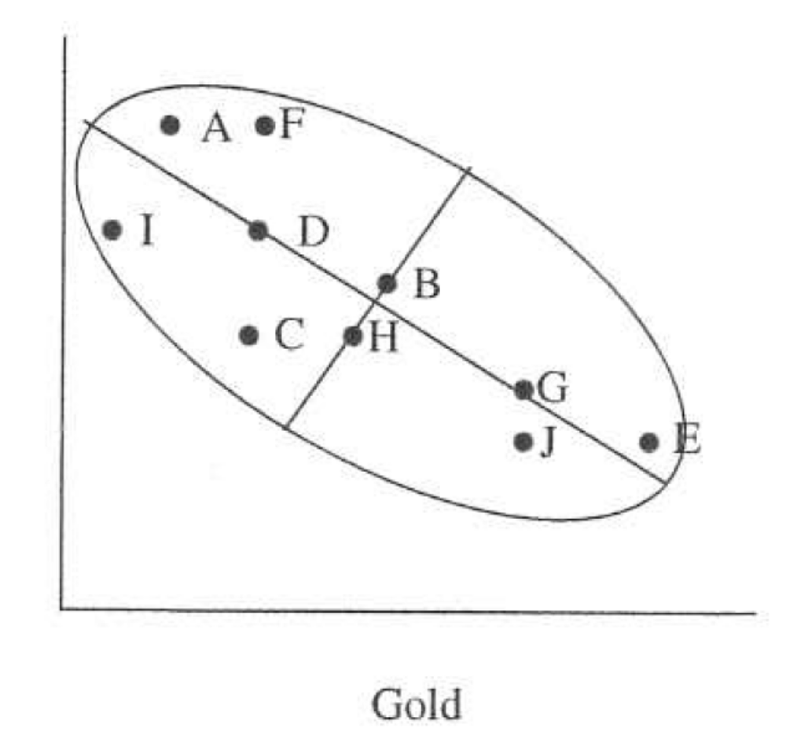
Principal Components Analysis: a graphical example
We can draw an ellipse of variation around these observations
Note that this ellipse has orthogonal axes: a long (major) axis and short (minor) axis
The major axis is PC1 and the minor axis is PC2
Eigenvector 1: Describes orientation of PC vector 1
Eigenvalue 1: Describes length
For more details of eigenvectors and eigenvalues, see Imbrie worksheet
McKillup & Dyer 2010

Slide 6
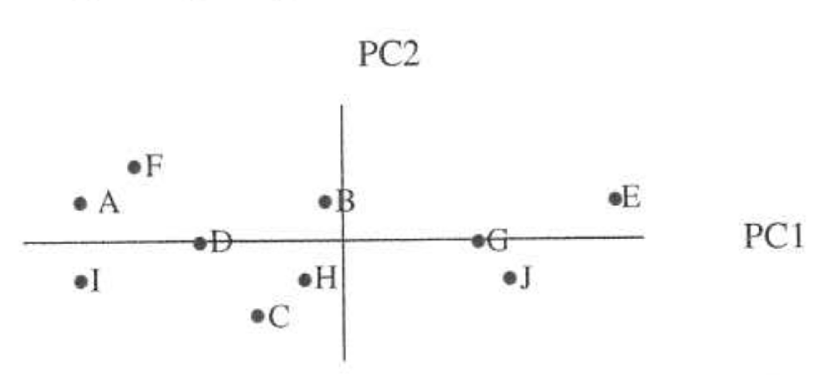
The scores describe the position of each sample in the new coordinate axes
High silver, low gold
High gold, low silver
Notice replacement of gold/silver axes with the new PC1/PC2 axes!
Each PC is optimally placed to describe the most possible variance in the data
But what do these PCs mean? They’re awfully abstract. A tradeoff between gain in variance explained versus a loss of easily interpretable meaning
McKillup & Dyer 2010

Slide 7
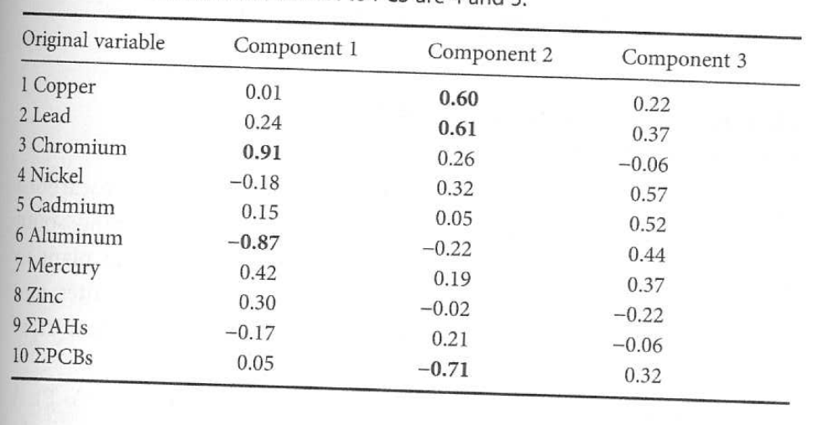
The loadings help us interpret the PCs, by describing their correlations to the original variables
McKillup & Dyer 2010

Slide 8
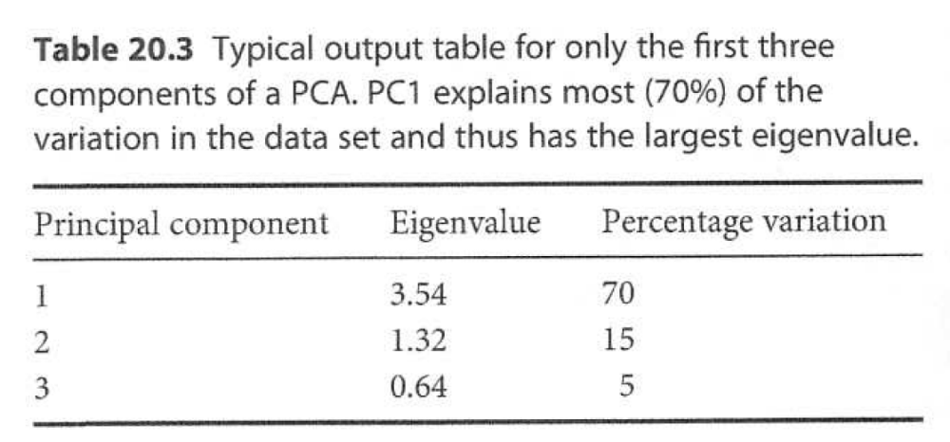
The percent variance explained is essential output – it tells us the importance of each PC
%Variance is essentially calculated from the Eigenvalue (see Imbrie)
Note that a single PC explains 70% of variance in this dataset!
McKillup & Dyer 2010

Slide 9
Non-Metric Multidimensional
Scaling (NMDS): Summary
An ordination technique, like PCA: reduces high- to low-dimensional data
NMDS is non-parametric and makes no assumptions about normality, linearity, etc.
Species abundances converted to rank order
Based on dissimilarities among sites: attempts to find the axes that best preserve pair-wise dissimilarities among sites
Attempts to minimize ‘stress’ (difference between original and new dissimilarities)

Slide 10
NMDS: Pros
Makes no assumptions about normality, linearity, etc.
Can handle non-linear/ordinal/categorical data
Can use any dissimilarity metric

Slide 11
NMDS: Cons
Computationally intensive
Might not find the true global solution; might get stuck in a local optimization minimum
Analyst has to prescribe the number of output dimensions – no clear rule – and results might vary given choice
Because of rank-ordering, can miss big changes in species abundances

Slide 12
Today’s Lab
Introduction
Imbrie Worksheet, part 2
PCA in R (sample dataset)
PCA in R (modern pollen dataset)
NMDS in R (modern pollen dataset)

