Slide 1
Challenge
We have a time series for a single variable.
How best to fit a curve to the data, given temporal autocorrelation
Which trends in the time series are statistically significant?
Simpson 2018 Frontiers Ecol Evol

Slide 2
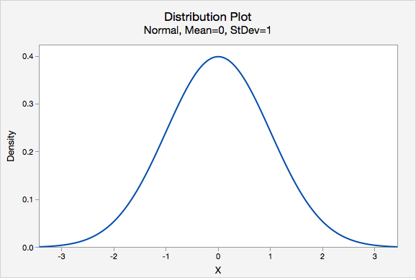
Temporal autocorrelation: When the state of the system at time t depends at least partially on its state at the prior time step t-1.
y_{t}
White Noise: y_{t} ~ N(μ,σ²)
Time (t)
Red noise: Watch out! It can very quickly produce patterns that ‘look’ real
Red Noise: y_{t} = y_{t-1} + ε_{t}
N(0, 1)
ε_{t} ~ N(μ,σ)
y_{t}
Bretherton 2014
https://atmos.washington.edu/~breth/classes/AM582/lect/lect8-notes.pdf
https://online.stat.psu.edu/stat200/book/export/html/124
Time (t)

Slide 3
Fitting models to time series data
Example: δ¹⁵N data from sediments retrieved from the Small Water site
Simpson 2018 Frontiers Ecol Evol

Slide 4
Linear and polynomial fits
Example: δ¹⁵N data from sediments retrieved from the Small Water site
y_{t} = β₀ + β₁x_{t} + ε_{t}
ε_{t} ~ N(0,1)
Simpson 2018 Frontiers Ecol Evol

Slide 5
Linear and polynomial fits
Example: δ¹⁵N data from sediments retrieved from the Small Water site
P=
y_{t} = β₀ + β₁x_{t} + β₂x²_{t} + β₃x³_{t} +· · · + β_{P}x^{P}+ ε_{t}
= β₀ +Σ β_{p}x^{p}_{t} + ε_{t}
Problems:
Choosing p: semi-arbitrary, underfitting vs. overfitting
Weird behavior at edges
ε_{t} assumptions: independent and identically distributed (IID)!
Polynomials are ‘globally’ fitted to entire dataset
ε_{t} ~ N(0,1)
Simpson 2018 Frontiers Ecol Evol

Slide 6
General Additive Models
Keep the linear framework, while allowing for locally non-linear and non-IID data!
Linear Model:
(Ordinary Linear Regression)
y_{t} = β₀ + β₁x_{t} + ε_{t}
ε_{t} ~ N(μ,σ²)
GAM:
y_{t} = β₀ + f(x_{t}) + ε_{t}
Instead of β₁x_{t}, we have a non-linear function based on x_{t} – very flexible framework that allows x to be transformed in various ways
The f(x_{t}) are also known as smooth functions (or ‘smooths’) of x_{t}
The smooths enable local fitting to data

Slide 7
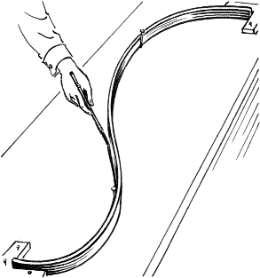
General Additive Models
Smooths: What should we use for f(x_{t})?
Many options… usually some variant of a spline
Splines: smooth curves that are locally fitted to a part of a larger curve, that are constrained to smoothly join together at locations called knots.
For example, a smooth curve S can be constructed as the sum of multiple cubic splines (C_{i}):
S= C₁(x) for a first range of x values
+ C₂(x) for a second range of x values
+ C₃(x) for a third range of x values
+ …
+ C_{n}(x) for the nth range of x values
Cubic Spline: C_{i}(x)=a_{i}x³ + b_{i}x² + c_{i}x + d_{i}
A wooden drafting spline with ‘knots’ (pegs)
https://en.wikipedia.org/wiki/Flat_spline

Slide 8
Example of Spline Fit
P=
Put another way, each f(x_{t}) is calculated as a sum of local basis functions: b_{j}(x). Here, the basis functions are cubic splines. Each spline gets its own weighting (Bj) and will locally dominate the signal:
f(x_{t}) =Σ b_{j}(x_{t})β_{j}
7 cubic splines (curves)
7 knots (evenly spaced, tick marks)
Right: Each spline locally weighted by its β_{j}
Simpson 2018
Frontiers Ecol Evol

Slide 9
Fitting vs. Overfitting: Smoothness parameter (λ)
Overfitted models: Overly influenced by data. Low generality and low predictive power
How to pick λ? Cross-validation analyses, maximum likelihood, restricted maximum likelihood, …
Simpson 2018 Frontiers Ecol Evol

Slide 10
Examples of GAM fitting
P=
y_{t} = β₀ + f(x_{t}) + ε_{t}
ε_{t} ~ N(μ, Λ σ²)
Top:
Bottom: Which is right?
Autocorrelation term to relax iid, handle differential spacing of samples
Simpson 2018 Frontiers Ecol Evol

Slide 11
Confidence Intervals and GAMs
Simpson 2018
Frontiers Ecol Evol
Coefficients in the basis functions are estimated as probability density functions
Can randomly draw coefficients from the PDFs to generate multiple GAMs, generate a posterior distribution of possible GAMs.

Slide 12
Confidence Intervals and GAMs
Can also calculate Confidence Intervals for First Derivatives

Slide 13
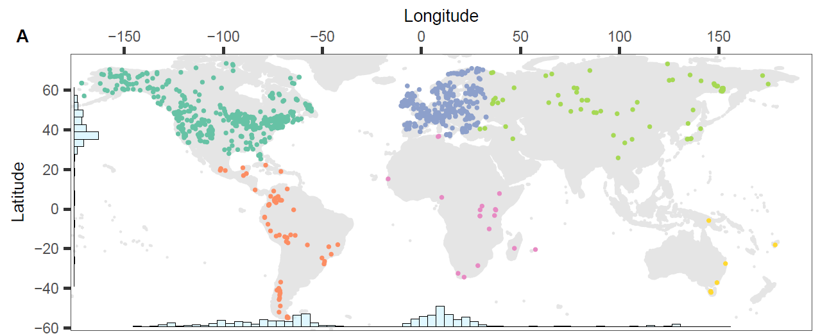
Confidence Intervals
Can also calculate Confidence Intervals for First Derivatives (slopes): are slopes significantly different from zero?
Data: Fossil pollen
Dots: Rates of Change (Χ² dissimilarity metric)
Curves: GAMs, with asterisks indicating significant slopes
Mottl et al. 2021 Science

Slide 14
Today’s Lab
Part 1: Introduction
Part 2: GAM fitting: Small Water example
Part 3: GAM fitting: Pick your pollen curve

