Slide 1
Outline
Part I: Introduction: Multivariate Data Analysis: Pre-Multiply or Post-Multiply?
Part II: Dissimilarity Metrics
Part III: Rates of Change

Slide 2
Multivariate Data Analytics: Pre-Operate or Post-Operate?
Correlation Matrix
(N x N)
Variables 1, 2, … N
PCA
Describes the relationships among variables
Samples 1, 2, ….M
Dissimilarity Matrix
Dissim
(M x M)
Describes the relationships among samples
In most eco. & geo. datasets
M>N
Hence M x M >> N x N
Notes:
Developed variant of modern analog technique for calibration
Level 1:
-match modern and fossil pollen samples
-close matches get assigned tree densities associated w/modern
-no matches=classic problem for analog approaches
-here, regroup into functional categories (e.g. spruce and fir regrouped to boreal conifers)
Level 2: rerun analysis
Level 3: regroup to very broad categories -- but didn’t work
Key point: allows finding of functional analogs when no compositional analogs exist

Slide 3
Outline
Part I: Introduction: Multivariate Data Analysis: Pre-Multiply or Post-Multiply?
Part II: Dissimilarity Metrics
Part III: Rates of Change

Slide 4
Dissimilarity Metrics: Measuring Distances in Multivariate Space
Common Metrics
Euclidean
Standardized Euclidean
Squared Chord
Bray-Curtis
Mahalanobis
Pollen Type 2 (%)
Common Spaces
Geographic (Spatial)
Community
Climate/Environment
Trait
Pollen Type 1 (%)
=Fossil
sample i
=Modern
sample j
Notes:
Developed variant of modern analog technique for calibration
Level 1:
-match modern and fossil pollen samples
-close matches get assigned tree densities associated w/modern
-no matches=classic problem for analog approaches
-here, regroup into functional categories (e.g. spruce and fir regrouped to boreal conifers)
Level 2: rerun analysis
Level 3: regroup to very broad categories -- but didn’t work
Key point: allows finding of functional analogs when no compositional analogs exist

Slide 5
Euclidean Distance
a²+b²=c²
(x₂,y₂)
c
b
a=x₂-x₁
b=y₂-y₁
c=[(x₂-x₁)²+(y₂-y₁)²]^{0.5}
(x_{1,}y₁)
a
Euclidean Distance for
n dimensions:

Slide 6
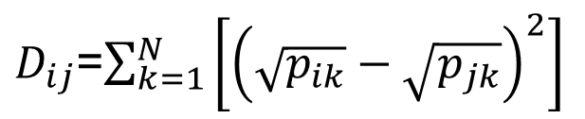
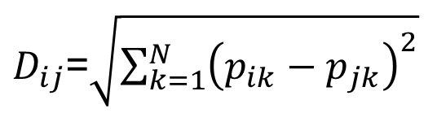
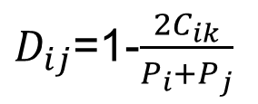

Distance Metrics, Characteristics, Applications
$D_{ij}$=$\sqrt{\sum_{k=1}^{N}{{\left(p_{ik}−p_{jk}\right)}^{2}}}$
Unweighted
Textbook Geometry
Euclidean
$D_{ij}$=$\sqrt{\sum_{k=1}^{N}{\left[\frac{{\left(p_{ik}−p_{jk}\right)}^{2}}{s_{}^{2}{}_{k}}\right]}}$
Standardized
Euclidean
Equal-Weight
Climate Data
Signal-to-Noise
Compositional Data
(abundances)
$D_{ij}$=$\sum_{k=1}^{N}{\left[{\left(\sqrt{p_{ik}}−\sqrt{p_{jk}}\right)}^{2}\right]}$
Squared Chord
$D_{ij}$=1-$\frac{2C_{ik}}{P_{i}+P_{j}}$
Compositional Data
(counts, presence/abs)
Bray-Curtis
i,j = indexes of samples in datasets P_{i}, P_{j}
k = index of variables N
s²_{k} = variance of variable k
C_{ik} = sum of all pollen of same type between datasets P_{i}, P_{j}

Slide 7
Choosing Your Metric: Rules of Thumb
Data Type: Some metrics designed only for presence-absence data (e.g. Bray-Curtis, Jaccard); others can handle scalar data.
Unweighted metrics: Dominated by the variables with the largest means and variances. (like covariance). Inappropriate if variables have different inherent units, scalings (e.g. climate data, T vs P). For compositional data, the most abundant taxa will dominate.
Equal-weight metrics: equally weight all variables. Often best for many mixed-variable datasets. But for compositional data, watch out! The many rare taxa usually have high noise/uncertainty, can swamp the signal
Signal-to-Noise Metrics: Intermediate between unweighted and equal-weight, downweight most abundant variables without attempting full standardization (e.g. by square-root transformation)

Slide 8
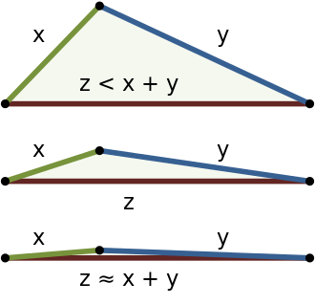
An Aside: Distance vs. Dissimilarity
Distance Metrics are a subclass of Dissimilarity Metrics
Distance Metrics must obey Triangle Inequality, Dissimilarity metrics don’t have to!
Euclidean Distance
Bray-Curtis Dissimilarity
https://en.wikipedia.org/wiki/Triangle_inequality

Slide 9
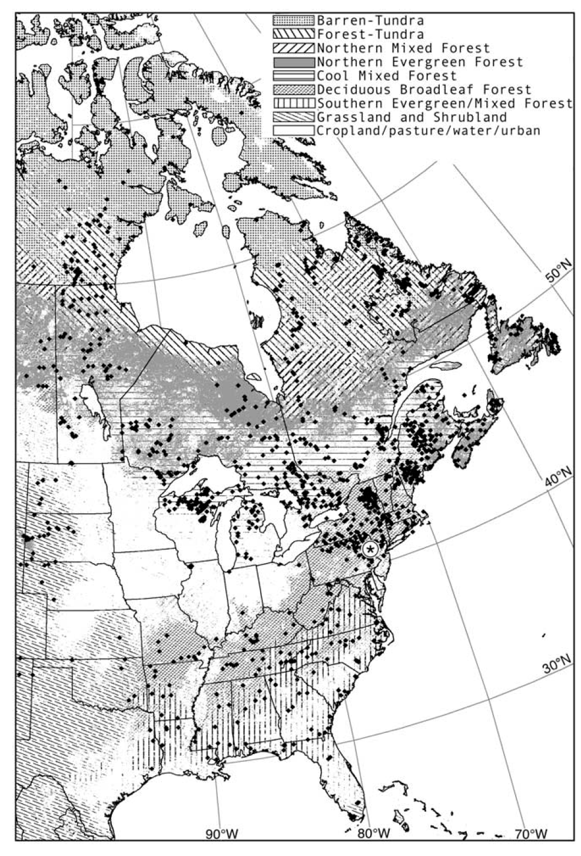
Which dissimilarity metric is the most discriminating?
Test: Assess ability of dissimilarity metrics to differentiate pairs of pollen samples drawn from same vegetation formation or from different formations
Gavin et al., 2003 Quaternary Research

Slide 10
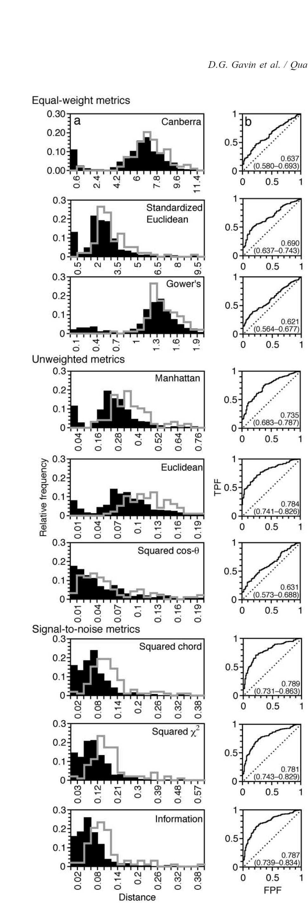

ROC (Receiver-Operating Characteristic) Analysis
A
AUC=0.631 to 0.784
AUC=0.621 to 0.690
AUC=0.781 to 789
Signal-to-noise metrics are the most discriminating
Squared-chord slightly better than other signal-to-noise metrics
Gray histograms: distances for same-biome pollen samples
Black histograms: distances for different-biome pollen samples
Gavin et al. 2003 QSR
Gavin et al., 2003 Quaternary Research

Slide 11
Outline
Part I: Introduction: Multivariate Data Analysis: Pre-Multiply or Post-Multiply?
Part II: Dissimilarity Metrics
Part III: Rates of Change

Slide 12
Dissimilarity Analyses: Challenges
Dissimilarity analyses lead to data expansion, not data reduction! Do not scale well as data volumes grow.
A raw dissimilarity matrix is not immediately interpretable by humans, unlike a correlation or covariance matrix
Variables 1, 2, … N
Samples 1, 2, ….M
Dissimilarity Matrix
(M x M)
Data Volume: M² Computation: M²
Samples 1, 2, ….M
Samples 1, 2, ….M
e.g. Earth Land Surface Area: 148.9 x 10⁶ km²
Dissimilarity Analysis of Terrestrial 1km Data Product: 2.2 x10¹⁵ (2,200 trillion) data points
In most eco. & geo. datasets
M>N
Notes:
Developed variant of modern analog technique for calibration
Level 1:
-match modern and fossil pollen samples
-close matches get assigned tree densities associated w/modern
-no matches=classic problem for analog approaches
-here, regroup into functional categories (e.g. spruce and fir regrouped to boreal conifers)
Level 2: rerun analysis
Level 3: regroup to very broad categories -- but didn’t work
Key point: allows finding of functional analogs when no compositional analogs exist

Slide 13
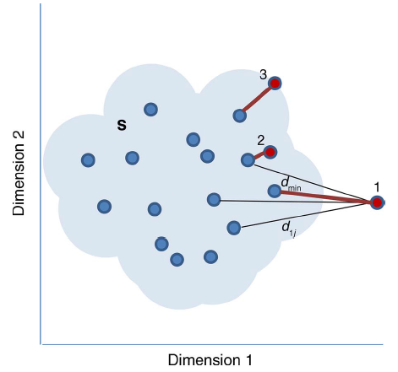
Dissimilarity Analyses: Common Solutions
Rate of Change (RoC) Analyses: Compare dissimilarity between each time step (Computationally cheap: each sample compared to one other) (this lab)
Novelty analyses: Compare every value to every other value, retain only the closest analogue(s). (Computationally expensive, data volume small) (next lab)
Time
Jacobson et al. 1987 DNAG Book
Notes:
Developed variant of modern analog technique for calibration
Level 1:
-match modern and fossil pollen samples
-close matches get assigned tree densities associated w/modern
-no matches=classic problem for analog approaches
-here, regroup into functional categories (e.g. spruce and fir regrouped to boreal conifers)
Level 2: rerun analysis
Level 3: regroup to very broad categories -- but didn’t work
Key point: allows finding of functional analogs when no compositional analogs exist

Slide 14
Today
Experiment with Different Dissimilarity Metrics
Interpolate to an Even time Interval
Calculate RoC for time bins

