Slide 1
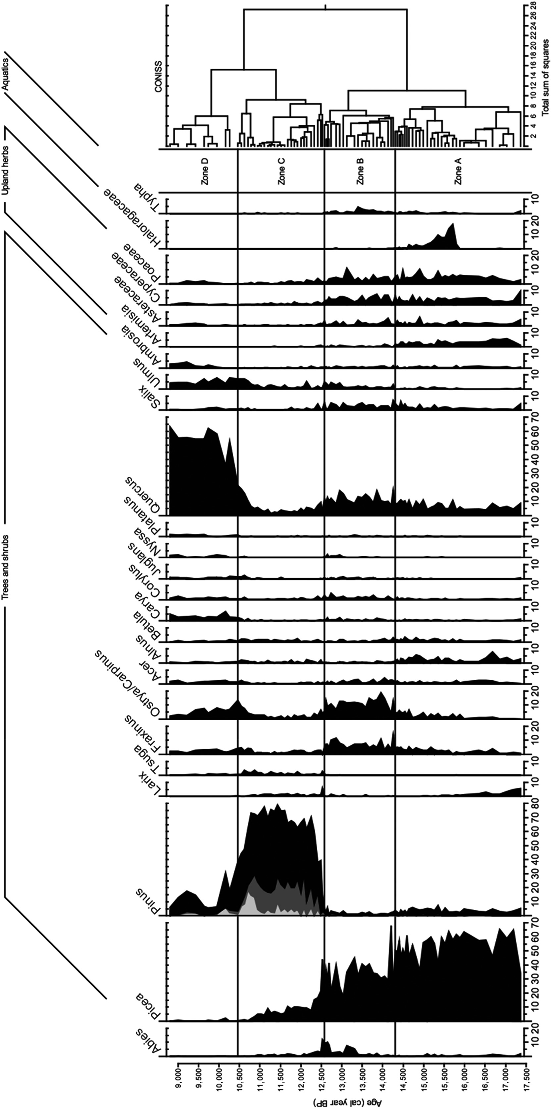
More than one way to kill a spruce forest: The role of fire and climate in the late‐glacial termination of spruce woodlands across the southern Great Lakes
Journal of Ecology, Volume: 109, Issue: 1, Pages: 459-477, First published: 08 October 2020, DOI: (10.1111/1365-2745.13517)
Notes:
Pollen percentages of major taxa (mean abundance >1%) at Triangle Lake Bog. Pollen types are summed to the genus or family level except for Pinus, which is shown at the subgenus level (light grey = Pinus strobus, medium grey = Pinus banksiana/resinosa, black = undifferentiated). CONISS vegetation zones are shown at right of diagram
IF THIS IMAGE HAS BEEN PROVIDED BY OR IS OWNED BY A THIRD PARTY, AS INDICATED IN THE CAPTION LINE, THEN FURTHER PERMISSION MAY BE NEEDED BEFORE ANY FURTHER USE. PLEASE CONTACT WILEY'S PERMISSIONS DEPARTMENT ON PERMISSIONS@WILEY.COM OR USE THE RIGHTSLINK SERVICE BY CLICKING ON THE 'REQUEST PERMISSIONS' LINK ACCOMPANYING THIS ARTICLE. WILEY OR AUTHOR OWNED IMAGES MAY BE USED FOR NON-COMMERCIAL PURPOSES, SUBJECT TO PROPER CITATION OF THE ARTICLE, AUTHOR, AND PUBLISHER.

