Slide 1
Modelling palaeoecological community data: a state-space approach
Quinn Asena, Anthony Ives, Jack Williams. and Jonathan Johnson

Slide 2
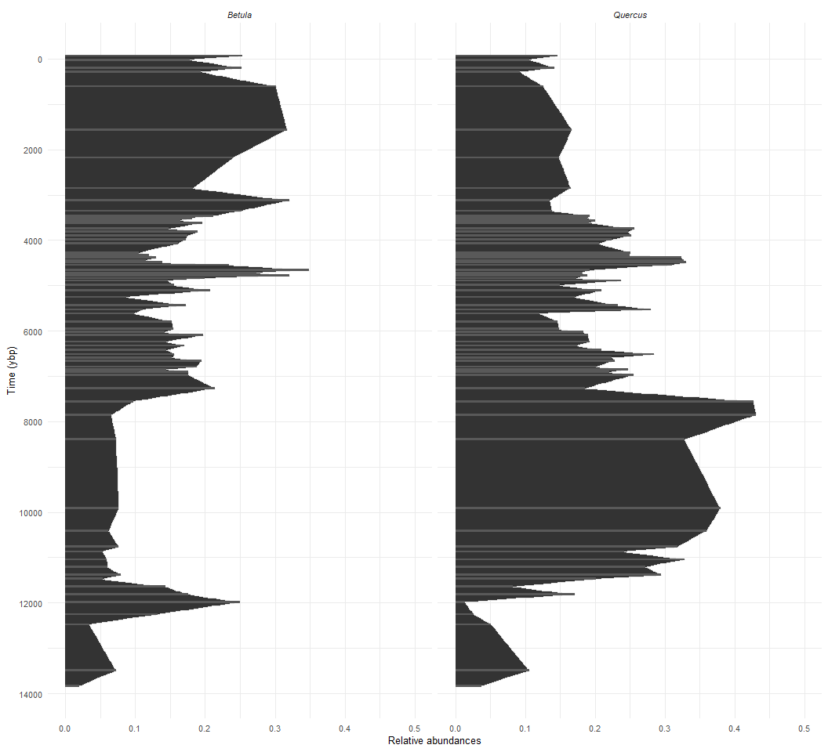
Is the past recoverable from the data?
Palaeoecologists are concerned with questions such as:
what are the drivers of community change?
role species-environment interactions?
role of density dependence and species interactions?
how can palaeoecological information inform present and future ecosystem states?

Slide 3
Palaeoecological proxy data
Typically comprise mulitple time-series (response):
e.g., pollen, diatoms…
Include environmental covariates (predictors):
e.g., isotopic data, charcoal data, lake level…
Palaeoecological data pose many statistical challenges:
Uneven sampling through time
Time averaging
Measurement uncertainty
Relative abundances

Slide 4
Descriptive approaches
Many descriptive approaches exist for analysing multivarivariate time-series:
Cluster analyses: CONISS
Ordination: PCA, NMDS…
Machine learning: MVRT, LDA (fancy cluster analyses)
Descriptive methods allow us to extract patterns from the data but not determine potential causes of those patterns.
Find image of cluster analysis

Slide 5
Beyond pattern recognition
The cutting edge in palaeoecology is to establish potential causes of observed patterns in species relative abundances. For example, are observed patterns driven by:
species interactions?
climate variability?
fire regime?
…
This is what we want to know if we are to use palaeoecology to inform management of contemporary ecosystems or inform potential future ecosystem states. No easy task!

Slide 6
State-space modelling
State-space modelling goes beyond descriptive approaches and attempts to estimate:
autoregressive / density dependent processes
interspecific interactions ($C$ matrix)
species-environment interactions ($B$ vector)
combinations of the above

Slide 7
State-space modelling
State-space modelling attempts to predict the “true” unobservable state of a system from observable variables. It does so via two equations, one that models the process of the system:
Process equation:
Something not right here Tony…:
$$Y=B0+C\left(Y−B0−BX\right)+BX$$
and one that models the observations from the system:
Observation equation:
$$Y_{t}=Multinomial\left(z_{t}\right)$$

Slide 8
State-space modelling
State-space models are not new to ecology and have been used for:
estimating animal populations
animal movement
plant cover data
and much more
However, state-space models are not well explored in palaeoecology.

Slide 9
State-space modelling
include eq on slide:
This new variant of a state-space model:
uses a multinomial distribution: accepts raw count data
accepts multiple predictor data streams in the same model: e.g., isotopic data, charcoal accumulation rates, fungal spores…
simultaneously fits multiple coefficients
models autocorrelation structure
Can be used to assess a range of possible causes of observed patterns in palaeo-data.

Slide 10
Empirical example
Demonstrating a three-taxon model from Sunfish Pond:
unpublished data: not presenting the dataset, focusing on the modelling approach (Johnson et al., unpub)
ACES project interested in abrupt transitions between dominant species

Slide 11
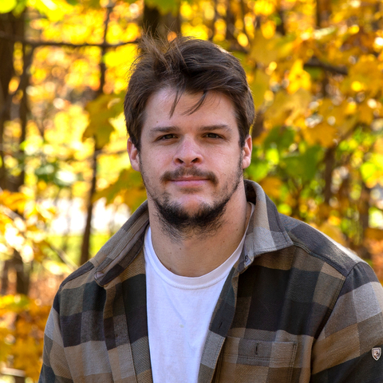
Jonathon Johnson (JJ)

Slide 12
Empirical example
This example is a three-taxon model:
two focal species (Betula and Quercus)
third ‘species’ is an aggregate of all other species
we fit species interactions
estimate species change through time
Remember, this is a multinomial problem so the we do not estimate the aggregate species directly.

Slide 13
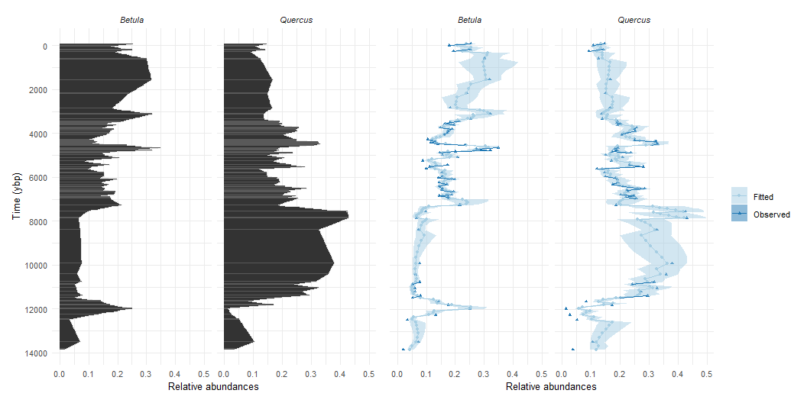
Time-forward model enables even intervals
Johnson et al., unpublished

Slide 14
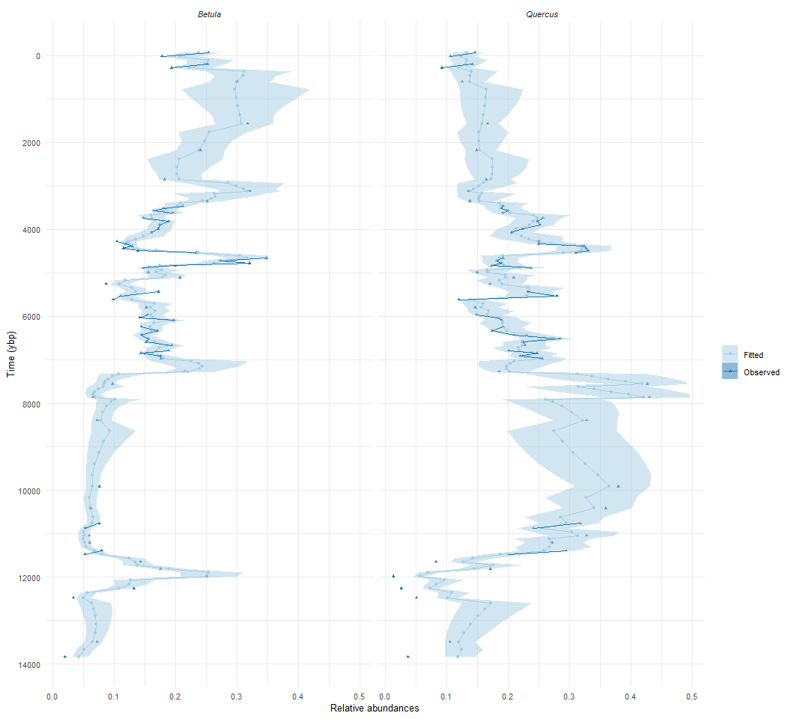
Species interaction estimates
$C$ matrix
other Quercus Betula other -0.074 0.000 0.000 Quercus 0.000 -0.006 0.121 Betula 0.000 -0.702 -0.459
columns = abundance; rows = change in abundance
density dependence on the diagonal
Quercus-Quercus near 0 means abundance of Quercus has little affect on the change in Quercus
Quercus-Betula -0.7 means that abundance of Quercus affects the change in Betula abundance

Slide 15
Estimating the effect of covariates
Estimate of change over time
$B$ vector
other Quercus Betula 0 0.048 -0.532
Overall:
Quercus increases with time
Betula decreases with time
estimates are relative!

Slide 16
Evaluating the model with simulated data
We cannot determine the accuracy of fitted coefficients empirically from palaeoecological data.
Simulation experiments are used to assess the success of recovering parameters:
data are simulated under known conditions with replication
the model is fit to the simulated replicate datasets
fitted models are assessed for how well input parameters are recovered

Slide 17
Evaluating the model with simulated data
$C$ matrix fit to the pollen data
other Quercus Betula other -0.074 0.000 0.000 Quercus 0.000 -0.006 0.121 Betula 0.000 -0.702 -0.459
$B$ vector fit to the pollen data
other Quercus Betula 0 0.048 -0.532
$C$ matrix fit to the simulated data
oh
$B$ vector fit to the simulated data
no!
100 reps
average difference between input and fitted parameters

Slide 18
Hypothesis testing
We cannot determine with certainty, outside of simulation, causation from palaeo-data.
What we can do is:
set up multiple working hypothese (Chamberlin, 1897)
couple descriptive methods with inferrential ones
assess which results lend support to the likelihood of each hypothesis being true
Given the data at hand the interaction matrix ($C$) indicates some competition between Quercus and Betula. Such an inference lends support to one hypothesis.

Slide 19
Acknowledgements
Aces team: - Jack Williams, Tony Ives, Angie Perotti, Nora Schlenker, Sam Wiles, Amanda Toomey, Adrian George, Bryan Schuman, David Nelson, Jonathon Johnson
National Science Foundation
UW-Madison

