Slide 1
Pancreas & Lesion Segmentation
A 3D tool that outlines the pancreas and flags a possible tumor — an assist for radiologists, not a diagnosis.
pancreas
lesion
Quinn · Week 3 · Experiment Review & Model Selection
Notes:
I just demoed the 3D viewer. This deck covers the graded experimentation: what we built, what we tried, the model we selected, and where we stand.

Slide 2
THE PROBLEM
Hand-tracing tumors is slow — and two people are judging
This tool proposes the outline so a radiologist can accept, edit, or reject it — saving time on a hard, manual task.
Radiologists hand-trace the pancreas and any tumor on 3D CT — slow, tedious work on a small, hard-to-see organ.
Our model proposes the outline; the human stays in charge. Assist, not automation.
The technical lead wants
Rigorous, single-variable, fairly-compared experiments and a sound model choice.
The business stakeholder wants
To know what it does, how accurate it is, and whether it can be trusted.
Notes:
Two audiences the assignment asks for: rigor for the technical lead, trust and usefulness for the stakeholder.

Slide 3
WHAT WE BUILT + THE KEY DECISION
A whole-box 3D model with a possible-tumor flag
The one feature-engineering decision that mattered: show the model the WHOLE pancreas at once, not random patches.
CT volume
→
SegResNet
→
Output
the 3D scan
pretrained (SuPreM)
pancreas + lesion + flag
Whole-box ROI: crop to the pancreas and feed the entire organ as one 128-voxel cube every training step, so the model always sees the whole pancreas in context instead of a random slab.
What the whole-box bought us
specificity 8% → 55%
the model stopped over-flagging healthy scans
Notes:
The whole-box ROI fixed the over-prediction structurally, without a hyperparameter change. It is a provided (oracle) ROI — we return to that honestly in the caveats.

Slide 4
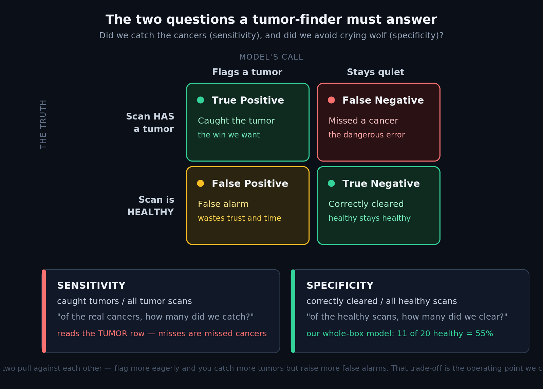
HOW WE MEASURE
Two questions, two metrics
We track how well we outline real tumors (lesion Dice) and how often we correctly leave healthy scans alone (specificity).
Lesion Dice — accuracy
When there IS a tumor, how well does our outline overlap the truth?
Specificity — trust
On a healthy scan, do we correctly stay quiet and not cry wolf?
Each is scored only where it is defined, so healthy scans can never dilute the tumor-outline score.
Notes:
Plain language: did we catch the cancers, and did we avoid crying wolf. The confusion matrix defines the four outcomes; the 55% is an illustrative teaching value.

Slide 5
THE EXPERIMENTS
What moved tumor accuracy — and what didn't
Every run changed one thing at a time. Recipe tweaks did nothing for tumor accuracy; structure, transfer, and data did everything.
Did NOT move it (all nulls)
DID move it
Balanced patch sampling
Loss reweighting
Bigger field of view
Finer resolution (helped the pancreas, not the tumor)
Whole-box ROI — structural change; fixed the over-prediction
SuPreM transfer — essential; from scratch collapses to 0.12
MORE DATA — the winner, by a wide margin
Four recipe knobs, four dead ends — each one ruled out a suspect.
Recipe tuning didn't raise tumor accuracy. Structure, transfer, and data did.
Notes:
The nulls are the control experiments — ruling out four recipe knobs is what made the data conclusion rigorous. Every run was single-variable with a pre-registered accept/reject bar, tracked in MLflow.

Slide 6
THE BREAKTHROUGH
Tumor accuracy scales with data
Holding the recipe fixed and training on more tumor cases roughly doubled our lesion-outline accuracy.
lesion Dice 0.26 → 0.52
Scaling tumor data from 95 to all 1,412 cases roughly doubled it — landing at the segmentation SOTA reference (~0.53).
The gain came from tighter outlines: with more examples the model stopped over-painting tumors.
A provided-ROI development number (an upper bound). A stricter control is running to confirm it.
Notes:
Single lever, dominant effect. Honest framing: two things changed vs the 300-case run (data and iterations), and it's a provided-ROI upper bound, so a pancreas-only control is running. Still, the trend is unambiguous.

Slide 7
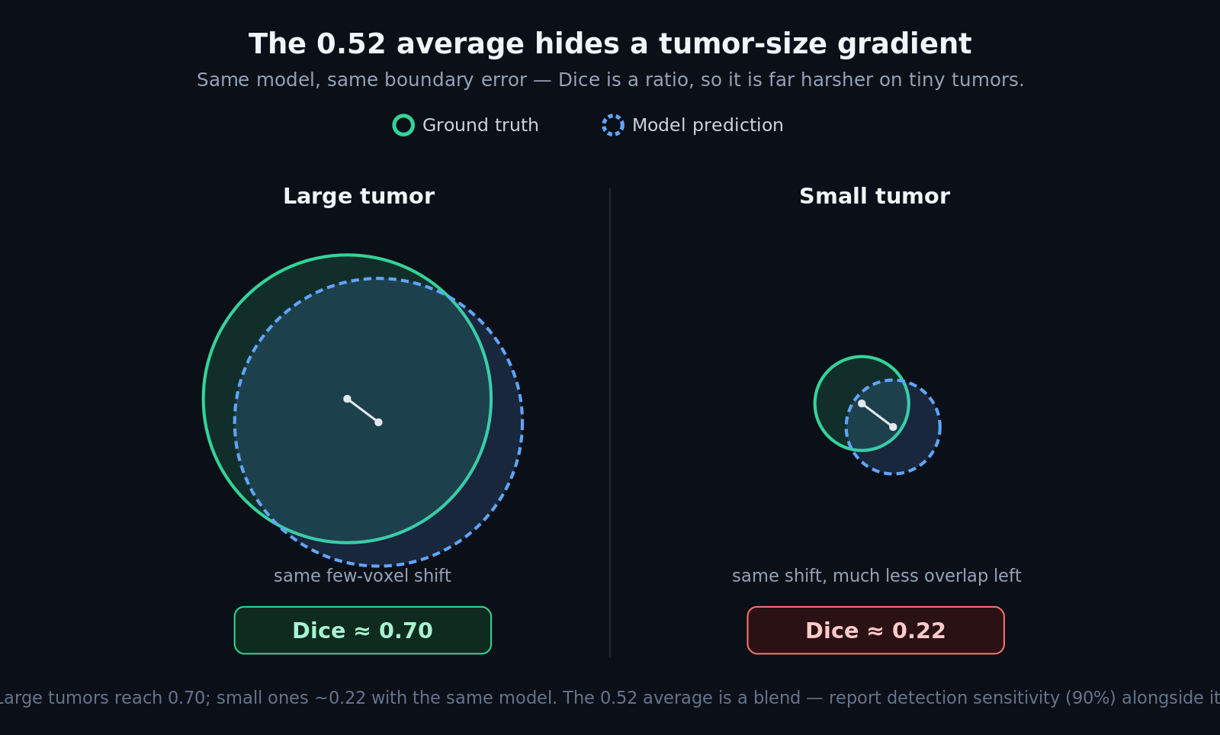
MODEL SELECTION
The model we selected, and the trade-offs
We're carrying forward the whole-box model trained on all 1,412 available cases — chosen on evidence, not just the top number.
Whole-box SuPreM-transfer SegResNet, trained on all 1,412 cases (706 tumor).
pancreas 0.837 · lesion 0.52 · detects 90% of tumors
Transfer is essential — the same model from scratch scores only 0.12.
It catches 90% of tumors; the remaining gap is outline precision on the smallest ones.
Notes:
Defend with evidence, acknowledge the tail. The size diagram explains why the average isn't higher: large tumors reach 0.70, small ones 0.22 — the 0.52 average is a blend, and we report 90% detection alongside it.

Slide 8
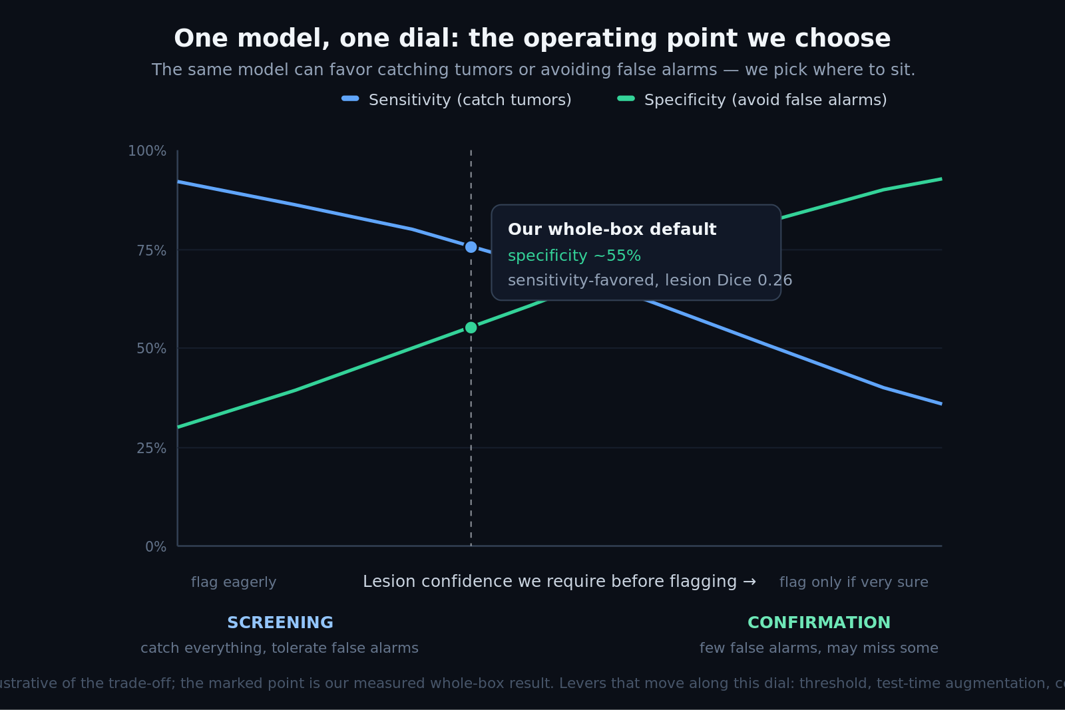
CAN WE TRUST IT?
A tunable operating point — and an honest audit
It flags 90% of tumors, its sensitivity/specificity is a dial we can set, and we audited our own metrics for honesty.
Detection: 90% of tumors are flagged — the core job of a CADe assist.
The sensitivity vs specificity balance is an operating point we choose (screening vs confirmation).
We audited the scoring (plus an independent AI pass): arithmetic correct, no train/validation leakage.
Stated honestly: a provided-ROI upper bound (control running), a development number, and mask-based specificity.
Notes:
The trust dimension. Leading with detection sensitivity and an honest self-audit is what a technical lead wants to hear.

Slide 9
PLAN HEALTH
Ahead of plan, and the path is clear
We finished Week 3 ahead of schedule and broke the accuracy ceiling; here is what Week 4 and beyond hold.
Weeks 1–3: done
Week 4: in progress
Week 5 + capstone
Data validated, pipeline built, and this week we broke the accuracy ceiling — 0.26 to 0.52.
A long training run on max data, the pancreas-only de-leak control, and a final held-out test pass.
UI polish, failure analysis, and the autonomous locate-then-segment cascade.
Level 4.5 (pancreas + lesion) is the line that must hold. Everything above it is a documented stretch goal.
Notes:
Plan transparency: honestly ahead. The data result reframed Week 4 from 'maybe try more data' to 'scale the proven lever and clean up the reporting'.

Slide 10
THE PRODUCT
What it looks like (demoed live)
A browser-based 3D viewer that shows the scan, the pancreas, and the flagged tumor — the demo you saw at the start.
React + NiiVue, static-first (no backend needed for the demo).
True 3D: rotate and cut through the volume, or browse the raw CT slices.
Toggle the model's prediction vs the radiologist's ground truth.
Plain-language 'possible lesion' summary; the technical metrics live in a separate view.
3D pancreas (green) + lesion (red)
Notes:
You saw this live at the start. It's the same files the pipeline exports — reusable straight into the Week 5 build.

Slide 11
Takeaways
Nulls are evidence.
Four dead-end experiments are what made the data conclusion airtight.
Data is the lever.
Scaling tumor data doubled accuracy, 0.26 to 0.52 — at the SOTA reference.
Honest and audited.
A provided-ROI upper bound with no leakage, a self-audit, and a de-leak control already running.
Notes:
Close: disciplined experiments, a data-driven breakthrough, a defensible and honestly-caveated model.

