Slide 1
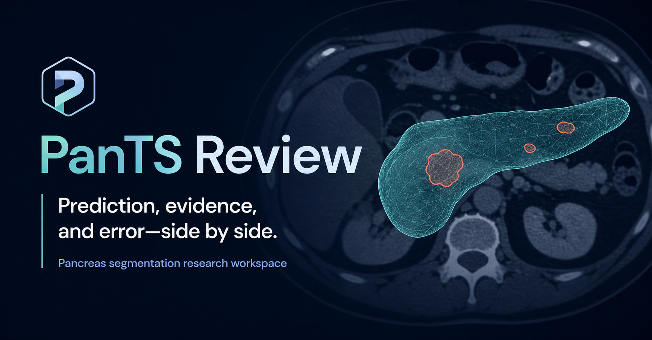
Quinn Evans · five-week independent ML project · Johns Hopkins PanTS dataset
Research use only — a segmentation and annotation-assist tool, not a diagnostic system.
Notes:
30 min talk + 10 min Q&A. Open by naming the scope out loud: segmentation + a CADe flag, never a diagnosis.

Slide 2
01
01
The problem and who it's for
Why the pancreas is uniquely hard, and what changes for the person reading the scan.
≈ 4 minutes
Notes:
[TRANSIT] 10 seconds. Say the section name and move.

Slide 3
THE PROBLEM
Why the pancreas is hard
Pancreatic cancer is among the deadliest — outcomes hinge on catching it early
The organ is soft, irregular, and hidden behind other structures
Tumors are often nearly invisible to the human eye on a CT slice
A radiologist reads hundreds of slices per scan, and most scans are normal
10.4%
of scans in this dataset
contain a tumor
A needle-in-a-haystack read, repeated all day.
Problem & business value
1
Notes:
[RIFF] Expand on whichever lands: the biology, the invisibility, or the volume of reading. The 10.4% is the business framing — most of the work is ruling things out.

Slide 4
THE USER
Who it's for, and what changes
Today
With this tool
Trace the pancreas by hand, slice by slice
Hunt for a lesion that may not be visible
Slow, tedious, and easy to miss something
A proposed outline is already drawn
Accept, edit, or reject it
A flag says “look here first”
Export the mask and finish the job
User: radiologist / imaging annotator
Problem & business value
2
Notes:
[RIFF] The decision this supports is triage and time: where to look first, and how much tracing work is left.

Slide 5
SCOPE
What this is — and what it isn't
It IS
A segmentation tool: it outlines the pancreas and any suspicious region
It IS
A CADe assist: it flags “there could be a tumor here” for review
It is NOT
A diagnosis — it never decides whether a patient has cancer
It is NOT
Autonomous — a human reviews and edits every single output
Problem & business value
3
Notes:
[TRANSIT] 20 seconds. Stating scope up front pre-empts half the Q&A.

Slide 6
02
02
Live demo
An unmarked scan, scored live by the deployed model, then checked against the truth.
≈ 7 minutes
Notes:
[TRANSIT] Make sure the endpoint is running and the UI is on the Scan library before you advance.

Slide 7
LIVE DEMO
Three things to watch
1
2
3
An unmarked scan
The model scores it live
The truth is revealed
Exactly what a radiologist sees — nothing drawn on it yet
A real call to the deployed endpoint, about half a second
Expert contours overlaid on the prediction — how close was it?
Every scan shown is held-out data the model never trained on.
Live demo
4
Notes:
[TRANSIT] Set expectations in 30 seconds, then switch to the app.

Slide 8
LIVE DEMO
PanTS Review · localhost:5173 · live inference on port 8000
Live demo
5
Notes:
[RIFF] 6-7 minutes. Runsheet: 1. Scan library — real held-out studies 2. Load one UNMARKED — this is what the radiologist sees 3. Analyze — live endpoint call, ~0.6s, 'scored just now' badge 4. Read the finding — flag, size, confidence 5. Reveal source of truth — red vs amber, Dice appears 6. 3D — rotate the pancreas with the lesion inside 7. Show the honest case: the healthy scan it over-calls Fallback: if the endpoint drops, the UI serves cached results — say so out loud, it is a designed behavior.

Slide 9
03
03
How it's built
The pipeline, the model, and how a checkpoint becomes something a person can use.
≈ 6 minutes
Notes:
[TRANSIT] The architecture diagram is next — give yourself room to walk it.

Slide 10
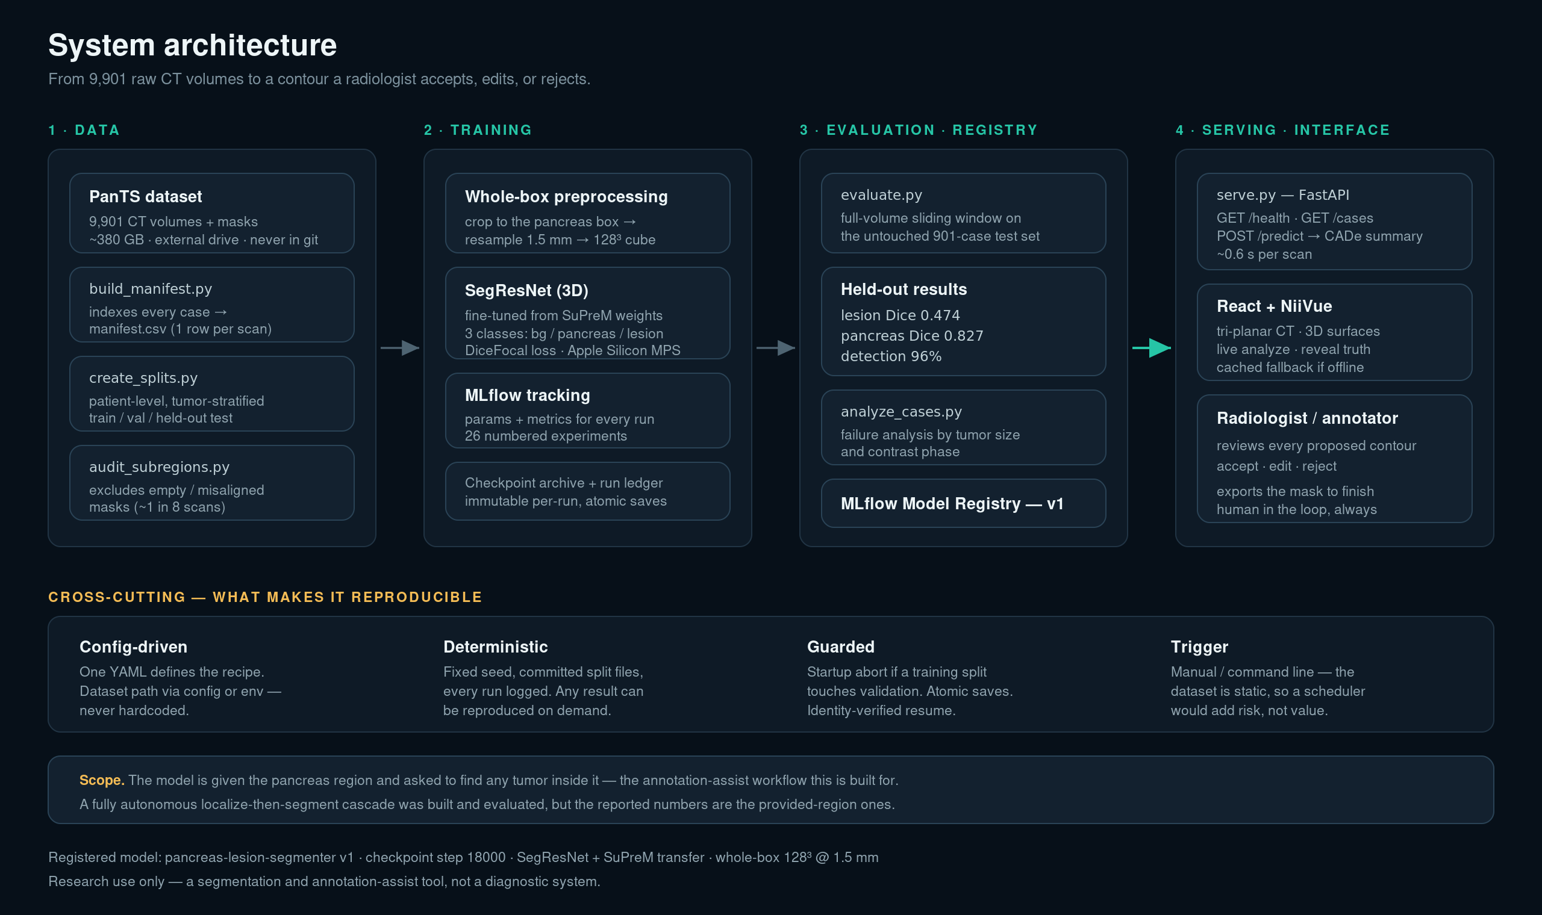
Notes:
[RIFF] 2-3 minutes. Walk it left to right: 1. DATA — 9,901 real volumes on an external drive, indexed, split by patient, audited for broken masks. 2. TRAINING — whole-box preprocessing into one 128 cube, SegResNet fine-tuned from SuPreM, every run in MLflow. 3. EVALUATION + REGISTRY — sliding-window scoring on the untouched test set, then the model is registered as v1. 4. SERVING + INTERFACE — FastAPI endpoint, React/NiiVue front-end, and a human who accepts, edits, or rejects. Then point at the cross-cutting band: that row is the answer to 'where is your DAG'. Ordering, reproducibility, logging and error handling are all delivered — only the scheduler is missing, and the dataset is static. Land on the scope line at the bottom: the model is GIVEN the pancreas region. Say it before anyone asks.

Slide 11
DATA PIPELINE
The data was the hard part
9,901 real CT volumes — about 380 GB, on an external drive, never in the repo
Split by patient, stratified by tumor, so no patient appears on both sides
Roughly 1 in 8 scans had a broken or empty mask — audited and excluded
Volumes range from 8 to over 1,000 slices, across four scanner manufacturers
9,901
CT volumes indexed
~1 in 8
masks broken or empty
Auditing data integrity turned out to be the work, not a distraction from it.
System walkthrough
6
Notes:
[RIFF] Good place to talk about real-world messiness versus clean teaching datasets.

Slide 12
MODEL
The model
3D SegResNet
Does the pretraining matter?
Fine-tuned from SuPreM — pretrained by the same Johns Hopkins lab
Three classes: background, pancreas, lesion
Whole-box input: the entire pancreas region as one cube
Trained on Apple Silicon (MPS), ~7-14 h per run
I measured it instead of assuming.
0.120
0.257
from scratch
SuPreM transfer
+0.13 lesion Dice — the pretraining is what makes this work at my data scale.
Caveat: the two runs also differ in learning rate and freeze schedule, so this is a strong signal rather than a perfectly clean ablation.
System walkthrough
7
Notes:
[RIFF] EXP-09. Single variable, same recipe. From scratch also flagged every healthy scan.

Slide 13
04
04
How I actually worked
Twenty-six experiments, one idea that changed everything, and the day I found my own number was wrong.
≈ 5 minutes
Notes:
[TRANSIT] This is the section to modulate. Four stories are coming — lean into whichever the room is leaning into.

Slide 14
METHOD
26 experiments, bars set in advance
Every experiment: a hypothesis and an accept/reject bar written BEFORE the run
One variable at a time — everything else held fixed
Each result logged with its decision, including the failures
Roughly one experiment per night: a training run is 7 to 14 hours
26
numbered experiments
Accepted, rejected, or null —
all of them written down.
If I couldn't say in advance what would make me abandon an idea, I wasn't testing it.
How I worked
8
Notes:
[RIFF — DROP IF BEHIND] Frame for the next three stories. If you are over time, skip this and open with the whole-box story instead.

Slide 15
STORY 1
The breakthrough was an idea, not a knob
The model found tumors but over-predicted them — flagging something on 92% of healthy scans
I tried the obvious knobs. Sampling: null. Loss function: null.
Two nulls told me the problem was structural, not a hyperparameter
So: stop feeding random patches. Feed the ENTIRE pancreas region as one cube.
One structural change
Pancreas Dice
0.72 → 0.81
Specificity
8% → 55%
Lesion Dice
new best
Became the architecture of the final model.
Two caveats I keep attached to this. It bundled several changes at once — crop, spacing, field of view, and sampling all moved — so it is evidence that whole-box works, not proof that one knob did it. And part of the specificity jump is structural: a pancreas box simply contains less tissue to false-alarm on than a whole scan, so 8% to 55% is not like-for-like.
How I worked
9
Notes:
[RIFF] The point: the nulls were informative. They told me where the problem wasn't, which is how I found where it was.

Slide 16
STORY 2
I found out my own number was wrong
An adversarial code audit found my data-scaling script sampled from the wrong column
My training set overlapped my validation set — 30 of the 40 cases I was reporting on had been trained on
I verified it myself, then fixed the root cause rather than the symptom
Added a guard that aborts training if a split ever touches validation — that class of bug can't recur silently
Rebuilt the splits, retrained, and re-reported the honest number
What I had reported
0.528
Same validation set, after the fix
0.415
That is the like-for-like drop. My 0.474 headline is a different, larger cohort — the held-out test set.
It did not collapse, so the underlying result was genuine — only the margin was contaminated.
How I worked
10
Notes:
[RIFF] The strongest credibility moment in the talk. Caught before external validation, which is exactly when you want it.

Slide 17
STORY 3
Two experiments I rejected
Anatomy-aware supervision
Looked like a clear win at an intermediate checkpoint — +0.041 lesion Dice.
I trained both arms to convergence before deciding. The effect vanished. Rejected.
More healthy training data
Cleared its specificity bar decisively — 17% up to 46%.
But detection fell to 88%, three cases below the floor I set in advance. Rejected.
A result you stop at because it looks good is not a result you can trust.
How I worked
11
Notes:
[RIFF] Both rejections are wins for the method. The second is the honest 'I didn't move my own goalposts' story.

Slide 18
05
05
Results, and where it falls short
The honest held-out numbers, what they mean for the user, and the two real limitations.
≈ 5 minutes
Notes:
[TRANSIT] Own the limitations here rather than waiting for Q&A.

Slide 19
RESULTS
Final numbers, and what they mean
Official held-out test set — 901 scans, scored once, never touched during development
96%
0.474
0.827
17%
detection sensitivity
lesion Dice · CI 0.42–0.52
pancreas Dice
specificity
Catch rate. Of the tumors present, almost all are surfaced for review.
Edit burden. A usable starting contour that still needs a human pass.
The tedious tracing is largely done, close to expert quality.
False-alarm rate. It cries wolf often, so a flag is a prompt, not a verdict.
Published PanTS benchmark: ~0.53 lesion Dice (MedFormer 0.529 · R-Super 0.534, which uses additional external data)
Results & limits
12
Notes:
[RIFF] Lead with detection — the number that matters for a CADe tool. Walk the business line under each stat, then the benchmark bar as the yardstick.

Slide 20
HONEST LIMITS
Limitation: the model is given the pancreas region
It is pointed at the pancreas rather than searching the whole scan on its own.
Why that was the right call for this project
It is a real workflow — in annotation-assist, the reviewer supplies the region
It isolates segmentation quality from localization error, so the number measures one thing
That constraint IS the whole-box breakthrough — the fix for over-prediction came from it
Not ignored: I built and evaluated the autonomous version, with a millimetre-level containment audit
Results & limits
13
Notes:
[RIFF] Own it first, then justify. Emphasise: this was a scoped decision, tested, not an oversight.

Slide 21
HONEST LIMITS
Limitation: specificity is low
It over-calls on healthy scans — 17% specificity is the weakest number in the project.
Deliberately deprioritised — and worked, not forgotten
For a CADe tool, a missed tumor costs more than a false alarm — detection came first
Four documented attempts: sampling ratio, loss function, an anatomical constraint, more healthy data
The model can discriminate — patient-level AUC 0.80 — so it is a threshold problem, not blindness
The honest conclusion: it needs a decision layer in front of it, not a more timid segmenter
Results & limits
14
Notes:
[RIFF] The AUC 0.80 line is the sophisticated point — the signal exists, the cut-off is misplaced. Retraining the segmenter to be timid made the outlines worse, which I measured.

Slide 22
HONEST LIMITS
Where it fails, precisely
Small < 1 cm³
Medium 1–8 cm³
Large > 8 cm³
0.067
0.512
0.610
lesion Dice · 78% detected
lesion Dice · 100% detected
lesion Dice · 100% detected
Small tumors are found but over-drawn — sometimes 25 to 50 times too large. The tool still surfaces them; the outline needs real editing.
Results & limits
15
Notes:
[RIFF — DROP IF BEHIND] Size is the dominant driver; this one behaviour caps Dice AND drives low specificity. Skippable if tight — the previous slide already names the weakness.

Slide 23
06
06
Reflection
What I set out to learn in week one, and what five weeks actually taught me.
≈ 3 minutes
Notes:
[TRANSIT] Slow down here. This is the part they remember.

Slide 24
REFLECTION
What I set out to learn
“Learn to set up a 3D image processing pipeline end to end — and prove I can build something that holds up on real-world data.”
Week 1 takeaway
1
The pipeline exists
Indexing through training, evaluation, registry, endpoint, and interface
2
2D → 3D taught me what changes
Memory is the constraint; how you crop is a modelling decision, not preprocessing
3
Real data was the part I underestimated
Broken masks, wild geometry, four scanner makers — auditing WAS the work
Reflection
16
Notes:
[RIFF] Close the loop honestly. The 'thrilled if it flags cancer even modestly' line pairs well with 96% detection.

Slide 25
REFLECTION
How AI actually shaped the work
What I planned
What it became
A coding accelerator and an explainer.
An adversarial reviewer I stopped trusting by default.
The loop: write a spec → a second AI reviews the plan → write code → review the code → a regression test for every bug found
It found my leakage bug — and it had also written that bug
The consistent failure mode: AI is confident about data it has not inspected
So the rule became: make it read the file and show me the output before it asserts anything
Reflection
17
Notes:
[RIFF] Honest and non-defensive. Both facts are true: AI found the bug, AI wrote the bug.

Slide 26
REFLECTION
If I'd had more time
These aren't regrets — they were deferred deliberately. I hit the goals I set for this project.
Validate the autonomous cascade
It is already built and it runs — a localizer finds the pancreas on the full scan, then the segmenter reads that box. What it lacks is a clean accuracy number after the leakage fix.
1
A decision layer for specificity
The AUC says the signal is there — the fix is a gate in front of the model, not a more timid model.
2
Train on all 9,000 scans
Data scale was the only lever that consistently moved accuracy, and I never found its ceiling.
3
Reflection
18
Notes:
[TRANSIT] 30 seconds. Frame as deliberate scope, not regret. One line about carrying it into the capstone is enough.

Slide 27
Where it landed
96%
0.474
901
of tumors flagged for review
lesion Dice vs a ~0.53 benchmark
held-out scans, scored once
A working 3D pipeline, an honest evaluation, and a tool a radiologist could actually sit down with.
Questions
Notes:
[TRANSIT] Land it and stop. 10 minutes of Q&A follows — see the Q&A prep sheet.

