Slide 1
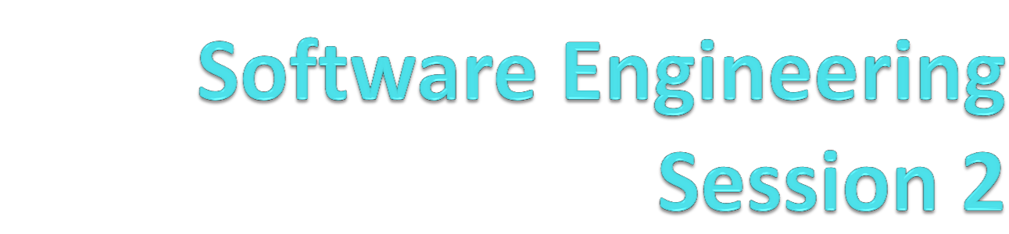
Jane Wu

Slide 2
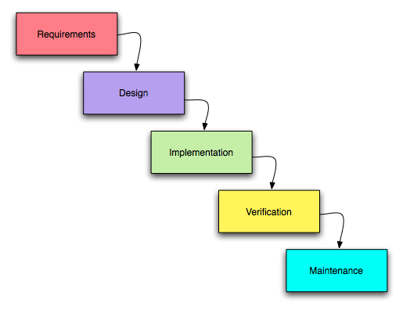
SDLC( software development life cycle ) is the process of developing information systems through investigation, analysis, design, implementation and maintenance. It is also known as Waterfall Model. (SDLC) is the entire process of formal, logical steps taken to develop a software product. The phases of SDLC can vary somewhat but generally include the following :

Slide 3
Waterfall model:
The Waterfall model is a sequential design process, often used in software development processes, in which progress is seen as flowing steadily downwards (like a waterfall) through the phases of Conception, Initiation, Analysis, Design, Construction, Testing, Production/Implementation, and Maintenance.
It is the same with waterfall development. Once a phase of development is completed, the development proceeds to the next phase and there is no turning back.
What is Agile Development?
https://www.youtube.com/watch?v=-zDct5d2smY
https://www.youtube.com/watch?v=9TycLR0TqFA

Slide 4
Advantages of waterfall model:
It allows for departmentalization and managerial control.
A schedule can be set with deadlines for each stage of development and a product can proceed through the development process.
Development moves from concept, through design, implementation, testing, installation, troubleshooting, and ends up at operation and maintenance.
Each phase of development proceeds in strict order, without any overlapping or iterative steps.
Works well for smaller projects where requirements are very well understood.

Slide 5
Disadvantages of waterfall model:
It does not allow for much reflection or revision. Once an application is in the testing stage, it is very difficult to go back and change something that was not well-thought out in the concept stage. Alternatives to the waterfall model include joint application development (JAD), rapid application development (RAD), synch and stabilize, build and fix, and the spiral model.
No working software is produced until late during the life cycle.
High amounts of risk and uncertainty.
Not a good model for complex and object-oriented projects.
Poor model for long and ongoing projects.
Not suitable for the projects where requirements are at a moderate to high risk of changing.

Slide 6
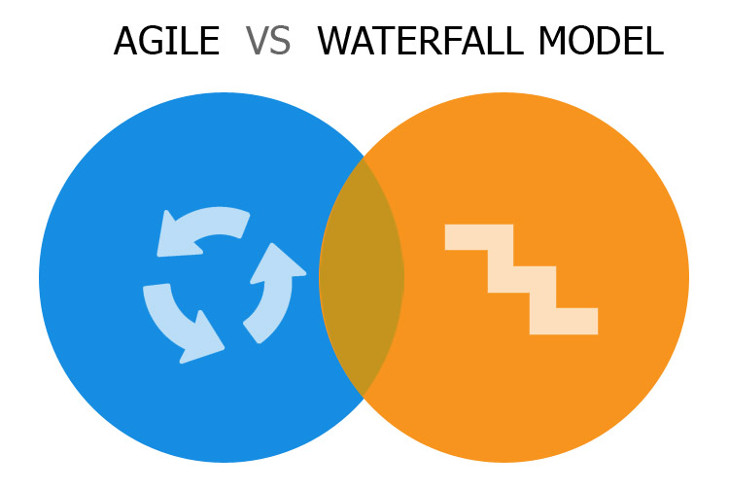

Slide 7
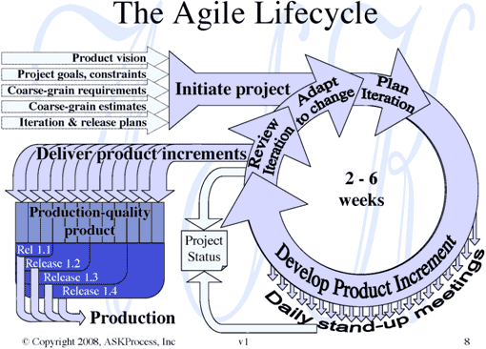

Slide 8
What is Agile?
Agile methodology is an approach to project management, typically used in software development. It helps teams respond to the unpredictability of building software through incremental, iterative work cadences, known as sprints. What is Agile Testing?
Testing practice for projects using agile methodologies, treating development as customer of testing and emphasizing a test-first design paradigm.
Agile software development
is a group of software development methods based on iterative and incremental development, where requirements and solutions evolve through collaboration between self-organizing, cross-functional teams. It promotes adaptive planning, evolutionary development and delivery, a time-boxed iterative approach, and encourages rapid and flexible response to change. It is a conceptual framework that promotes foreseen interactions throughout the development cycle.

Slide 9
Scrum is also an agile development method, which concentrates particularly on how to manage tasks within a team-based development environment. Scrum is the most popular and widely adopted agile method –it is relatively simple to implement and addresses many of the management issues that have plagued IT development teams for decades.
The agile product backlog in Scrum is a prioritized features list, containing short descriptions of all functionality desired in the product. When applying Scrum, it's not necessary to start a project with a lengthy, upfront effort to document all requirements. Typically, a Scrum team and its product owner begin by writing down everything they can think of for agile backlog prioritization.
This agile product backlog is almost always more than enough for a first sprint. The Scrum product backlog is then allowed to grow and change as more is learned about the product and its customers.

Slide 10
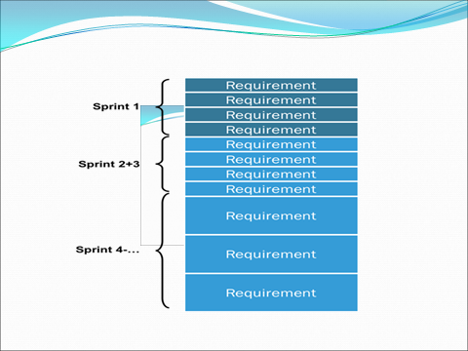
Product Backlog is dynamic; it constantly changes to identify what the product needs to be appropriate, competitive, and useful. As long as a product exists, its Product Backlog also exists.

Slide 11
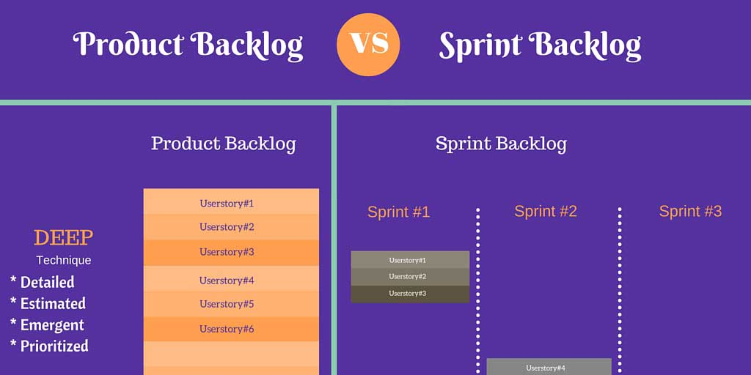

Slide 12
USER STORY
A user story - simply put, is a way to define a software feature from an end-user perspective. For example, a user story may look like "As a user, I want to be able to update my profile with age, present occupation and social interests, so that people visiting my profile page get an idea of my interests". Generally, it is good to follow this template:
As a <end-user-type>, I want to be able to <user-requirement> so that <reason>.
This gives the developers a clear idea of what they need to develop and why. User stories are generally added in the product backlog, but in some cases they can even be added to sprint backlog based on the judgment of scrum master.
Another important aspect of developing a user story is that, it usually involves a programmer and tester, perhaps a user interface designer or analyst, a database designer, or others. It is rare for a user story to be fully developed by a single person. Even when that happens, the person would be filling multiple of those roles. Read more about user stories in our previous blog post.

Slide 13
TASKS- Developer’s point of view:
Sometimes it makes sense to break a user story down into the work that needs to be done. Tasks are not normally written in user story format. Instead, they are written by the team, for the team, so use language the team will understand.
A task is a piece of work that needs doing, usually in order to build toward a bigger story. As such, it does not have independent deliverable functionality or generate business value, and, unlike a story, it normally is not a vertical (end-to-end) slice. Most tasks tend to be for programmers, but they could be for anyone on the team.
Task completed in one day
Task planned during sprint planning

Slide 14
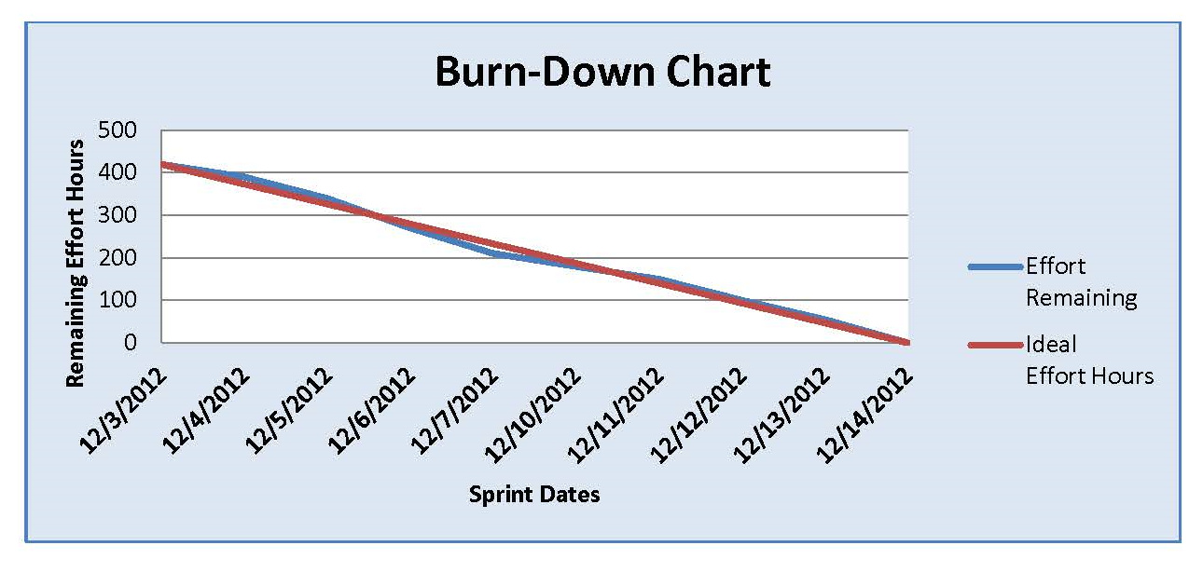

Slide 15
The Manifesto for Agile Software Development is based on twelve principles:
Customer satisfaction by early and continuous delivery of valuable software
Welcome changing requirements, even in late development
Working software is delivered frequently (weeks rather than months)
Close, daily cooperation between business people and developers
Projects are built around motivated individuals, who should be trusted
Face-to-face conversation is the best form of communication (co-location)
Working software is the primary measure of progress
Sustainable development, able to maintain a constant pace
Continuous attention to technical excellence and good design
Simplicity—the art of maximizing the amount of work not done—is essential
Best architectures, requirements, and designs emerge from self-organizing teams
Regularly, the team reflects on how to become more effective, and adjusts accordingly

Slide 16
Why Agile?
Agile development methodology attempts to provide many opportunities to assess the direction of a project throughout the development lifecycle.
Agile methodology could be described as “iterative” and “incremental.” In waterfall, development teams only have one chance to get each aspect of a project right. In an agile paradigm, every aspect of development — requirements, design, etc. — is continually revisited throughout the lifecycle.
Agile shortens development cycles. It minimizes all types of risks, roots out waste, and it ensures you are always working on the most important needs of the business.

Slide 17
What is Agile software development ?
Adaptable software creation, also known as agile software development. Agile development is a style of software development that emphasizes customer satisfaction through continuous delivery of functional software.
Based on a variety of iterative development disciplines including extreme programming (XP), agile methods put developers to work in small teams to tight budgets and short timescales.

Slide 18
Agile software development is an iterative method of software development which requires short cycles of design, development and test. Central to this approach is the division of projects into small iterations, called sprints, that require less planning and can be completed within short time frames, usually measured in weeks.
Agile development methods also allow for better collaboration while the software is built. Each sprint incorporates all stages of the traditional development cycle, including analysis, design, coding and testing. Once a sprint is complete, it is ready for deployment.

Slide 19
What are the Advantages of Agile Methodology?
Customer satisfaction by rapid, continuous delivery of useful software
Working software is delivered frequently (weeks rather than months)
Face-to-face conversation is the best form of communication
Close, daily cooperation between business people and developers
Continuous attention to technical excellence and good design
Simplicity
Regular adaptation to changing circumstances

Slide 20
Disadvantages of Agile model:
In case of some software deliverables, especially the large ones, it is difficult to assess the effort required at the beginning of the software development life cycle.
There is lack of emphasis on necessary designing and documentation.
The project can easily get taken off track if the customer representative is not clear what final outcome that they want.
Only senior programmers are capable of taking the kind of decisions required during the development process. Hence it has no place for newbie programmers, unless combined with experienced resources.

Slide 21
When to use Agile model:
When new changes are needed to be implemented. The freedom agile gives to change is very important. New changes can be implemented at very little cost because of the frequency of new increments that are produced.
Unlike the waterfall model in agile model very limited planning is required to get started with the project. Agile assumes that the end users’ needs are ever changing in a dynamic business and IT world.
Both system developers and stakeholders alike, find they also get more freedom of time and options than if the software was developed in a more rigid sequential way.

Slide 22
What are Agile Methods? Agile Modeling, Scrum, Agile Unified Process (AUP), Agile Data Method Essential Unified Process (EssUP), Extreme programming (XP) Feature Driven Development (FDD), Getting Real, Open Unified Process (OpenUP), Lean software development
What are Agile practices? Test Driven Development (TDD), Continuous Integration, Pair Programming, Planning poker
What is Agile Testing? Testing practice for projects using agile methodologies, treating development as the customer of testing and emphasizing a test-first design paradigm.

Slide 23
Scrum Sprint :
In product development, a scrum sprint is a set period of time during which specific work has to be completed and made ready for review.
Each sprint begins with a planning meeting. During the meeting, the product owner (the person requesting the work) and the development team agree upon exactly what work will be accomplished during the sprint. The development team has the final say when it comes to determining how much work can realistically be accomplished during the sprint, and the product owner has the final say on what criteria needs to be met for the work to be approved and accepted.
The duration of a sprint is determined by the scrum master, the team's facilitator. Once the team reaches a consensus for how many days a sprint should last, all future sprints should be the same. Traditionally, a sprint lasts 14 days.

Slide 24
Scrum Framework.
The scrum process. A sprint (or iteration) is the basic unit of development in scrum. The sprint is a time boxed effort; that is, it is restricted to a specific duration. The duration is fixed in advance for each sprint and is normally between one week and one month, with two weeks being the most common ... Scrum is not a methodology. It simply provides structure, discipline and a framework for Agile development. The whole project is made up of a series of Sprints or Sprint Cycles (1 to n) where each Sprint is of the same duration.

Slide 25
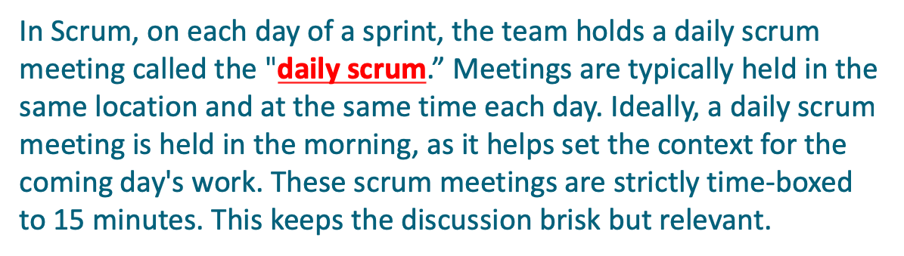
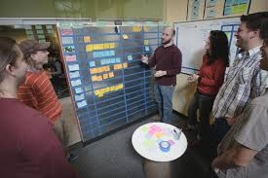
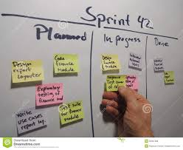

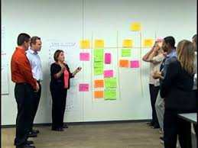

Slide 26
The Daily Scrum:
On each day of a sprint, the team holds daily meetings (“the daily scrum”). Meetings are typically held in the same location and at the same time each day. Ideally the daily scrum meeting is held in the morning as it helps set the context for the coming day's work. These daily standup meetings are strictly time-boxed to fifteen minutes. This keeps the discussion brisk but relevant. The daily scrum is not used as a problem-solving or issue resolution meeting. Issues that are raised are taken offline and usually dealt with by the relevant sub-group immediately after the meeting.
During the daily standup each team member answers the following three questions:
What did you do yesterday?
What will you do today?
Are there any impediments in your way?
By focusing on what each person accomplished yesterday and will accomplish today the team gains an excellent understanding of what work has been done and what work remains.

Slide 27
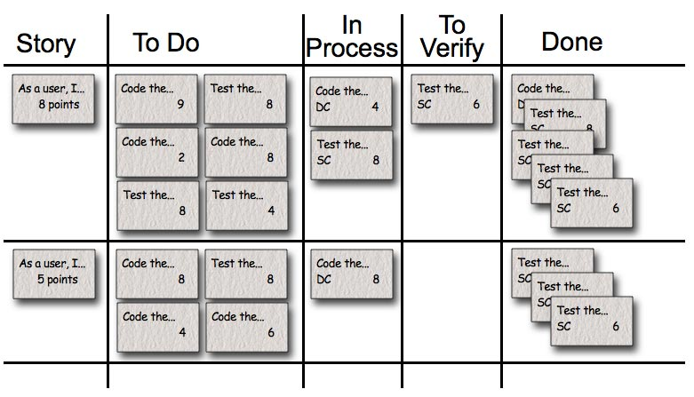

Slide 28
Alternative Frameworks.
Compared to Scrum, there are also other Agile Frameworks that are popular in industry. Kanban is another Framework.
Kanban is NOT Timeboxed, there is one continuous backlog that team members pick from.
Best for projects with widely-varying priorities

Slide 29
Following are the types of testing:
Defect testing
Path testing
Unit testing
Integration testing
Black box testing
White box testing
Regression testing
End To End Testing
Automation testing
User acceptance testing
Performance testing
Load testing
Alpha testing
Beta testing
Stress testing
Functional testing
Security Testing
Smoke testing (Ad-hoc testing)
Shakeout testing

Slide 30
Q&A:
1. Explain the Agile workflow? A method of development based on breaking large project into small pieces and evaluating progress and tasks frequently
2. What greatest contribution you make for the company? I offer a fresh mindset to projects that has allowed the team to take new approaches to often repeated tasks that have saved many hours of time and developments resources.
3.Who is presenting the newly created functionality in the meeting? The developer who contributed most to the project.
4. How will you explain the new technology you just learned in the technology meeting? I will present general overview of the technology, then how we used it, its advantages/ disadvantages over other potential solutions and key takeaways had during development.
5. Do you write your own project demo? do you put it on your GitHub. Yes, A Demo is done along with the tasks. I host it on GitHub to give new users some example of the implanted product that they canintrout with.

Slide 31
Integration testing -----is the phase in software testing in which individual software modules are combined and tested as a group. It occurs after unit testing and before validation testing. Integration testing takes as its input modules that have been unit tested, groups them in larger aggregates, applies tests defined in an integration test plan to those aggregates, and delivers as its output the integrated system ready for system testing.

Slide 32
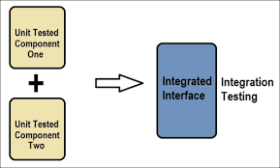
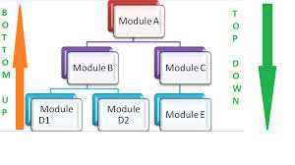
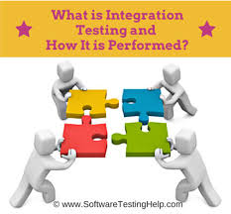


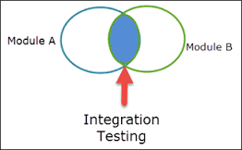


Slide 33
What is Integration testing ?
It is a test to check whether all the modules are combined together or not and working successfully as specified in the requirement document.
Each developer works on different modules. When they finish their code, the configuration management team puts them together and prepares a build. QA tester need to make sure that these modules, which are now combined, work as per requirement document
It is performed by the developers or testers. During Integration Testing the modules are integrated together and end-to end testing is performed. Also the interface between the modules is tested.

Slide 34
Regression testing is a type of software testing that ensures that previously developed and tested software still performs the same way after it is changed or interfaced with other software. Changes may include software enhancements, patches, configuration changes, etc. During regression testing, new software bugs or regressions may be uncovered. Sometimes a software change-impact analysis is performed to determine which areas could be affected by the proposed changes. These areas may include functional and non-functional areas of the system.

Slide 35
Regression Testing is defined as a type of software testing to confirm that a recent program or code change has not adversely affected existing features.
Regression Testing is required:
When there is a change in requirements and code is modified according to the requirement
New feature is added to the software
Defect fixing
Performance issue fix

Slide 36
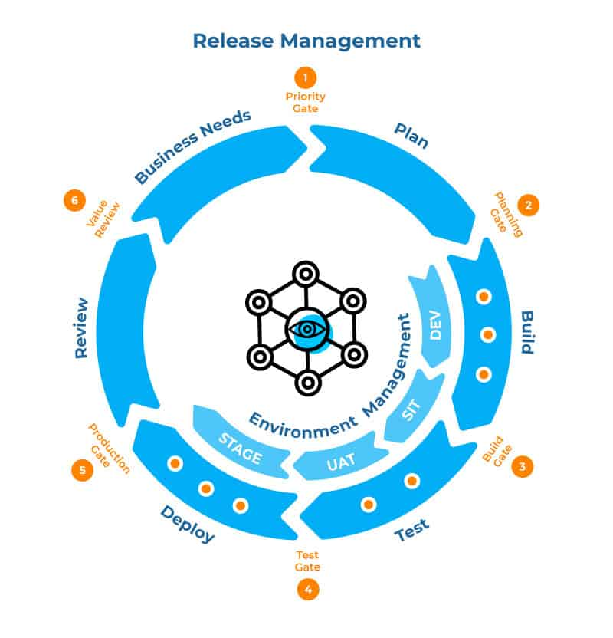

Slide 37
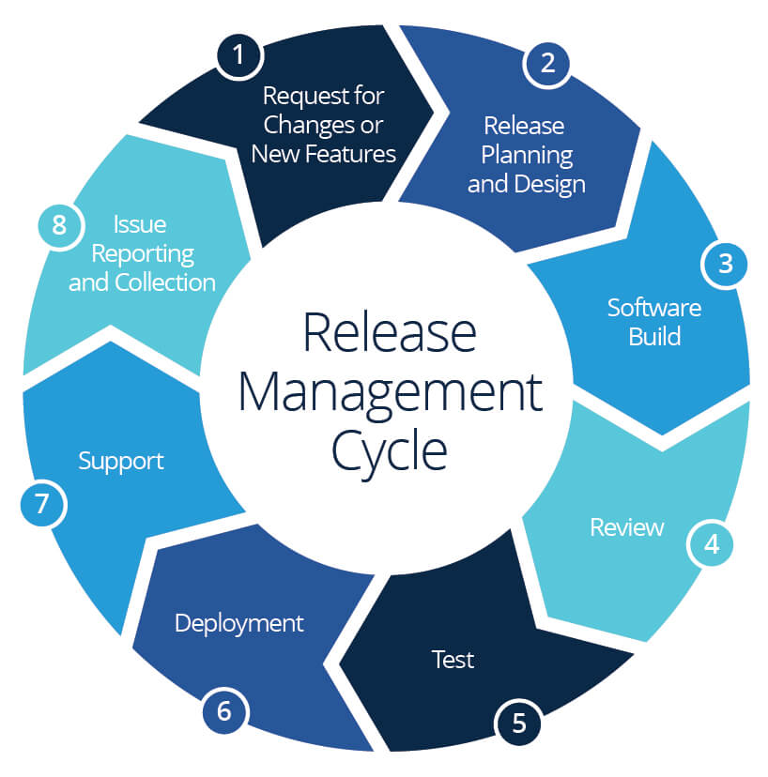

Slide 38
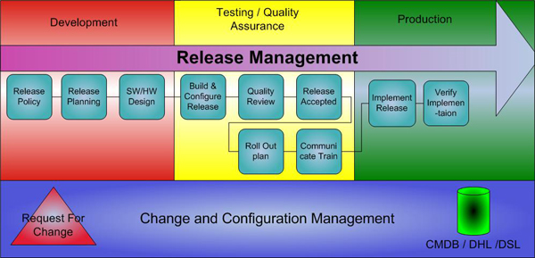

Slide 39
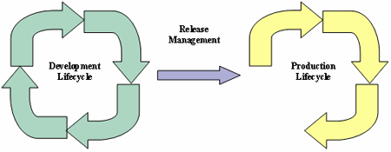
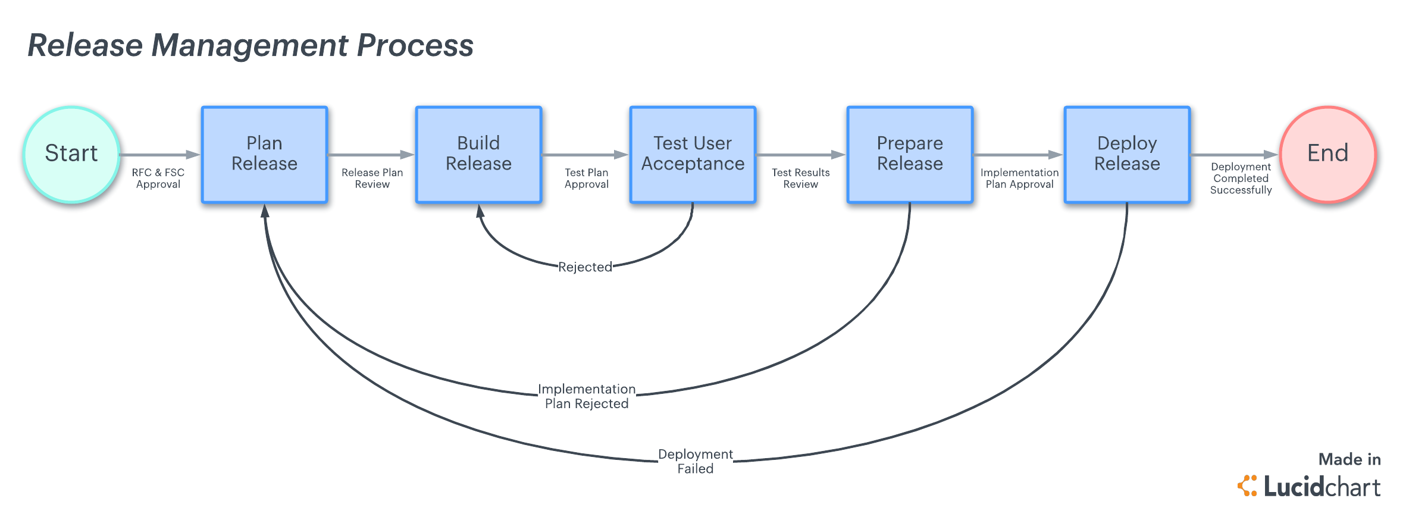

Slide 40
What is JIRA :
JIRA is a proprietary issue tracking product, developed by Atlassian, commonly used for bug tracking, issue tracking, and project management. http://www.atlassian.com/software/jira/demo
Issues are everywhere... they aren't just bugs in your code. Issues are tasks filling your inbox, ideas proliferating in spreadsheets, and requests hiding in legacy business systems.
Use JIRA to easily capture and organize your issues, prioritize and take action on what's important, and stay up-to-date with the activity going on around you.
Rally is another Rally Services are the key to creating organization-wide agility—building the right products that users love. It help you avoid scattershot Agile, with uncoordinated teams, disconnects, silos, and unnecessary risks.
What is Bamboo?
Bamboo does more than just run builds and tests. It connects issues, commits, test results, and deploys so the whole picture is avaliable to your entire produce team: from project managers to devs & testers to sys admins.

Slide 41
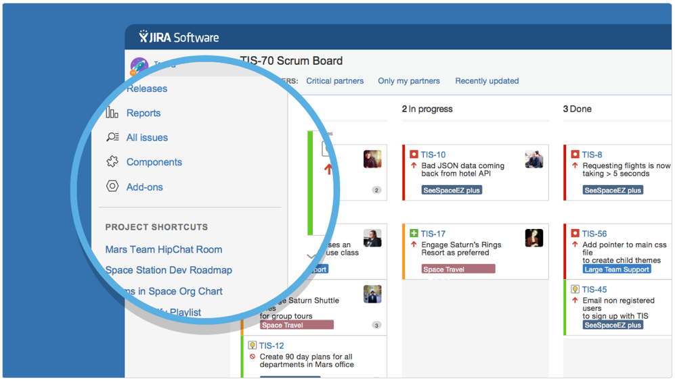

Slide 42
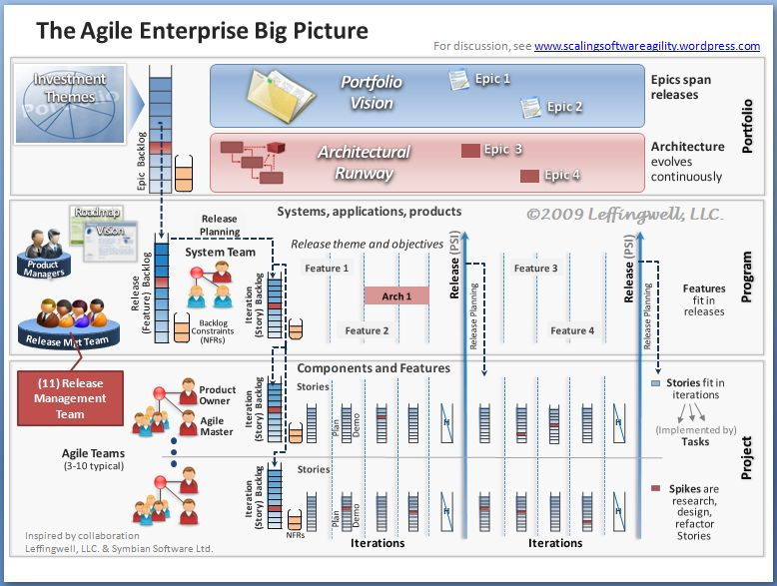

Slide 43
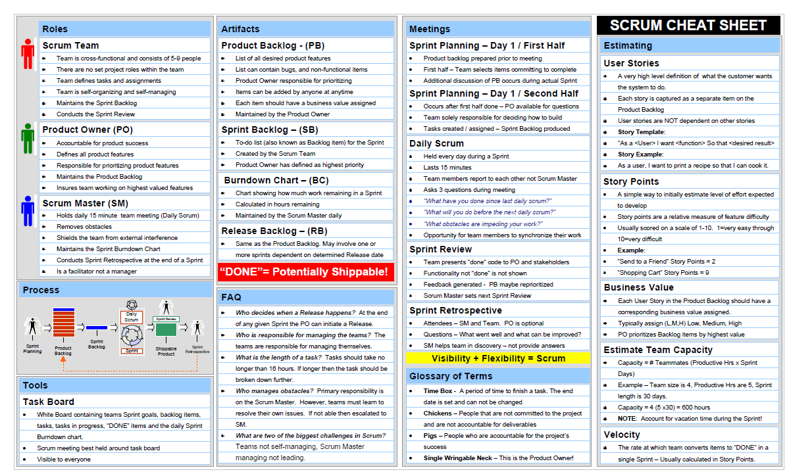

Slide 44
What is Grey Box Testing:
Grey-box testing is a combination of white-box testing and black-box testing. The aim of this testing is to search for the defects if any due to improper structure or improper usage of applications.
Gray-box testing is also known as translucent testing. A black-box tester is unaware of the internal structure of the application to be tested, while a white-box tester knows the internal structure of the application. A gray-box tester partially knows the internal structure, which includes access to the documentation of internal data structures as well as the algorithms used.
Gray-box testers require both highlevel and detailed documents describing the application, which they collect in order to define testcases.

Slide 45
What is a Module?
A ‘Module’ is a software component that has a specific task. It can be a ‘link’ which can go inside to its component detail.
What does Walk-thru meeting mean?
Before start working in a module and/or after accomplishing the testing of a module, the tester calls a meeting to disseminate his findings or to share his queries to other tester or leads of the company working on the same application that is called the Walk-thru meeting.

Slide 46
In agile software development, a release is a deployable software package that is the culmination of several iterations. Releases can be made before the end of an iteration.
What is Build?
When each of the different modules of software is prepared, they are put in a single folder by the Configuration Management Team (CMT) and it is called the ‘Build’. In other word, the developers put their code in the shared location (folder) and all those code (modules) are combined together so that it is a complete application that works.
What is meant by the Build Deployment?
When the Build so prepared by the CMT is sent to different Test Environments, it is called the Build Deployment.

Slide 47
What is a Test Strategy?
A test strategy is an outline that describes the testing portion of the software development cycle. It is created to inform project managers, testers, and developers about some key issues of the testing process.
This includes the testing objective, methods of testing new functions, total time and resources required for the project, and the testing environment.
The test strategy describes how the product risks of the stakeholders are mitigated at the test-level, which types of test are to be performed, and which entry and exit criteria apply.
The test strategy is created based on development design documents.. It is written by the Test Manager or Lead.
The following are some of the components that the Test Strategy includes:
1 Test Levels. 2 Roles and Responsibilities. 3 Environment Requirements. 4 Testing Tools. 5 Risks and Mitigation. 6 Test Schedule. 7 Regression Test Approach. 8 Test Groups. 9 Test Priorities. 10 Test Status Collections and Reporting. 11 Test Records Maintenance. 12 Requirements traceability matrix. 13 Test Summary

Slide 48
Release:
Making a version of software available to the public.
A software version which has been made available to the public.
Deploy:
To install, test and implement a computer system or application.

Slide 49
What is Stress testing?
Is a form of testing that is used to determine the stability of a given system or entity
Stress testing may have a more specific meaning in certain industries, such as fatigue testing for materials.
In software testing, a system stress test refers to tests that put a greater emphasis on robustness, availability, and error handling under a heavy load, rather than on what would be considered correct behavior under normal circumstances.
In particular, the goals of such tests may be to ensure the software does not crash in conditions of insufficient computational resources (such as memory or disk space), unusually high concurrency, or denial of service attacks.

Slide 50
Extreme programming (XP) is a software development methodology which is intended to improve software quality and responsiveness to changing customer requirements.
As a type of agile software development, it advocates frequent "releases" in short development cycles, which is intended to improve productivity and introduce checkpoints where new customer requirements can be adopted.
Other elements of extreme programming include: programming in pairs or doing extensive code review, unit testing of all code, avoiding programming of features until they are actually needed, a flat management structure, simplicity and clarity in code, expecting changes in the customer's requirements as time passes and the problem is better understood, and frequent communication with the customer and among programmers.
The methodology takes its name from the idea that the beneficial elements of traditional software engineering practices are taken to "extreme" levels, on the theory that if a little is good, more is better.
Critics have noted several potential drawbacks, including problems with unstable requirements, no documented compromises of user conflicts, and a lack of an overall design specification or document.

Slide 51
What is Test Driven Development (TDD)?
TDD is a software development process that relies on the repetition of a very short development cycle: first the developer writes an (initially failing) automated test case that defines a desired improvement or new function, then produces the minimum amount of code to pass that test, and finally re-factors the new code to acceptable standards.
Test-driven development is related to the test-first programming concepts of extreme programming, In test-driven development a developer creates automated unit tests that define code requirements then immediately writes the code itself. Developers often use testing frameworks, such as xUnit , to create and automatically run sets of test cases.

Slide 52
What is Pair programming ?
All code to be sent into production is created by two people working together at a single computer.
The best way to pair program is to just sit side by side in front of the monitor. Slide the key board and mouse back and forth.
Both programmers concentrate on the code being written. Pair programming is a social skill that takes time to learn.
The best pair programmers know when to say "let's try your idea first." Don't expect people to be good at it from the start. It helps if you have someone on your team with experience to show everyone what it should feel like.

Slide 53
What is a Unit Testing ?
Unit testing is a software verification and validation method in which a programmer tests if individual units of source code are fit for use. Unit Testing is performed by the developers. Unit Testing is also called as Module Testing. During Unit Testing, a developer tests s single module.
It is a test to check the code whether it is properly working or not as per the requirement
What is Functional testing ?
It is a test to check whether each and every function of that application is working as per the requirement (remember this work “as per requirement document”-you must say this in the interview). It is a major test where 80% of the tests are done. In this test, the Test Cases are executed (or run).

Slide 54
What is Regression Testing?
It is retesting a previously tested program following modification to ensure that faults have not been introduced or uncovered as a result of the changes made. Imagine finding as error, fixing it and then re-testing it.
Regression Testing refers to execution a standard series of tests to make sure that the change did not disturb anything else. Sometime fixing a problem causes a new problem in some part of the application, which had no problems before.
Automation Tools are useful for the Regression Testing. When a new functionality is added to the software, we need to make sure that the added new functionality does not break the other parts of the application.
Or when defects (bugs) are fixed, we need to make sure that the bug fix has not broken the other parts of the application. To test this, we perform a repetitive test, which is called regression test.

Slide 55
What is Ad Hoc Testing?
A testing phase where the tester tries to “break” the system by randomly trying the system’s functionality can include negative testing as well.
What is stress testing?
Stress testing is subjecting a system to an unreasonable load while denying it the resources (e.g., RAM, disc, mips, interrupts, etc.) needed to process the load. The idea is to stress a system to the breaking point in order to find bugs that will make that break potentially harmful.
What is Test Case?
Test Case is a commonly used term for a specific test. This is usually the smallest unit of testing. A Test Case will consist of information such as requirements testing, test steps, verification steps, prerequisites, outputs, test environment, etc.

Slide 56
SMOKE TESTING:
Smoke testing originated in the hardware testing practice of turning on a new piece of hardware for the first time and considering it a success if it does not catch fire and smoke. In software industry, smoke testing is a shallow and wide approach whereby all areas of the application without getting into too deep, is tested.
A smoke test is scripted, either using a written set of tests or an automated test
A Smoke test is designed to touch every part of the application in a cursory way. It’s shallow and wide.
Smoke testing is conducted to ensure whether the most crucial functions of a program are working, but not bothering with finer details. (Such as build verification).
Smoke testing is normal health check up to a build of an application before taking it to testing in depth.

Slide 57
SANITY TESTING:
A sanity test is a narrow regression test that focuses on one or a few areas of functionality. Sanity testing is usually narrow and deep.
A sanity test is usually unscripted.
A Sanity test is used to determine a small section of the application is still working after a minor change.
Sanity testing is a cursory testing, it is performed whenever a cursory testing is sufficient to prove the application is functioning according to specifications. This level of testing is a subset of regression testing.
Sanity testing is to verify whether requirements are met or not, checking all features breadth-first.

Slide 58
What is User acceptance testing (UAT) ?
It is also called as Beta Testing . Once system testing is done and the system seems stable to the developers and testers, system engineers either invited the end users of the software to see if they like the software or send the software the way it is then software will be deployed in the production.
Otherwise necessary changes will be made to the software and software will pass through all phased of testing again.
In this type of testing, the software is handed over to the user in order to find out if the software meets the user expectations and works as it is expected to. In this testing, the tester may do the testing or the clients may have their own testers (For example, banks may have their own teller employees who can test the application).

Slide 59
What is Black box testing ?
It is test where a tester performs testing without looking into the code. (OR it is a testing method where the application under test is viewed as a black box and the internal behavior of the program is completely ignored. Testing occurs based upon the external specifications. Also known as behavioral testing, since only the external behavior of the program is evaluated and analyzed.)
What is White box testing ?
It is a test where a tester looks into the code and performs the testing.
What is Alpha testing ?
In this type of testing, the users are invited at the development center where they use the application and the developers note every particular input or action carried out by the user. Any type of abnormal behavior of the system is noted and rectified by the developers.
What is Beta testing ?
In this type of testing, the software is distributed as a beta version to the users and users test the application at their sites. As the users explore the software, in case if any exception/defect occurs that is reported to the developers.

Slide 60
What is Change Control? It is a document that describes the additional functionalities that are added after the Business Requirement Document is signed off. It can be updated in the old business requirement document or it can be a separate document. (For example, in the Business Requirement Document, on the login page, there are User Name and Password fields. The owner of the software wants to add, “If you do not have User Name and Password, please click here.” This is a change. But this change came after the document is signed off by the Project Managers. Now this is a change control and comes as a separate document. (It is also called Change Request, Modification Request).

Slide 61
CVS, SVN, GIT & PVCS
The Concurrent Versions System (CVS), also known as the Concurrent Versioning System, is a client-server free software revision control system in the field of software development.
CVS became popular with commercial software developers and also the open source software world and is released under the GNU General Public License. Active development of CVS is continuing.
In software development, Git is a distributed revision control and source code management (SCM) system with and emphasis on speed.
Git is free software distributed under the terms of GNU General Public License version2.

Slide 62
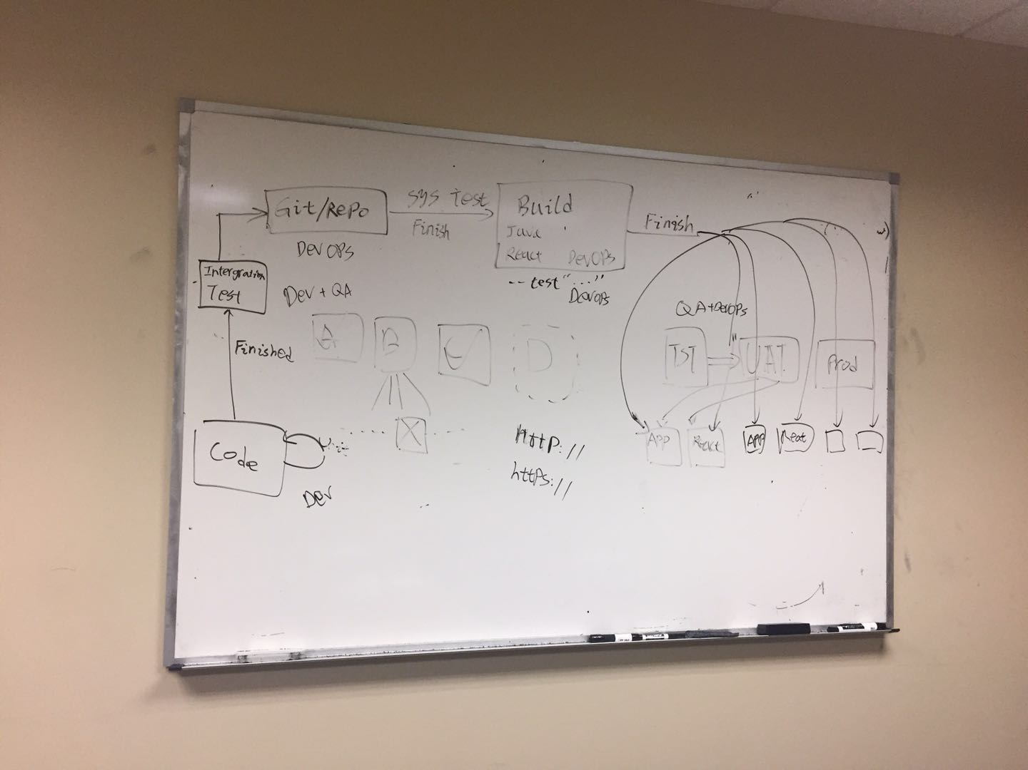
The work flow:

