Slide 2
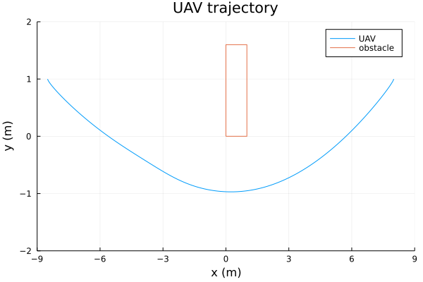
## Physical parameters for the cart-pole example (Standard units)
const L = 18.0 # length of map
const W = 4.0 # width of map
const H = 10.0 # height of map
const l = 1.0 # length of table
const w = 1.6 # width of table
const T₁ = 0.0 # table right below corner x - position
const T₂ = 0.0 # table right below corner y - position
# initial position
const A₁ = -8.5
const A₂ = 1.0
const A₃ = 1.5
# final position
const B₁ = 8.0
const B₂ = 1.0
const B₃ = 1.5
# UAV parameters
const m = 1.8 # mass of UAV
const Ixx = 0.029125
const Iyy = 0.029125
const Izz = 0.055225
const r₁ = 0.45 # radius of UAV
const g = 9.8
A
B
@NLconstraint(model, [j = 1:n], ((q₁[j]-l/2)^2 / ((l/2+r₁)^2*2) + (q₂[j]-w/2)^2 / ((w/2+r₁)^2*2)) ≥ 1.0)

Slide 3
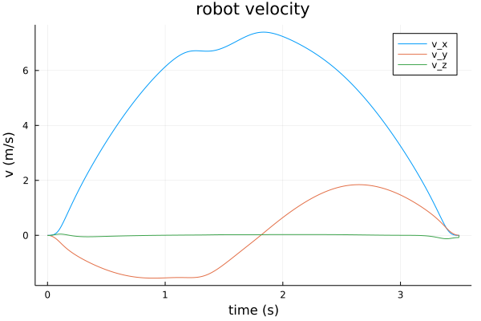
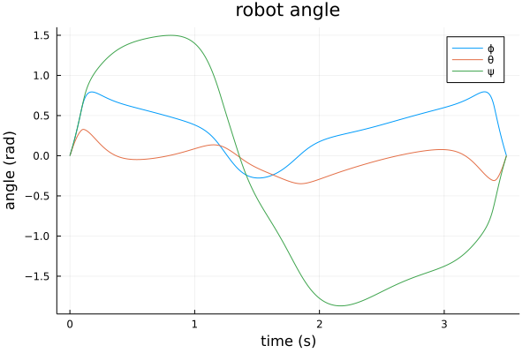
# ̇x = v_x
# ̇y = v_y
# ̇z = v_z
# ̇ϕ = p + (q⋅sinϕ + r⋅cosϕ)⋅tanθ
# ̇θ = q⋅conϕ - r⋅sinϕ
# ̇ψ = (q⋅sinϕ + r⋅cosϕ)/cosθ
# ̇v_x = (sinψ⋅sinϕ + cosψ⋅sinθ⋅sinϕ)⋅T/m
# ̇v_y = (-cosψ⋅sinϕ + sinψ⋅sinθ⋅cosϕ)⋅T/m
# ̇v_z = -g + cosθ⋅cosϕ⋅T/m
# u = [T, p, q, r]

