Slide 1
Java Parallel Processing Framework
Open Source Grid Computing

Slide 2

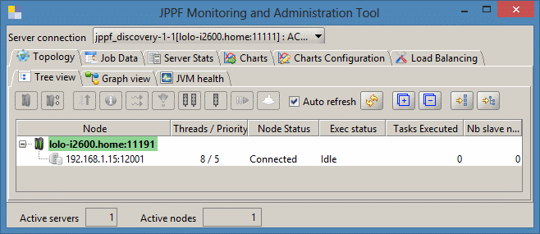
JPPF Overview
Java Based Grid Computing Solution
Execution of Java Applications in Parallel
Open Source
Quick to Initialise
Highly Scalable
Graphical Monitoring and Management Tools
Fault Tolerance and Recovery Capablities

Slide 3
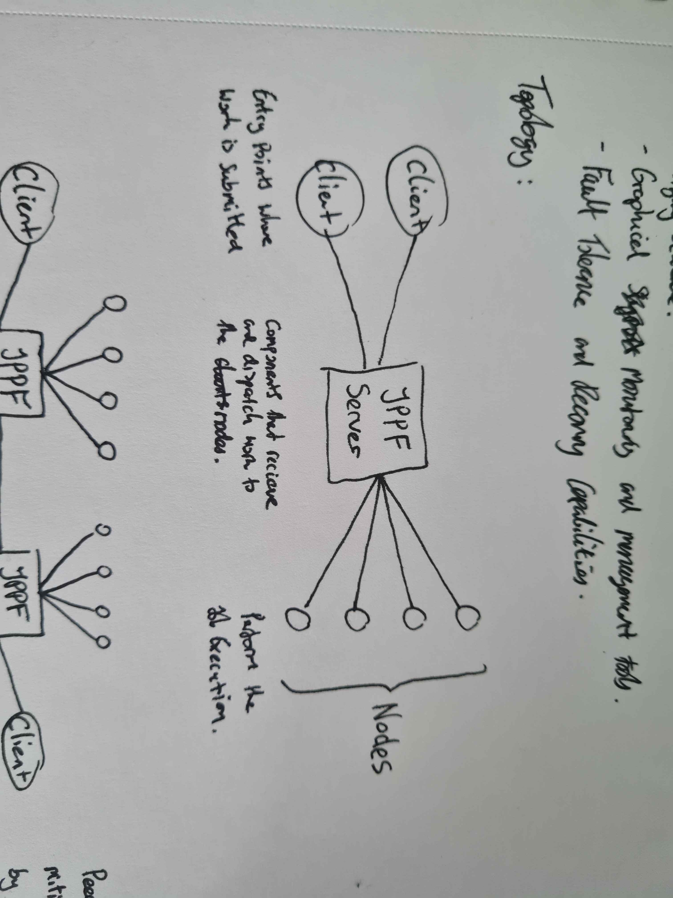
Topology

Slide 4
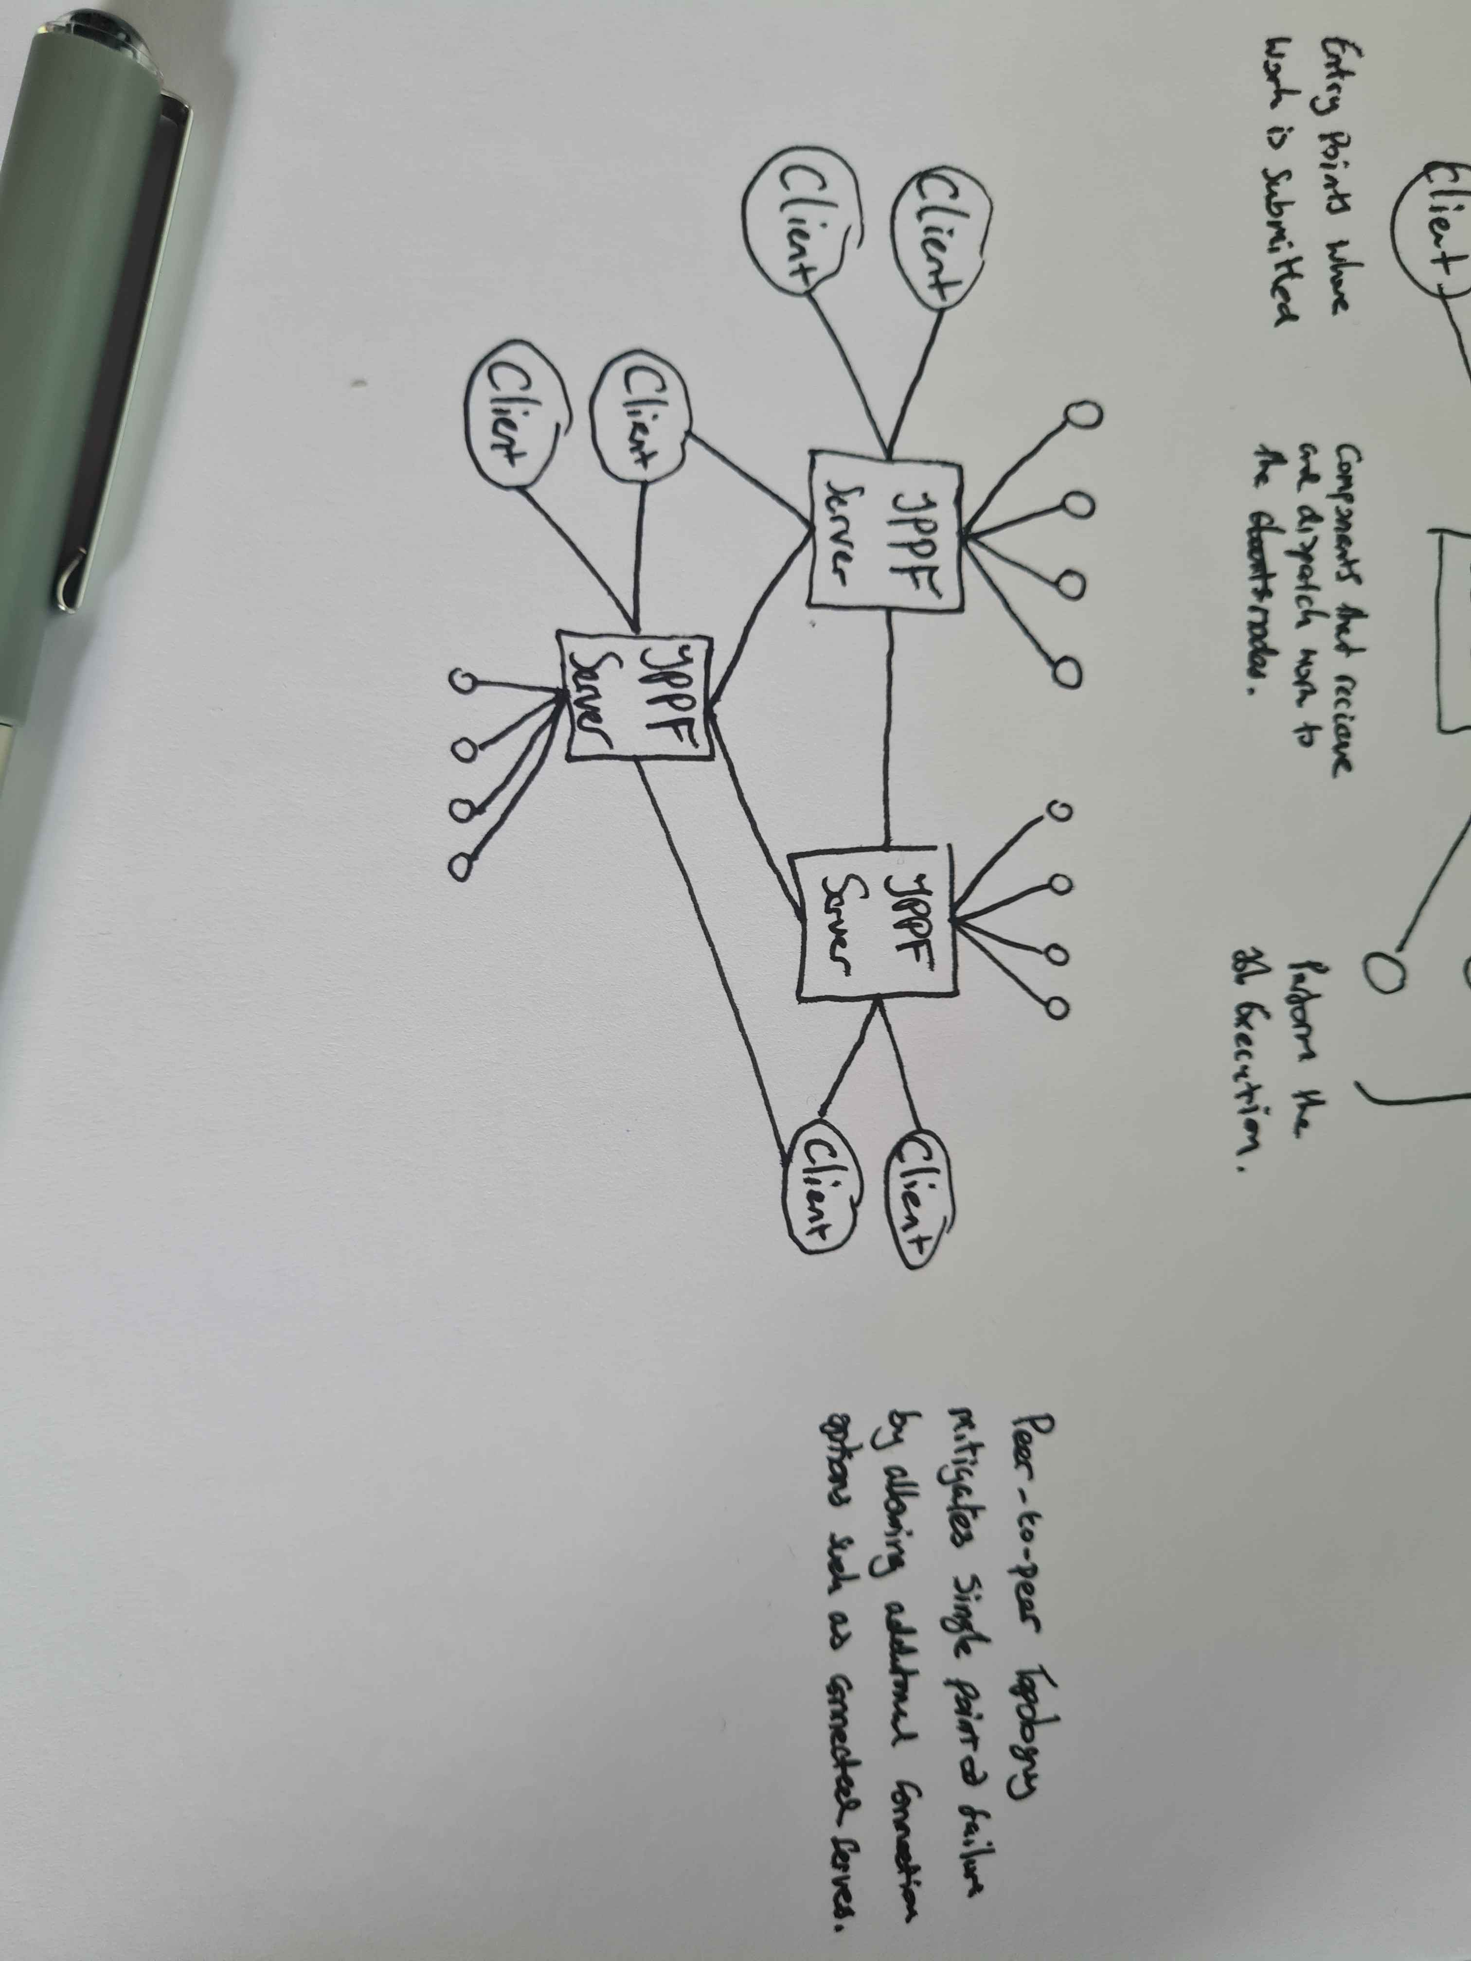
Topology
Additional connectivity options allow the mitigation of risks arising from single point of failure
JPPF servers can be connected in a peer-to-peer design.

Slide 5
Installing JPPF
Probably configure a docker image for this
Basic set up

Slide 6
Server and Node
Run through the basic set up of a JPPF server and its design principles
Connect to a node

Slide 7
Management UI
Configure Management UI to show the connected server and node
Show the different measurement options

