Slide 1

Stay on Stray
Presented by Team SnapCat

Slide 2

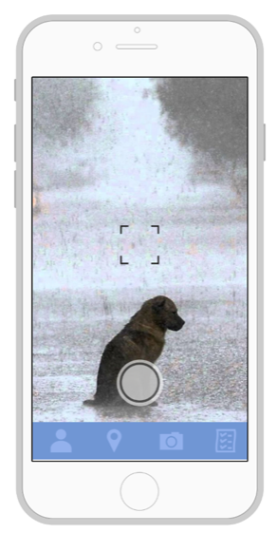
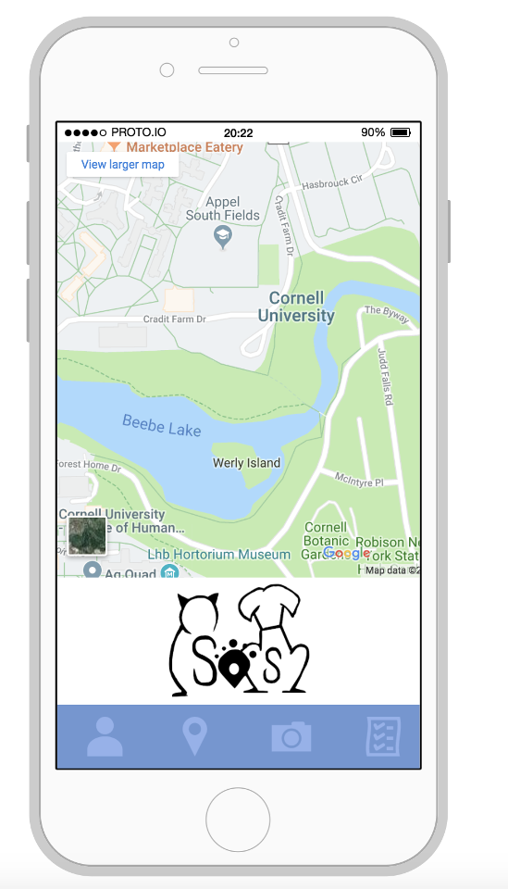
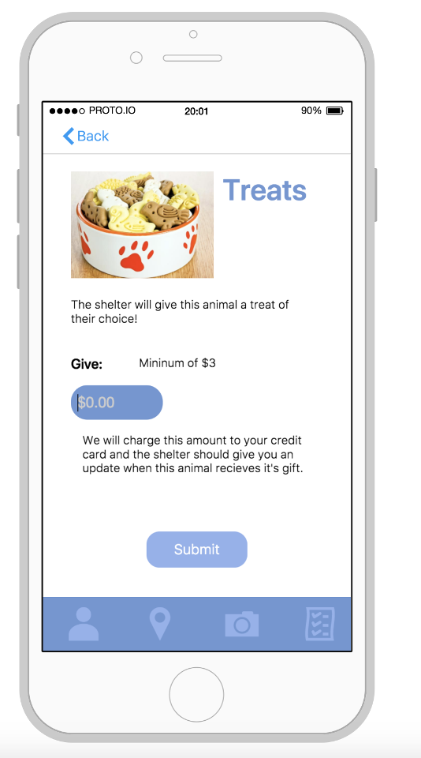
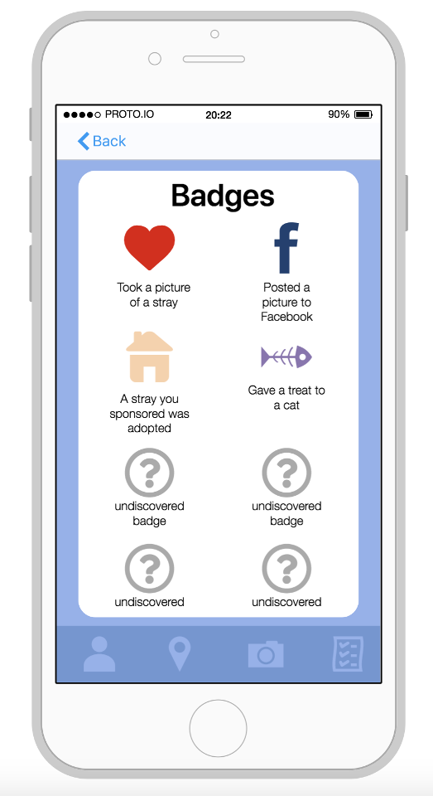

Introducing Stay on Stray (S.O.S.)
Snap
Track
Engage
Reward

Slide 3





Value Proposition for Agencies
Increase Donations
Efficient Acquisitions
Higher Adoption rates
Stray Management Software
Making app users part of the rescue process will foster future sponsorship purchases at the shelter
Real-time GPS tracked photos will prevent trips to redundant strays and increase successful retrieval rates
Increased customer engagement with animals will lead to a higher adoption rates
S.O.S hopes to offer Stray Management Software and an Adoption CRM platform in the future…
Current Benefits
Future Offering

Slide 4
$5.0 Million in Revenue by Year Five
Key Assumptions
8 Million animals brought to shelters each year
Facilitate in 25% of animal captures by year 5
50% of captured animals receive sponsors
Average gifts/services of $25
S.O.S margin of 20% percent on gifts/services

Slide 5
Appendix

Slide 6







S.O.S: The new road home
Local agency is notified and retrieves animal
Upload a geo-tagged photo of the animal
Come across a lost or stray pet
Your animal is adopted or returned to owner
Receive awards for uploads, retrievals & gifts
Buy gifts and sponsorships for your animal

Slide 7
Risks and Mitigation
Risk | Severity | Mitigation
Slow App User Growth |  | Trial test market – Possibly LA “no Kill” Zone Pushed out by shelter’s to owners of lost pets Posts to Social Media and local community boards
Animal Attack Lawsuits |  | Disclaimer in the terms of use agreement and In-app about engagement of animals
Low Agency Adoption/Utilization |  | Promote S.O.S’ ability to drive donations and increase adoption rates Assign customer success Rep for trial market to prove concept to future clients

Slide 8
Exhibit A – Revenue Flow Years 1 - 10

Slide 9
The current animal rescue process is stressful, ambiguous, and often ineffective
I found an animal, who do I call?
Rescue Statistics
8 million animals enter shelters every year
2.6 million animals are euthanized
23% of new household pets are rescues from shelters
How do I know if my animal has been seen?
I lost my pet, who do I get in contact with?

