Slide 1
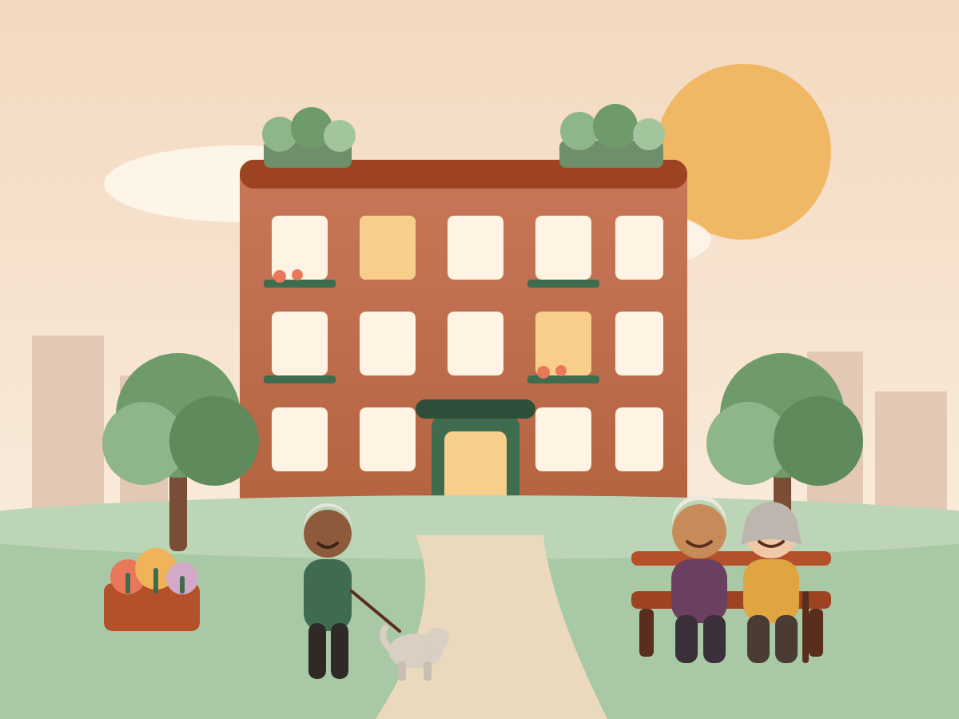
BOARD MEETING · CO-OP PLATFORM
A website and a helping hand for OWN
Six things that matter to you
Notes:
Hello, and thank you for having us.

Slide 2
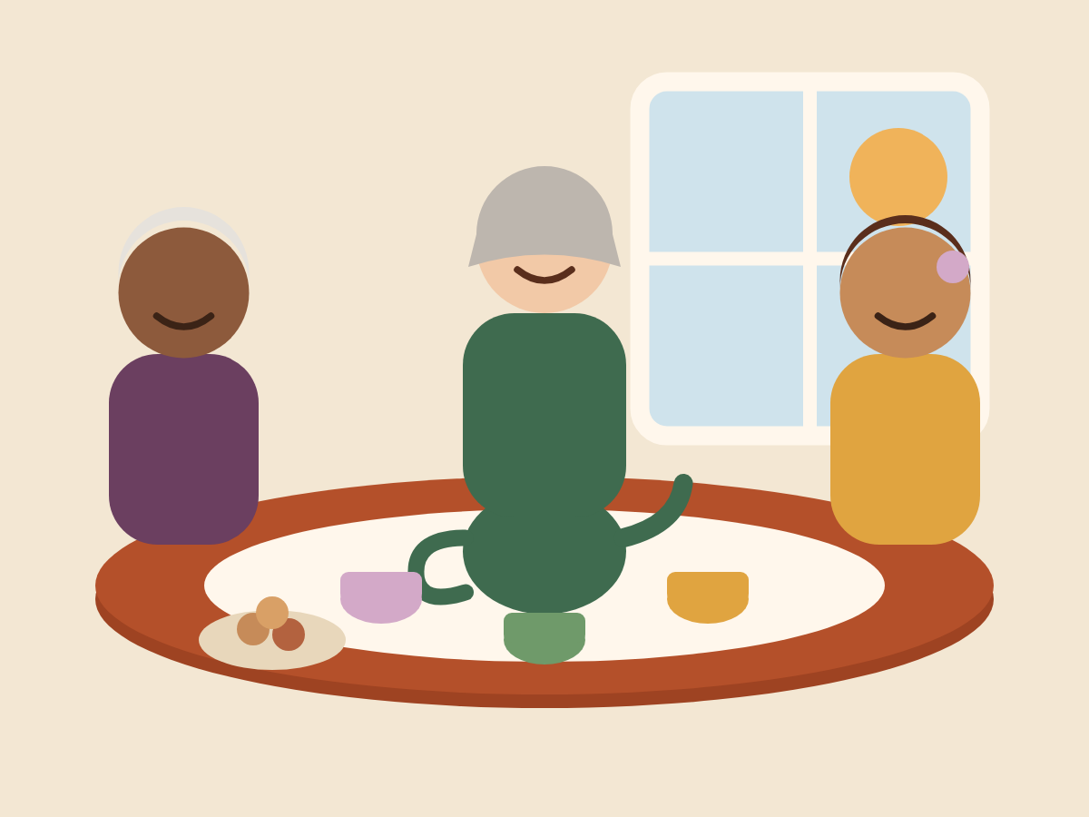

A website. And a helping hand
Some of us love the internet.
Some of us like it simple. That is fine.
This is for everyone.
Notes:
Some of us love the internet. Some of us would rather keep things simple, and that is perfectly fine. This platform is for everyone. It is a website, and it is also a helping hand.

Slide 3





Six things that matter
A beautiful, easy website
OWN runs it
Notices nobody misses
Easy repair requests
Bigger words
Your own photo
Aa
● Working today
○ Coming next
Notes:
Today we will show you six things. Each one is something you told us matters. For each one, we will say plainly whether it works today, or whether it comes next.

Slide 4
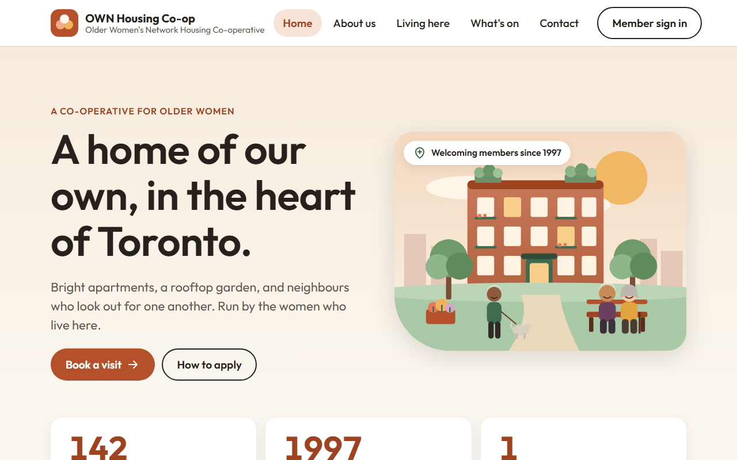
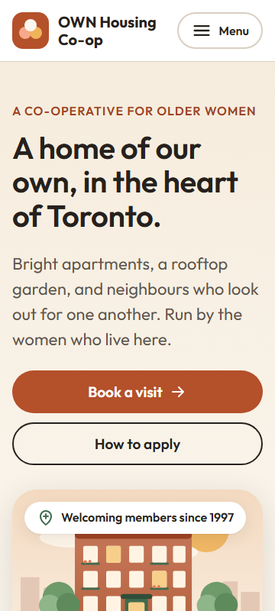
1 · Beautiful and easy to read
○ Coming next · design drawn
On a computer
On a phone
Notes:
First, a website that is beautiful and easy to read. This is the design we drew for OWN. It is warm. It has big words, big buttons, and pictures of home. It is not live yet, but this is the look we are building toward.

Slide 5
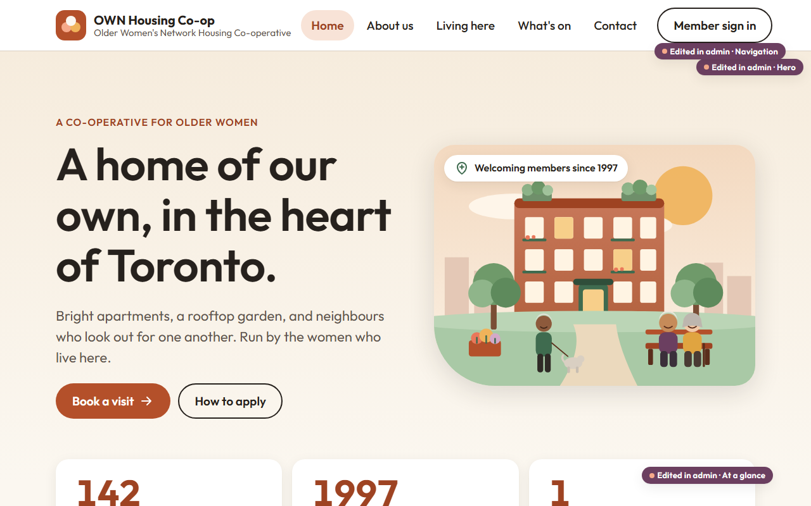
2 · OWN runs it
Purple tags mark what the office can change
Notes:
Second, OWN runs it. Nobody else. Someone in your office signs in to a simple admin desk. Every purple tag on this screen marks a part of the website that the office can change by themselves. The words, the photos, the menu.

Slide 6
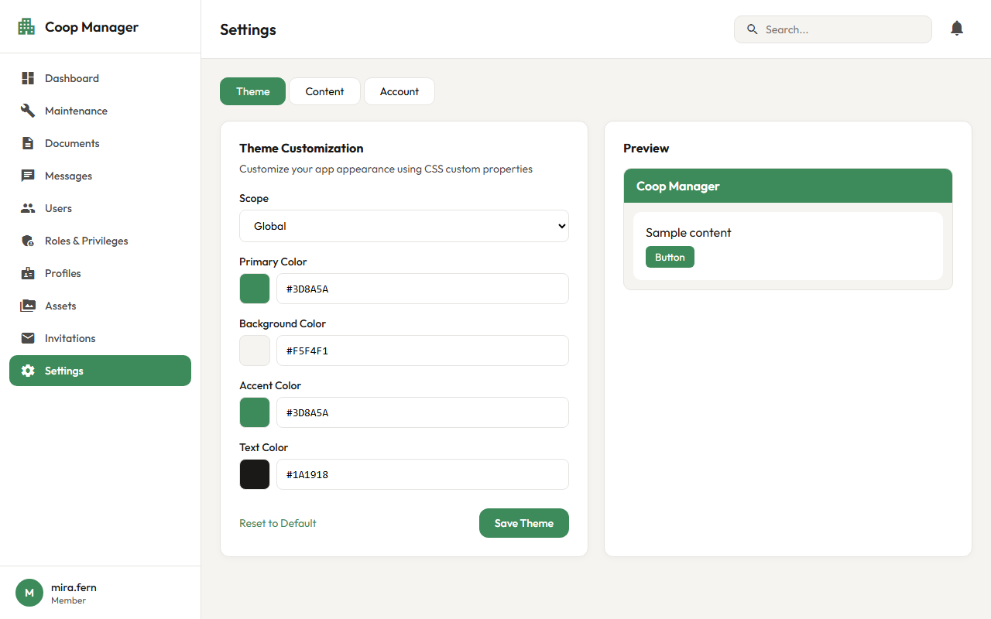
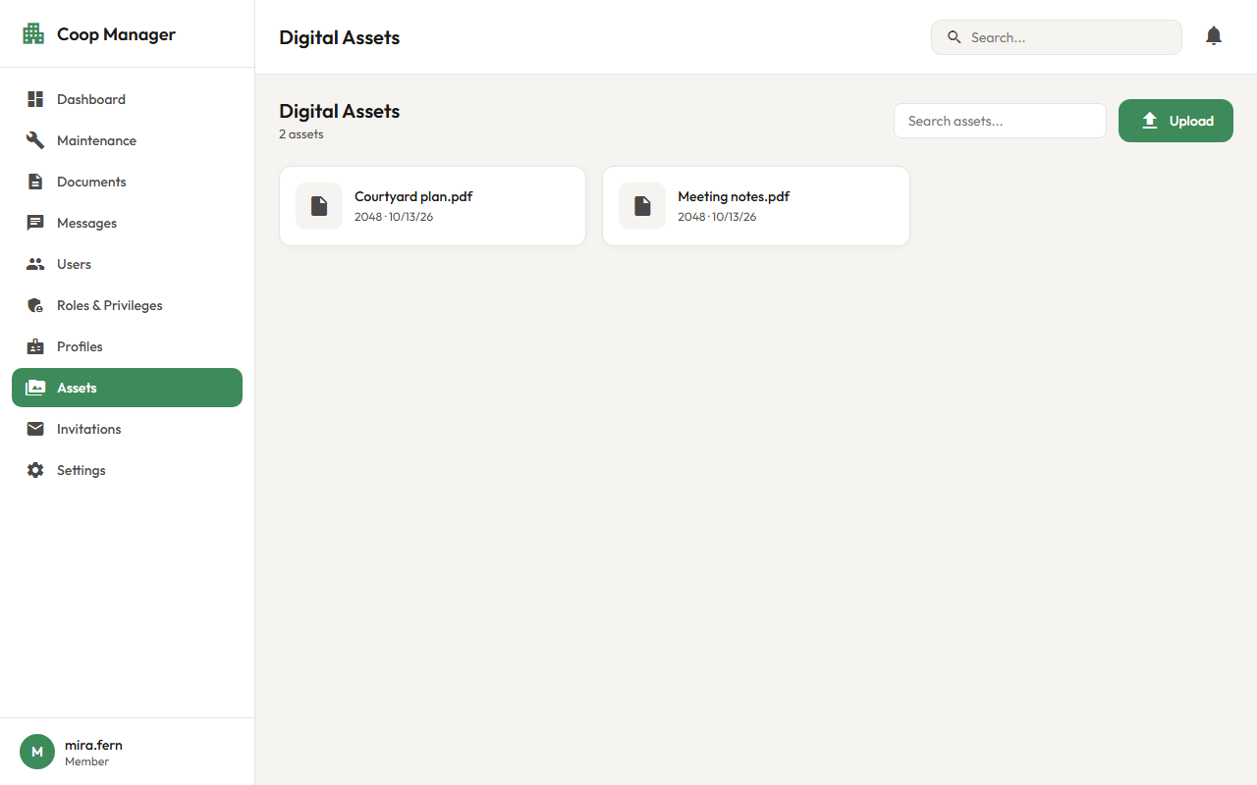
2 · OWN runs it
● Working today
Change the colours
Keep a library of photos
Notes:
Today, the office can already change the colours, and keep a library of photos. Coming next is adding and removing whole pages, and editing lists, like your board of directors. So when you hold your yearly election, the new directors can appear on the website the same afternoon. No programmer needed.

Slide 7



2 · OWN runs it
○ Coming next
Add and remove pages
Edit the board of directors list
New directors after each election
Notes:
Today, the office can already change the colours, and keep a library of photos. Coming next is adding and removing whole pages, and editing lists, like your board of directors. So when you hold your yearly election, the new directors can appear on the website the same afternoon. No programmer needed.

Slide 8
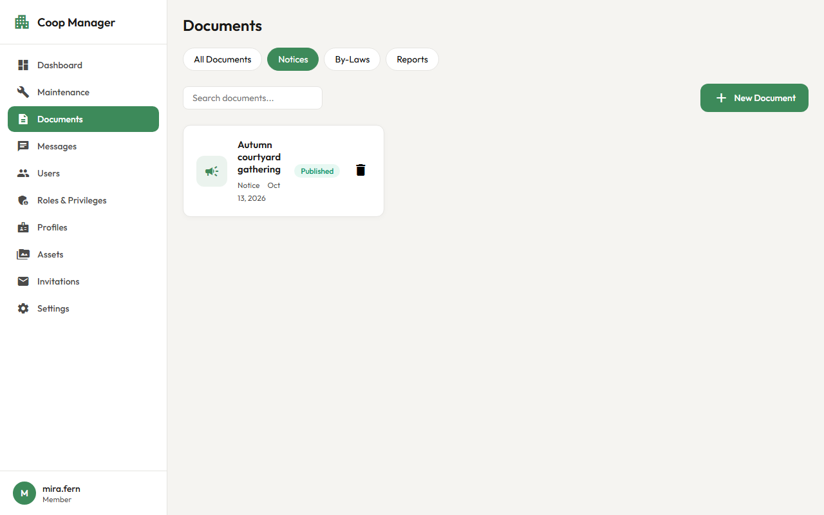
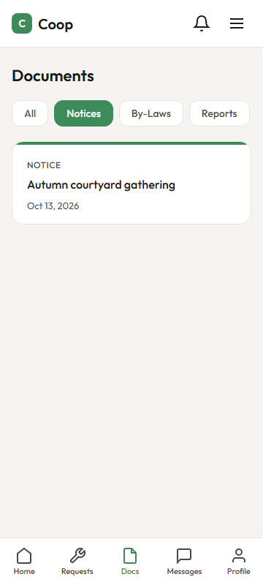
3 · Notices nobody misses
● Working today
→
The office writes it once
Members see it
Notes:
Third, notices that nobody misses. The office writes a notice once. It shows on the front page of the website, and in the documents page for members. This works today. Sending a notice straight to your phone or email is a later step.

Slide 9
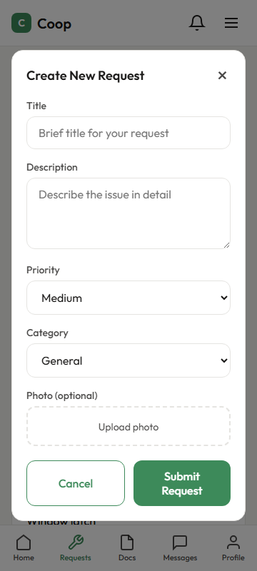
4 · Easy repair requests
● Working today
1
Tap “New request”
2
Type a few words
3
Send
The member's form
Notes:
Fourth, a leaking tap should be easy to report. A member taps new request, types a few words, and sends it.

Slide 10
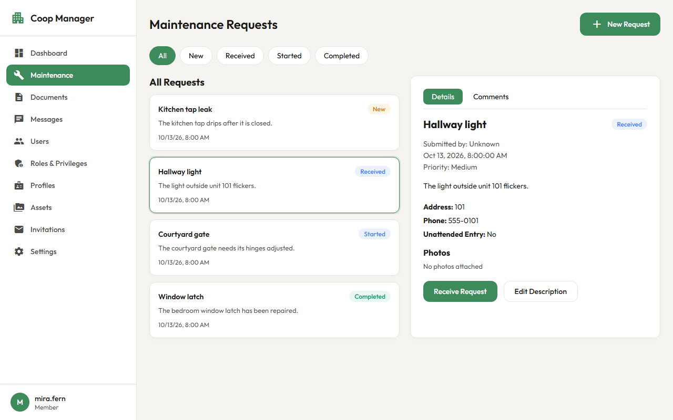
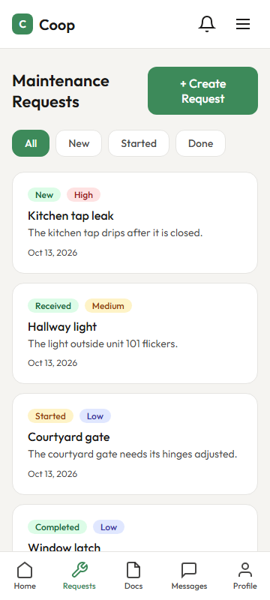
4 · New to done
● Receiving works today
○ Started, finished, photos next
→
The office taps “Receive”
The member follows along
Notes:
The office sees it at once, and taps receive, so the member knows someone is on it. The member can follow the request from new, to received, to done. Reporting, receiving and following a request works today. Buttons for started and finished, and photos, come next.

Slide 11
5 · Bigger words, up to 400%
○ Coming next
→
Normal size
400%: one easy column
Notes:
Fifth, bigger words. Any member can make the text bigger, all the way to four hundred percent, and still use the whole site. Everything stacks into one easy column, and nothing falls off the edge. We design for this on every screen, and we will test it before anyone has to rely on it. This part is coming next.

Slide 12
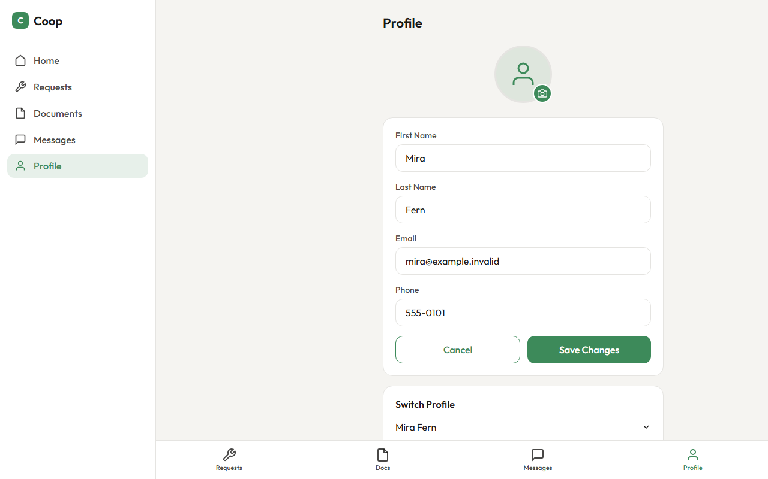
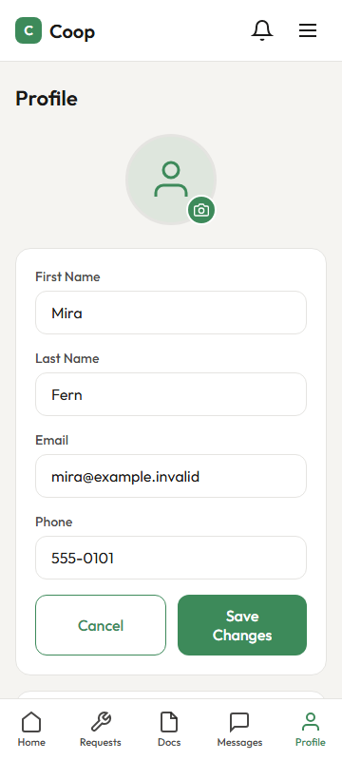
6 · Your own photo
○ Coming next
The screen is drawn
On a phone
Notes:
Sixth, your own face. Members can add their own profile picture, so neighbours see who is writing. The screen is drawn, and a place to keep the pictures is ready. Joining them together is coming next.

Slide 13
In short
● Working today
○ Coming next
Notices
Repair requests
Your colours
A photo library
The new website design
Pages and lists you edit
Bigger text
Profile pictures
Notes:
So, in short. Working today are notices, maintenance requests, your colours, and a library of photos. Coming next are the new website design, pages and lists the office can edit, bigger text, and profile pictures.

Slide 14
Three small things
1
Two members try notices and repair requests
2
Tell us the first three pages you want
3
Choose who in the office will be your admin
Notes:
We ask three small things. First, let two members try notices and maintenance requests. Second, tell us the first three pages you want on your website. Third, choose who in your office will be your admin.

Slide 15
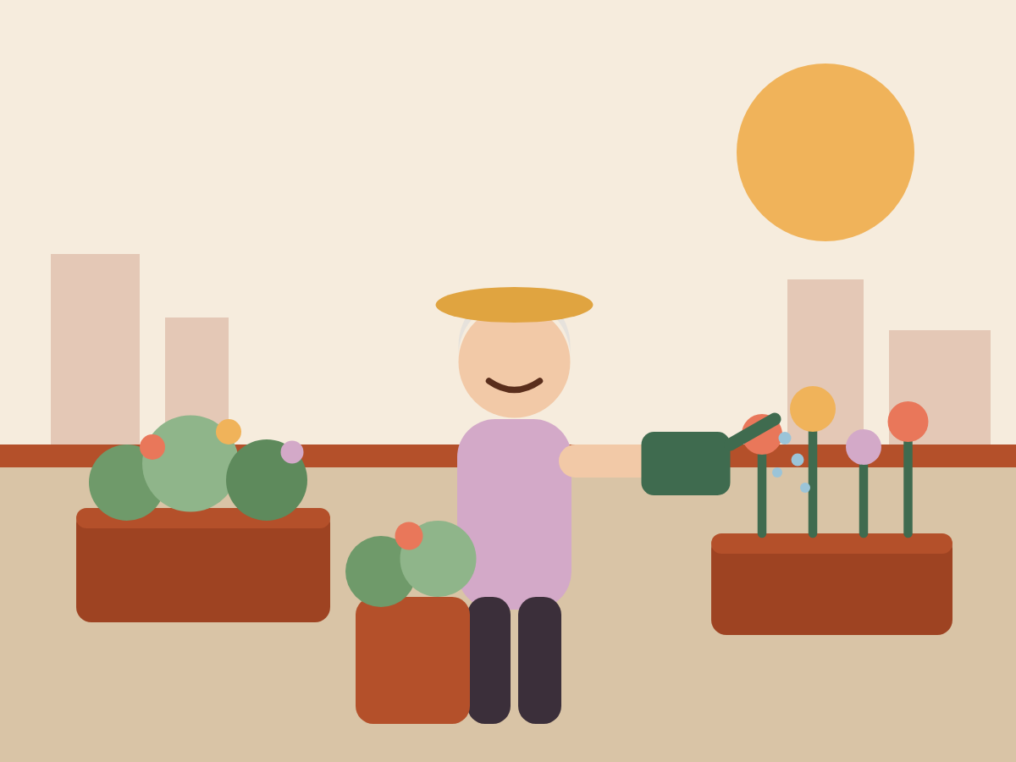
Thank you
Questions, however small, are welcome.
Notes:
Thank you. We would be glad to answer any question, however small.

