Slide 1
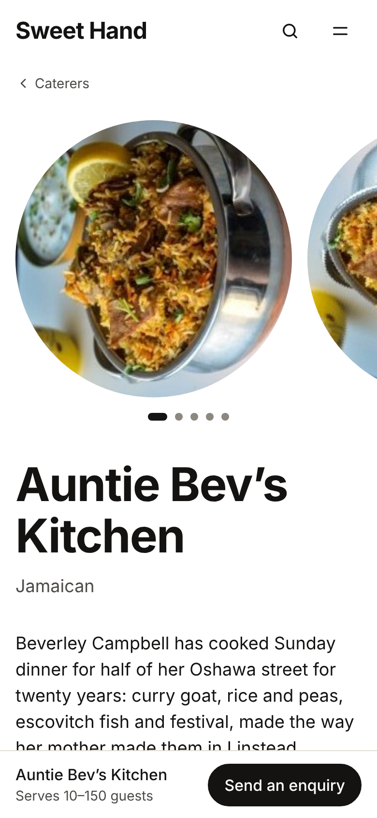
You have a sweet hand.
Let Toronto find it.
Sweet Hand for Caribbean caterers and home cooks in Toronto and the GTA. Opens Thursday 26 November 2026.
Notes:
Open warm. Thank them for the time and say who you are. "Sweet Hand is a new site where people in Toronto and the GTA find Caribbean caterers by dish, by island and by area. It opens on Thursday the 26th of November. I have two asks at the end: sign up, and follow us on Facebook." The phone shows a caterer's page: a fictional caterer from our demo data, Auntie Bev's Kitchen.

Slide 2
Right now, people find you by word of mouth
1
2
3
A cousin
A church group
A WhatsApp chat
who tells a friend
and the next christening
that scrolls away by Sunday
Everybody asks who made the pelau. The black cake is gone before the speeches. But the people planning the next wedding have no way to find you.
Notes:
Ask how people find them today. Most will say family, church, WhatsApp, Instagram. Agree: it works, but it stops at the people who already know them. "Everybody asks who made the pelau. Your black cake is gone before the speeches. But someone planning a wedding in Brampton next spring has no way to find you."

Slide 3
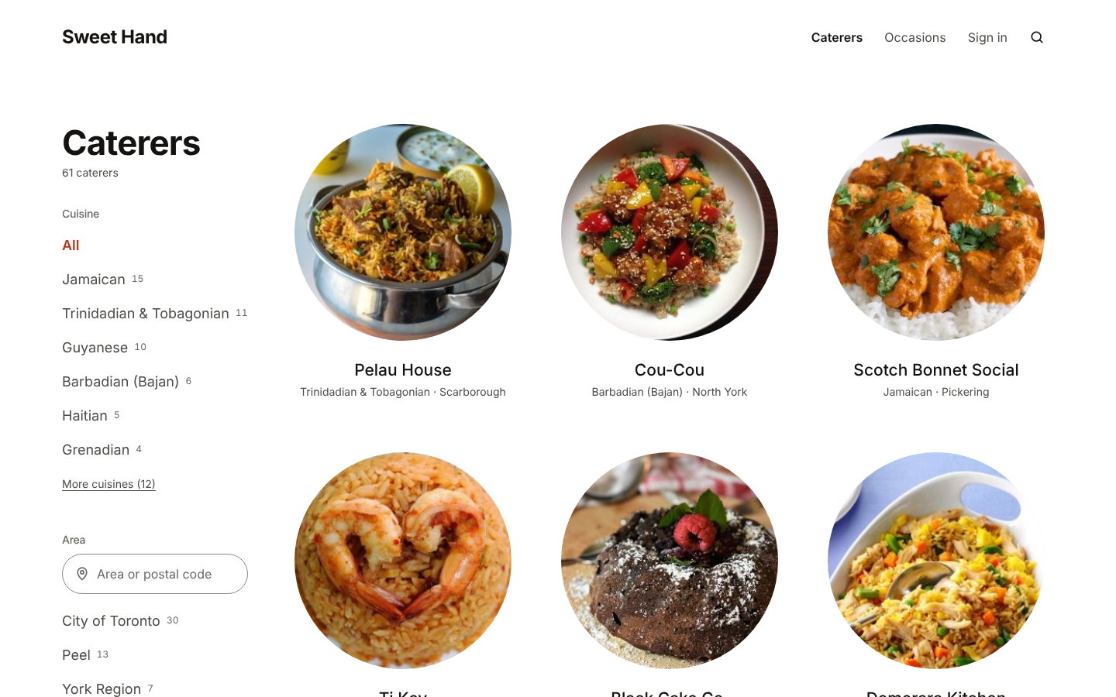
One place to find Caribbean caterers
People search by tradition, by area and by occasion.
Jamaican
Trinidadian and Tobagonian
Guyanese
Barbadian (Bajan)
Haitian
Grenadian
Vincentian
St. Lucian
Each tradition by name, never just "Caribbean".
Notes:
This is the caterer listing. People pick a tradition, an area such as Scarborough or Brampton, and an occasion such as a wedding or a repast. Every tradition has its own name: Jamaican, Trinidadian and Tobagonian, Guyanese, Bajan, Haitian, Grenadian, Vincentian, Lucian and more. Ask them which they cook, and use their words. The caterers on screen are fictional demo data.

Slide 4
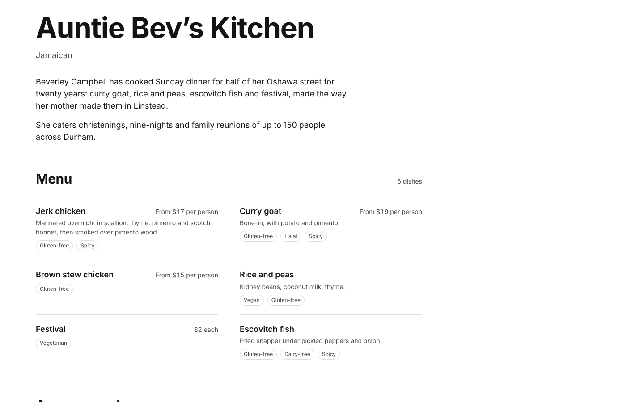
Your own page
Your photos and your story
The traditions you cook from
The event sizes and occasions you take
Your menu, with prices if you want them
Reviews from customers after their event
A "Send an enquiry" button
Notes:
Walk through the page from the top: photos, name, the traditions they cook from, their description in their own words, guest numbers and occasions, the menu, the areas they serve, reviews, and the "Send an enquiry" button. Reviews only come from customers whose enquiry got a reply and whose event has passed. People send an enquiry with their date and guest count; the caterer agrees the details directly. No money moves through Sweet Hand.

Slide 5
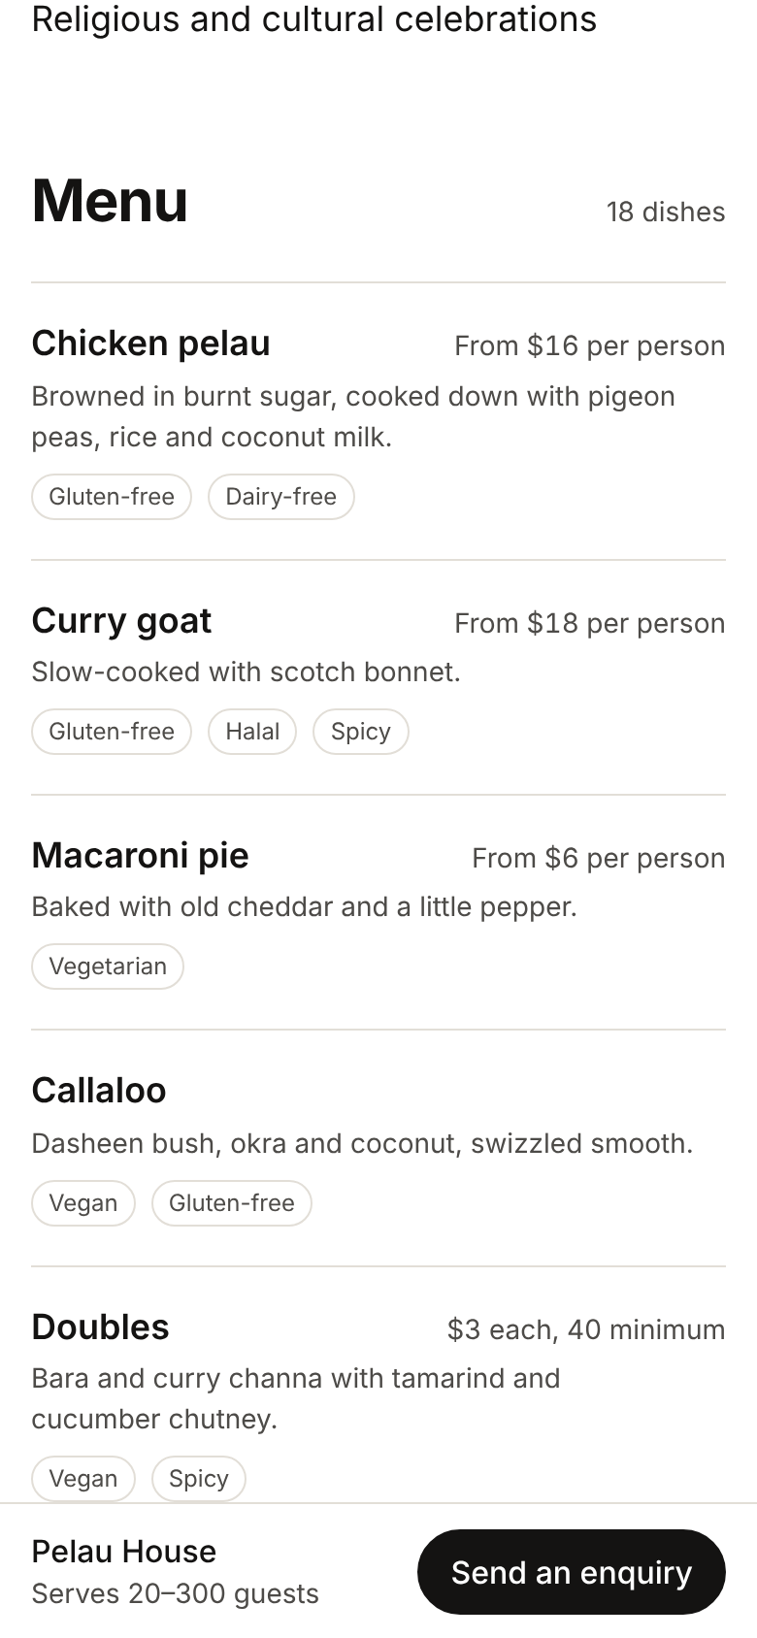
A menu people can trust at a glance
Every dish can carry dietary and allergen tags from one fixed list, shown as labels, not buried in the description.
Vegetarian
Vegan
Gluten-free
Dairy-free
Halal
Contains nuts
Contains shellfish
Spicy
You choose the tags for your own dishes. Sweet Hand does not certify or inspect kitchens.
Notes:
Show the menu on the phone. Each dish has a name, an optional description, optional price guidance like "From $16 per person", and tags from a fixed list: vegetarian, vegan, gluten-free, dairy-free, halal, contains nuts, contains shellfish and spicy. Allergens are labels, so a parent with a nut allergy can see them straight away. Say clearly that the caterer chooses the tags and that Sweet Hand does not certify or inspect anyone's kitchen.

Slide 6
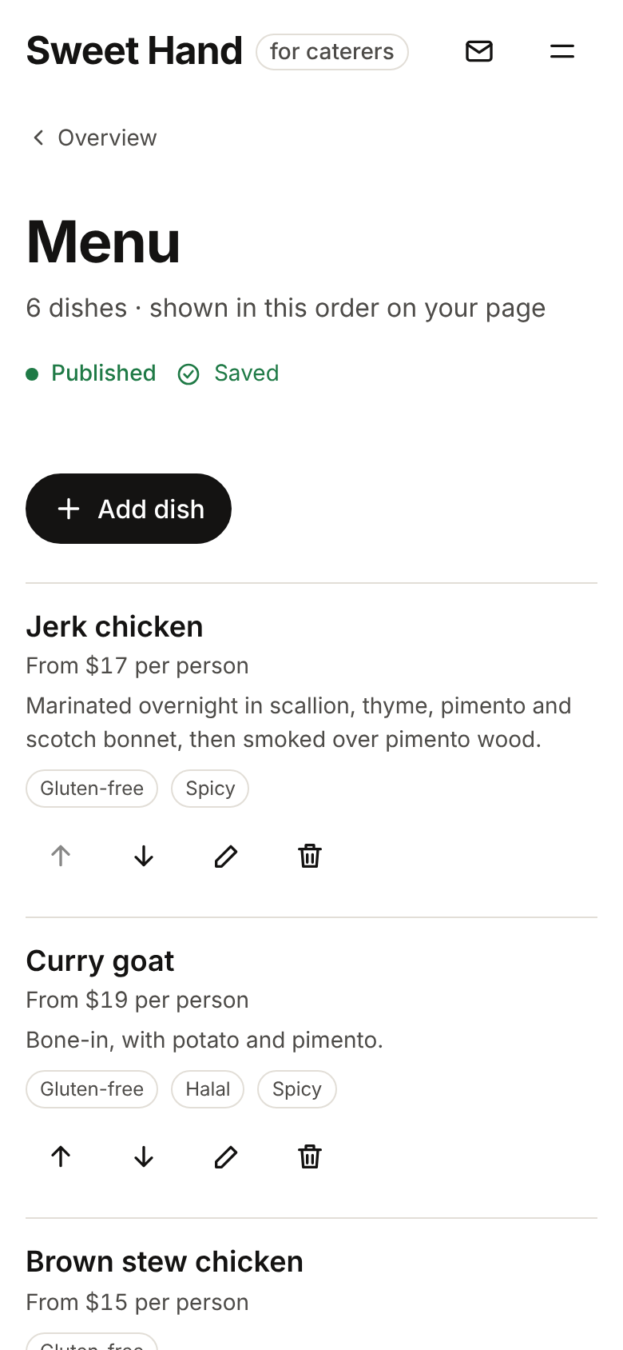
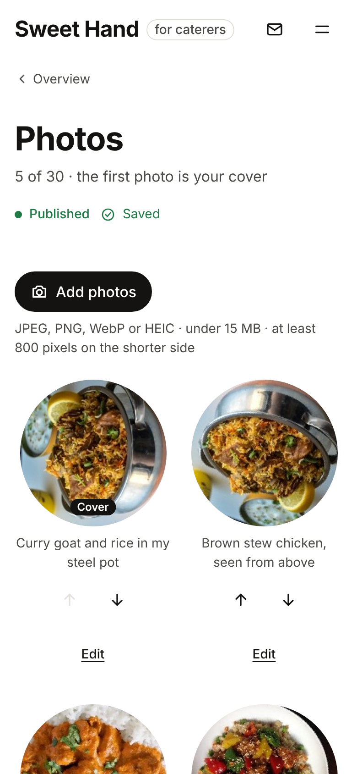
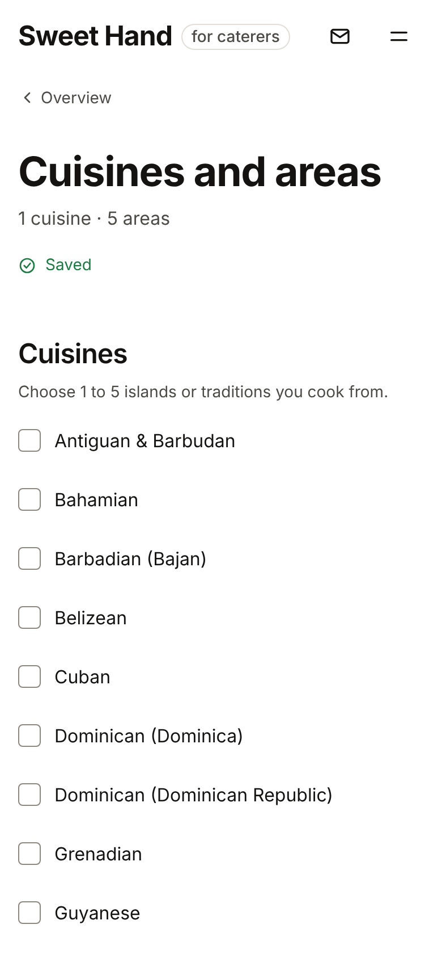
Build it from your phone
Your page saves as you go. A checklist shows what is left. When it is complete, you send it in and our team reviews it within 3 business days.
Menu
Photos
Cuisines and areas
Notes:
Everything works on a phone: add dishes, reorder them, upload photos and pick your cover, and choose your traditions and the areas you serve. Changes save by themselves, and a checklist shows what is left. To send a page in you need a description, your traditions and areas, guest numbers, at least one occasion, 3 to 30 photos, 3 to 50 dishes and a current food handler certificate. Our team reviews every page within 3 business days. That review is not a kitchen inspection.

Slide 7
Your kitchen, your rules
Free to list
You set the menu, the batches and the days
Your home address stays private
No listing fee and no commission. You agree the price with your customer.
You decide what you cook, how much, and which enquiries you take.
People see the areas you serve, never your address. Your phone and email stay private until you share them.
Food handler details are your own statement: only you and the Sweet Hand team see your certificate.
Notes:
Three promises we can keep. Free to list, with no fees. You set the menu, the batches and the days. Your home address never shows: your page lists the areas you serve, like Ajax or Pickering, and your phone and email are only shared if you choose to share them with a customer in that conversation. The food handler certificate is required to be listed, but only you and the Sweet Hand team see it, and we never say a kitchen is certified.

Slide 8
100
What you get
10 of your dishes, shot in our studio in downtown Toronto. About 90 minutes. You bring the food and keep the photos.
What we ask
A complete profile on Sweet Hand, and a launch-day post on 26 November.
A free photoshoot for the first 100 caterers who register
To confirm
How "first 100" is counted, the last day to book, and how shoot days are booked. Ask your sales person.
Notes:
Say the offer word for word: "The first 100 caterers who register get a free photoshoot: 10 of their dishes, shot in our studio. In return we ask for a complete profile and a launch-day post." The shoot is about 90 minutes in our downtown studio; they bring the food and keep the photos for their own Instagram. How "first 100" is counted, the last day to book and how shoot days are booked are still to confirm with the founder. Do not promise a place. Say: "Register today; the first 100 registrations get the shoot, and I'll confirm your place."

Slide 9
Coming ideas we are exploring
Not promised. Not at launch. No dates.
Exploring
Exploring
Delivery
Awards
We are exploring delivery through a courier partner. At launch, you agree pickup or delivery with each customer yourself.
We are exploring awards, for example "GTA’s Best Jerk Chicken". No categories, rules or dates yet.
Follow the Facebook Page to hear first.
Notes:
Be careful on this slide. These are ideas we are exploring, not features and not promises. Delivery: at launch the caterer agrees pickup or delivery with each customer. We are exploring delivery through a courier partner for later; Sweet Hand will not run its own delivery fleet. Awards: we are exploring ideas like "GTA's Best Jerk Chicken"; there are no categories, rules or dates. If they ask when, say "We don't know yet. Follow the Facebook Page and you'll hear first."

Slide 10
Opens
Thursday 26 November 2026
Toronto and the GTA, right before the Christmas orders. Black cake, sorrel, pastelles, ponche de crème: be listed before the rush.
Notes:
Sweet Hand opens to the public on Thursday 26 November 2026, in Toronto and the GTA. That is right before Christmas: black cake, sorrel, pastelles, ponche de crème, garlic pork. Makers add their Christmas items to their menu and people send an enquiry for their date and quantity. Signing up now means being there on day one.

Slide 11
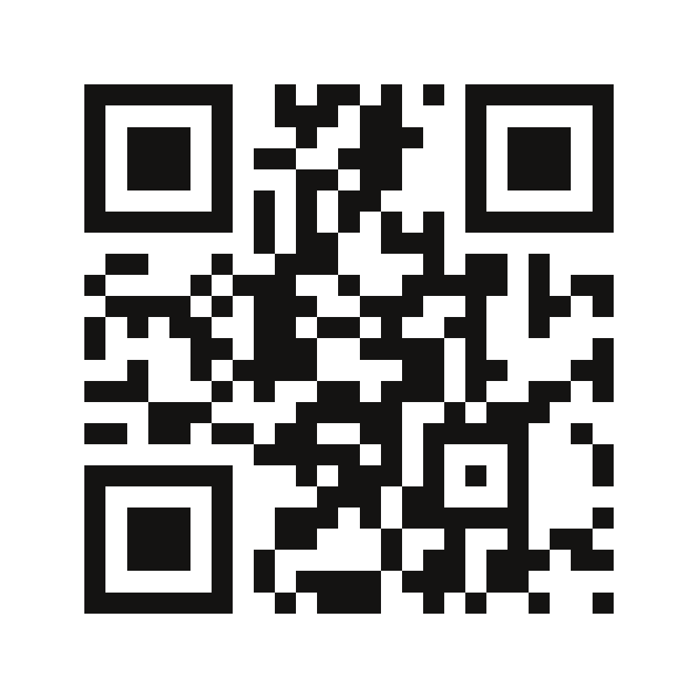
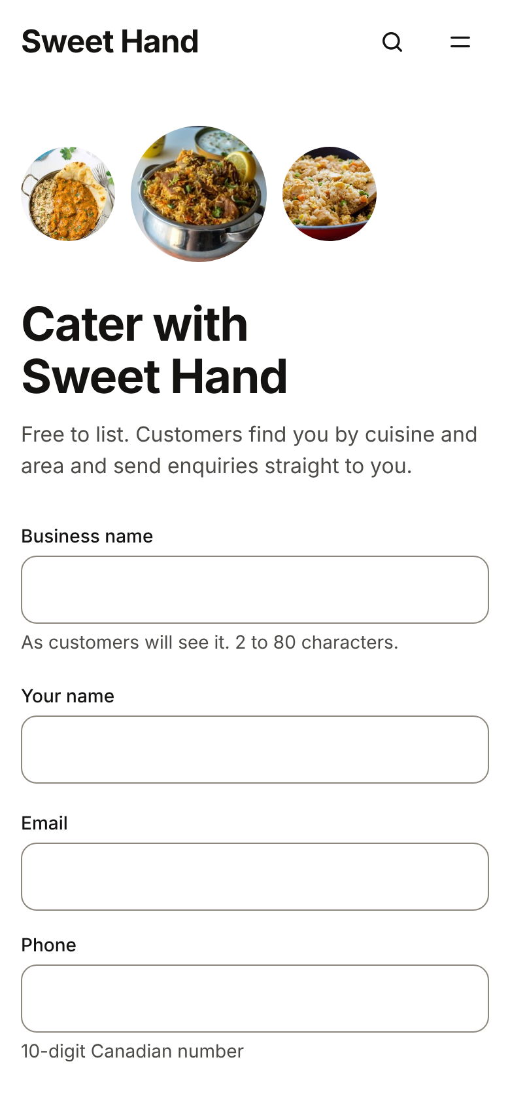
Sign up now: two minutes
1
Scan the code or go to sweethand.ca
2
Press "Join as a caterer"
3
Before 26 November: add your business name and email, then confirm the link we send. We email you once, on launch day.
sweethand.ca
4
From 26 November: create your caterer account and build your page.
Notes:
Do it with them now, on their phone. Scan the code or type sweethand.ca, then press "Join as a caterer". Until launch day that puts them on the launch list as a caterer: business name and email, then they confirm the link in the email, and we email them once, on launch day. From 26 November the same button opens caterer registration, shown on the phone: business name, their name, email, phone and a password. Founding caterers may be invited to build their page before launch; that is planned, not built, so don't promise it. Then log the lead.

Slide 12
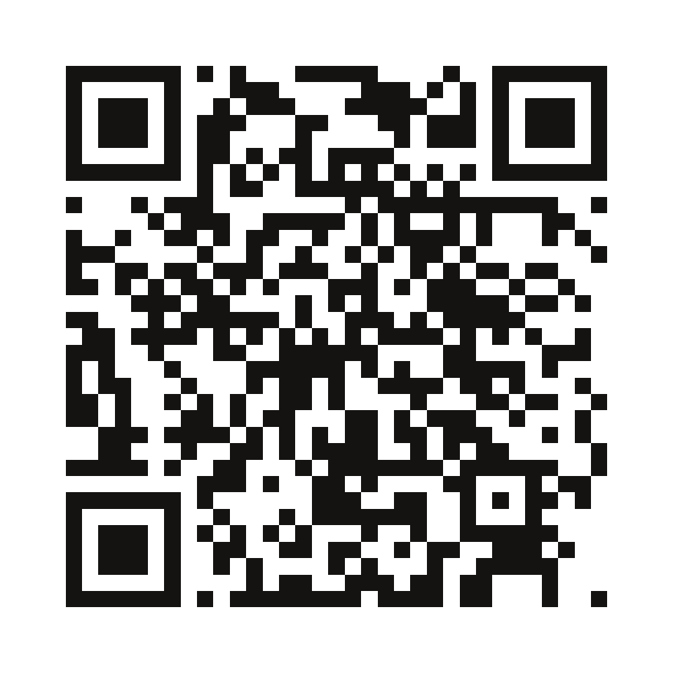
Follow Sweet Hand on Facebook
Where you hear it first:
The launch, first
Photoshoot days
The caterers who join
The ideas we are exploring
facebook.com/profile.php?id=61595065212396
Notes:
Second ask. Open the Facebook app with them and follow the Sweet Hand Page: scan the code, or search the link. That is where we announce the launch, the photoshoot days, the caterers who join and the ideas we are exploring, like delivery and awards. Note in the tracker whether they followed.

Slide 13
Questions?
1
Sign up
sweethand.ca → Join as a caterer
2
Follow us
Sweet Hand on Facebook
Free to list. You set the menu, the batches and the days. Your home address stays private.
Notes:
Take questions. Answer from the FAQ; if it is not there, or the FAQ says "to confirm", say "I'll check and come back to you" and write it down. Never promise delivery, awards, orders or a photoshoot place. Close with both asks: "Let's get you signed up: sweethand.ca, Join as a caterer. And can you follow Sweet Hand on Facebook while we're here?"

