Slide 1

Active Learning for Multi-Target Regression
Quinten Danneels
Thesis supervisor: prof. dr. Celine Vens
Daily advisor: dr. Felipe Kenji Nakano
Notes:
I am Quinten Danneels and welcome to my intermediate thesis presentation.
My master thesis is called: Active Learning for Multi-Target Regression and is situated in the field of Machine Learning.
The supervisor and co-supervisor for this thesis topic are: …

Slide 2
Overview
Literature study
Active learning
Multi-target regression
Research question
Approach
Next steps
Notes:
I would first like to provide you with an overview of the presentation:
1st brief summary of the lietarture study that I conducted
2nd present my research question and the relevancy of it
3rd approach
4th next steps

Slide 3
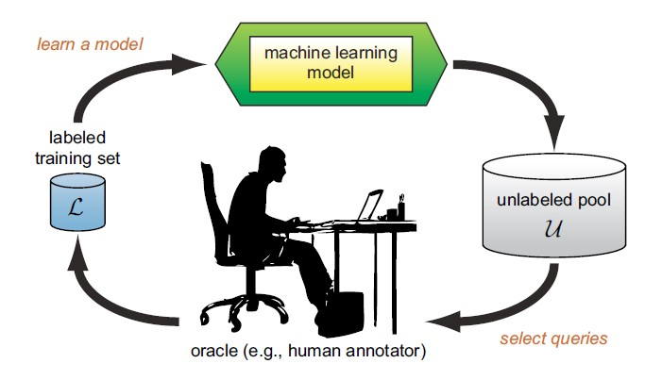
Literature study: Active learning
Active learning: selecting the instances to train the algorithm on
Passive learning: using all the instances to train the algorithm on
Burr Settles. Active learning literature survey. 01 2010.
Notes:
Active learning tries to select the most informative instances to train an algorithm on, where passive learning just uses all the possible instances to train an algorithm on.
The active learning cycle starts with an initial small labelled training dataset L. An algorithm is trained on this dataset L. Next, the algorithm chooses which data instances that are the most informative and presents them to an oracle, which in turn labels these instances. These newly labelled instances are added to the training set L and the cycle is restarted. This is done untill a stop criterion is reached.

Slide 4
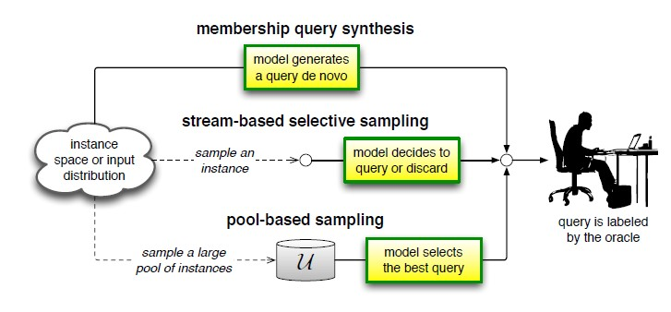
Literature study: Active learning
Scenarios:
Burr Settles. Active learning literature survey. 01 2010.
Notes:
In active learning, there are some different problem scenarios. These scenarios describe from where the instances are originated.
1st membership query synthesis. Here, the instances that can be queried are existing instances from an underlying distribution or self-generated instances by the model itself.
2nd stream based selective sampling. Here, only existing instances are one by one presented to the model. Then, the model has to decide if it wants to know the label or to discard the instance.
3rd and last pool based sampling. Most frequently used scenario. Here, a pool of existing instances are collected and the model queries the most informative instances of this pool.

Slide 5
Literature study: Active learning
Query strategies:
Uncertainty sampling:
Probabilistic methods: classification
Query = instance where the model is the most uncertain about
Query by committee (QBC):
Committee of models
Query = instance on which the committee disagrees the most
Expected model change (EMC):
Query = instance that implies the biggest change in the model parameters
Notes:
In active learning is the selection of the most informative instances central. Therefore some frequently occuring query strategies will be explained here.
1st is Uncertainty sampling. This strategy is mainly used for classification problems. The instance that will be queried is the instance where the model is the most uncertain about.
2nd is QBC. This strategy assembles a commitee of models trained on the same dataset. The instance that will be queried is the instance where the committee has the most disagreement about.
3rd is EMC. This stratgey speaks for itself. The instance that will produce the biggest change in model paramters will be chosen as query.

Slide 6
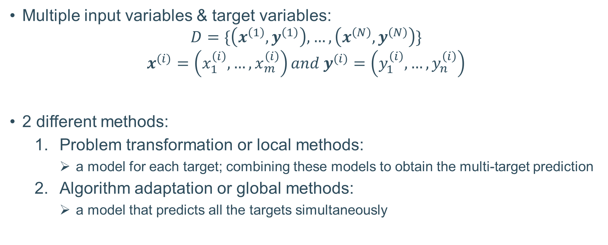
Literature study: Multi-target regression
Multiple input variables & target variables:
$$D=\{\left(x^{\left(1\right)}, y^{\left(1\right)}\right), …,\left(x^{\left(N\right)}, y^{\left(N\right)}\right)\}$$
$$x^{(i)}=\left(x_{1}^{\left(i\right)}, …,x_{m}^{\left(i\right)}\right)and y^{(i)}=\left(y_{1}^{\left(i\right)}, …,y_{n}^{\left(i\right)}\right)$$
2 different methods:
Problem transformation or local methods:
a model for each target; combining these models to obtain the multi-target prediction
Algorithm adaptation or global methods:
a model that predicts all the targets simultaneously
Notes:
The second part of the literature study handles multi target regression. MTR problem consists of a dataset D where the upper digit corresponds to the number of the instance. When we look closer at the x and y vector, we can see that they consist of multiple feature values. Where x has input features and y has target features.
There are 2 main methods to tackle these MTR problems. First, we have PT or local methods. These methods build a model for each target and they combine these models to obtain the MT prediction. Secondly, we have algorithm adaptation or global methods. These methods methods try to create a model that predicts all the targets simultaneously.

Slide 7
Research question
How can active learning effectively be combined with multi-target regression?
Which approach has the best effect performance wise, instance based or target based?
Relevancy:
Gap in research
Beneficial cost wise
Notes:
This research topic is relevant mainly because there are no or few research studies performed on combining these 2 concepts. Is it because people tried it already but it led to bad results or nobody did think about this gap. We don’t know. Also the application of active learning, which leads to fewer labelling costs, is also relevant in practical circumstances.

Slide 8
Approach
Datasets:
24 benchmark datasets
7 → 700 input features and 2 → 16 target features
Proposed active learning method:
Local method: random forest for each target
Yields good results
Not a lot of time needed to train
Local methods can handle missing values
Scenario: pool-based sampling
Query strategy: QBC
It works for multi-label classification
Instance based
Target based
Notes:
The approach of this thesis is as follows:
We have 24 benchmark datasets to our disposal. These datasets range from 7 to 700 input features and from 2 to 16 target features. These also have a practical meaning, some describe the product prices after 1 day, the other describe the water quality, and so on.
The AL method that is proposed consists of a local MTR method, namely random forest fro each target. Why? Because it yields good results for STR, not a lot of time needed to train and it can handle missing values. The AL scenario is pool based sampling because we already have a pool of instances, the datasets, to our disposal. The query strategy that will be used in this method is QBC. Due to the random forest, there are multiple models build so a committee is already available. It also works for multi-label classification.
The different approaches that will be looked at are the instance based approach. Here, when we ask the oracle to label the instance, we get all the target features for this instance. This will not have a beneficial effect in all cases. Therefore the other approach, the target based approach, just queries specific targets for specific instances.

Slide 9
Approach
Baseline method:
Best competitor
Method we want to beat
Upper bound method:
Label every instance and putting it in the training dataset L
Lower bound method:
Query instances at random
Notes:
The baseline method is a method that is the best competitor in literature. This is the one we try to beat. The upperbound method just labels every instance and is in the initial phase putted in the training dataset L. The lowerbound uses no heuristic when querying, so the instances are queried at random.

Slide 10
Next steps
March:
Proposed active learning method
Baseline method
Upper + lower bound method
April:
Experiments
Evaluation
May:
Conclusion + Abstract
Revision

Slide 11
Questions?

Slide 12
Presentation remarks
Use more figures (f.e. instance and target based)
Instance with missing target values → not used in instance based, used in target based for the available values
Instance based → 1 oracle
Target based → multiple oracles (practical why? Domain knowledge, dividing the labelling effort, have to use the same quality of targeting)

