Slide 1

Active Learning for Multi-Target Regression
Supervisor: Prof. dr. Celine Vens
Co-supervisor: Dr. Felipe Kenji Nakano
Quinten Danneels
Academic year 2022 – 2023
Master of Artificial Intelligence in Business and Industry
Notes:
Good afternoon, I am Quinten Danneels and welcome to my thesis presentation.
My master thesis is called: Active Learning for Multi-Target Regression and is situated in the field of Machine Learning.
This thesis is conducted to obtain the degree for the advanced master of AI in business and industry.
The supervisor and co-supervisor for this thesis topic are: …

Slide 2
Overview
Research Question
Active Learning
Multi-Target Regression
Methodology
Results
Conclusion
Notes:
I would first like to provide you with an overview of the presentation:
First, I will start by presenting my research question for this thesis.
Then, I will present a brief summary of the literature study that I conducted where the first part is about active learning and the second part about multi-target regression.
Thereafter, I will talk about the methodology applied in this thesis as well as the results that obtained by our expirements.
To end this presentation, I will discuss the conclusions that we have derived out of our results.

Slide 3
1. Research Question

Slide 4
1. Research Question
How can active learning be effectively combined with multi-target regression?
Notes:
The research question of this thesis is: …
This research topic is quite relevant because to our knowledge there are no or few studies performed on combining these 2 concepts. Is it because nobody tought about this gap? Or is it because researchers already tried it but it led to bad results? We don’t know.
In addition to this academic aspect, this research topic also has advantages in practice. To better understand this, we first need to look at what active learning really means.

Slide 5
2. Active Learning

Slide 6
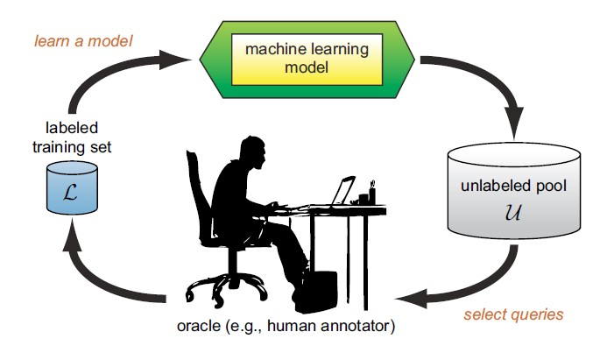
2. Active Learning
2. Active Learning
Active learning: selecting instances to train the algorithm on
Passive learning: using all the instances to train the algorithm on
Burr Settles. Active learning literature survey. 01 2010.
Notes:
Active learning tries to select the most informative instances to train an algorithm on, where passive learning just uses all the possible instances to train an algorithm on. Therefore, active learning can reduce the labelling costs quite a bit.
The active learning cycle starts with an initial small labelled training dataset L. An algorithm is trained on this dataset L which results in a model. Next, the model chooses which data instances that are the most informative and presents them to an oracle, which in turn labels these instances. These newly labelled instances are added to the training set L and the cycle is restarted. This is done untill a stopping criterion is reached.

Slide 7
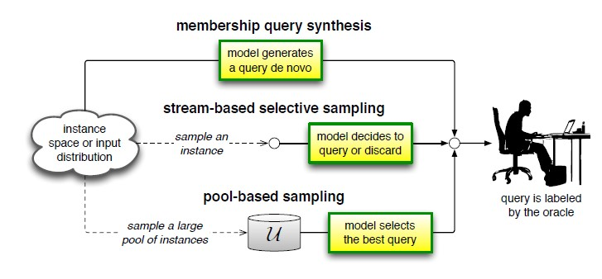
2. Active Learning
Scenarios:
Burr Settles. Active learning literature survey. 01 2010.
Notes:
In active learning, there are some different problem scenarios. These scenarios describe from where the instances originate from.
1st membership query synthesis. Here, the instances that can be queried are existing instances from an underlying distribution or self-generated instances by the model itself.
2nd stream based selective sampling. Here, only existing instances are one by one presented to the model. Then, the model has to decide if it wants to know the label or to discard the instance.
3rd and last pool based sampling. Most frequently used scenario. Here, a pool of existing instances are collected and the model queries the most informative instances of this pool. This is the active learning scenario that is present in this thesis.

Slide 8
2. Active Learning
Query strategies:
Uncertainty sampling:
Classification problems
Query = instance where the model is the most uncertain about
Query by committee (QBC):
Committee of models
Query = instance on which the committee disagrees the most
Expected model change (EMC):
Query = instance that implies the biggest change in the model parameters
Notes:
In active learning is the selection of the most informative instances central. Therefore some frequently occuring query strategies will be explained here.
1st is Uncertainty sampling. This strategy is mainly used for classification problems. The instance that will be queried is the instance where the model is the most uncertain about.
2nd is QBC. This strategy assembles a commitee of models trained on the same dataset. The instance that will be queried is the instance that the committee disagrees on the most.
3rd is EMC. This stratgy speaks for itself. The instance that will produce the biggest change in the model parameters will be chosen as query.
In this thesis, we will use QBC as the query strategy.

Slide 9
3. Multi-Target Regression
Notes:
Now that we now what active learning means, it is time to have a look on what multi-target regression really is.

Slide 10
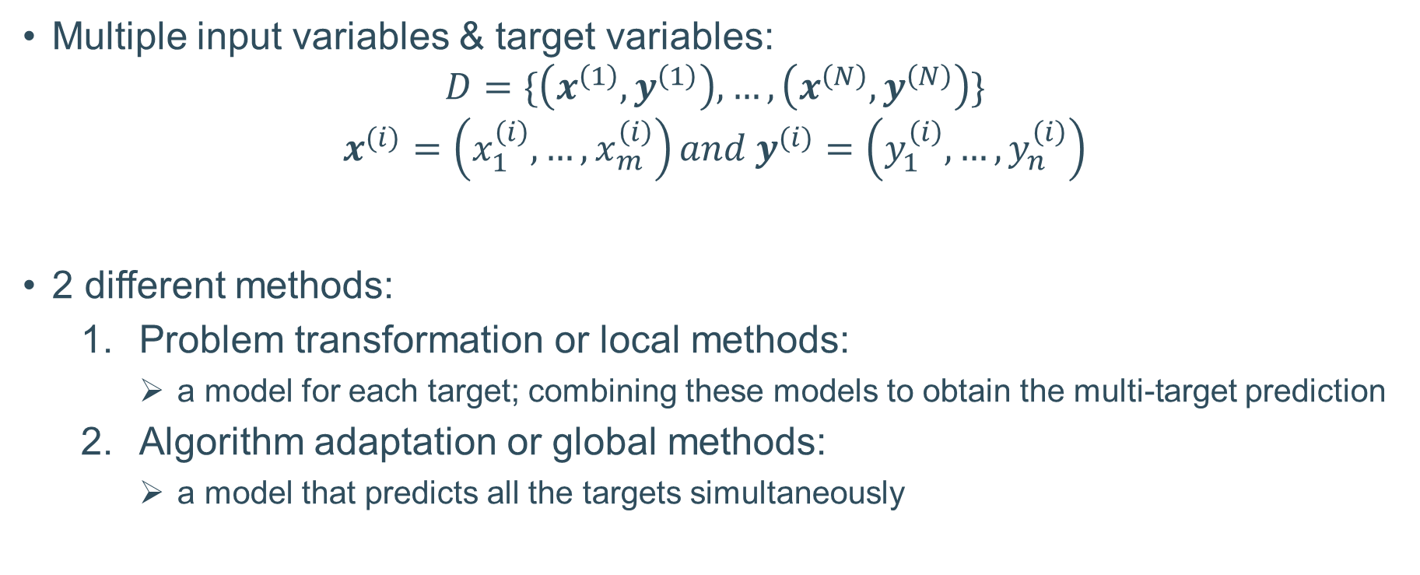
3. Multi-Target Regression
Multiple input variables & target variables:
$$D=\{\left(x^{\left(1\right)}, y^{\left(1\right)}\right), …,\left(x^{\left(N\right)}, y^{\left(N\right)}\right)\}$$
$$x^{(i)}=\left(x_{1}^{\left(i\right)}, …,x_{m}^{\left(i\right)}\right)and y^{(i)}=\left(y_{1}^{\left(i\right)}, …,y_{n}^{\left(i\right)}\right)$$
2 different methods:
Problem transformation or local methods:
a model for each target; combining these models to obtain the multi-target prediction
Algorithm adaptation or global methods:
a model that predicts all the targets simultaneously
Notes:
MTR problem consists of a dataset D where the upper digit corresponds to the number of the instance. When we look closer at the x and y vector, we can see that they consist of multiple feature values. Where x has m features and y has n targets.
There are 2 main methods to tackle these MTR problems. First, we have PT or local methods. These methods build a model for each target and they combine these models to obtain the MT prediction. Secondly, we have algorithm adaptation or global methods. These methods methods try to create a model that predicts all the targets simultaneously.
In our case we will focus on local methods.

Slide 11
4. Methodology
Notes:
Now that we have both seen the concepts of AL and MTR, it is time to discuss the the methodology of this thesis. This will mainly be centered around the design of our proposed AL method called QBC-RF.

Slide 12
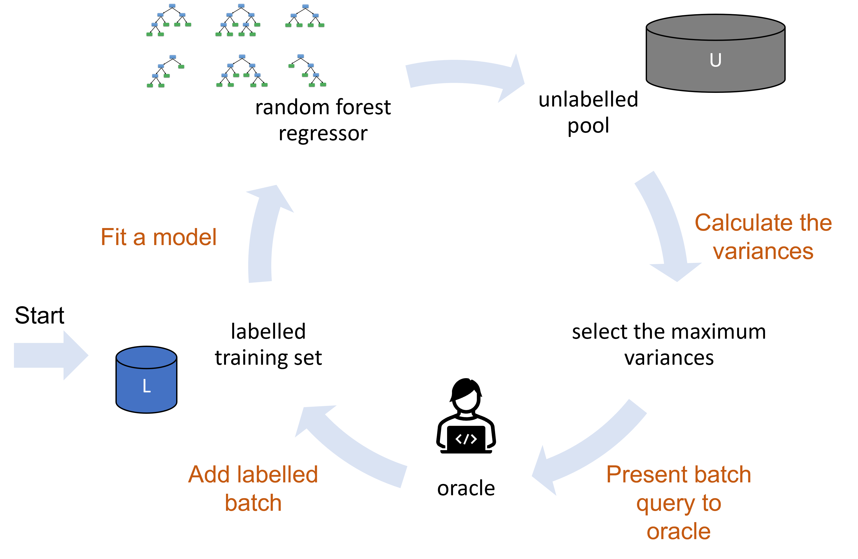
4. Methodology
QBC-RF:
Notes:
The active learning method that we have designed for multi-target regression is called Query-By-Commitee with Random Forest or in short QBC-RF. Like I’ve already said QBC consists a committee of models that chooses the most informative instance based on a disagreement measure. Here, the committee of models is composed of a random forest regressor per target because we use a local method. In our case we chose 100 regressor trees per random forest. The variance of the predictions is used as a disagreement measure. The bigger the variance the more the committee of models disagree on the labelling of the data instance. A batch of instances is then presented to the oracle. Because we use an instance based approach, the oracle will provide a label for each target. This is the opposite of a target based approach where the oracle will only label one specific target.

Slide 13
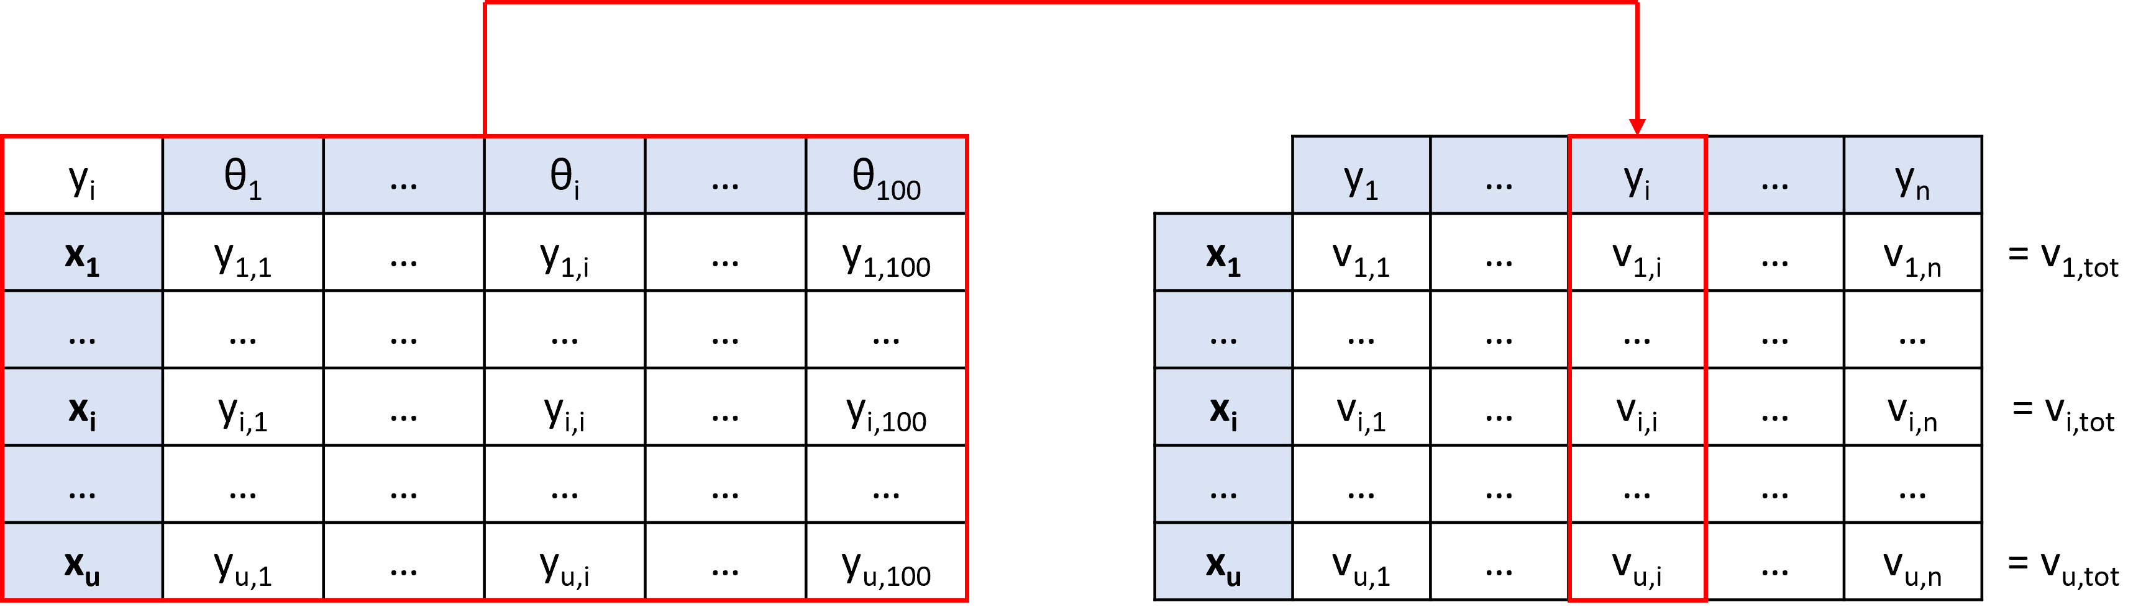
4. Methodology
Variance:
Notes:
To illustrate the computation of the variance a little bit more: here we are focused on the target yi. The rows consist of the features x of the data instances in the unlabelled pool. The columns consists of the 100 regressor trees which are trained on the labelled. Each model will predict a value for target yi for each data instance. Based on these predictions we can compute the variance per instance for target yi. If we do this for all the targets, then we compute the sum of variances to obtain the total variance per data instance.

Slide 14
4. Methodology
Baseline method: Greedy Sampling on the inputs
Similar to QBC-RF
Distance in in the input space
Lower bound method: Random Sampling
No heuristic
Upper bound method
Notes:
In this thesis, we also used a baseline method. This was not easy because we could not find research on AL for MTR. Therefore, we used a AL for STR that we have adapted in our local approach. This baseline method is quite similar to QBC-RF. The only difference lies in the selection of the queries. Greedy sampling will choose the instances that are the furthest removed from the labelled training set L and present these to the oracle. We also used another competitor in the form of random sampling. Here, we did not use a heuristic but choose random instances from the unlabelled pool. Finally, we also defined an upper bound method which is just a passive learning method. Here, we just trained a random forest regressor on the concatenation of the labelled training set L and the labelled unlabelled pool U.

Slide 15
4. Methodology
Datasets:
10 benchmark datasets
Features: 10 700
Targets: 2 16
10:70:20 ratio
Performance metrics:
R²-score, MAE, MSE
Friedman-Nemenyi test
Notes:
We used a selection of 10 benchmark datasets which cover relevant applications such as water quality or product prices after 1 day. The amount of features ranges from 10 to 700 and the amount of targets range from 2 tot 16. We also splitted the dataset in a 10:70:20 ratio meaning that 10% of the dataset is used as the training dataset L, 70% is used as the unlabelled pool U and 20% is used as test set T.
As performance metrics, we use the R squared score which can be interpreted as the percentage of variation in the target values which can be explained by the percentage of variation in the feature values. We also use the mean absolute and mean squared error. In addition to these metrics, we also apply the friemand-nemenyi test. The friedmann test shows us if there is a statistical difference between algorithms and the nemenyi test shows us which algorithms are statistically different from each other.

Slide 16
5. Results
Notes:
Now that we have covered the methodology of this thesis, we can go over to the results.

Slide 17
5. Results
R²-score and MAE:
Curves
AUC
Friedman-Nemenyi test
Average values
Notes:
In the following slides we will only look at the R squared scores and the MAE values. The MSE will not be handled because the errors are quite small and when you square them they will be even smaller. These values are hard to compare the performance of the methods.
We will look at a small selection of the curves, an overview of the area under the curve of all the curves and finally we used these AUC values to perform the Friedman-Nemenyi test.
It is important to note that the values of the curve are average values. We randomized the datasets 5 times because the performance is dependent of the initially chosen labelled training dataset and unlabelled pool.

Slide 18
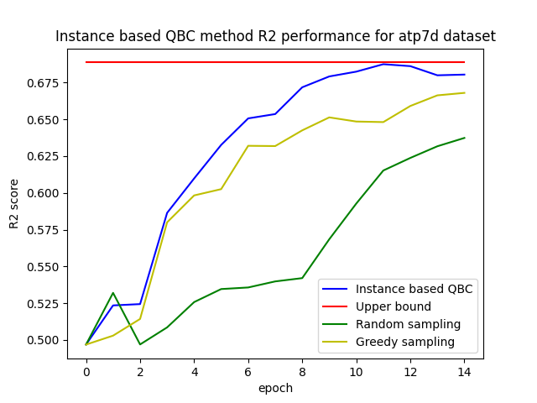
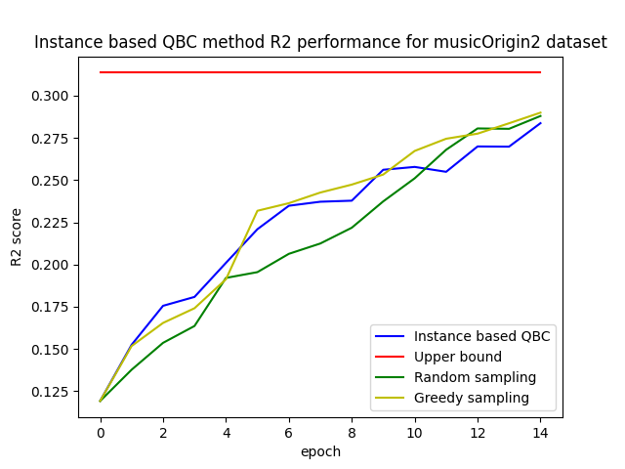
5. Results
R²-score curves:
Notes:
The curves for the atp7d dataset are shown at the left, while the curves for the musicorigin2 dataset are shown at the right. We can see that the QBC-RF and greedy sampling method outperform the random sampling method on these 2 curves. While on the left, the QBC-RF method is better than the greedy sampling method, on the right that isn’t the case.

Slide 19
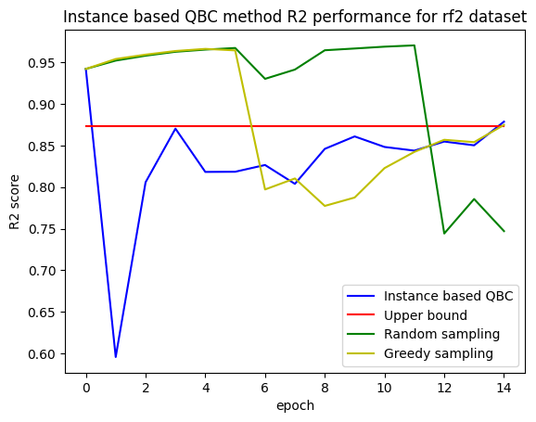
5. Results
R²-score curves:
Notes:
We expect that the QBC-RF and greedy sampling method outperform the random sampling all the time. Unfortunately this is not always the case as can be seen on these curves. Here the initial performance is better than the upper bound performance. We also see after a couple of epochs that the performance decreases quite fast. This is because the dataset contains noisy data instances. QBC-RF will choose these data instances early because the committee of models disagree the most on these instances, while the greedy sampling will choose these data instances also early because these noisy data instances will be further removed from the training set in the input space. That is the reason whu random sampling is performing better in this case.

Slide 20
5. Results
R²-score AUC:
Dataset | QBC-RF | Greedy | Random
andro | 3.760 | 3.739 | 3.362
atp7d | 8.857 | 8.561 | 7.815
edm | 5.473 | 5.227 | 4.861
friedman | 0.534 | 0.539 | 0.500
mp5spec | 9.701 | 9.524 | 9.833
musicOrigin2 | 3.151 | 3.202 | 3.004
oes97 | 10.542 | 10.504 | 9.924
rf2 | 11.554 | 12.265 | 12.923
scm1d | 12.477 | 12.453 | 12.327
sf1 | -7.105 | -8.440 | -11.912
Total wins | 6 | 2 | 2
Notes:
The following table consists of AUC values of the curves that I have just presented. The best values, being the highest values, per dataset are indicated in bold. In general, we can conclude that the QBC-RF method is better than both greedy and random sampling. This can be seen in the total of wins that the QBC-RF method has over the other 2.

Slide 21
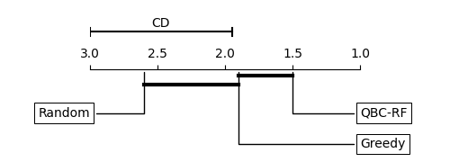
5. Results
R²-score Friedman-Nemenyi test:
Notes:
The Friedman-Nemenyi test using these AUC values shows us that the QBC-RF method is ranked the highest, which supports our claim that QBC-RF outperforms the other 2 methods. Also, we can see that using a heuristic is better than choosing the queries at random which is suspected. The bold lines connect methods which are not statistically different. So QBC-RF and greedy sampling are not statistically different but QBC-RF and random sampling are.

Slide 22
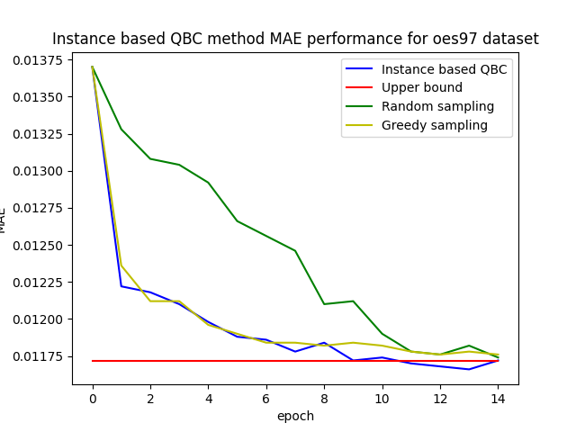
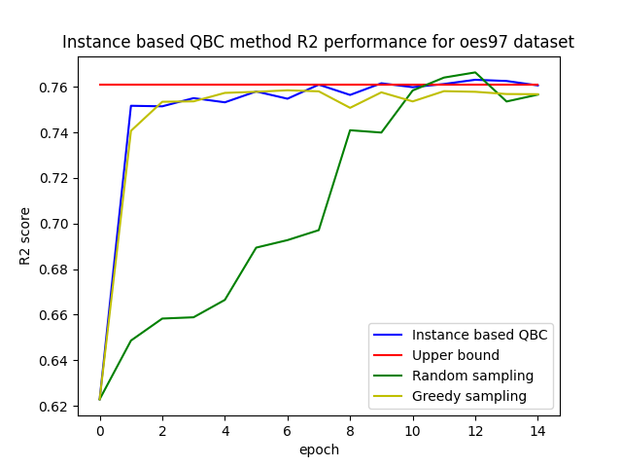
5. Results
MAE curves:
Notes:
Now when looking at the MAE curve of the oes97 dataset on the left, you can clearly see that it has the same shape of the R squared curve on the right when it is mirrored around the x-axis. This is the case for most of the datasets. Therefore, the assumptions made when discussing the R squared scores also can be made here.

Slide 23
5. Results
MAE AUC:
Dataset | QBC-RF | Greedy | Random
andro | 0.171 | 0.179 | 0.178
atp7d | 0.074 | 0.077 | 0.079
edm | 0.579 | 0.620 | 0.0624
friedman | 0.513 | 0.512 | 0.513
mp5spec | 0.159 | 0.159 | 0.151
musicOrigin2 | 0.207 | 0.205 | 0.207
oes97 | 0.167 | 0.168 | 0.174
rf2 | 0.002 | 0.002 | 0.002
scm1d | 0.006 | 0.006 | 0.006
sf1 | 0.281 | 0.315 | 0.321
Total wins | 5 | 2 | 1
Notes:
The following table consists of AUC values of the MAE curves. The best values, being the lowest values because we want the loss to be as low as possible, per dataset are indicated in bold. In general, we can conclude that the QBC-RF method is better than both greedy and random sampling. This can be seen in the total of wins that the QBC-RF method has over the other 2.

Slide 24
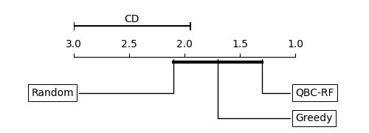
5. Results
MAE Friedman-Nemenyi test:
Notes:
The Friedman-Nemenyi test using these AUC values shows us that the QBC-RF method is again ranked as highest. Also, we can see that using a heuristic is better than choosing the queries at random which is suspected. But when using the MAE AUC values, we can see that the 3 methods are not statistically different from each other.

Slide 25
6. Conclusion
Notes:
This brings us now to the conclusion of this thesis.

Slide 26

6. Conclusion
Active learning framework: QBC-RF, Greedy and Random sampling method
Active learning Multi-target regression
Future work
Target based approach
Disagreement measures
Global methods
Notes:
We have succesfully developped an active learning framework containing the QBC-RF, greedy and random sampling methods. This is unique for MTR. The QBC-RF method, our proposed method, also outperforms current state of the art algorithms. We have also shown that AL can be used for MTR problems with some good results. Further work can be carried out: we focused on an instance based approach. A target based approach can better mimic the reality where an expert is only specialised in one target but not in all of them. We also believe that this approach can enhance our method and make it more effective because the instances that will be queried are not the same for every target. For example instance 1 and 2 can be more informative for target 1, while instance 3 and 4 can be more informative for target 2. We used variance as a disagreement measure but there are still some other possibilities that can be looked at. Also global methods can be looked at instead of local methods.
Before I end this presentation, I want to thank all of you for your attention. In special I also want to thank Celine and Felipe for their guidance and pleasant cooperation during this thesis.

Slide 27
Questions?
Notes:
Are there some questions?

