Slide 1
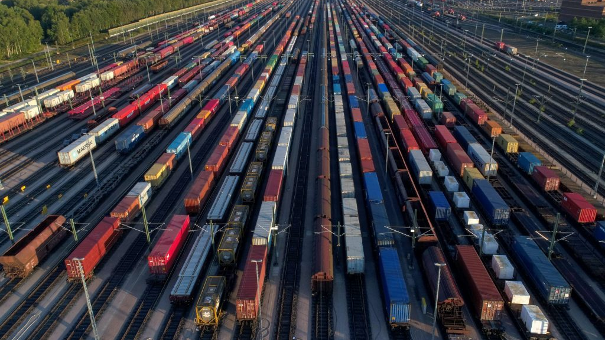

Train Path Request Fulfilment Prediction midterm meeting
Advanced Data Science for TTE (CIEM6302)
Quinten Schimmel - 5266408
Reno Heng Gong - 6215246
Rosanne de Jong - 5374588
Wendy Chi - 5340942

Slide 2
Problem description
Train path request process
Insight planning process
Positive response expectation
Submission with probability of fulfillment

Slide 3
Planning
Relevant?

Slide 4
How can a data-driven model be used to predict the likelihood that a train path request by an operator will be granted by ProRail based on historical data?

Slide 5
How can a data-driven model be used to predict the likelihood that a train path request by an operator will be granted by ProRail based on historical data?
How does time tolerance (earliest and latest preferred departure) affect the probability?
How good is the match between the request of the operator and the response of ProRail?
Do route structure and stabling/service needs influence outcomes?
Are operator, planning phase, and request timing (hour/day/week) predictive?
Difference between operation moment (day) and request timing

Slide 6
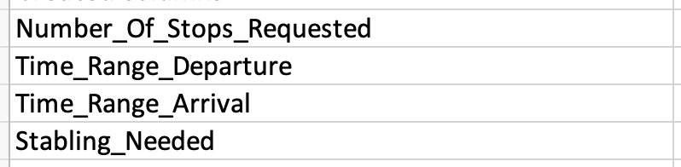
Data cleaning
Rows
Use only reactions: AANGEBODEN and GEEN_AANBIEDING_MOGELIJK
Use only Ad_HOC requests
Use only NEW request
Columns
Keep required columns based on research questions
Create additional columns
Numerical data
How many data points - how many after cleaning

Slide 7
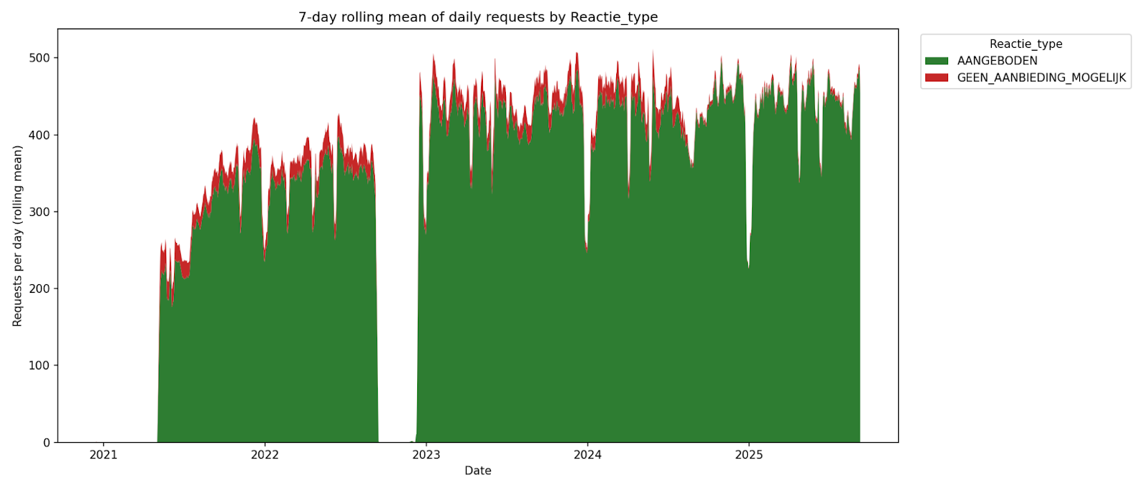

Slide 8
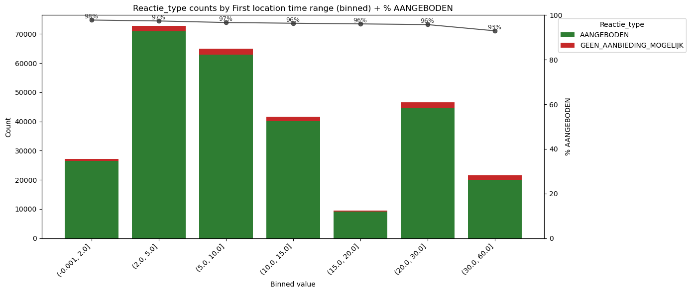
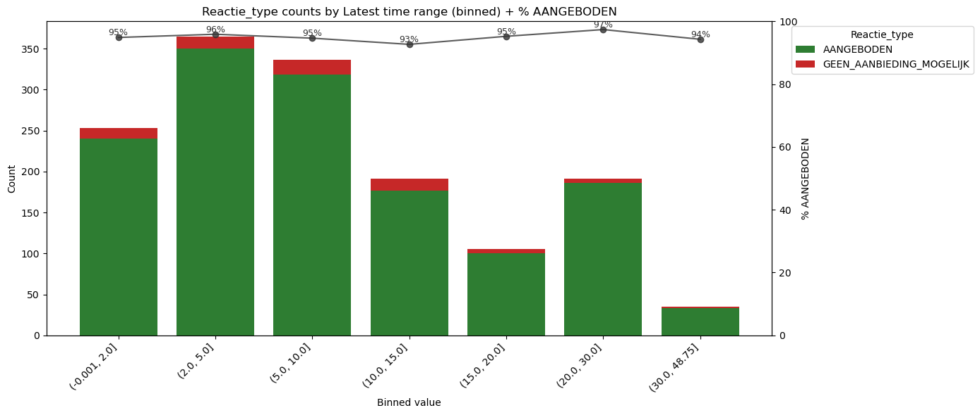
Data
How does time tolerance (earliest and latest preferred departure) affect the probability?

Slide 9
Data
How good is the match between the request of the operator and the response of Prorail?
More feature engineering needed

Slide 10
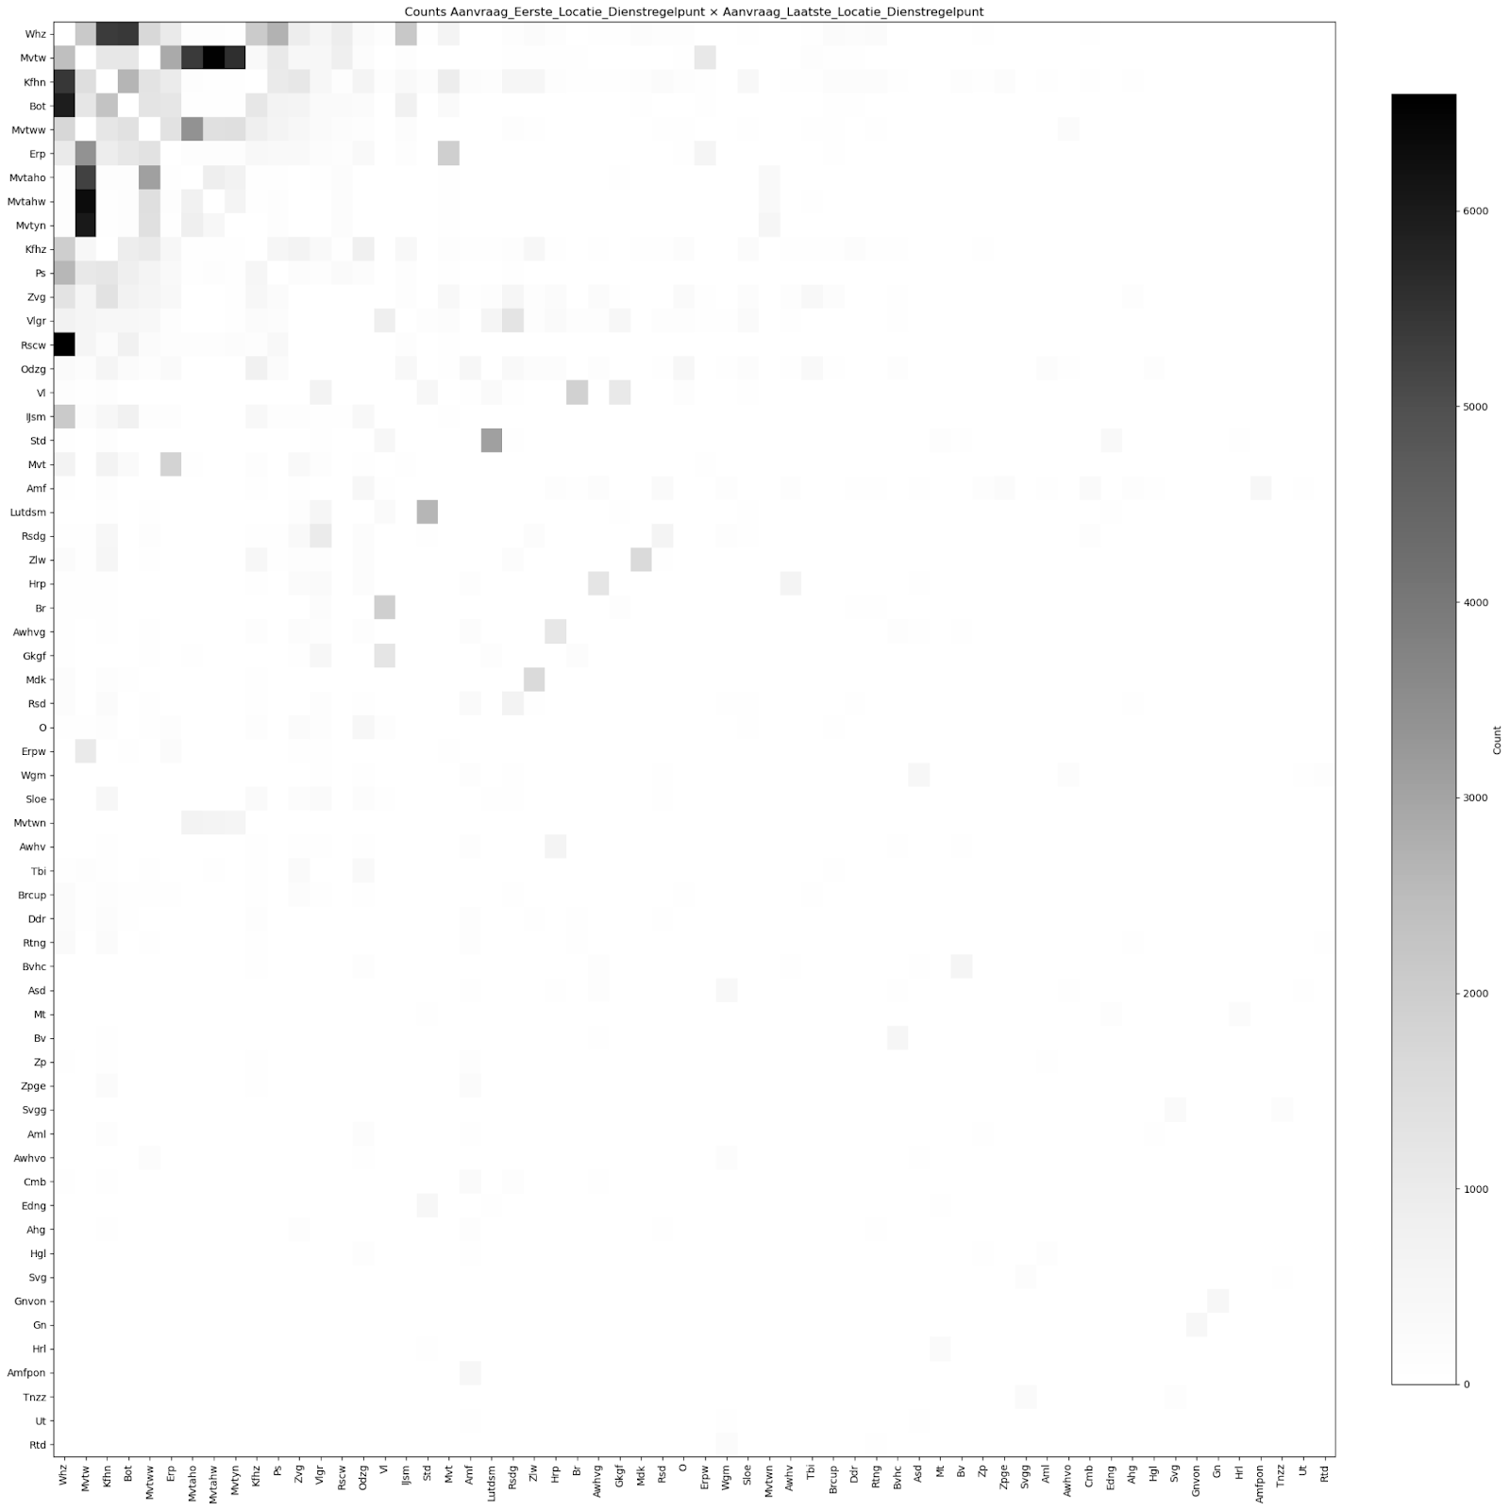
Data
Do route structure and stabling/service needs influence outcomes?
Absolute counts
Kijfhoek Noord, Botlek, Railservice center Waalhaven - Waalhaven Zuid
Maasvlakte - Maasvlakte

Slide 11
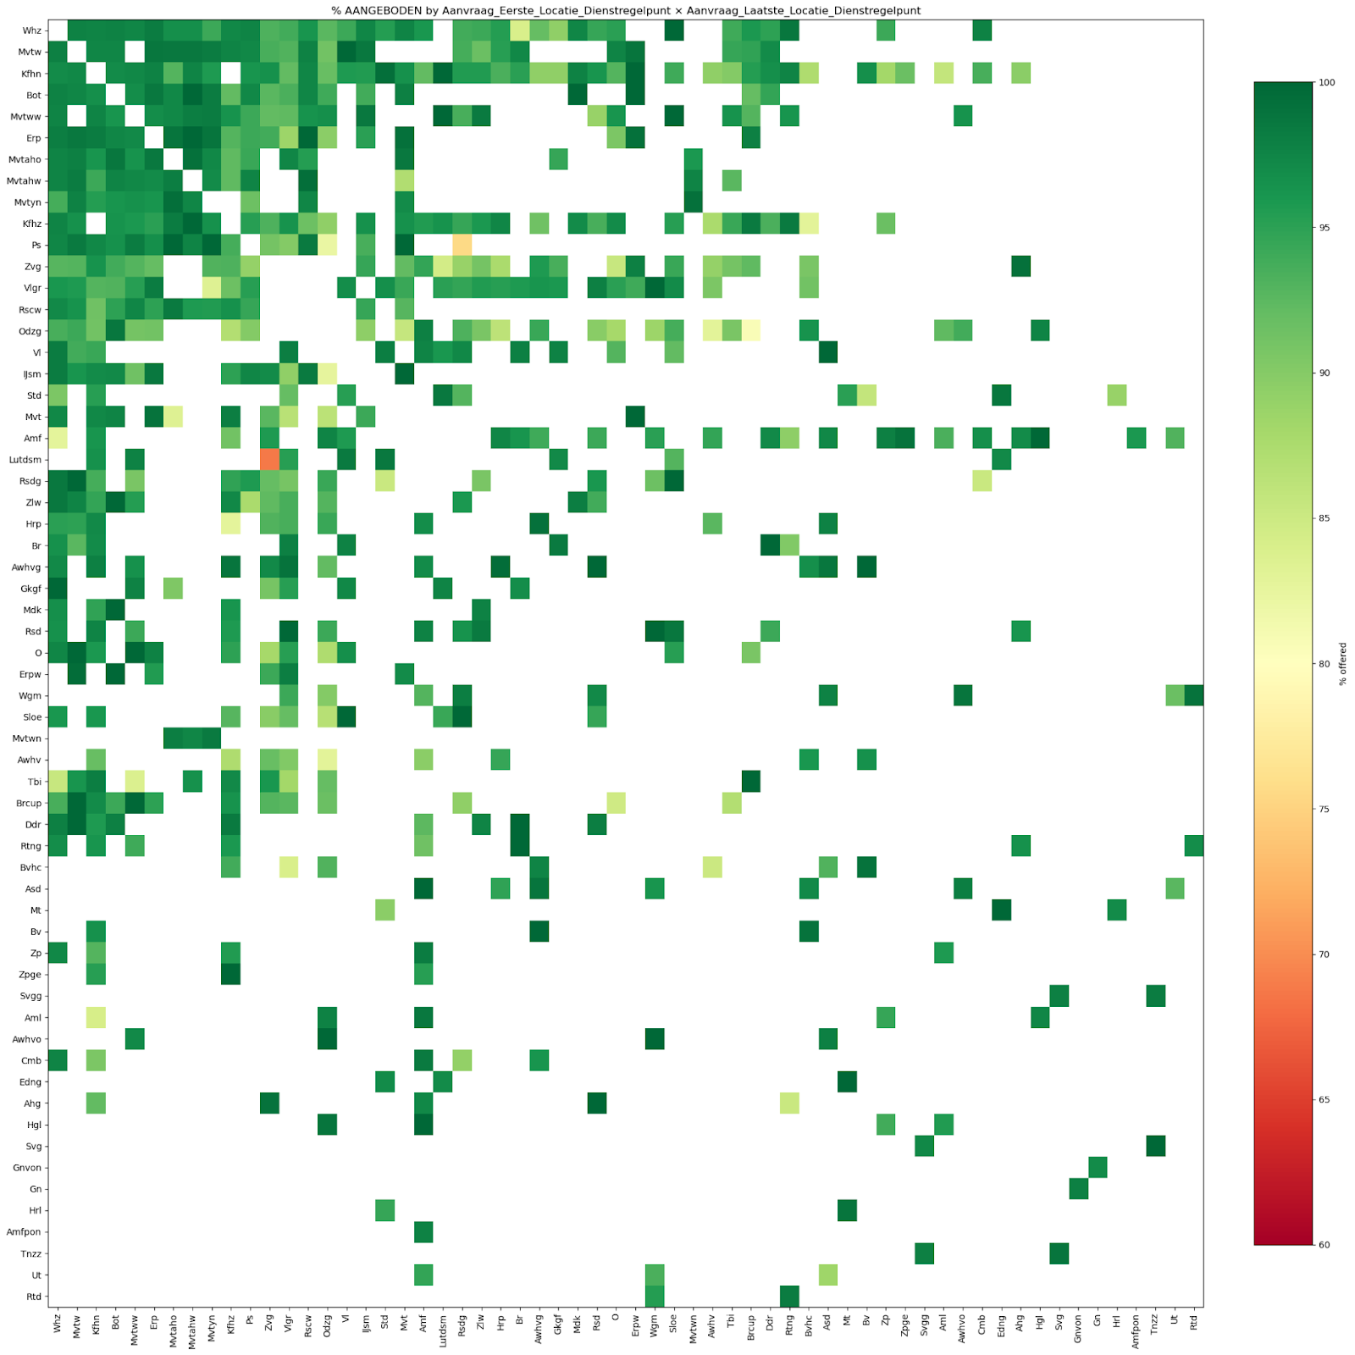
Data
Do route structure and stabling/service needs influence outcomes?
Relative counts: Surprising
Lutterade DSM - Zevenaar grens

Slide 12
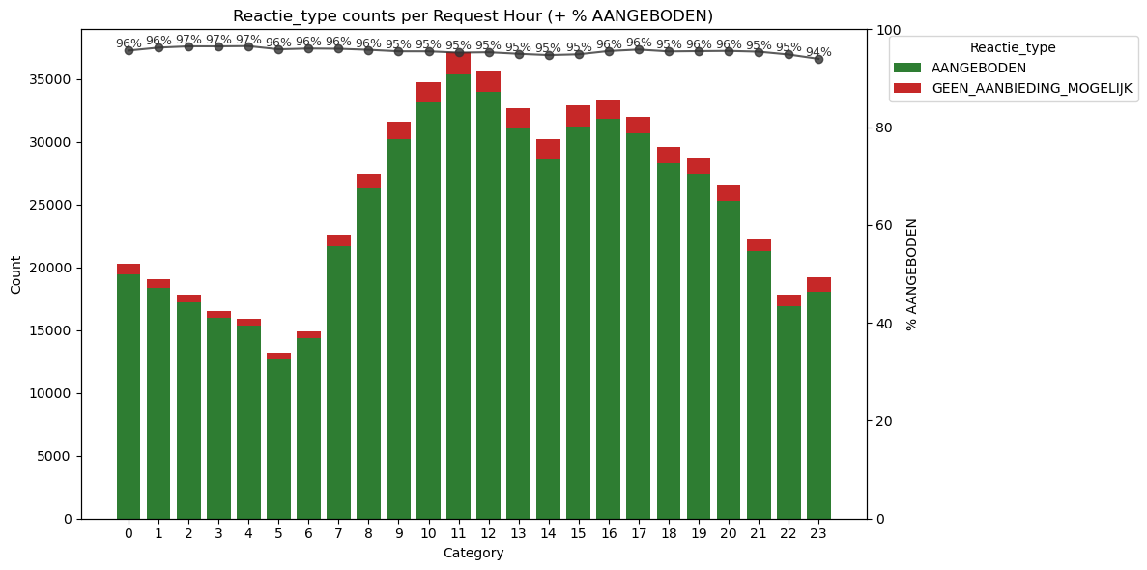
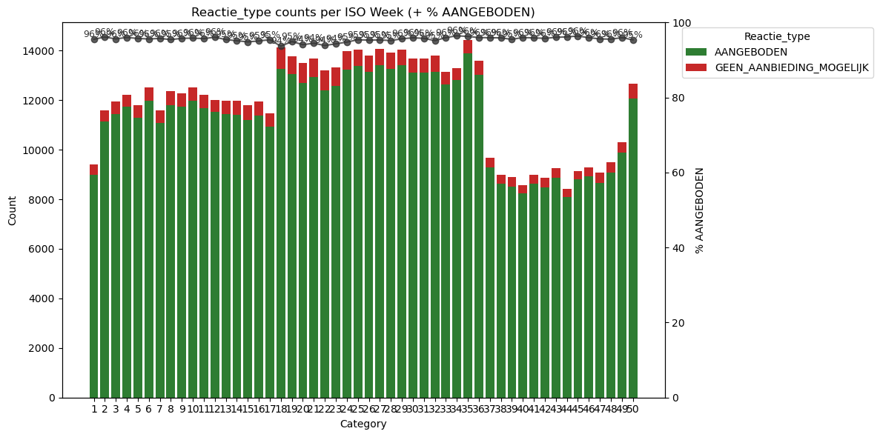
Data
Are operator, planning phase, and request timing (hour/day/week) predictive?
Hour: Absolute numbers increase after 6 in the morning and decrease after 16 pm.
Week: Significant increase from the start of the , few requests during Christmas break

Slide 13
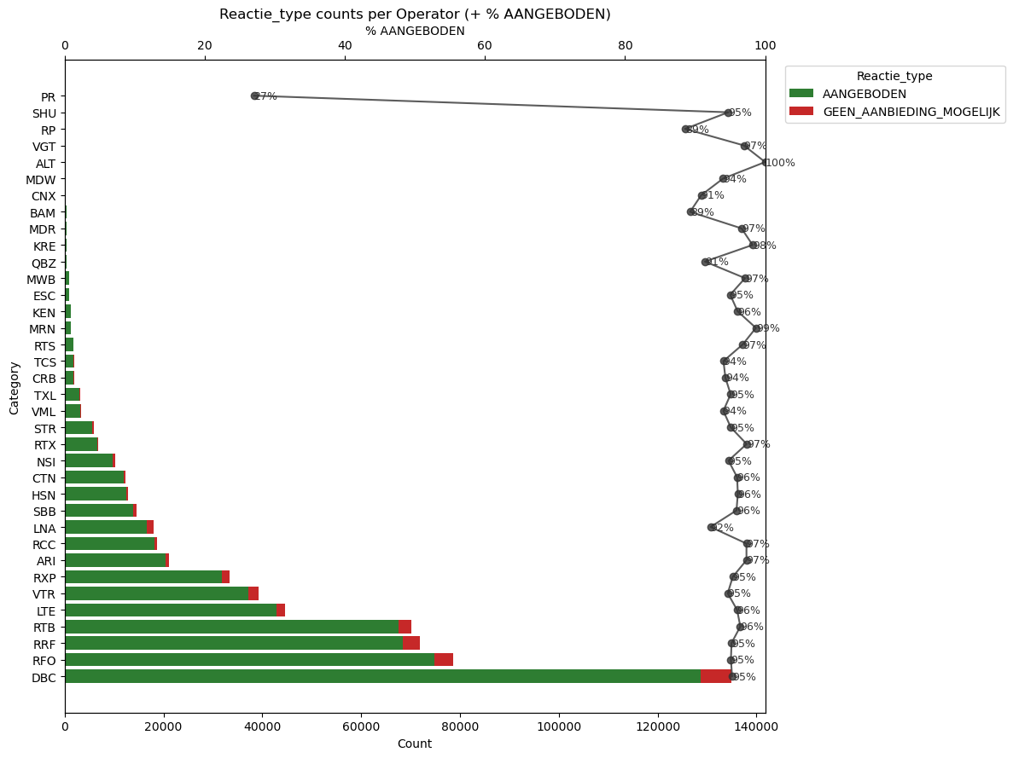
Data
Are operator, planning phase, and request timing (hour/day/week) predictive?

Slide 14
Data
Difference between operation moment (hour) and request timing

Slide 15
Possible solutions
Linear regression

Slide 16
Demo
Prediction example

Slide 17
Process
How did we work?
What went wrong?
Wrong dataset
What do we consider for the future?

Slide 18
Next steps
Focus on rejected requests
Our questions

Slide 19
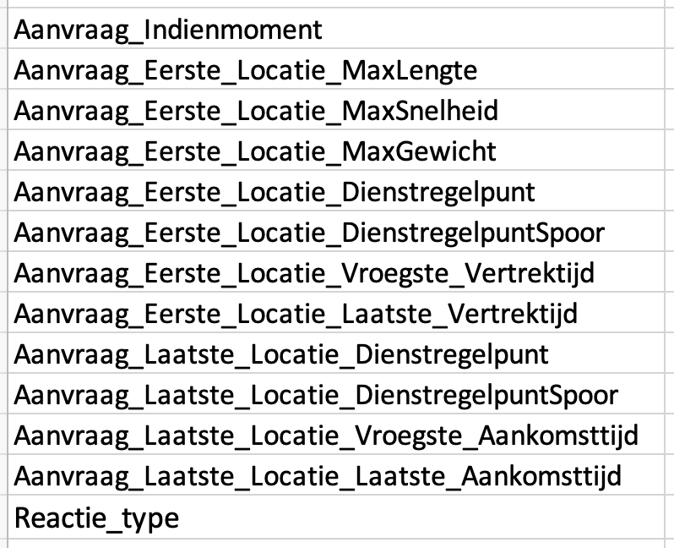
Appendix
Used columns

