Slide 1

NutriMetrics Team 6

Slide 2
Introduction
The Problem – The United States has been having an ongoing health epidemic with the rapidly rising obesity rates. There has been a lack of resources to show how locality could be affecting these rates.
Our Goal- For NutriMetrics, the primary objective is to efficiently organize information regarding the accessibility of healthy food throughout each state and its correlation with obesity rates.
The Database- By serving as a centralized hub, the system aims to offer a seamless resource for officials seeking insights into strategically addressing obesity hotspots through the expansion of food access

Slide 3
Glossary
• County – County Name
• Population – The Total Count from the 2010 Census
• State – State Name
• Housing Data (Residing in Group Quarters) – Count of Population Residing in Group Quarters
• Housing Data (Total Housing Units) – Occupied Housing Unit Count from 2010 Census
• Vehicle Access – Housing Units without Vehicles Beyond ½ Mile, 1 Mile, 10 Miles, and 20 Miles
• Low Access Numbers
o Children – Population of Children Beyond ½ Mile, 1 Mile, 10 Miles, and 20 Miles
Low Income – Low Income Beyond ½ Mile, 1 Mile, 10 Miles, and 20 Miles
o Seniors – Senior Population Beyond ½ Mile, 1 Mile, 10 Miles, and 20 Miles
o Total – Total Population Count Beyond ½ Mile, 1 Mile, 10 Miles, and 20 Miles

Slide 4
Goals & Business Requirements
1. Comprehensive Database Management System:
Develop a robust and scalable nationwide database management system capable of consolidating information on food accessibility and obesity rates across all states.
2. User-Friendly Interface:
Design an intuitive and user-friendly interface accessible to both health officials and the general public, ensuring ease of use and efficient data retrieval.
3. Data Integration:
Implement mechanisms for seamless integration of diverse data sources, including obesity rates and geographic proximity to local shopping centers, to provide a holistic overview of food accessibility.
4. Real-time Updates:
Enable real-time updates to ensure that the database remains current, reflecting the latest information on food availability and obesity trends across different regions.
5. Geospatial Analysis:
Incorporate geospatial analysis capabilities to visualize and analyze the proximity of the population to local shopping centers, facilitating targeted interventions in areas with limited healthy food access.

Slide 5
Goals & Business Requirements Cont.
6. Data Privacy and Security:
Implement stringent data privacy and security measures to safeguard sensitive health information, complying with industry standards and regulations.
7. Customized Reporting:
Provide customizable reporting features to allow health officials to generate tailored reports, enabling them to identify critical areas for intervention and resource allocation.
8. Scalability and Accessibility:
Design the system to be scalable to accommodate future expansions and accessible from various devices, ensuring widespread availability and usability for both officials and the public.
9. Collaboration Capabilities:
Incorporate collaborative functionalities, allowing health officials to share insights and best practices, fostering a community-driven approach to addressing obesity challenges.
10. Training and Support:
Develop comprehensive training programs and ongoing support systems to ensure that users, including health officials and the general public, can maximize the benefits of the Food Access Portal System effectively.

Slide 6
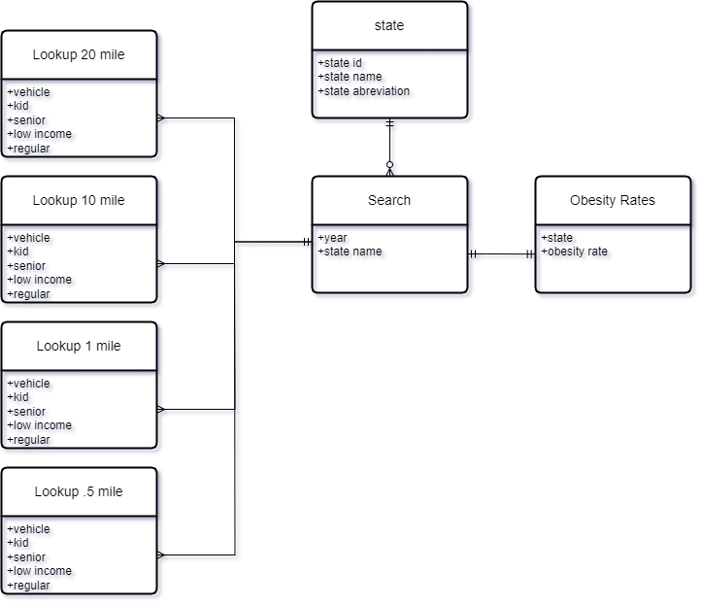
Conceptual Model

Slide 7
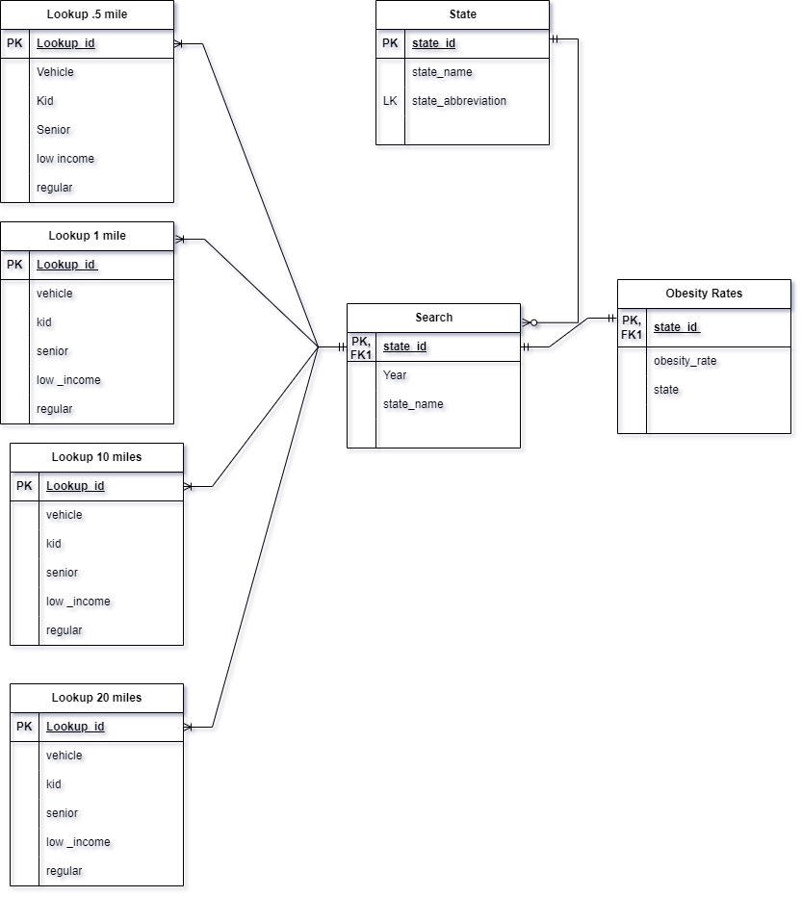
Logical Model

Slide 8
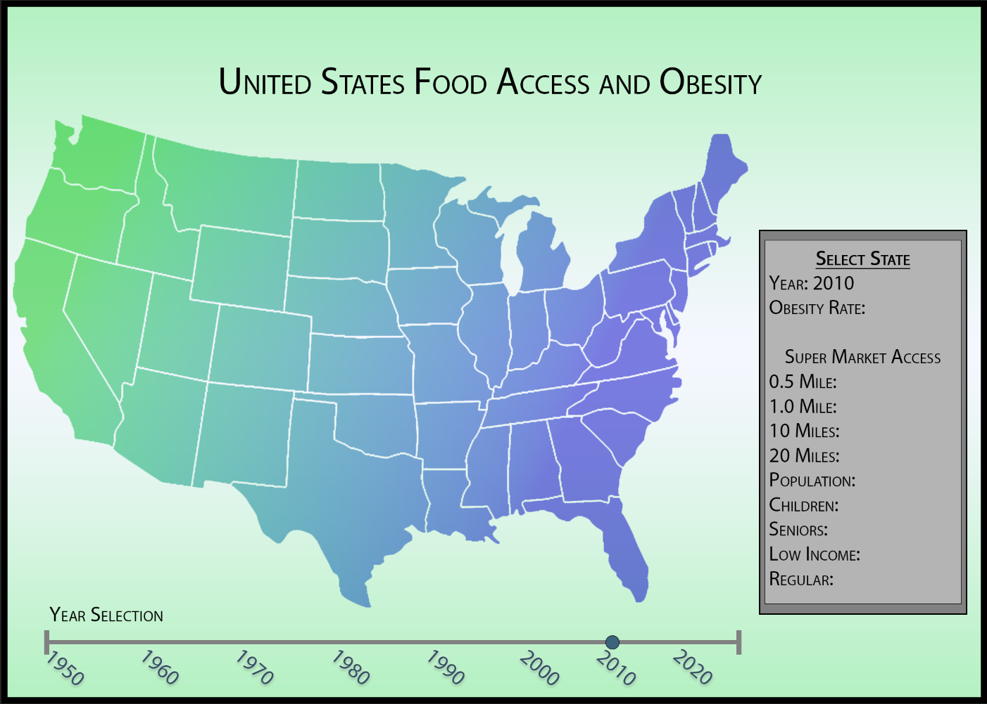
Sample In

Slide 9
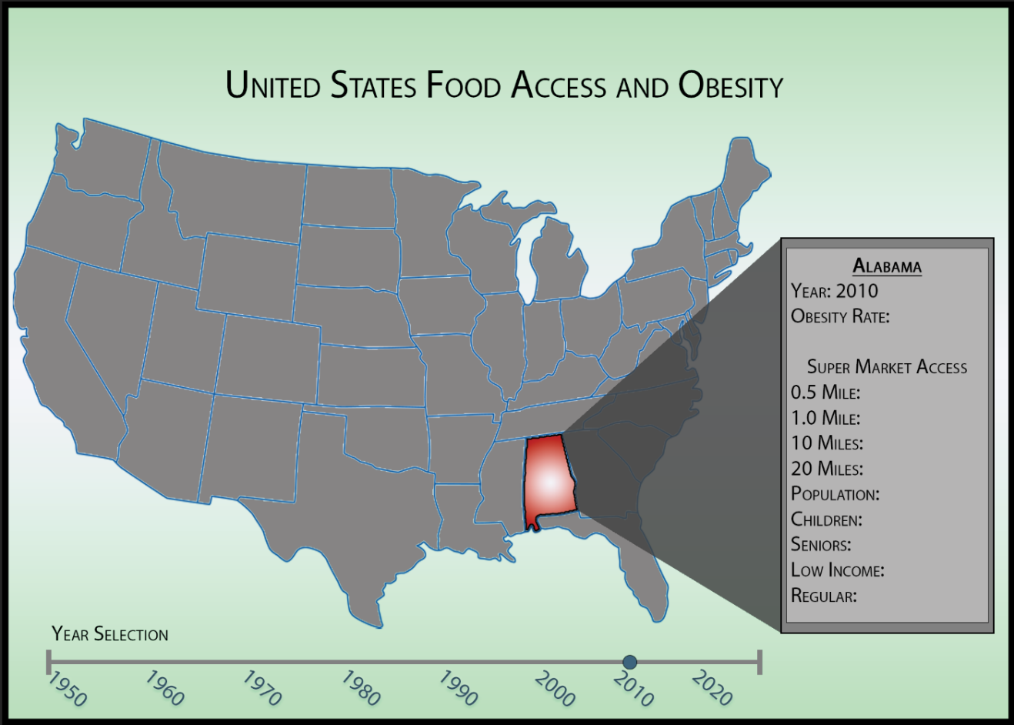
Sample Out

Slide 10
Answered Data Questions
How would you join and display all relevant information as per the graphical interface shown in figure 4?
How would you calculate obesity percentage given a state with more than 30% going by population?
How would you display the correlation between vehicle access within 10 miles of a supermarket and state obesity percentage from each state?
How would you display the 5 worst states with food shortages specifically regarding children within 10 miles of a supermarket?
How would you implement a trigger to enforce population constraints? i.e. when inserting new data how do you ensure the population won’t decrease?
How would you implement a function to get obesity and population info from a given state by abbreviation?

Slide 11
Conclusion
Key features will include obesity prevalence data and proximity analysis, indicating how closely the majority of the population resides in relation to local shopping centers.
This initiative is poised to empower decision-makers with valuable data for informed policy interventions and promote healthier lifestyle choices among the public.

