Slide 1
Insurance profiling
Valknut solutions

Slide 2
Recess sprint details:
Meeting with Telesure (our client’s client)
Social media parameters research documentation as per client’s request
Sprint planning meeting to discuss project changes
Follow up meeting after completion of previous sprint and to receive next sprint backlog
Collaborative pair programming for 5 days as a team in one location
Weight estimation of sprint backlog
Multiple stand up meetings per day

Slide 3
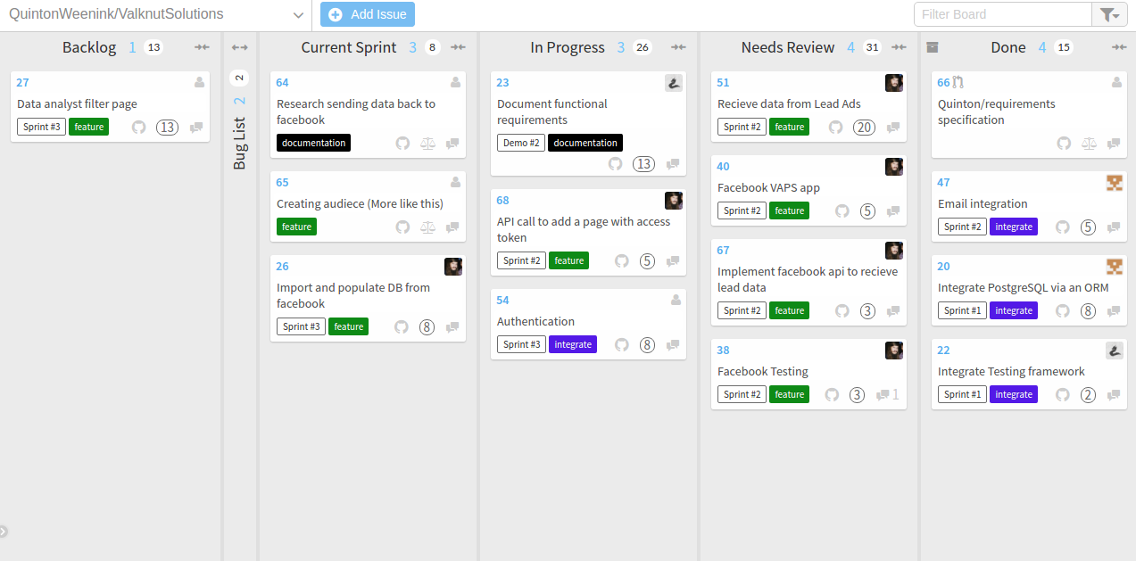
Agile board:
*insert waffle board*

Slide 4
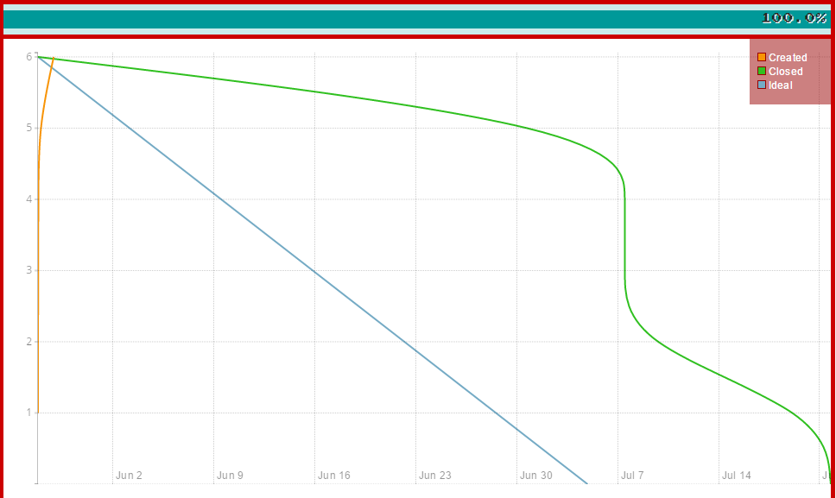
Sprint #1

Slide 5
Sprint #2
*insert burndown of 2*

Slide 6
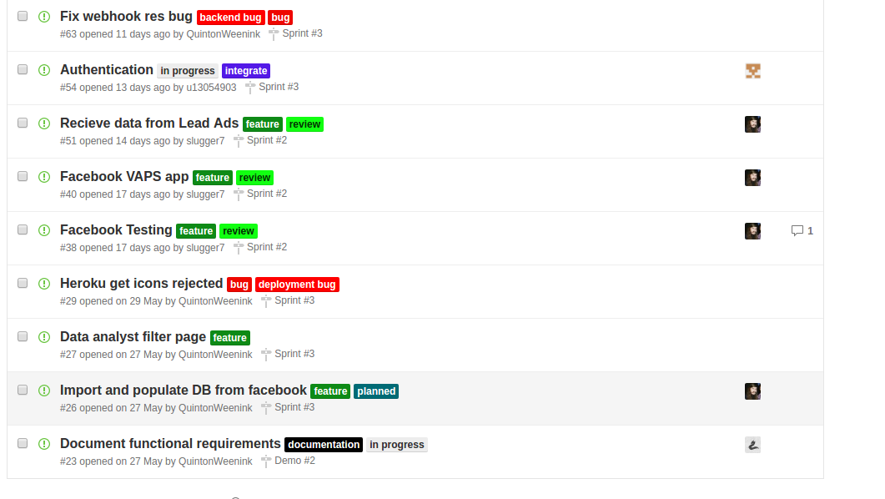

Slide 7
List of features added in past sprints
Database integration via Sequelize using postgresql
Lead ad ( Kevin explanation… pages,ads etc)
Implementation of RESTful API for front-end Angular and backend API calls
Integration of the testing framework Mocha with some route unit tests? -- edit...
Implementation of email functionality
Deployment to live server hosted on the Heroku platform
Version control branching
Update of Functional requirements document (added use cases etc.. (Quinton))

