Slide 1
Insurance profiling
Valknut solutions

Slide 2
Recess sprint details:
Meeting with Telesure (our client’s client)
Sprint planning meeting to discuss project changes
Follow up sprint after completion of previous sprint and to receive next sprint backlog
Collaborative pair programming for 5 days as a team in one location
Weight estimation of sprint backlog
Multiple standups per day – Discuss certain problems as a team

Slide 3
Agile board:
*insert waffle board*

Slide 4
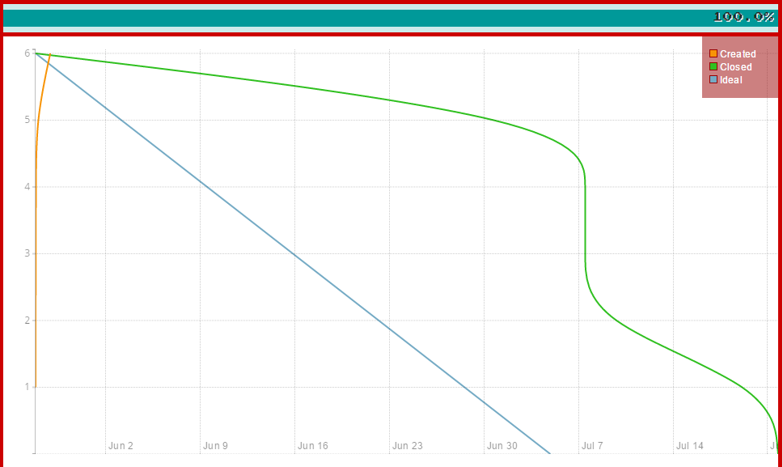
Burndown of Sprint #1

Slide 5
Burndown of Sprint #2
*insert burndown of 2*

Slide 6
Git issue list
*insert list of issues*

Slide 7
Commits for June recess
*insert git graph for commits*

Slide 8
List of features added in past sprints
Database integration via Sequelize using postgresql
Lead ad ( Kevin explanation… pages,ads etc)
Api integration ( backend changes, frontend changes etc)
Testing integration (use of mocha etc..)
Email integration functionality
Update of Functional requirements document (added use cases etc.. (Quinton))

