Slide 1
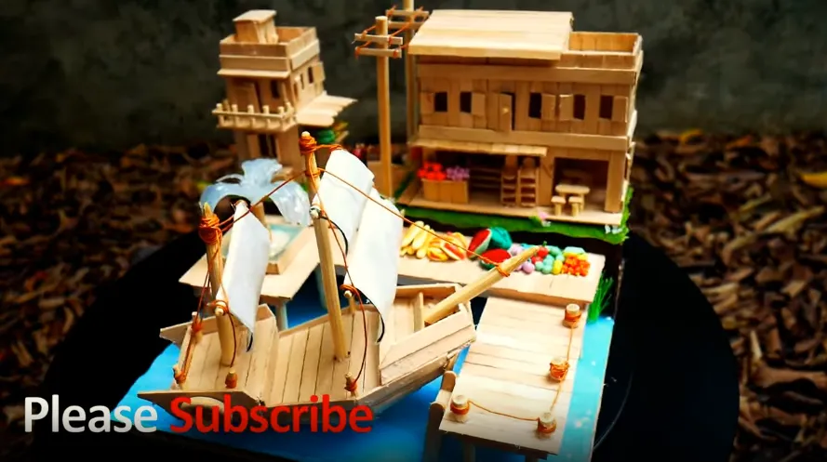
Can you build this with popsicle sticks?

Slide 2
Use Decomposition!
To build that model, we’ll need...
  Small building
  Large building
  Base
  Ship

Slide 3
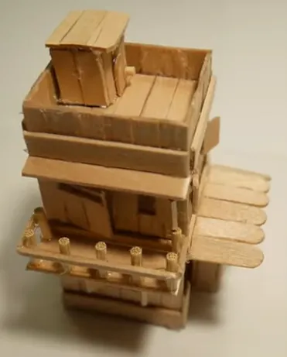
Can you build the small building?

Slide 4
Use Decomposition again!
To build the small building, we’ll need...
  Top floor
  Second floor
  Ground floor

Slide 5
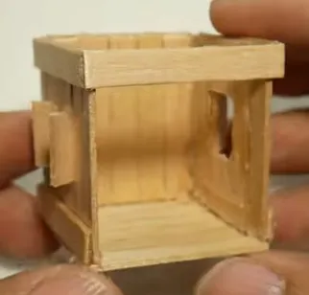
Can you build the ground floor?

Slide 6
Use Decomposition again!
To build the ground floor, we’ll need...
  3 walls
  Floor

Slide 7
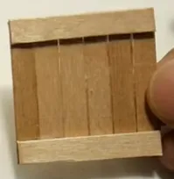
Can you build the wall?
Sure you can! That’s easy!

Slide 8
Decomposition turns a big problem into many smaller parts
Small problems are easy to solve
Solve all the small problems and the big problem will be solved too!

