Slide 1
Crossfilter and DC.js
bard.hanssen@sintef.no

Slide 2
Crossfilter
"A JavaScript library for exploring large multivariate datasets in the browser"
Sorting of data using dimensions and groups
Filtering data across dimensions

Slide 3
Dimensions
Data values must be naturally-ordered values (numbers, strings, dates, etc.)
Values cannot be NaN or undefined
var crossfilterData = crossfilter(data); // Create a crossfilter object
var dailyDimension = crossfilterData.dimension(function(d) { return d3.time.day(d.dateTime) });
var nameDimension = crossfilterData.dimension(function(d) { return d.name });

Slide 4
Groups
Groups dimension data
Does not observe filters on parent dimension
var nameCountGroup = nameDimension.group().reduceCount(); // Count instances of dimension value
var nameSumGroup = nameDimension.group().reduceSum(function(d) { return d.quantity }); // Sum specified value by dimension
var nameAverageGroup = nameDimension.group().reduce( // custom grouping that calculates average of a value
function(p, v) { // adding a value to group
p.count ++;
p.total += +v. quantity;
p.average = p.count != 0 ? (p.total / p.count) : NaN;
}, function(p, v) { // removing a value from group
p.count ++;
p.total += +v. quantity;
p.average = p.count != 0 ? (p.total / p.count) : NaN;
}, function() { // initial object
return { count: 0, total: 0, average: 0 };
});

Slide 5
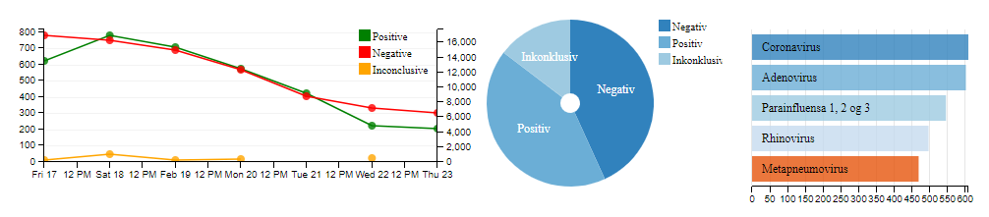
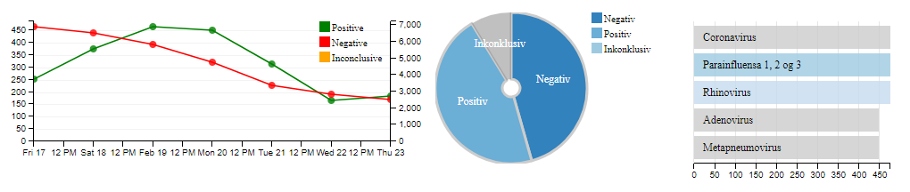
DC.js
Interactive Charting library
Powered by D3 and Crossfilter
Allows for efficient exploration
of data using visual analytics

Slide 6
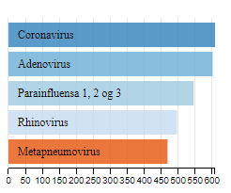
Creating charts
Creating a simple row chart
var nameChart = dc.rowChart("#name-chart-container");
nameChart
.width(300)
.height(200)
.dimension(nameDimension)
.group(nameGroup)
.elasticX(true)
.render();

Slide 7
Useful functions
Charts:
.label() // Set labels of charts (Rendered name of pie chart slices, rows in row charts, etc.)
.title() // Set tooltip of charts (Information shown on hover)
.valueAccessor() // Set the function used to access values from the crossfilter group (pie chart slice size, y-axis value in line charts, x-axis value in row charts, etc.)
Required if grouping function returns an object
.keyAccessor() // Set the function user to access keys from crossfilter group. (pie chart slice names, x-axis position in bar chart, etc.)
.on() // Perform actions when specified events occur.
General:
dc.renderAll() - Renders all current charts
dc.filterAll() - Removes all current filters

Slide 8
Useful links
Crossfilter GitHub:
https://github.com/crossfilter/crossfilter
Crossfilter API docs:
https://github.com/crossfilter/crossfilter/wiki/API-Reference
DC.js GitHub:
https://dc-js.github.io/dc.js/
DC.js API docs:
http://dc-js.github.io/dc.js/docs/html/
DC.js examples:
http://dc-js.github.io/dc.js/examples/
D3:
https://d3js.org/
D3 API docs:
https://github.com/d3/d3/blob/master/API.md

