Slide 1
SUMMER RESEARCH PROGRAM · ÖZYEĞİN UNIVERSITY
29.07.2026
RESEARCH PROJECT PRESENTATION
One network, many pendulums
A physics-informed neural network that learns Model-Predictive Control for a double inverted pendulum — and, before the rig was finished, showed that the motor gearing made balancing physically impossible.
Çağlar Ayyıldız · Student Burçin Ünlü · Mentor
01
Theory
02
Simulation
03
Application
04
Prototype
Notes:
Title, one-line summary, introduce yourself and your mentor Burçin Ünlü. The one-liner already signals the headline: the simulation caught an infeasible hardware design before the rig was built. Under 30 seconds.

Slide 2
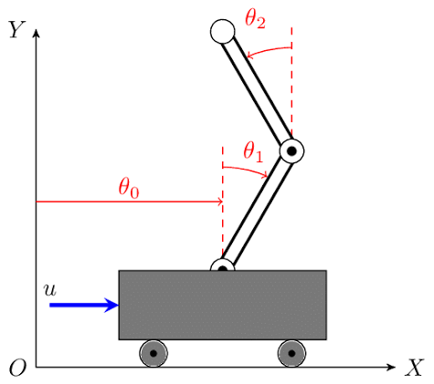
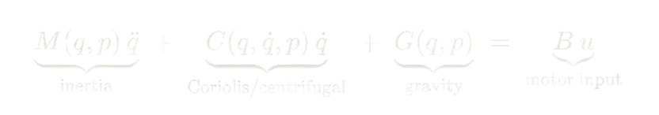

01 · THEORY
Theoretical foundation
What phenomenon are you studying, and what question are you asking?
THE PHENOMENON — WHY IT MATTERS
A cart carrying two stacked pendulums is unstable and underactuated: one motor must fight gravity on two links at once. It is the classic hard testbed for nonlinear control.
GOVERNING EQUATION
M(q,p) q̈ + C(q,q̇,p) q̇ + G(q,p) = B u
RESEARCH QUESTION
Euler–Lagrange equations of motion
Can a single network, given the pendulum's physical parameters (m₁,m₂,l₁,l₂), learn an MPC-equivalent controller that generalizes to pendulum shapes never solved during training, without retraining?
q = [ s, θ₁, θ₂ ] state: cart pos. [m], link angles from vertical [rad]
u motor command — voltage [V], bounded to the ±24 V bus
WHAT IS ALREADY KNOWN
p = [ m₁, m₂, l₁, l₂ ] masses [kg], lengths [m] — the network's inputs
Nonlinear MPC balances such pendulums well but must be re-solved for every new configuration; imitation learning (DAgger, Ross 2011) distills a controller into a fast network, and physics-informed NNs (Raissi 2019) forces the network to stay in the boundaries of physics, this project combines all three.
M, C, G inertia / Coriolis / gravity; — only the cart is driven
SUMMER RESEARCH PROGRAM · Özyeğin University
02 / 05
Notes:
Say it as F=ma for the whole system: inertia, its own swinging, and gravity on the left; one motor on the right. Point at B=[1,0,0] — the motor only touches the cart, that's what underactuated means and why it's hard. Then: because the equation is differentiable, it becomes the simulator everything else is built on.

Slide 3
02 · SIMULATION / 03 · APPLICATION
Simulation and application
How did you model it, and what did you build?
02 · SIMULATION
03 · APPLICATION
Method & tools
PyTorch differentiable dynamics + CasADi/IPOPT MPC teacher; RK4 integration
What the tool does
6 states
+ 4 params
→
one voltage
Training signals
L_data (imitate MPC) · L_physics (roll commands through the real dynamics) · L_barrier (limits) · L_EL (collocation), annealed data→physics
How to run it
Load the self-contained checkpoint, call model(state, params) each step. Swap in different (m, l) to control a new pendulum and it shouldn’t need a retraining.
Assumptions: MPC is ground truth · idealized friction
SUMMER RESEARCH PROGRAM · Özyeğin University
03 / 05
Notes:
Simulation: differentiable plant plus a CasADi MPC teacher, and four training signals — imitation plus three physics-based ones. Application: state plus physical parameters to one voltage in a single forward pass, ~26 thousand multiply-adds, which is why it fits an ESP32 and MPC does not.

Slide 4
04 · PROTOTYPE
Prototype and results
What did you build or measure, and what did you find?
THE FINDING
At first closed-loop evaluation failed for every controller including the MPC teacher. The cause was the physical limitations I was trying to set into physics because of my rig and with the correct changes I was able to solve the problem.
Cart-speed ceiling vs. ability to balance
Why: the gearing trades force for speed
closed-loop MPC teacher from near-upright, 3 initial conditions each (n=3)
GT2 pulley
cart v_max
force
accel
20-tooth (original)
0.40 m/s
173 N
115 m/s²
60-tooth (revised)
1.20 m/s
58 N
38 m/s²
SUMMER RESEARCH PROGRAM · Özyeğin University
04 / 05
Notes:
Lead with this: everything failed closed-loop, including the teacher. That looked like a broken project until the diagnostic — cart velocity pinned at exactly the motor's top speed in every failed run. Sweeping only the speed ceiling: at 0.4 m/s nothing balances, at 1.2 m/s it does. The gearing was the problem: 173 newtons to move a 1.5 kg cart is absurd overkill while the speed starves. The simulation caught an infeasible hardware spec before the rig was finished — that is the result.

Slide 5
CLOSING
Conclusions and next steps
WHAT WE FOUND
The pipeline runs end-to-end, and its most useful output was a hardware verdict: the 20-tooth gearing makes balancing infeasible; 60-tooth (1.2 m/s) lets the MPC teacher balance. At the corrected spec every config now solves — 200/200, zero dropped.
LIMITATIONS
The learned controller still does not balance every time. It holds the links near upright but drifts off the rail. DAgger cut validation error 31% without fixing it so imitation quality is not the bottleneck. The problem is physical rig.
REFERENCES
[1] Raissi, Perdikaris & Karniadakis — Physics-Informed Neural Networks, 2019
[2] Ross, Gordon & Bagnell — DAgger (imitation learning), 2011
[3] Andersson et al. — CasADi (nonlinear optimization / MPC), 2019
Thank you — questions?
caglarayyildiz08@gmail.com
SUMMER RESEARCH PROGRAM · Özyeğin University
Çağlar Ayyıldız · Mentor: Burçin Ünlü
05 / 05
Notes:
One honest finding, one limitation, one next step. The finding is the hardware verdict — the simulation earned its keep by catching an infeasible design before it was built. Then own the limitation without hedging: the learned controller does not balance yet, LQR beats it, and DAgger improving validation by 31% without changing closed-loop behaviour tells me the bottleneck is not imitation quality. That is a real diagnostic lead, not an excuse. End on it and invite questions.

