Slide 1
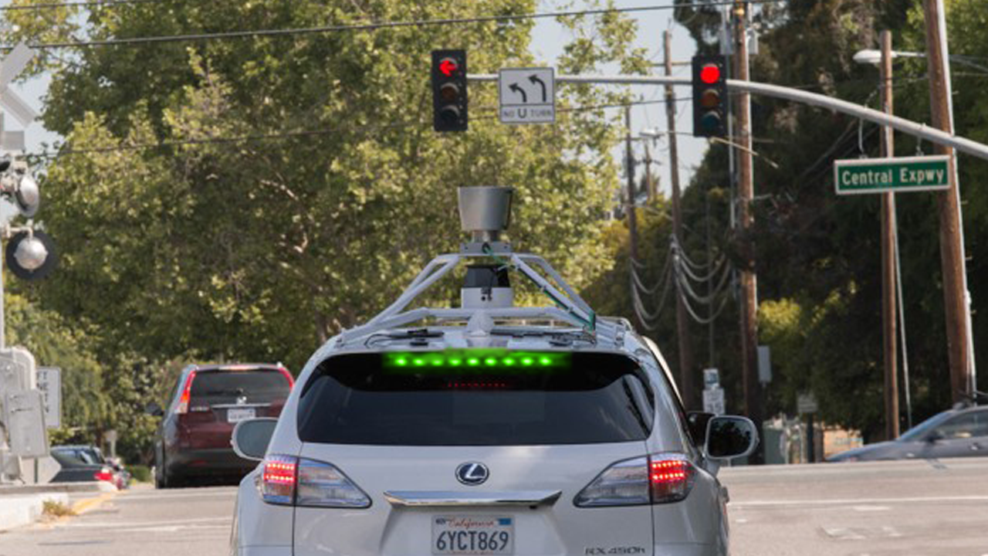
Join the green wave!
Smart cars as infrastructure

Slide 2
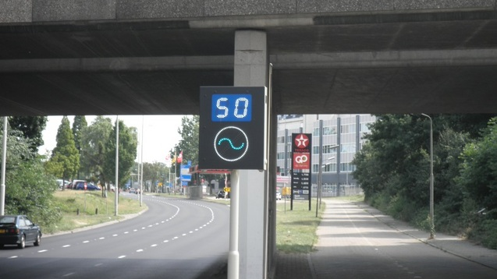
The green wave
Project ended in 2014

Slide 3
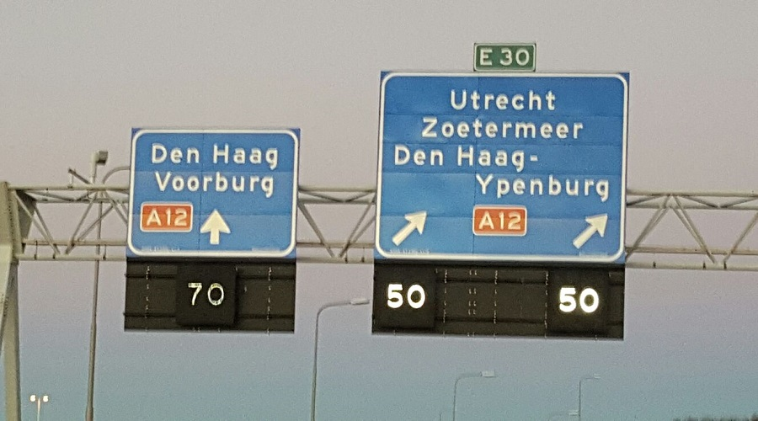
Matrix signs

Slide 4


Connected vehicles as free infrastructure!

Slide 5
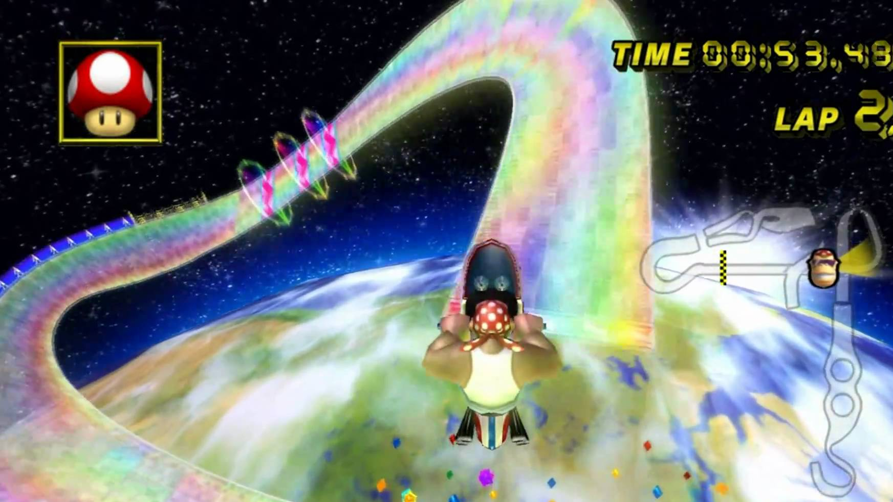
Join the golden wave
Efficient and green traffic
Everybody benefits
First implementation ready
Cheap
Great slogan

Slide 6
Stakeholders
Owners of connected vehicles
1
Rijkswaterstaat
2
Car manufacturers
3
Owners of “dumb” cars
4

Slide 7
Hacked this event
”Time to green”
LED strip for the car
Connection between them
Dynniq
Done!
API ready!

