Slide 1
Vehicles as infrastructure

Slide 2
Golden wave

Slide 3
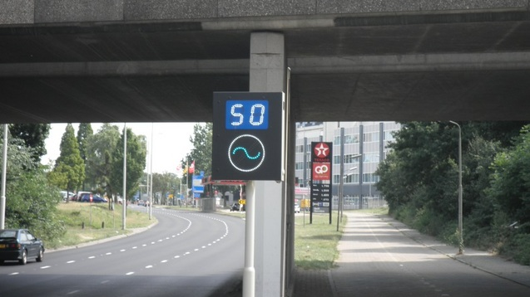
The green wave
Project ended in 2014

Slide 4
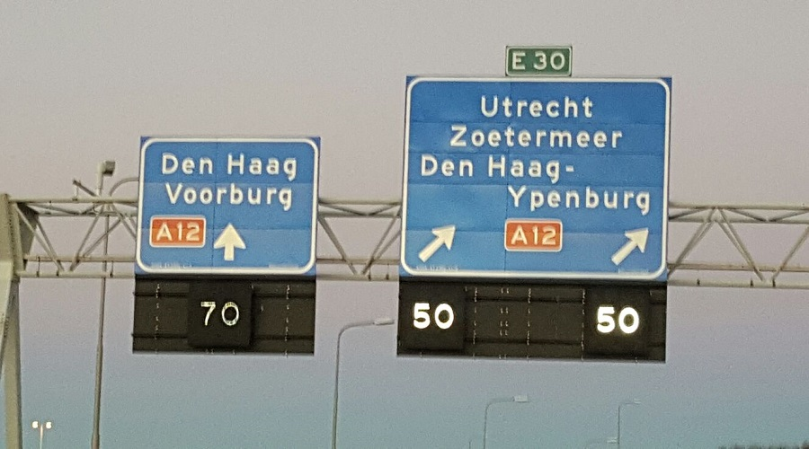
Matrix signs

Slide 5
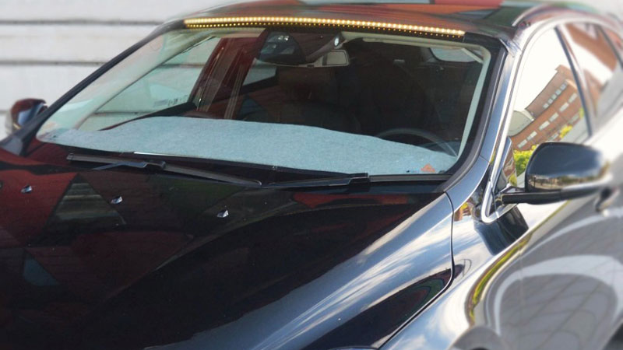
Autonomous vehicles serve “manual” drivers

Slide 6


Connected vehicles as free infrastructure!

Slide 7
Demonstration

Slide 8
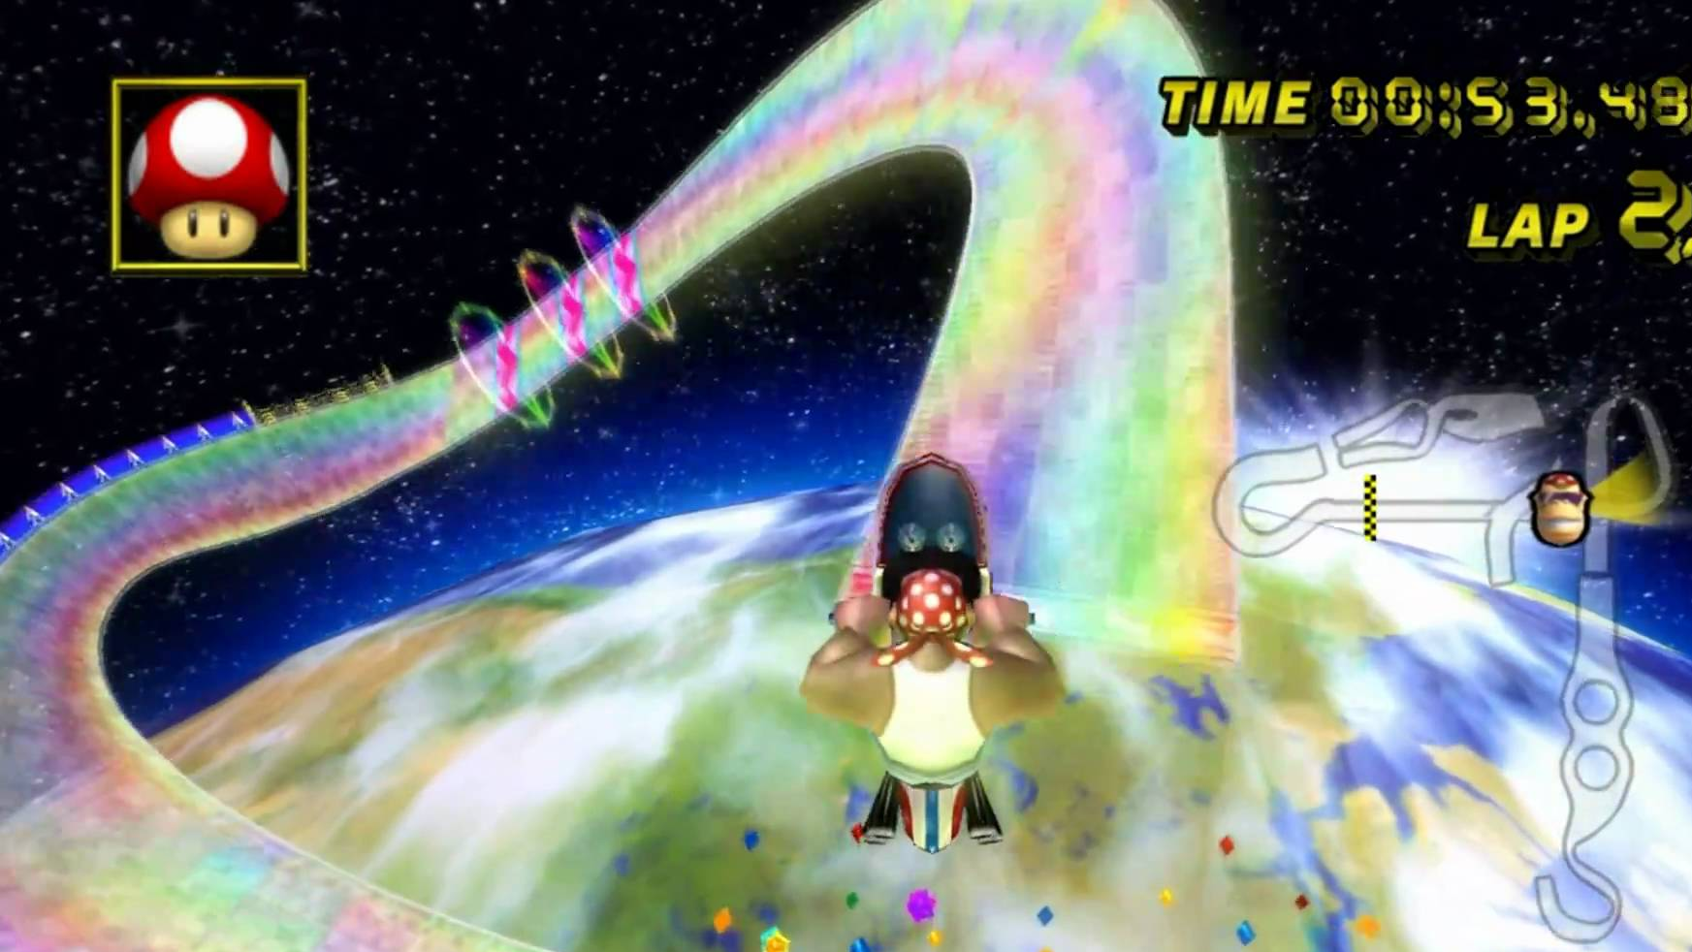
Join the golden wave
Efficient and green traffic
Everybody benefits
First implementation ready
Cheap

Slide 9
Stakeholders
Owners of connected vehicles
1
Rijkswaterstaat
2
Car manufacturers
3
Owners of “dumb” cars
4

Slide 10
Hacked this event
”Time to green”
LED strip for the car
Connection between them
Dynniq
Done!
API ready!

