Slide 1
American sign language recognition✌️
Project by Nagim Isyanbaev and Viktor Kovalev

Slide 2

Problem
Currently, the majority of deaf or hard of hearing individuals use sign language for communication. However, the most regular people are not familiar with sign language or have the time to learn it. And not everyone deaf or hard of hearing can write and read regular letters.

Slide 3
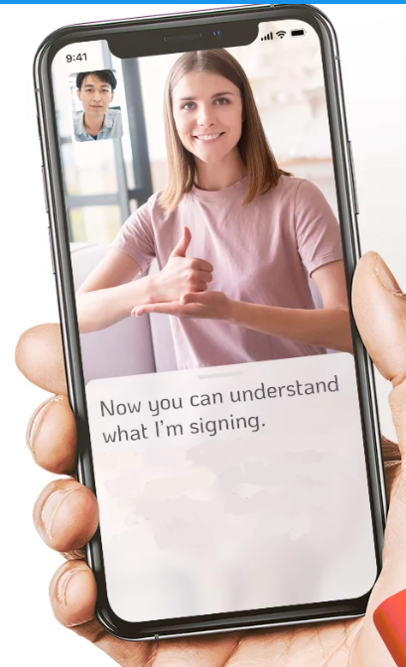
Solution
The solution will be an application or website with machine learning models that can translate SL to text in real-time, catering to the needs of those who require fast and accurate translation.

Slide 4
Data
We will utilize the WLASL (World Level American Sign Language) dataset, or a subset, to train our model. Additionally, we have the option to develop a custom dataset by recording videos.

Slide 5
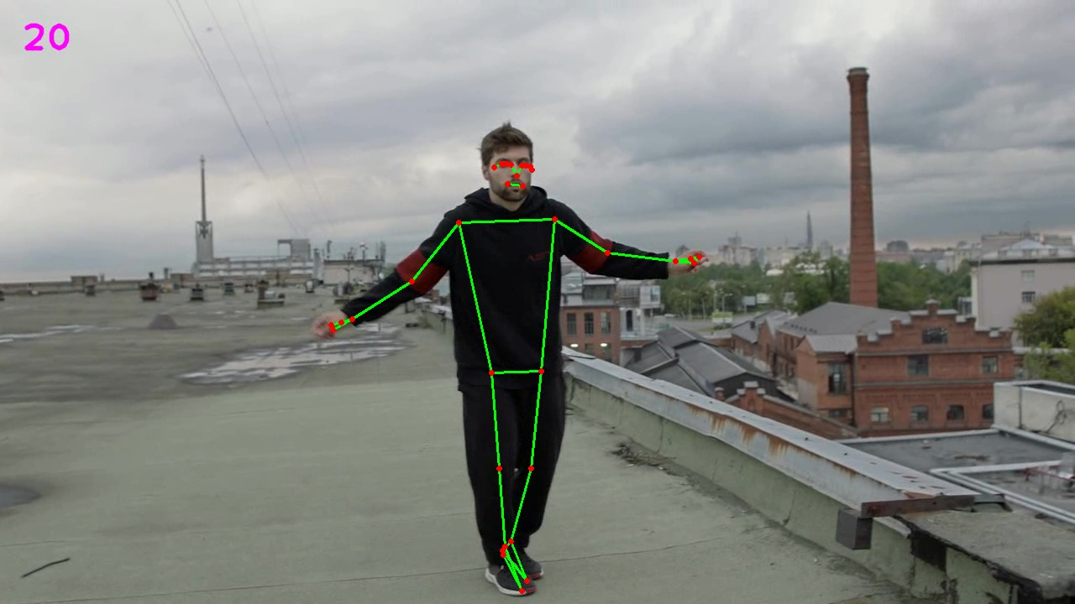
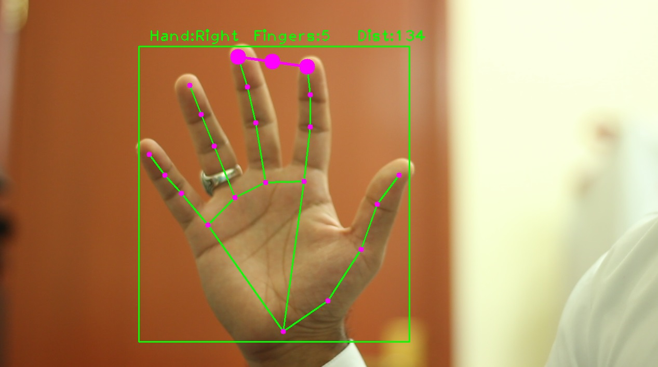
Model pipeline
Hands and pose recognition by MediaPipe
LSTM for sequence analysis
ANN for classification

Slide 6
Initial results
Now we will demonstrate our current result to you :)

Slide 7

Thank you for your attention!

