Slide 1
Impromptu meeting

Slide 2
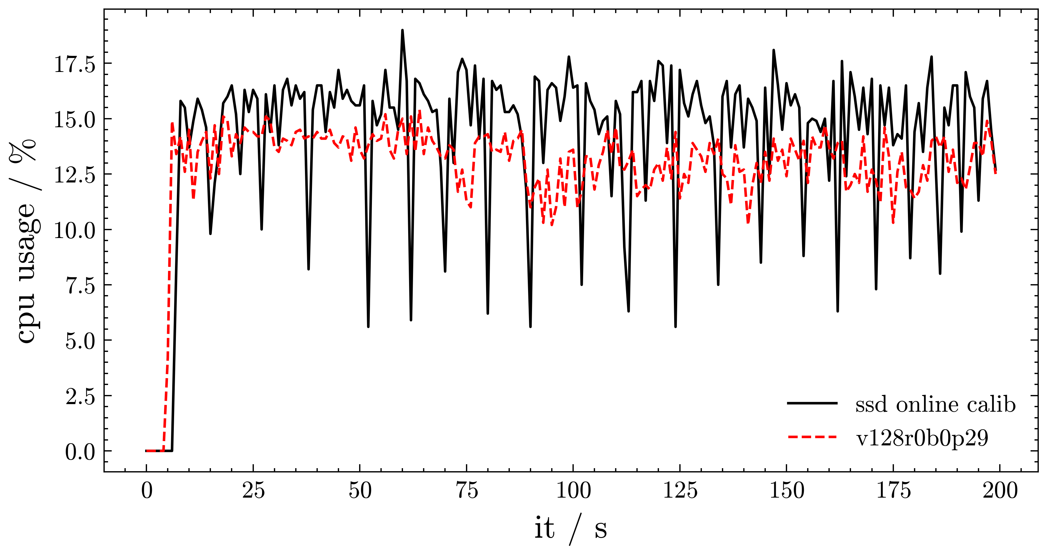
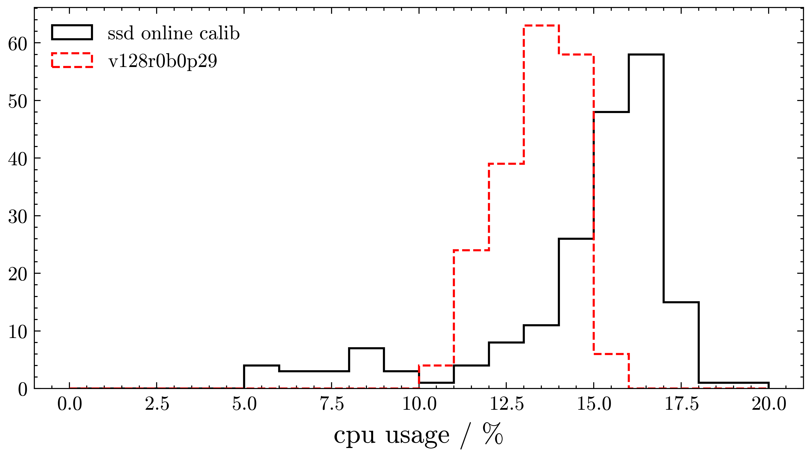
Possible FPGA trigger/counter
Move resource intensive tasks to FPGA
  Have counter that gives # of T70 events on FPGA-level
  3-fold coinc. of 1.75 VEM + 1-fold coinc. of 2.5 VEM (WCD)
  1-fold coinc. of 2.64 MIP (SSD)

Slide 3
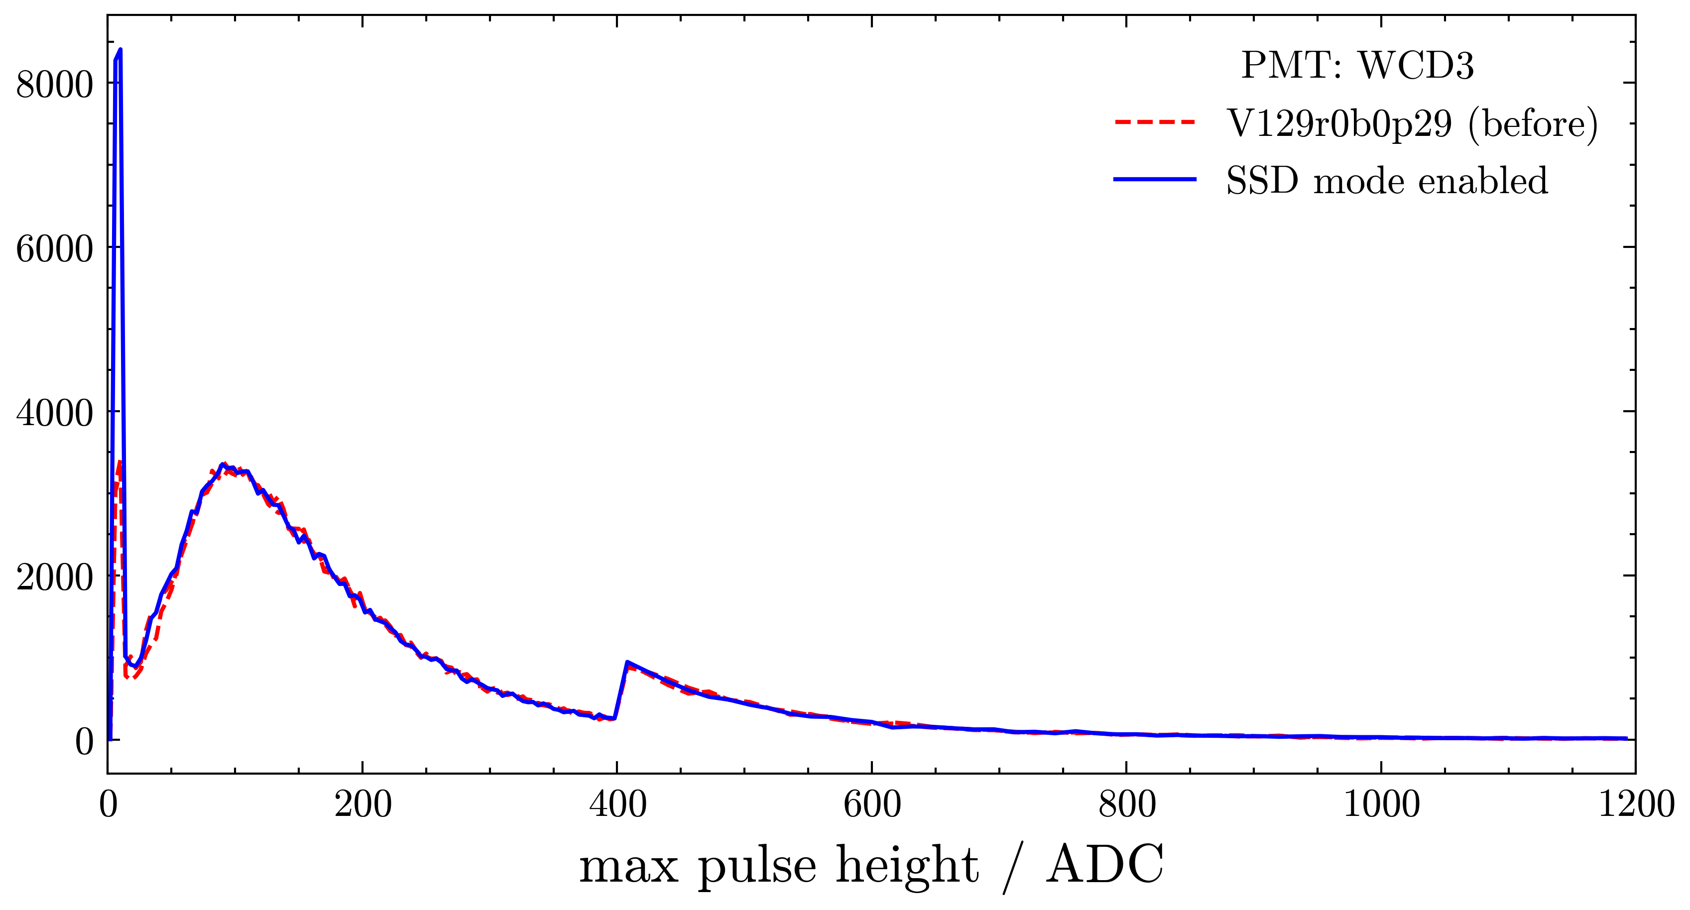
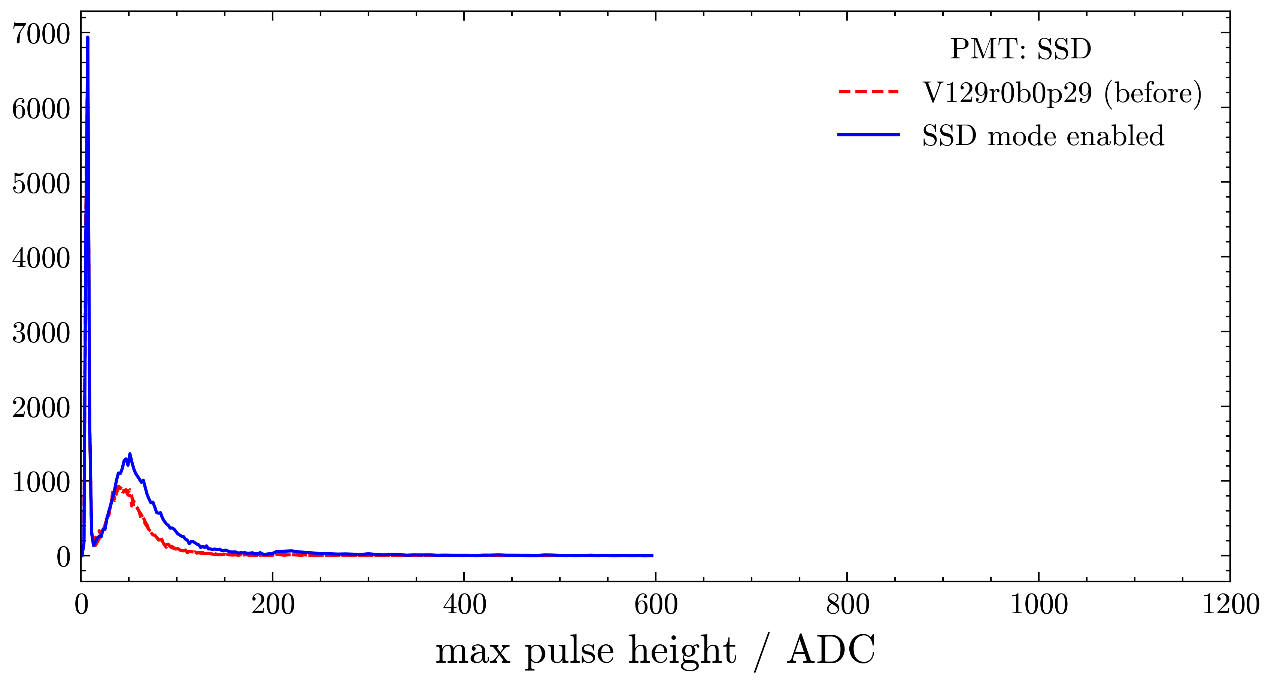
Status of SSD online calibration
Changes since SD/UMD calibration meeting
  disentangle histo calculations from rate counting/threshold setting
  Enable SSD trigger mode in FPGA muon buffer

Slide 4
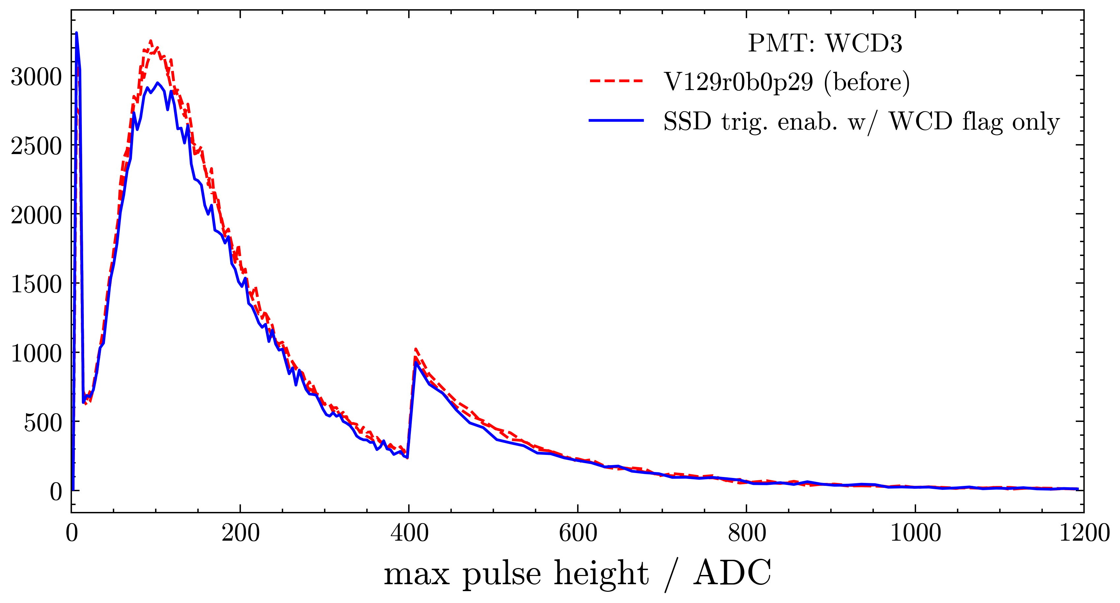
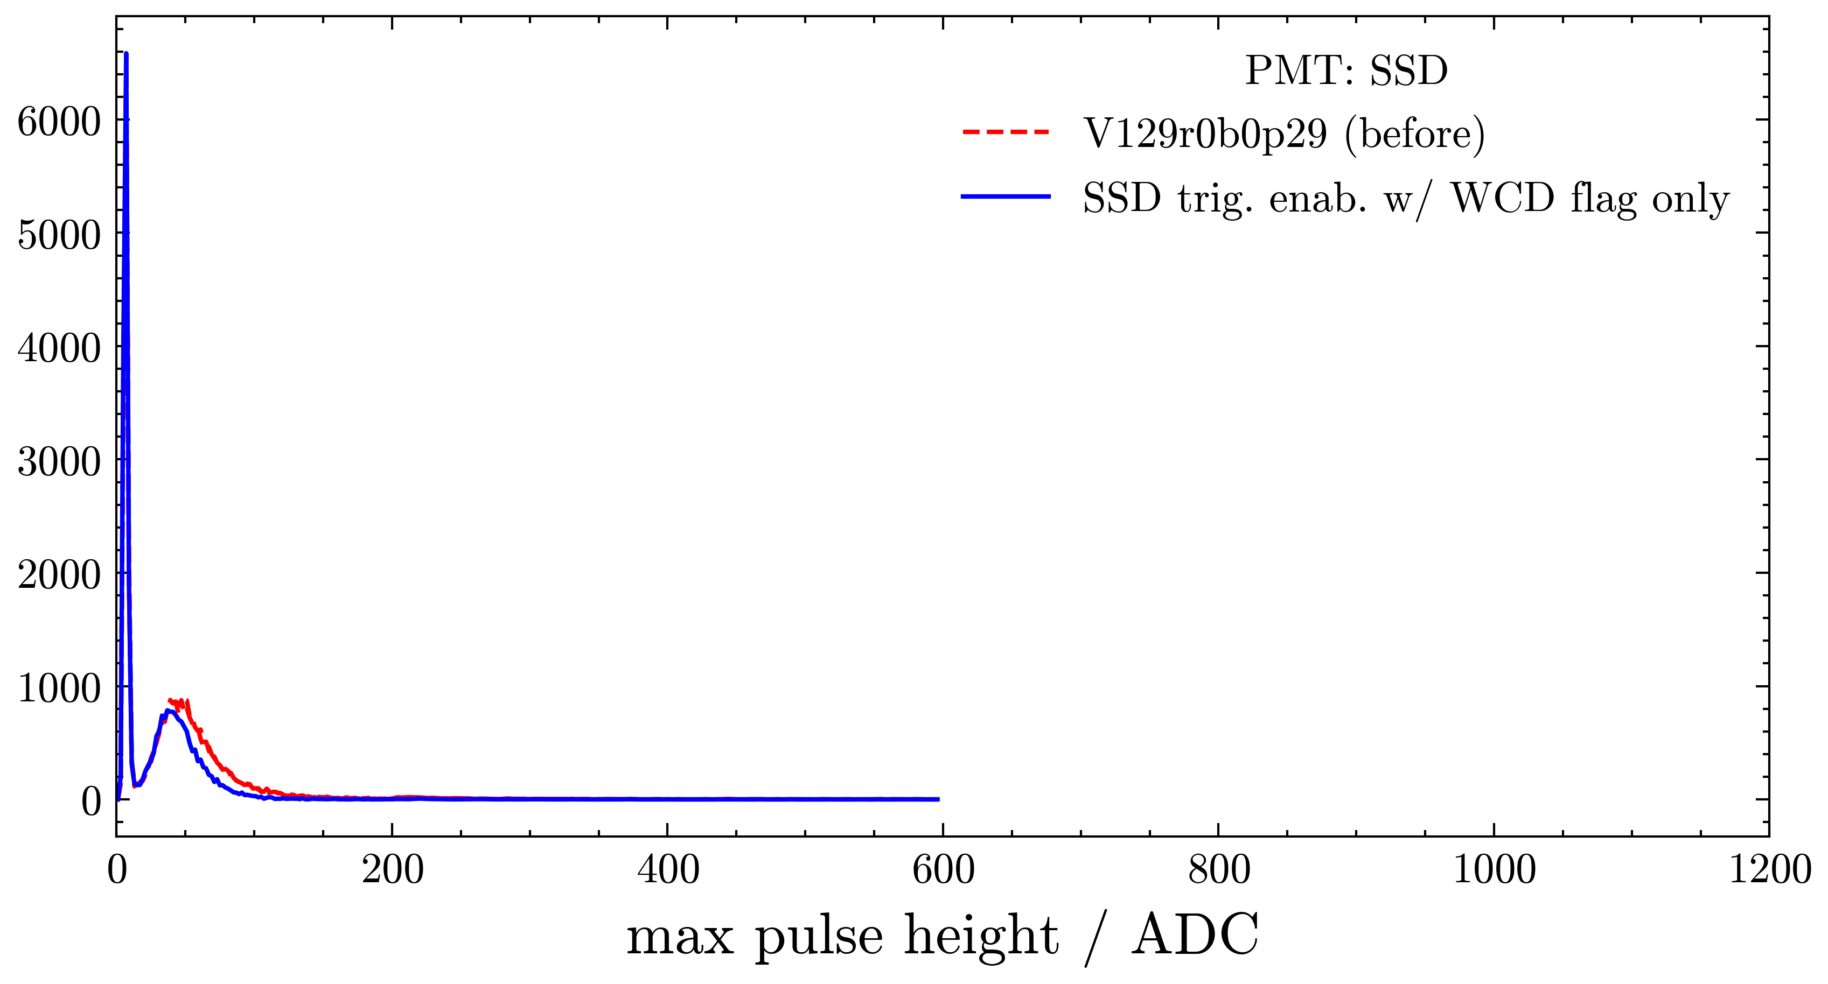
Status of SSD online calibration
Changes since SD/UMD calibration meeting
  disentangle histo calculations from rate counting/threshold setting
  Enable SSD trigger mode in FPGA muon buffer
  Add events to histogram based on PMT trigger flags

Slide 5
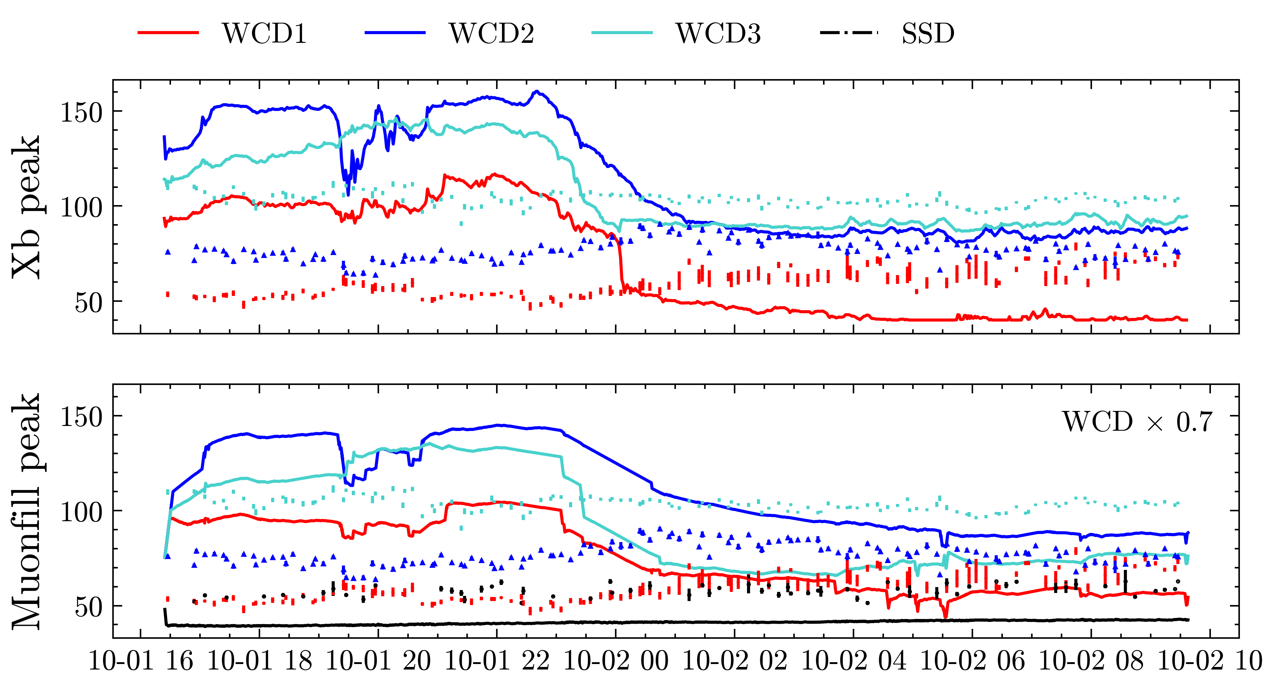
Need for other testing station
Hard to compare Xb, Muonfill: none reproduce Offline peak!

Slide 6
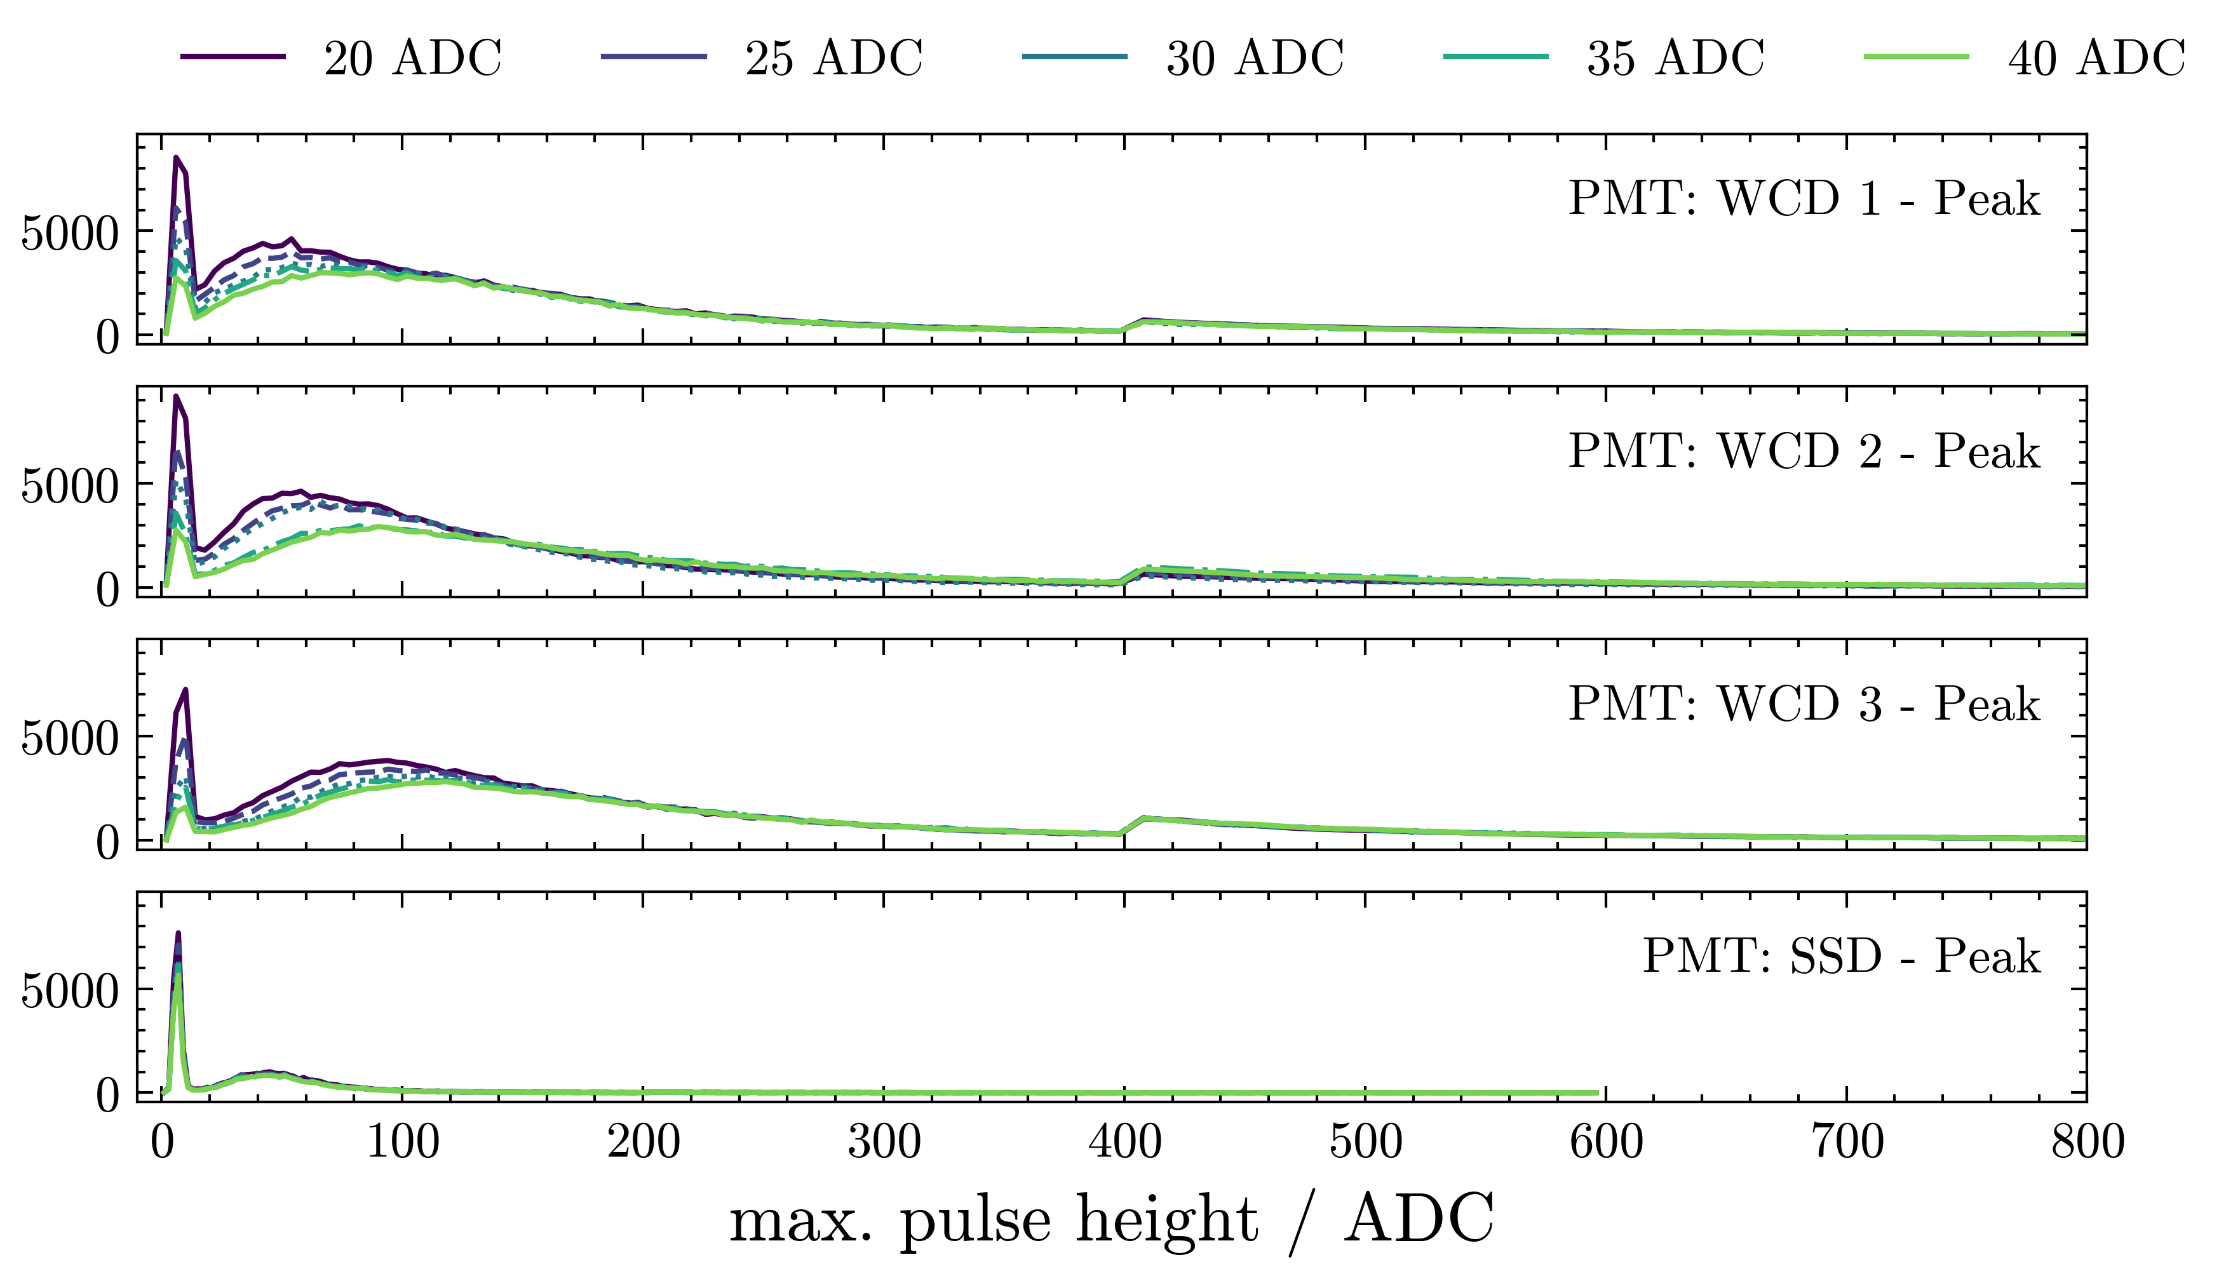
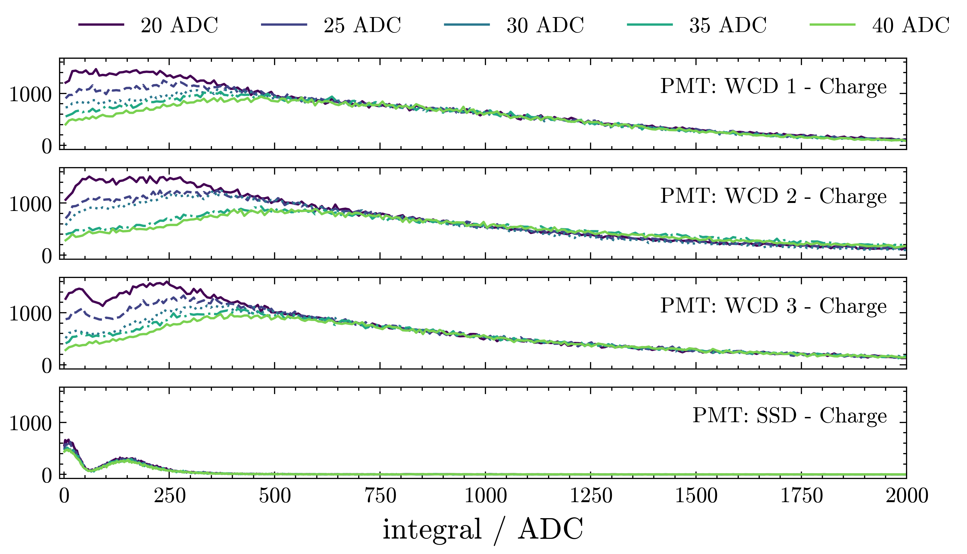
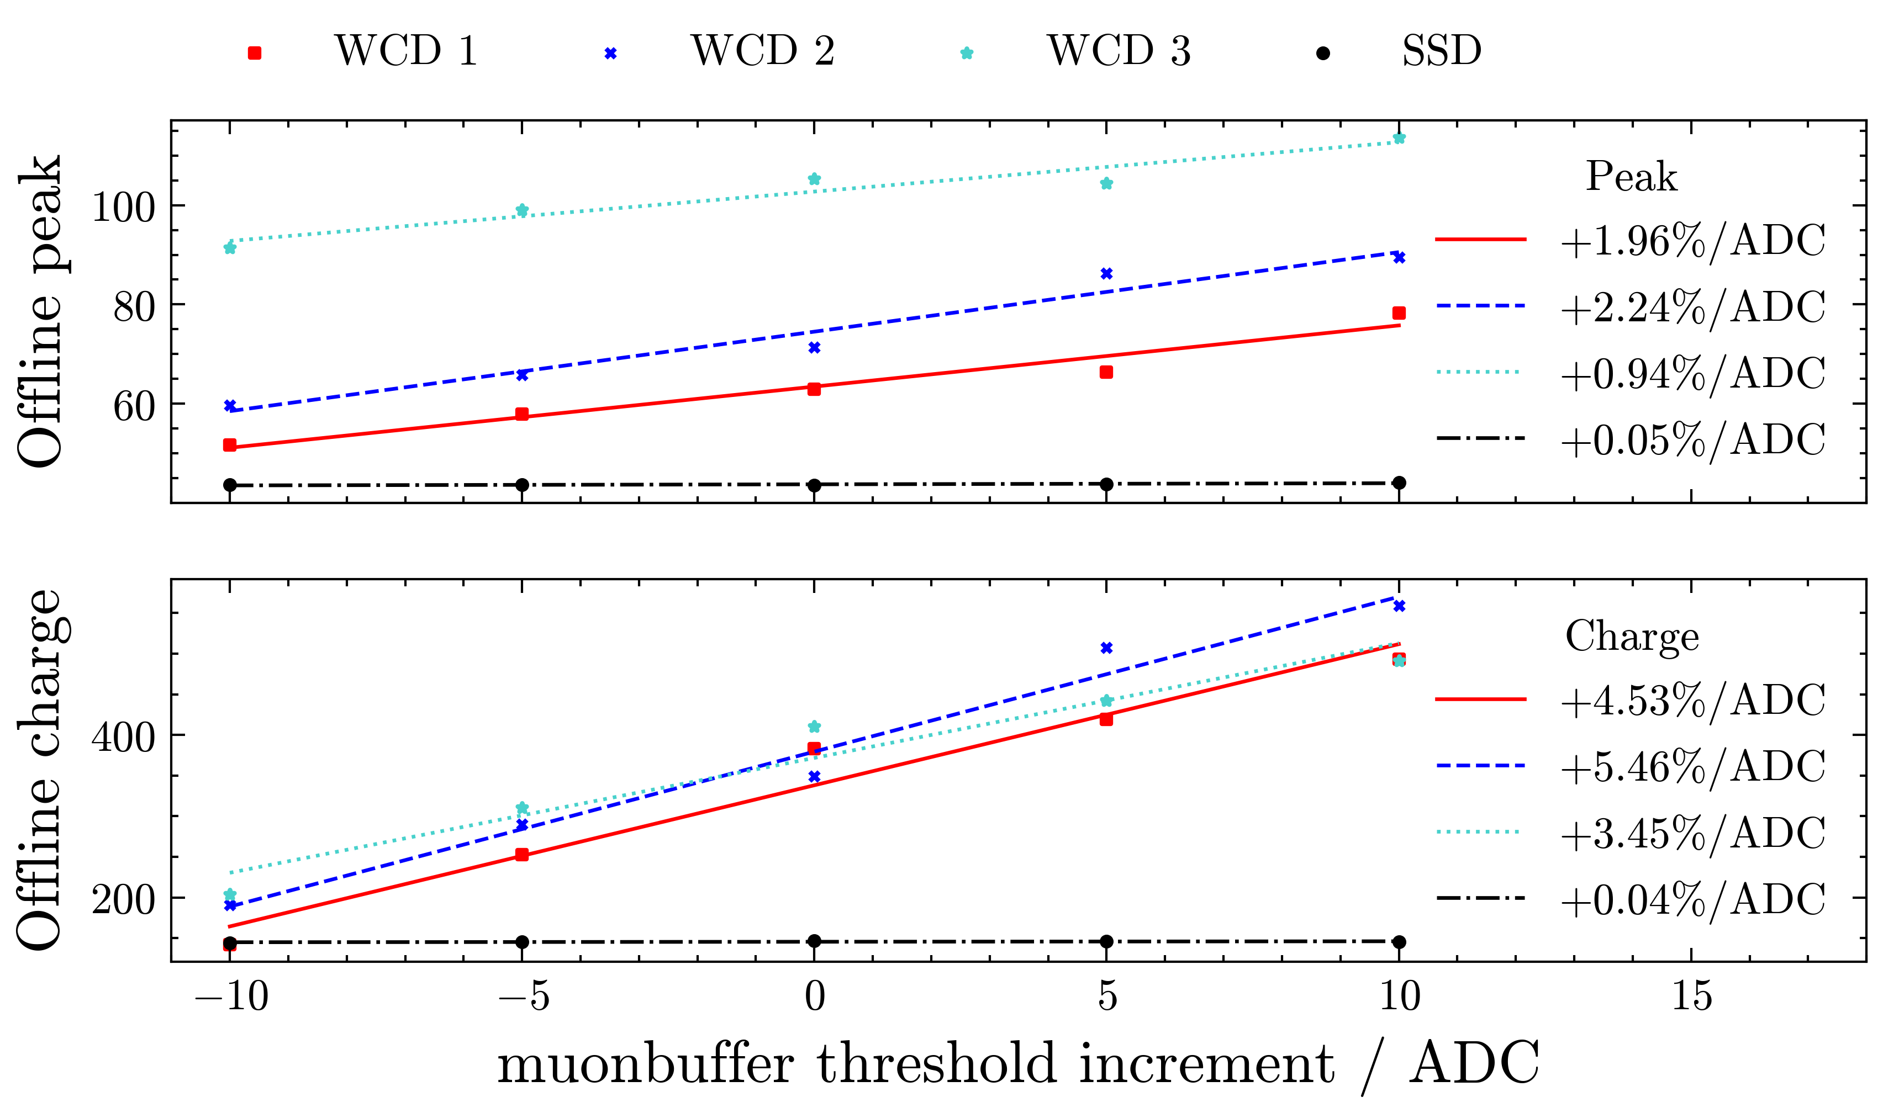
WCD calib dependence on trigger threshold

Slide 7
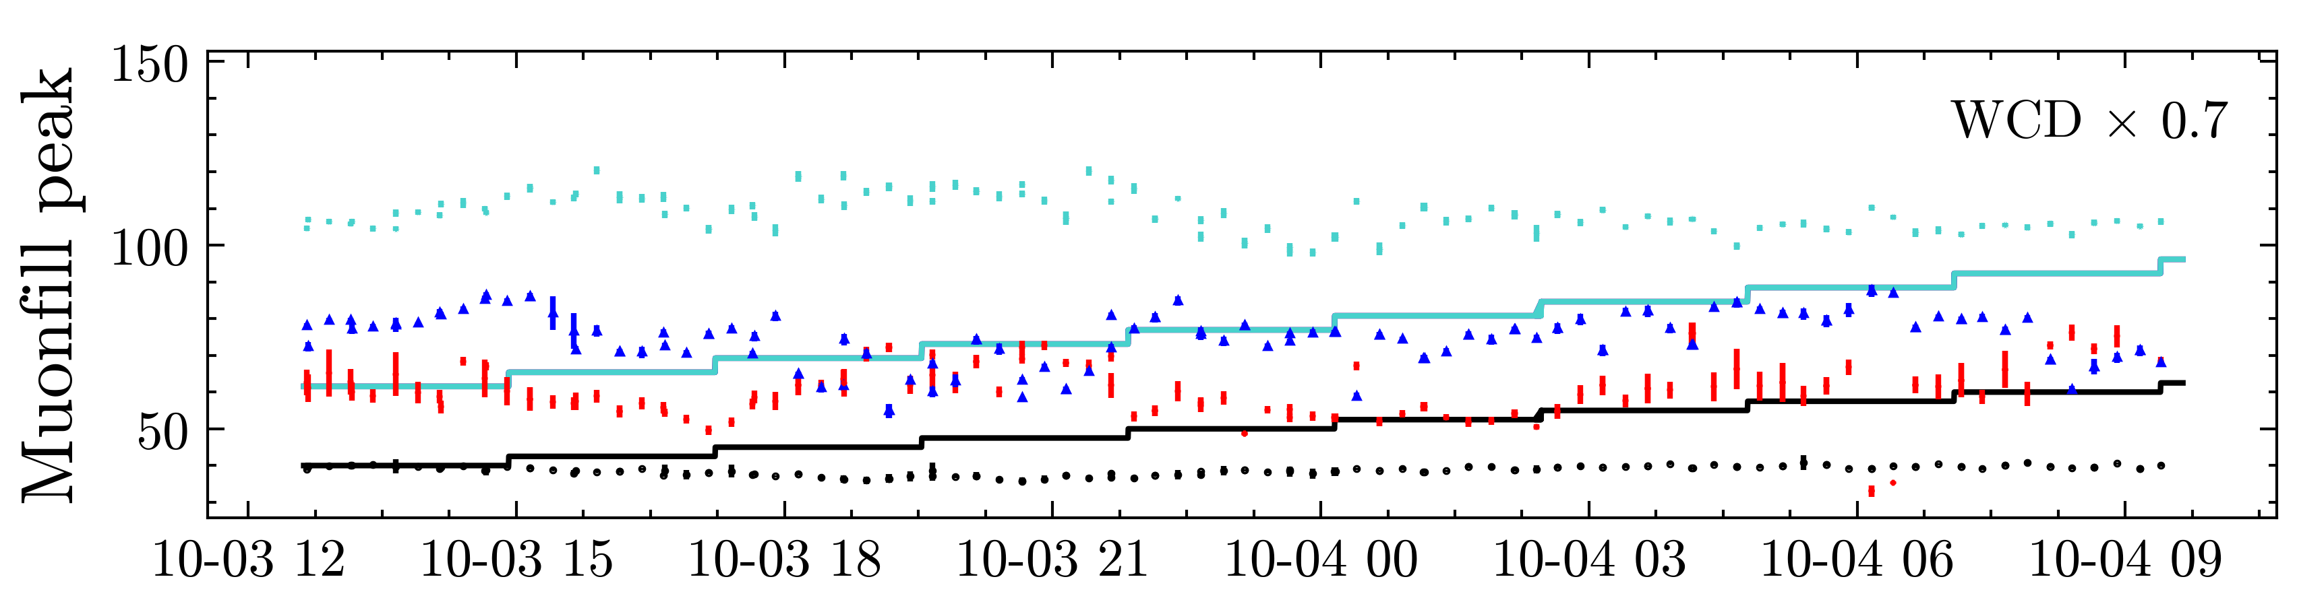
Upcoming
Characterise fluctuations in T70 rates
  Seem larger than Poissonian in at least 1 PMT, why?
  Unique to Didi?

Slide 8
Backup

