Slide 1
Towards a rate-based online MIP peak

Slide 2
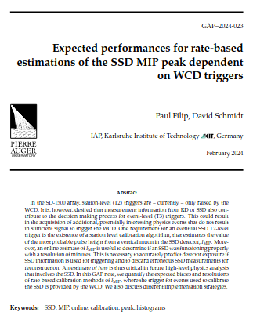
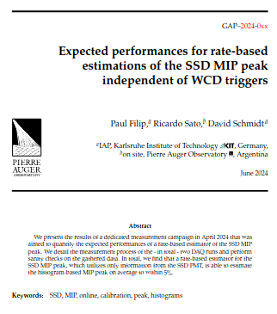
Recap
GAP2024_023
  Analyze muon histograms to derive rate-threshold for SSD shower buffer events, predict MIP with it
  Caveats due to implicit dependence on WCD calib.
GAP2024_0XX (pending...)
  Run dedicated tests on Infill stations
  WCD-independent SSD calib. feasible
  Error on rate-based MIP peak < 5%

Slide 3
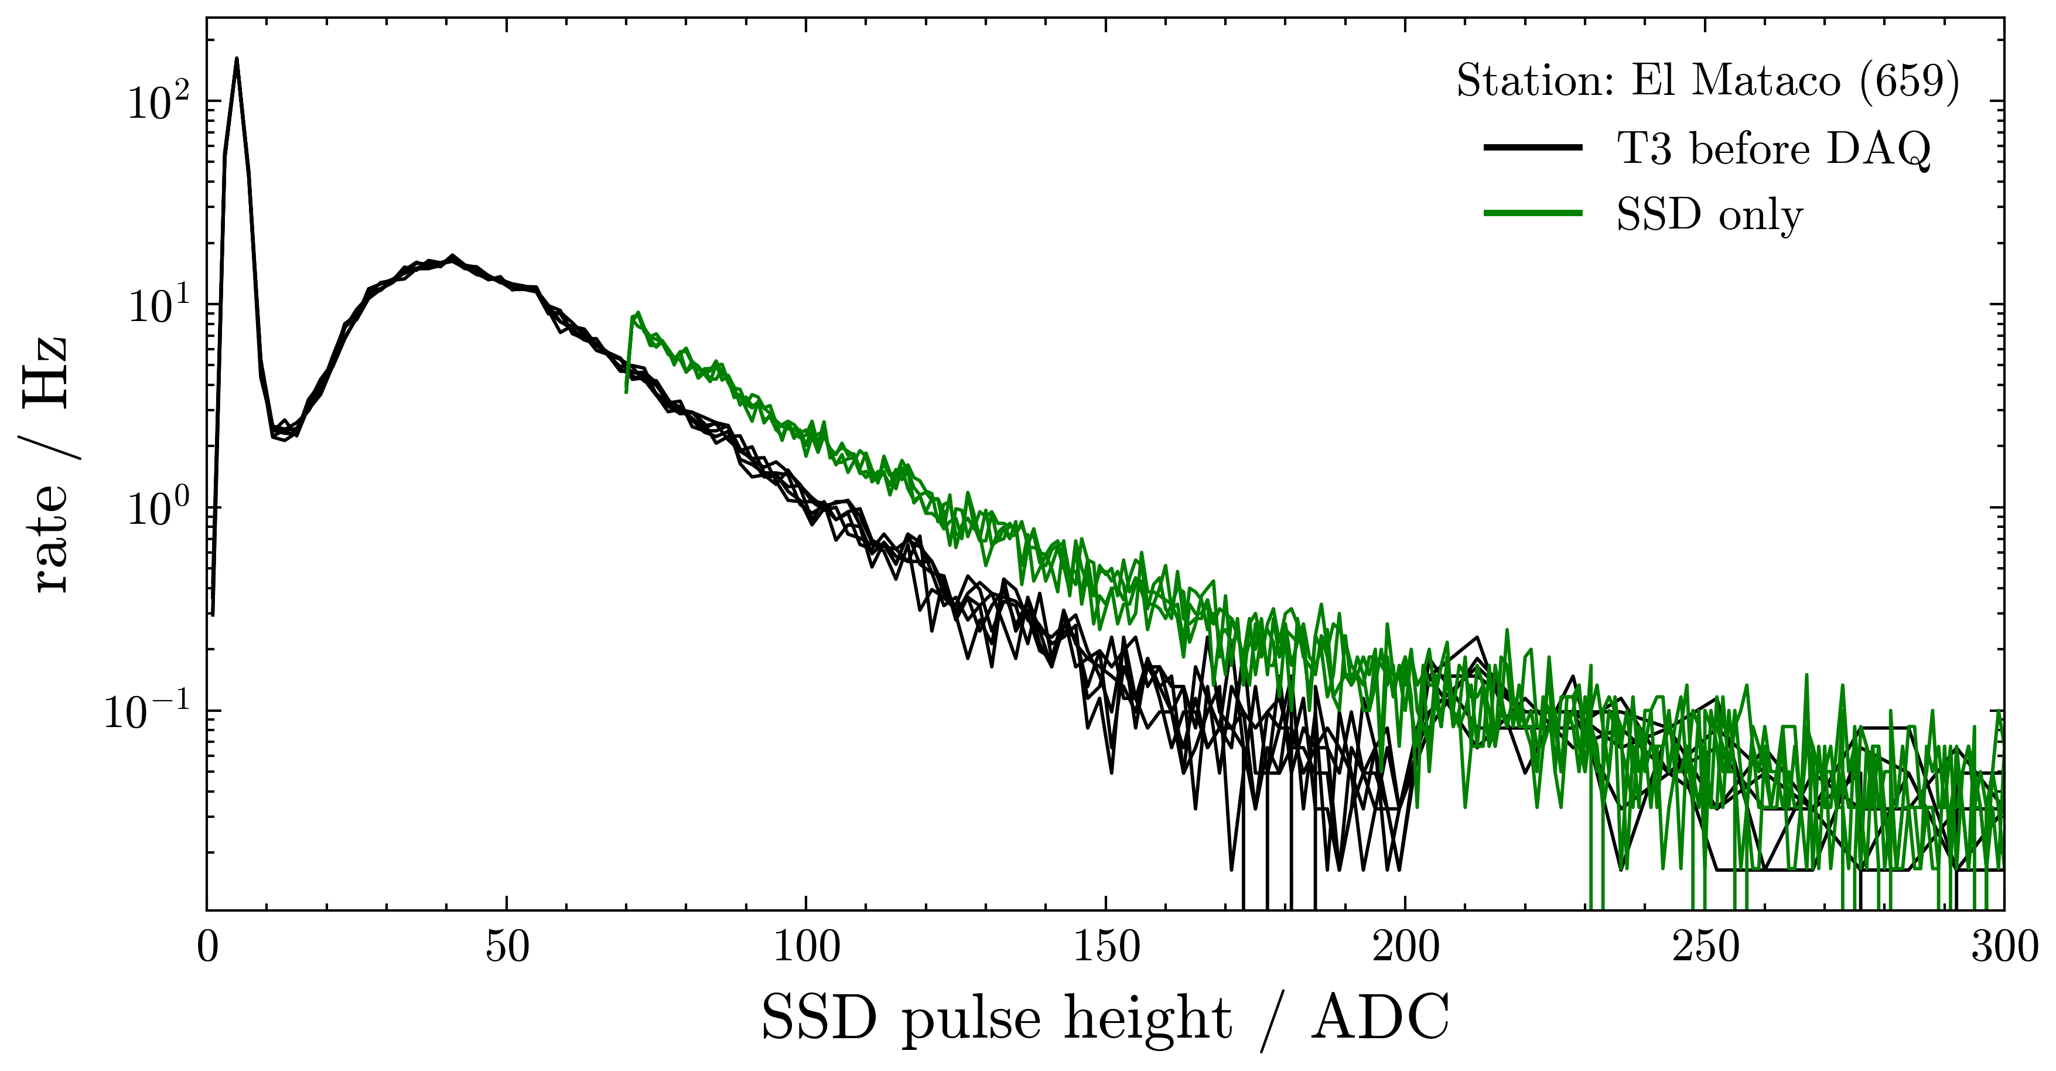
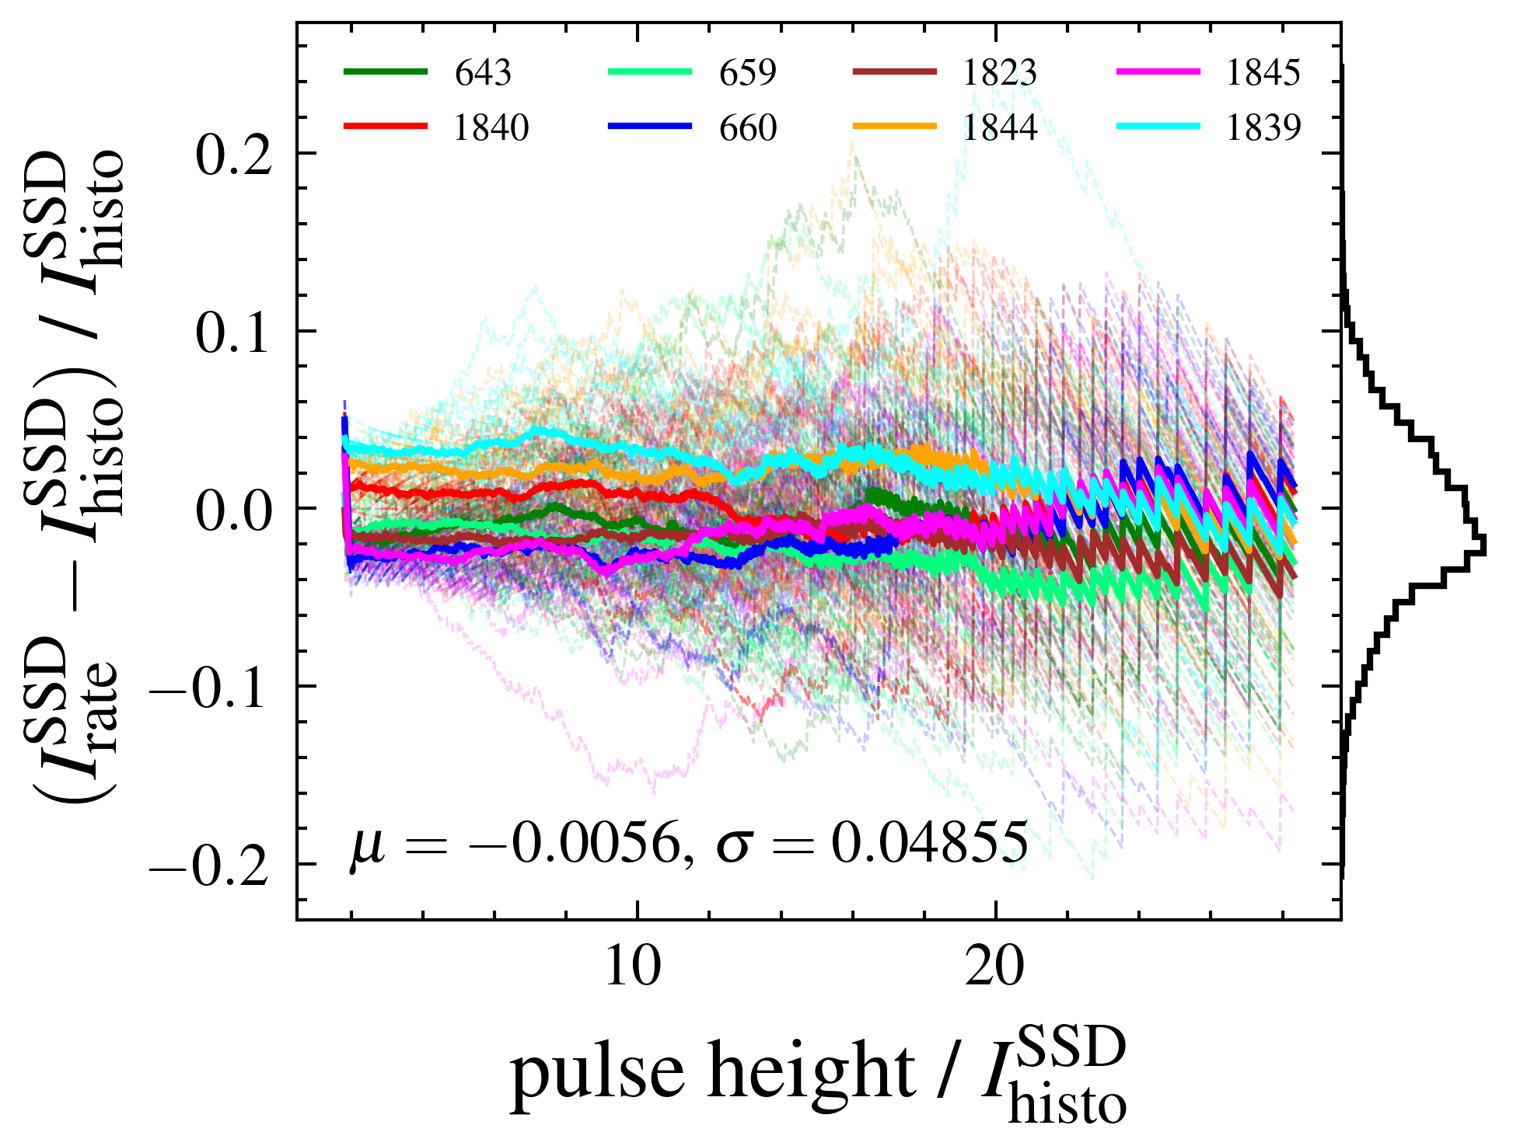
Recap
GAP2024_0XX (pending...)

Slide 4
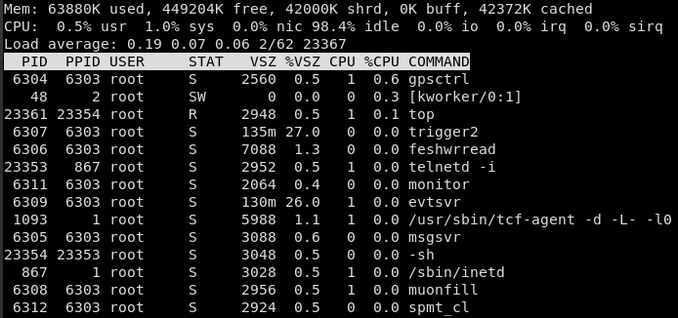
Changes in LS software
trigger2 process
  reads ShowerBuffer
  ( = WCD-T1 traces)
  Handles T2s, etc …
  online calibration
mounfill process
  reads MuonBuffer (now: 1 LMPT > 30 ADC)
  Builds all histograms used for offline calibration

Slide 5

Changes in LS software
trigger2 process
  reads ShowerBuffer
  ( = WCD-T1 traces)
  Handles T2s, etc …
  online calibration
mounfill process
  reads MuonBuffer (now: 1 LMPT > 30 ADC)
  Builds all histograms used for offline calibration
  . . .

Slide 6
Backup

Slide 7
