Slide 1
The Pierre Auger Fluorescence Detector

Slide 2
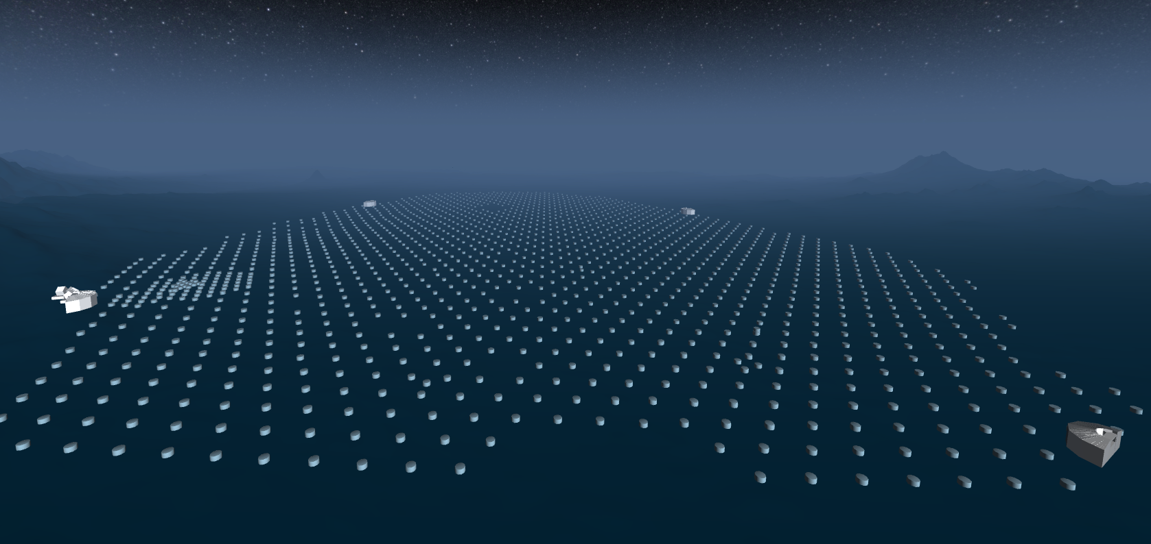
Physics
LA
LM
HE/CO
LL

Slide 3
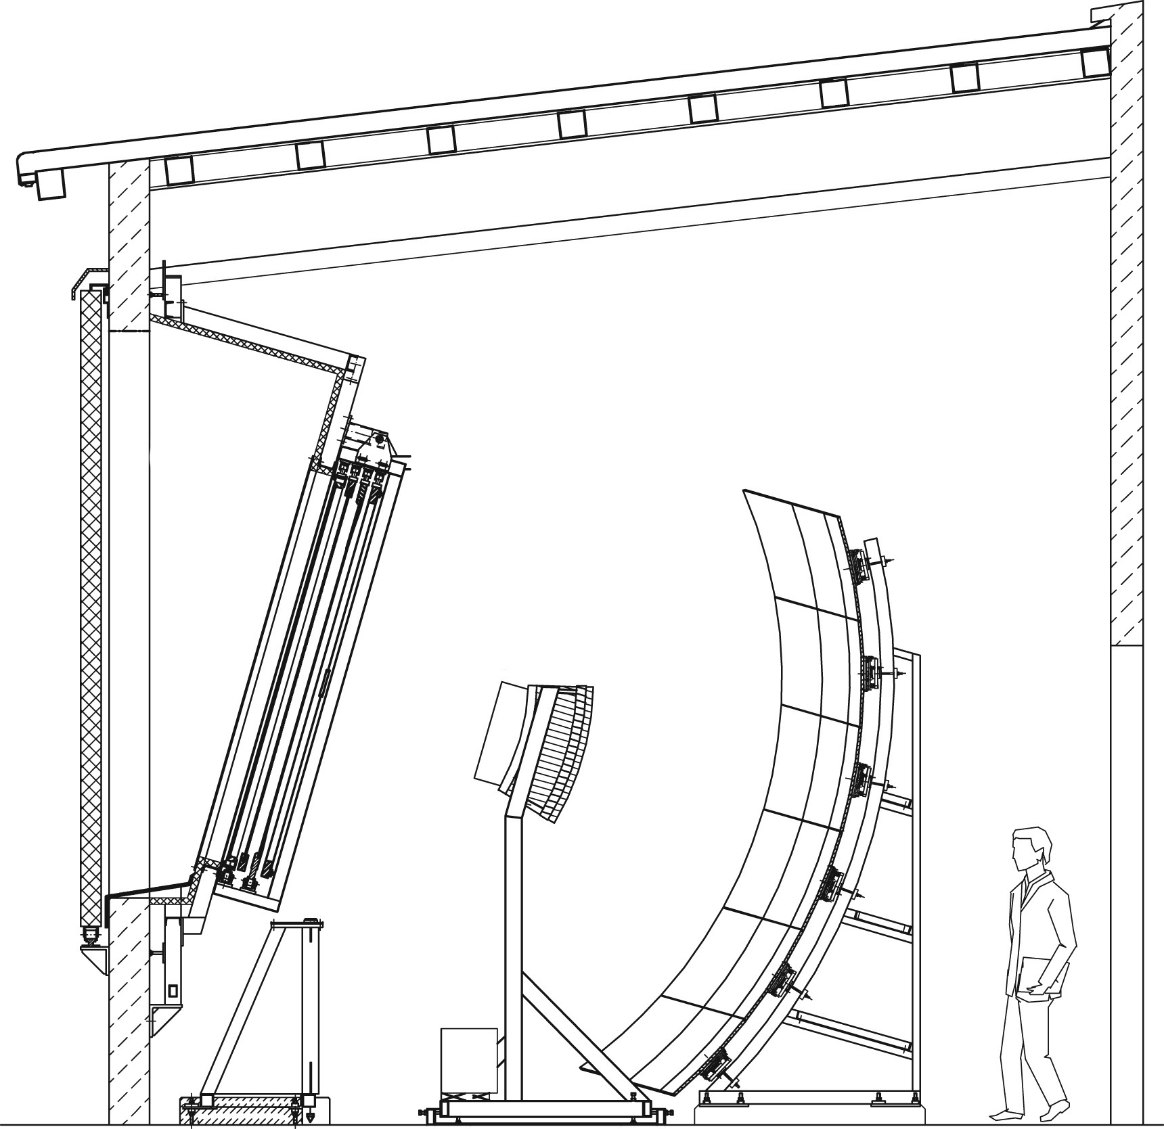
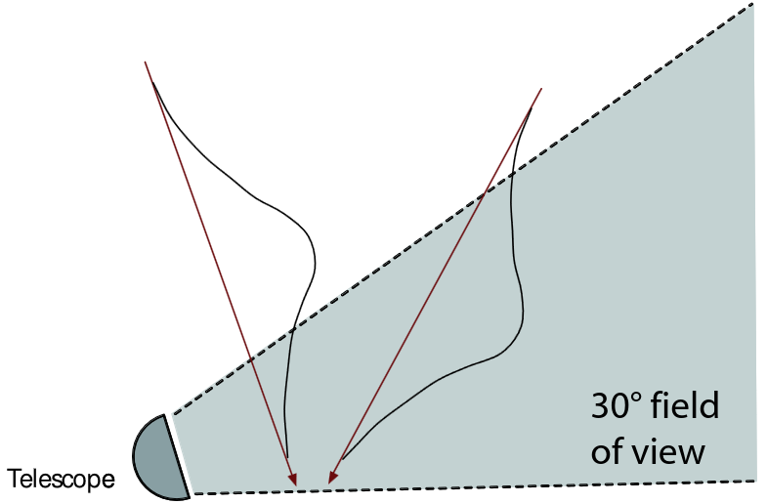
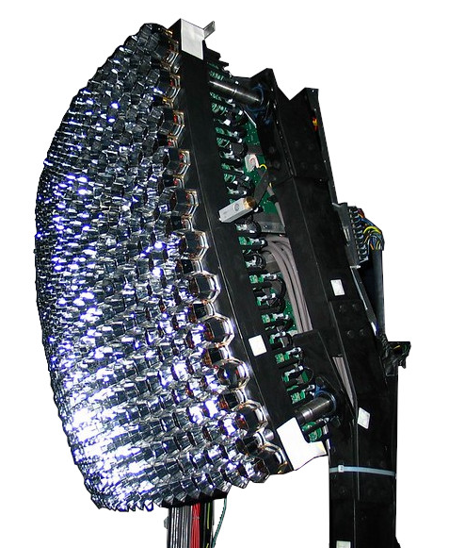
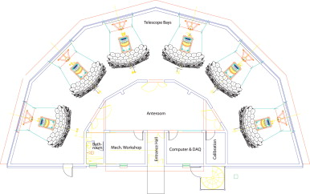
Hardware
5 sites, 27 telescopes
  6 telescopes/bays per building (HEAT: 3)
  Wide angle 30°x30° FOV per bay
  Camera consists of 440 PMTs
  10 MHz sampling rate (HEAT: 20 MHz)
HEAT
  High-elevation extension of FD
  See higher showers / lower E
See also (e.g. for thesis)
  J. Abraham et al, NIMA-A 620 (2010) 227-251
  M. Kleifges et al, ICRC31 (2009) 10-13

Slide 4
Hands-on session

Slide 5
Backup

