Slide 1
Towards an online MIP calibration

Slide 2
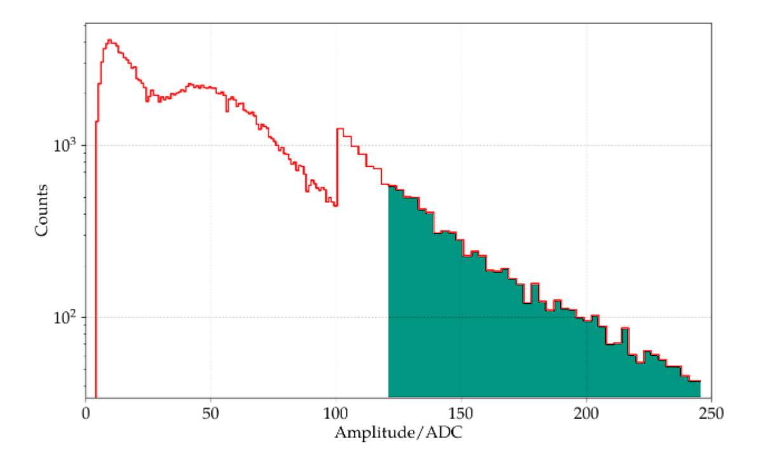
Current (WCD) calibration
WCD offline calibration
  Fit muon hump in histogram
WCD online calibration
  Calibration trigger with threshold , that satisfies:
    Threefold coinc. of
    >1 PMT above
  Iteratively adjust threshold until 70 Hz rate is reached
  Threshold equals
  Accurate to ~2%
  See also GAP2023-049
Streich 2022
change in binning

Slide 3
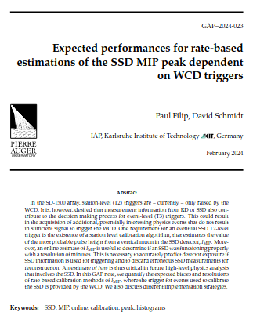
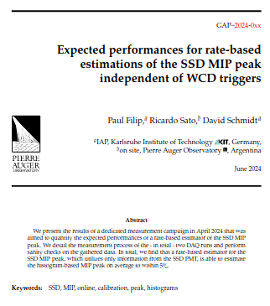
Recap of past work
GAP2024_023
  Analyze muon histograms to derive rate-threshold for SSD shower buffer events, predict MIP with it
  Caveats due to implicit dependence on WCD calib.
GAP2024_0XX (pending...)
  Run dedicated tests on Infill stations
  WCD-independent SSD online calibration feasible
  Error on rate-based MIP peak < 5% on average

Slide 4
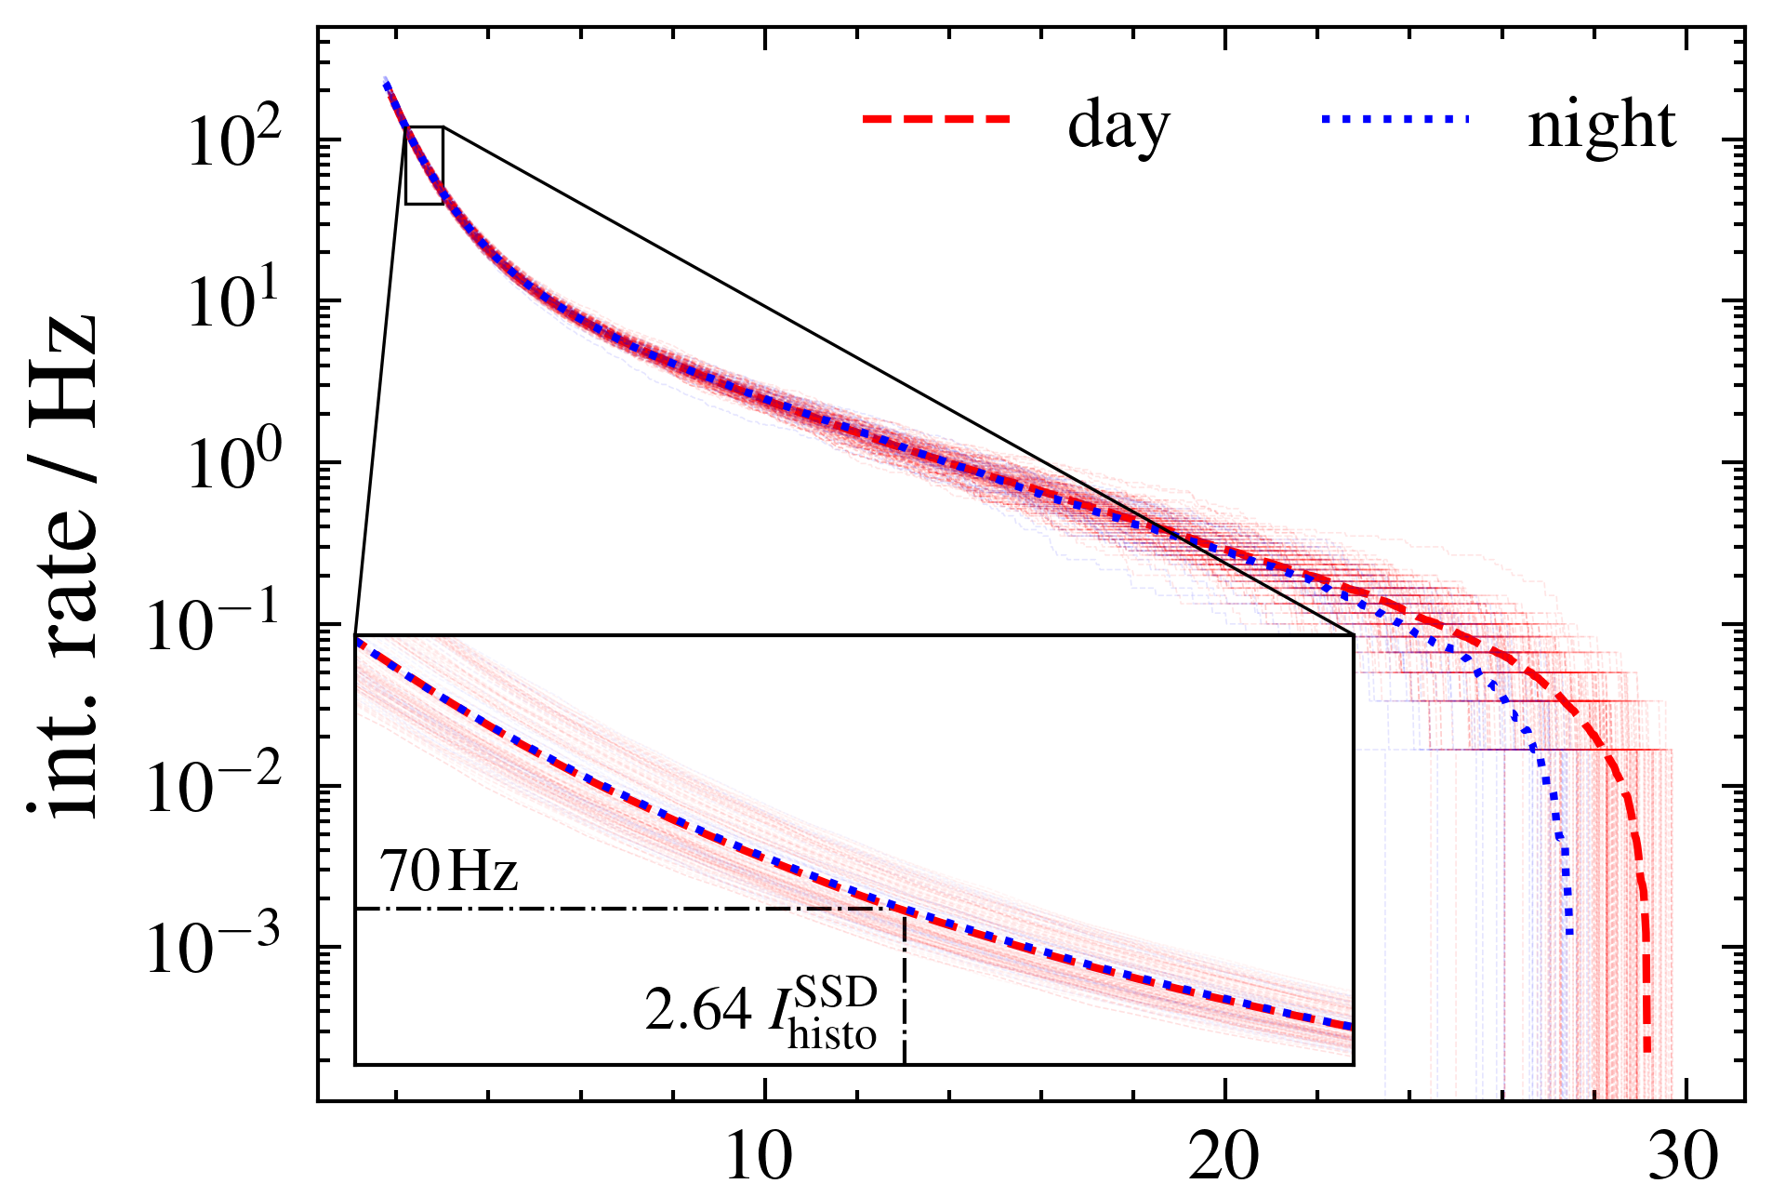
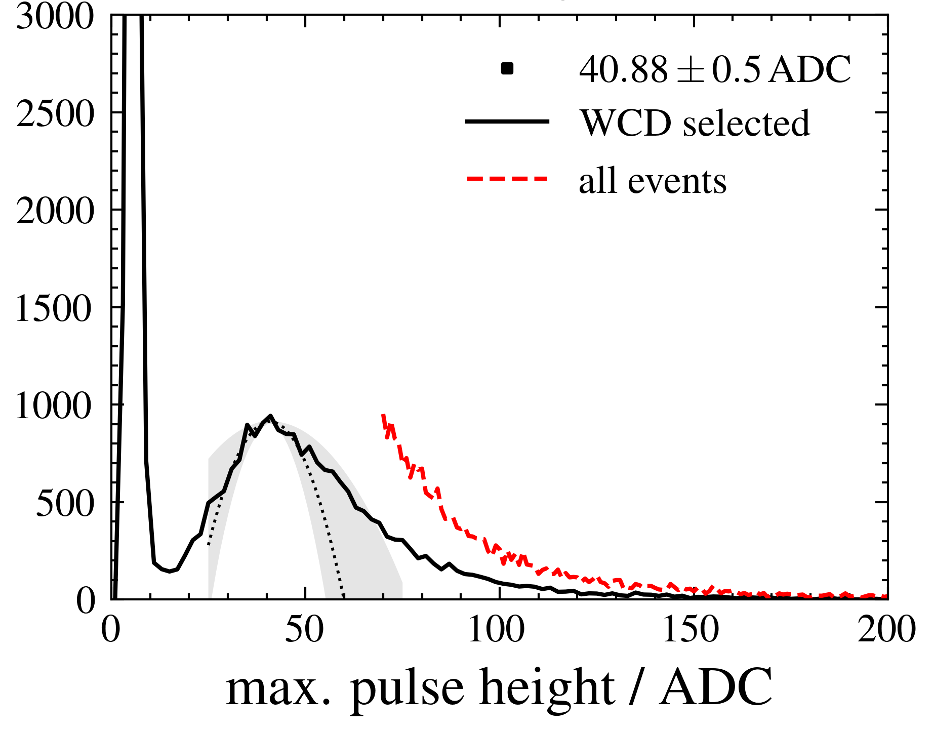
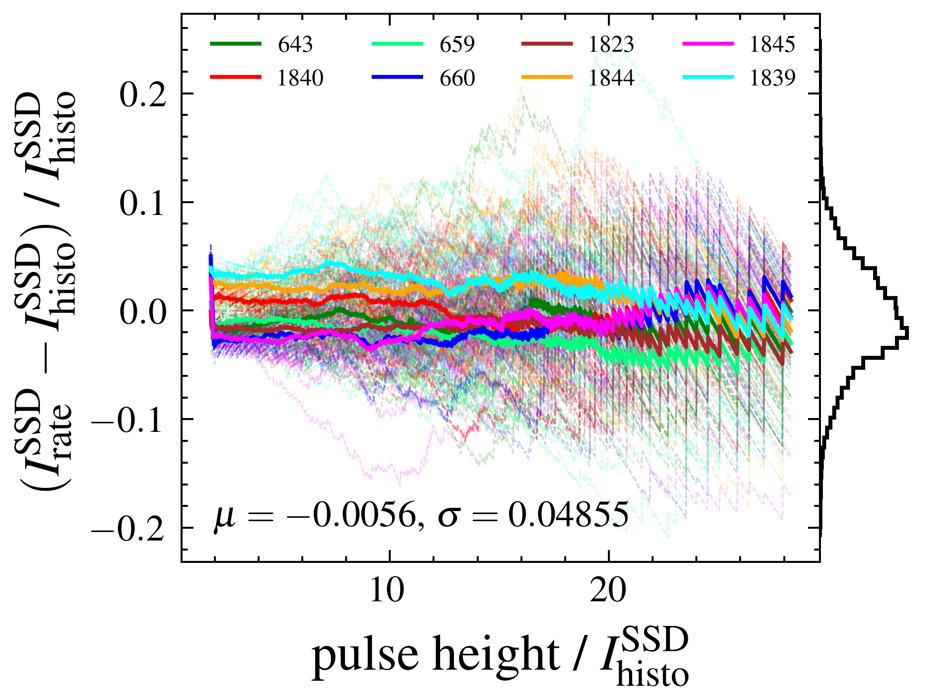
Recap of past work
GAP2024_0XX (pending…)
Strong EM background, cause detector deadtimes

Slide 5
muonBuffer vs. showerBuffer
SSD currently in slave mode to WCD
  Only see events where WCD registered signal
  Could bias SSD calibration. (i.e. masked/broken WCDs)
  Change of default trigger settings needed
Different triggers write in different registers
Muon trigger (SB, >30 ADC)
  Used to build muon histograms
  Handled by muonfill process
→ muonBuffer (69 bins, FBW)
T1/2 (Th, ToT-like, etc)
  Sent to CDAS upon T3 request
  Handled by Trigger2 process
→ showerBuffer (2048 bins, FBW)

Slide 6
Backup

