Slide 1
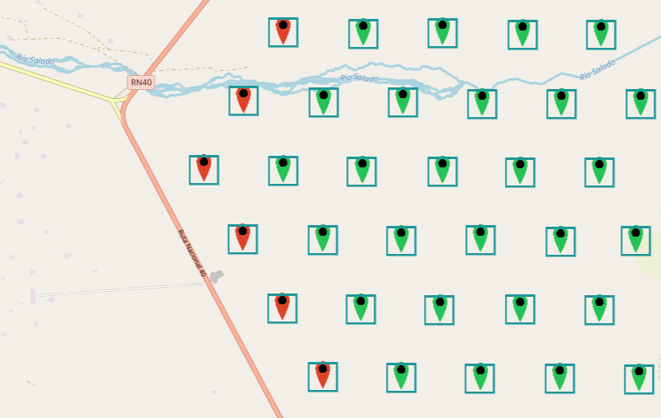
(Hardare?) problems in the test hexagon
Las Leñas
Malargüe

Slide 2
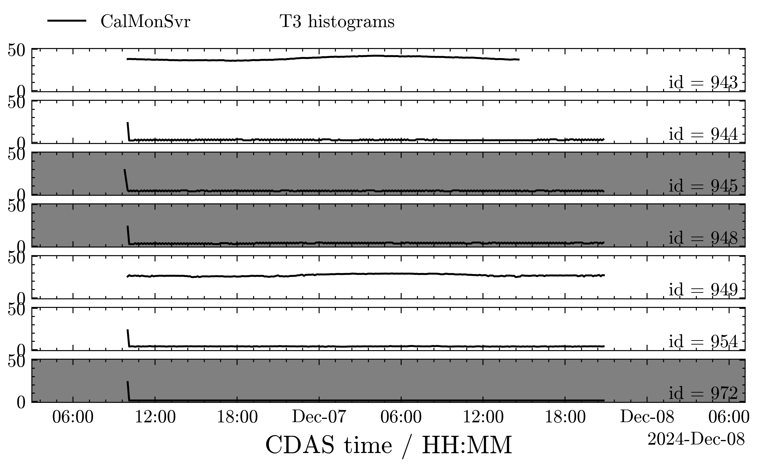

Slide 3
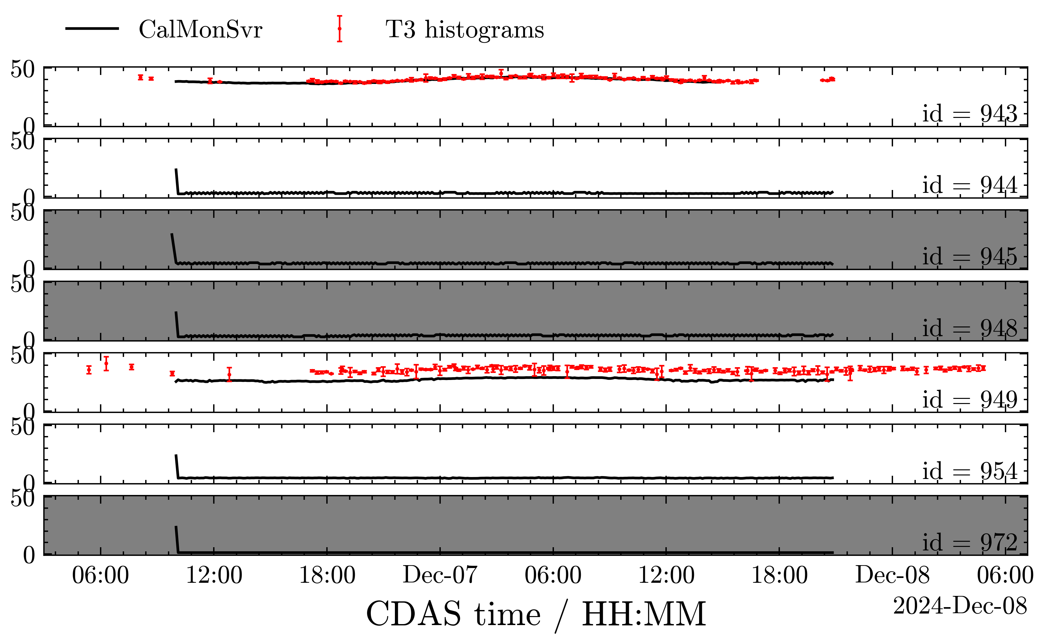

Slide 4
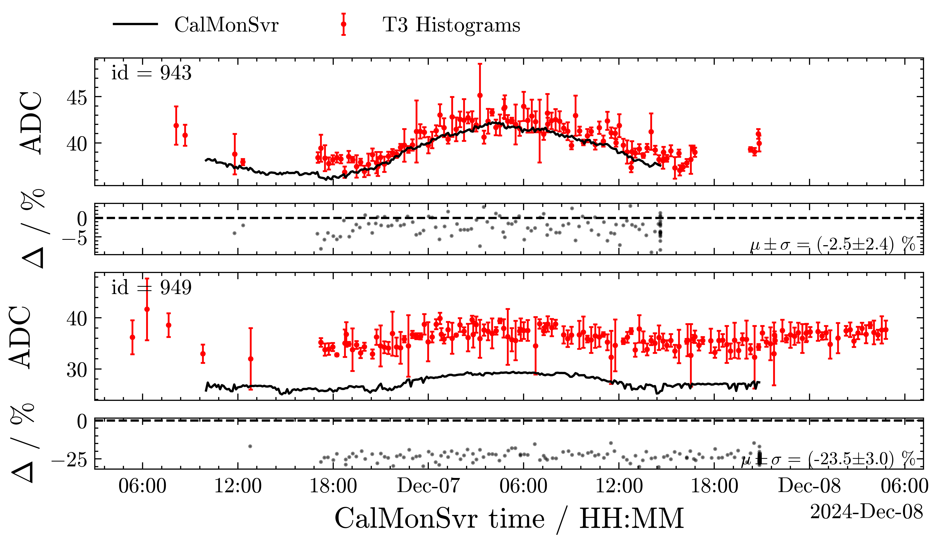

Slide 5
Summary
SSD online calibration status in hexagon:
  943: ok, but dcd from CDAS?
  944: fail (hardware?)
  945: no SSD PMT
  948: no SSD PMT
  949: okish? But issues w/ masked PMT
  954: fail (hardware?)
  972: no SSD PMT

Slide 6
Backup

Slide 7
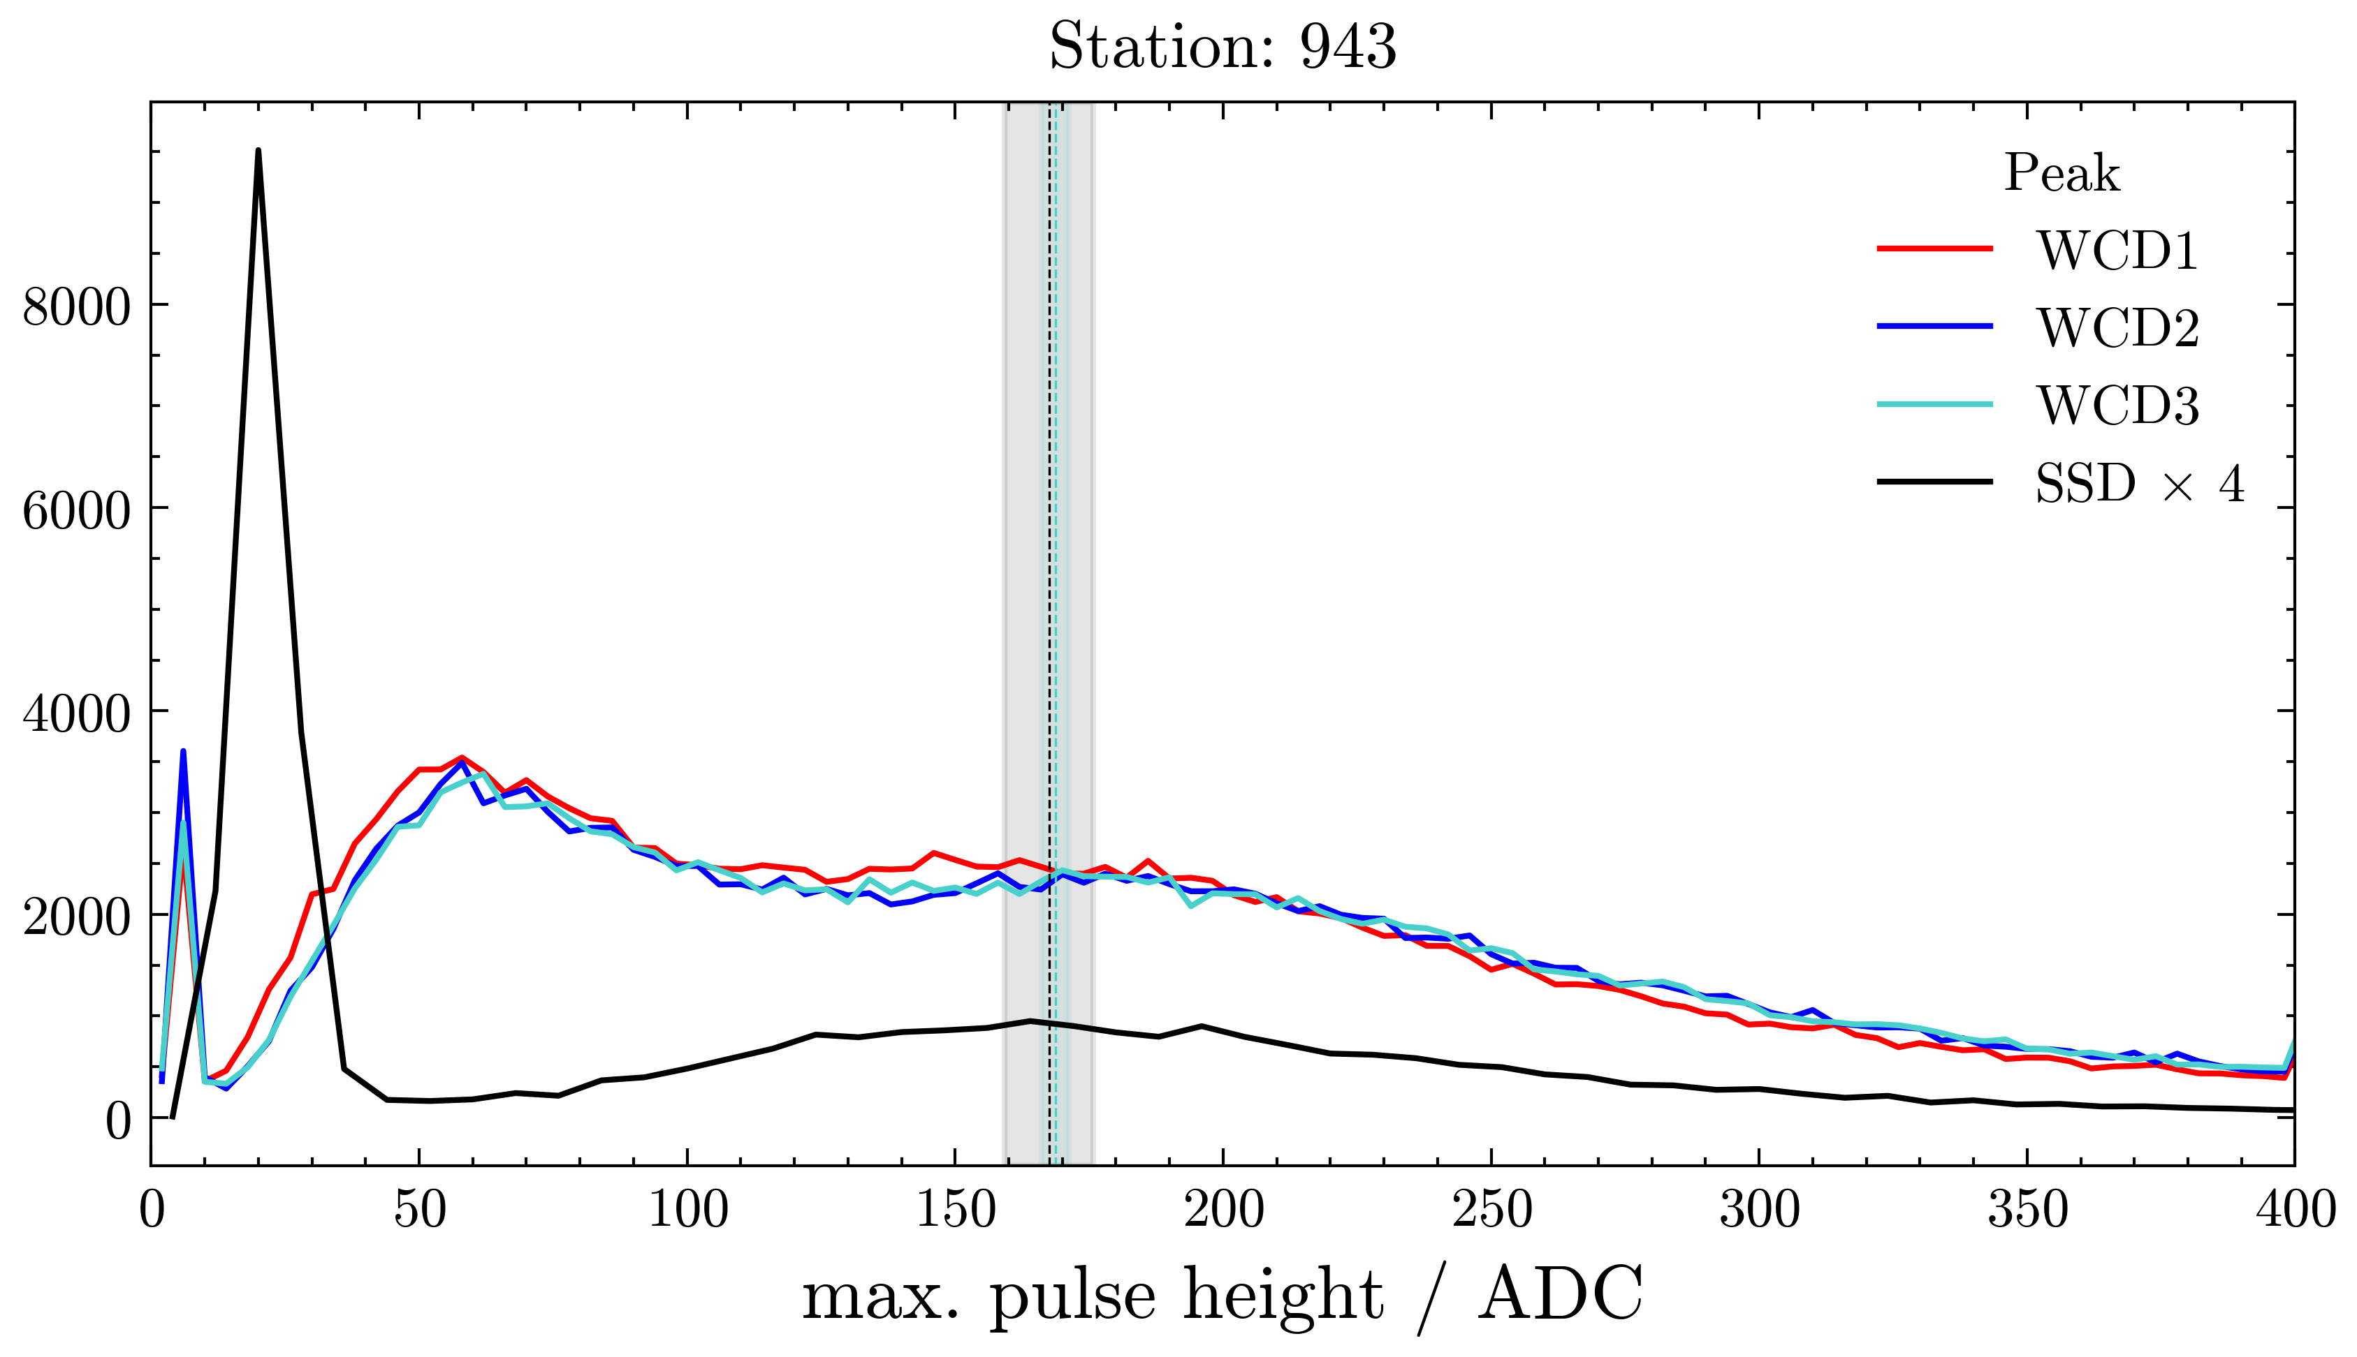

Slide 8
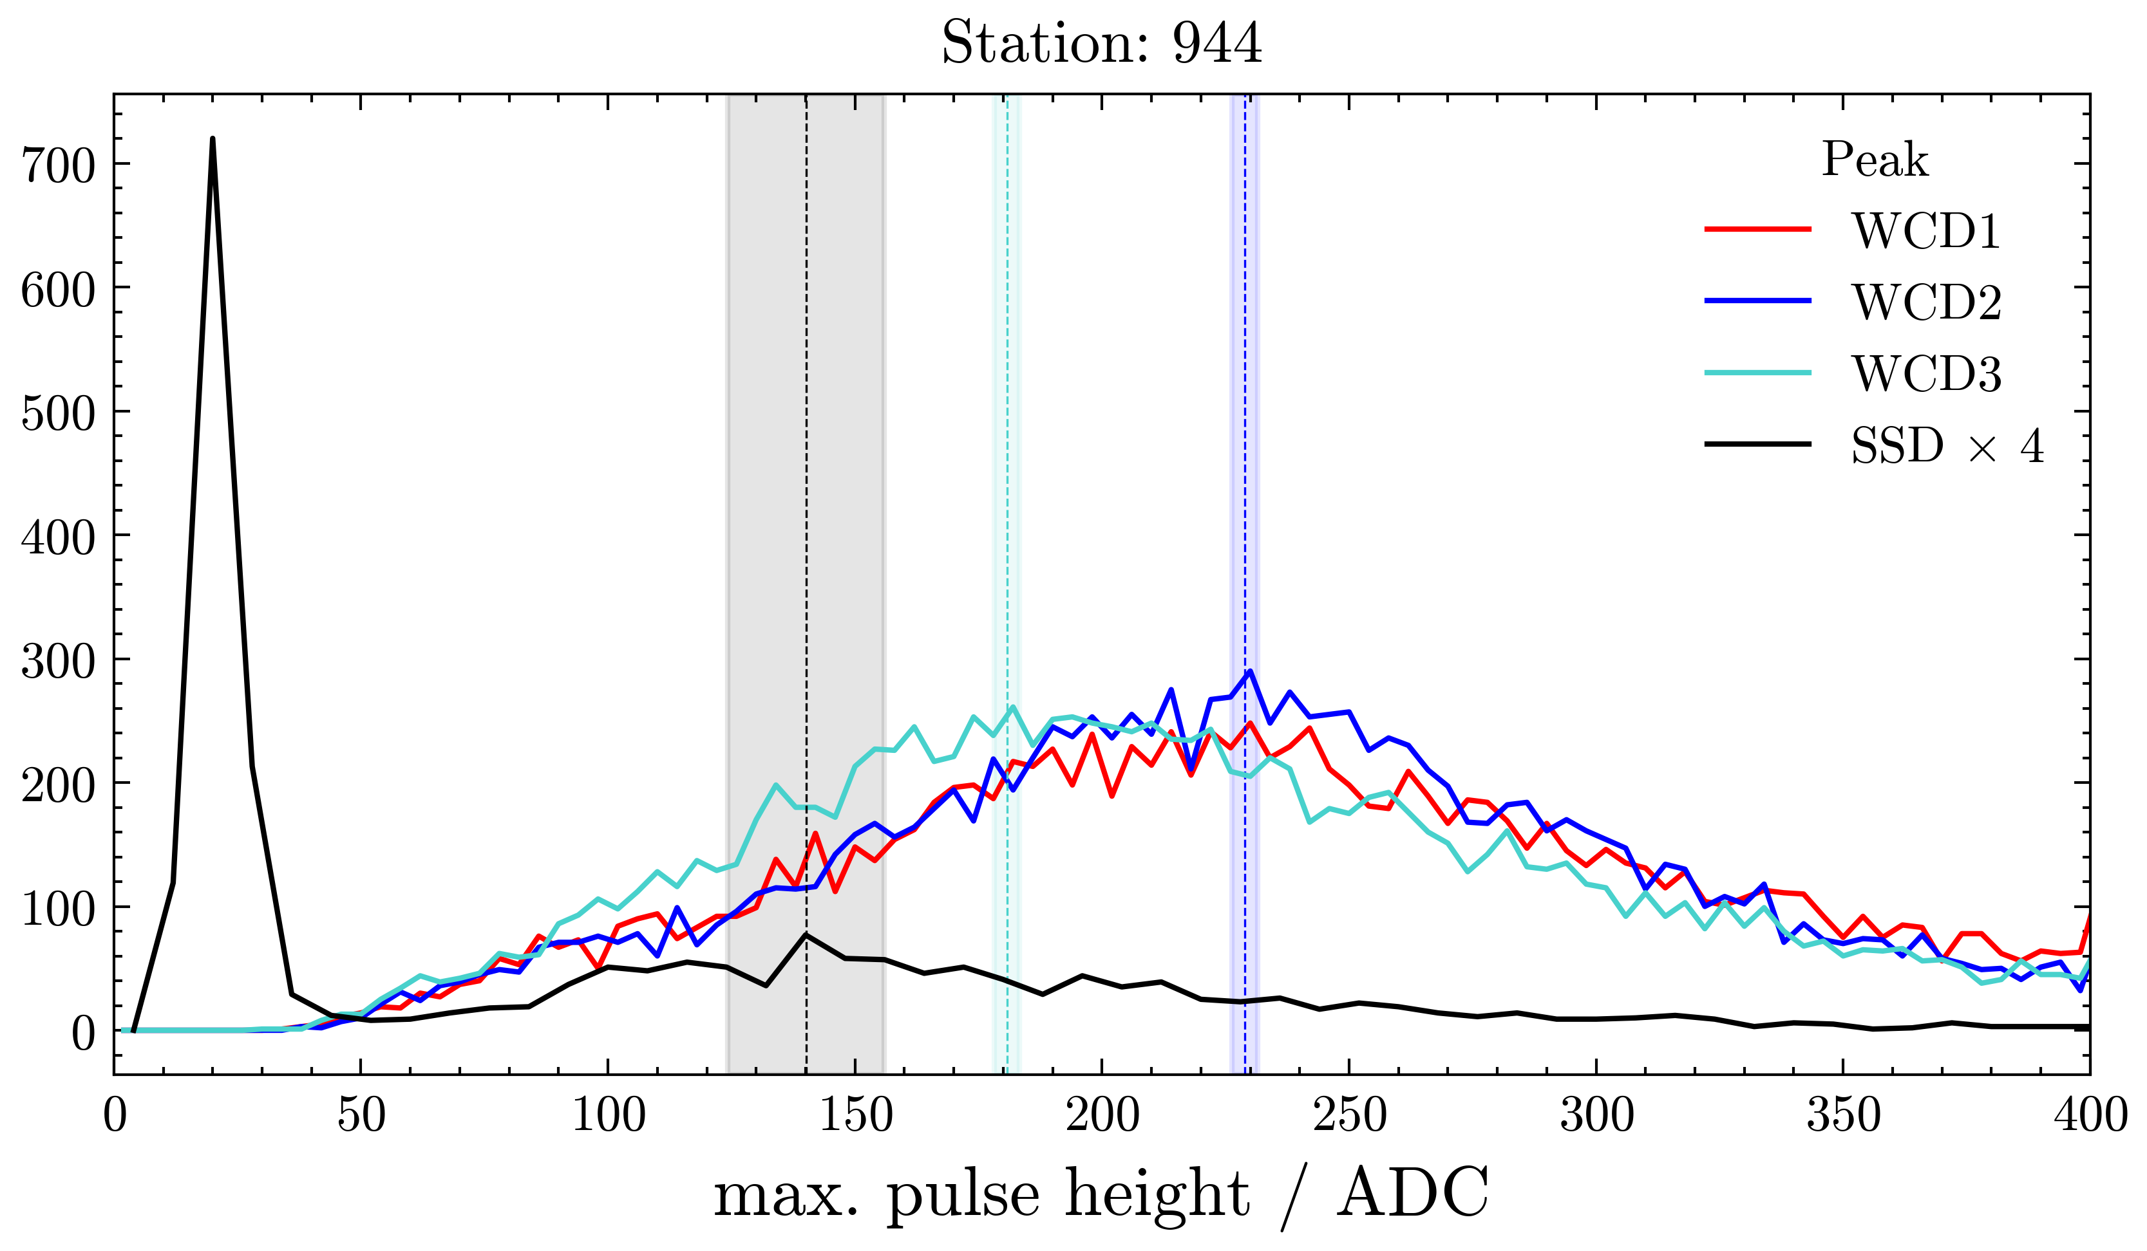

Slide 9
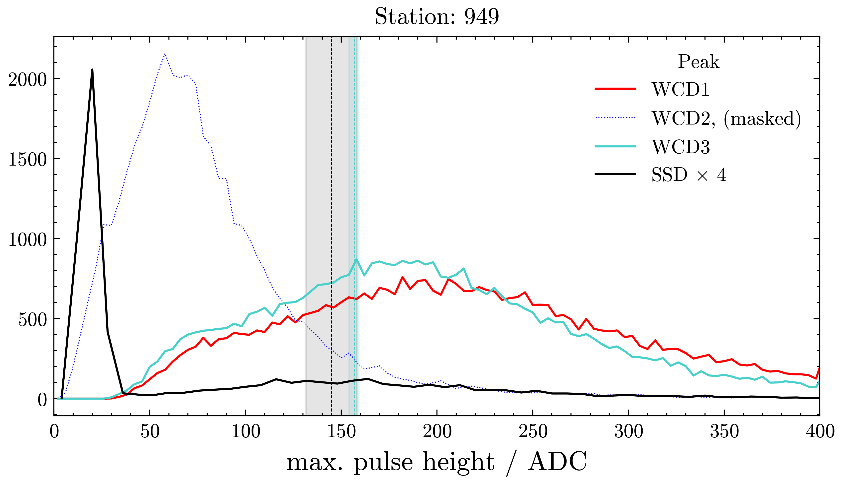

Slide 10
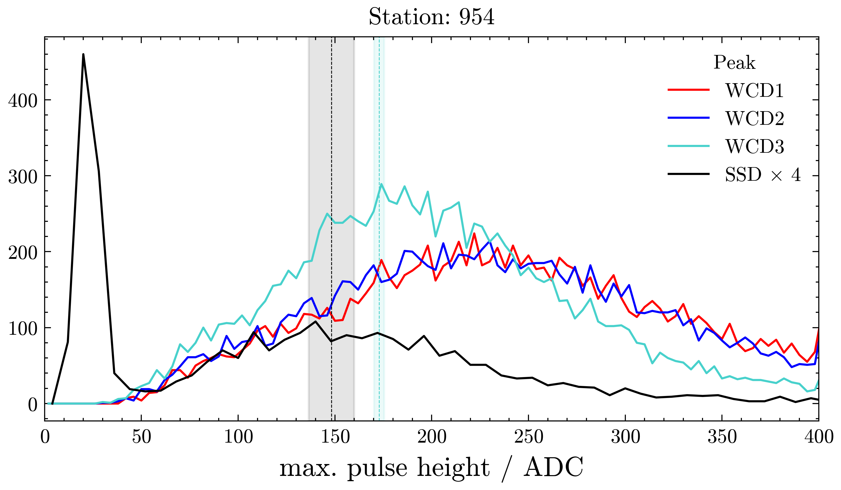

Slide 11
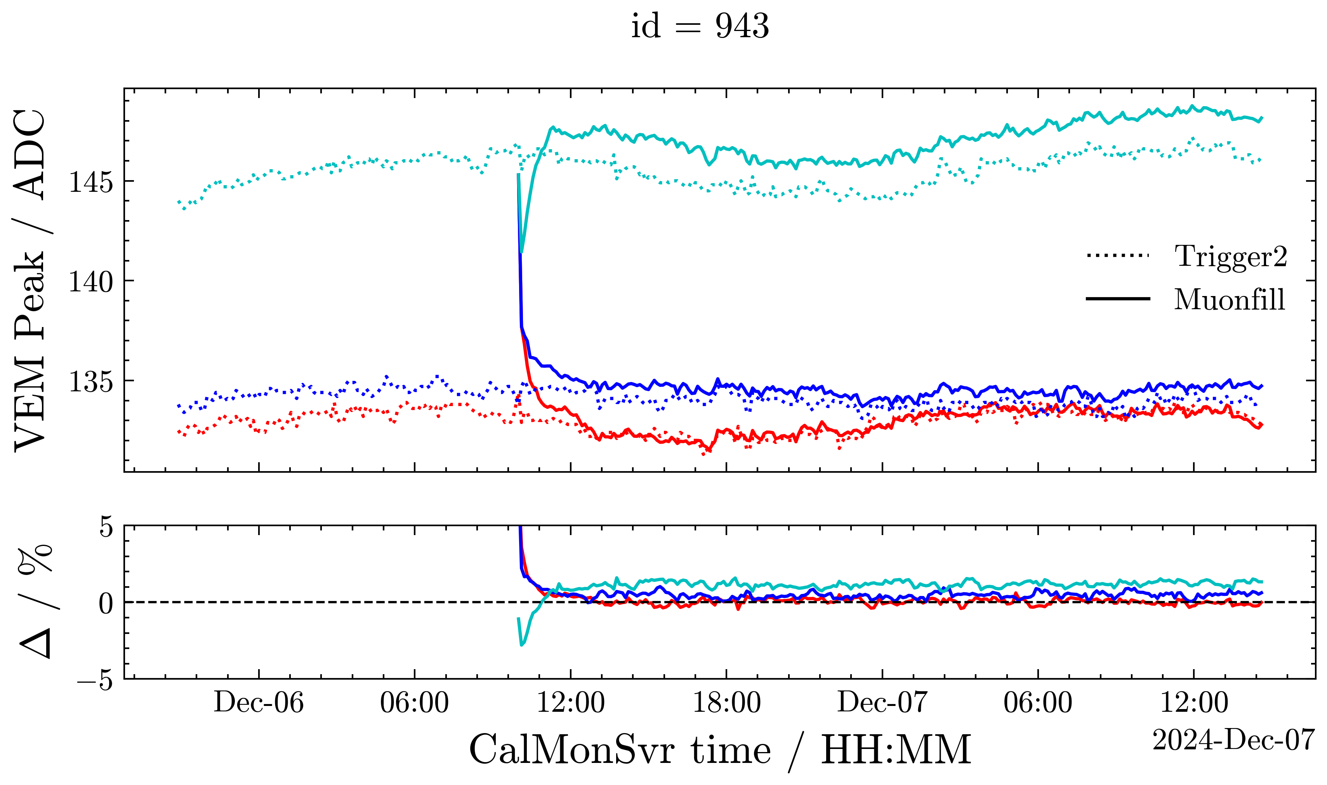

Slide 12
