Slide 1
SSD online calib status

Slide 2
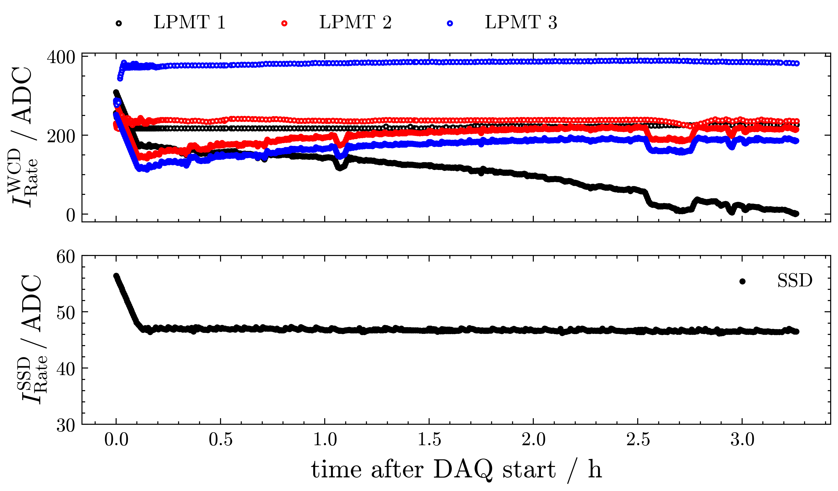
First results of integration test
SSD stable
Realistic?
too stable?
Some issues:
  WCD calib values
  DAQ restarts?

Slide 3
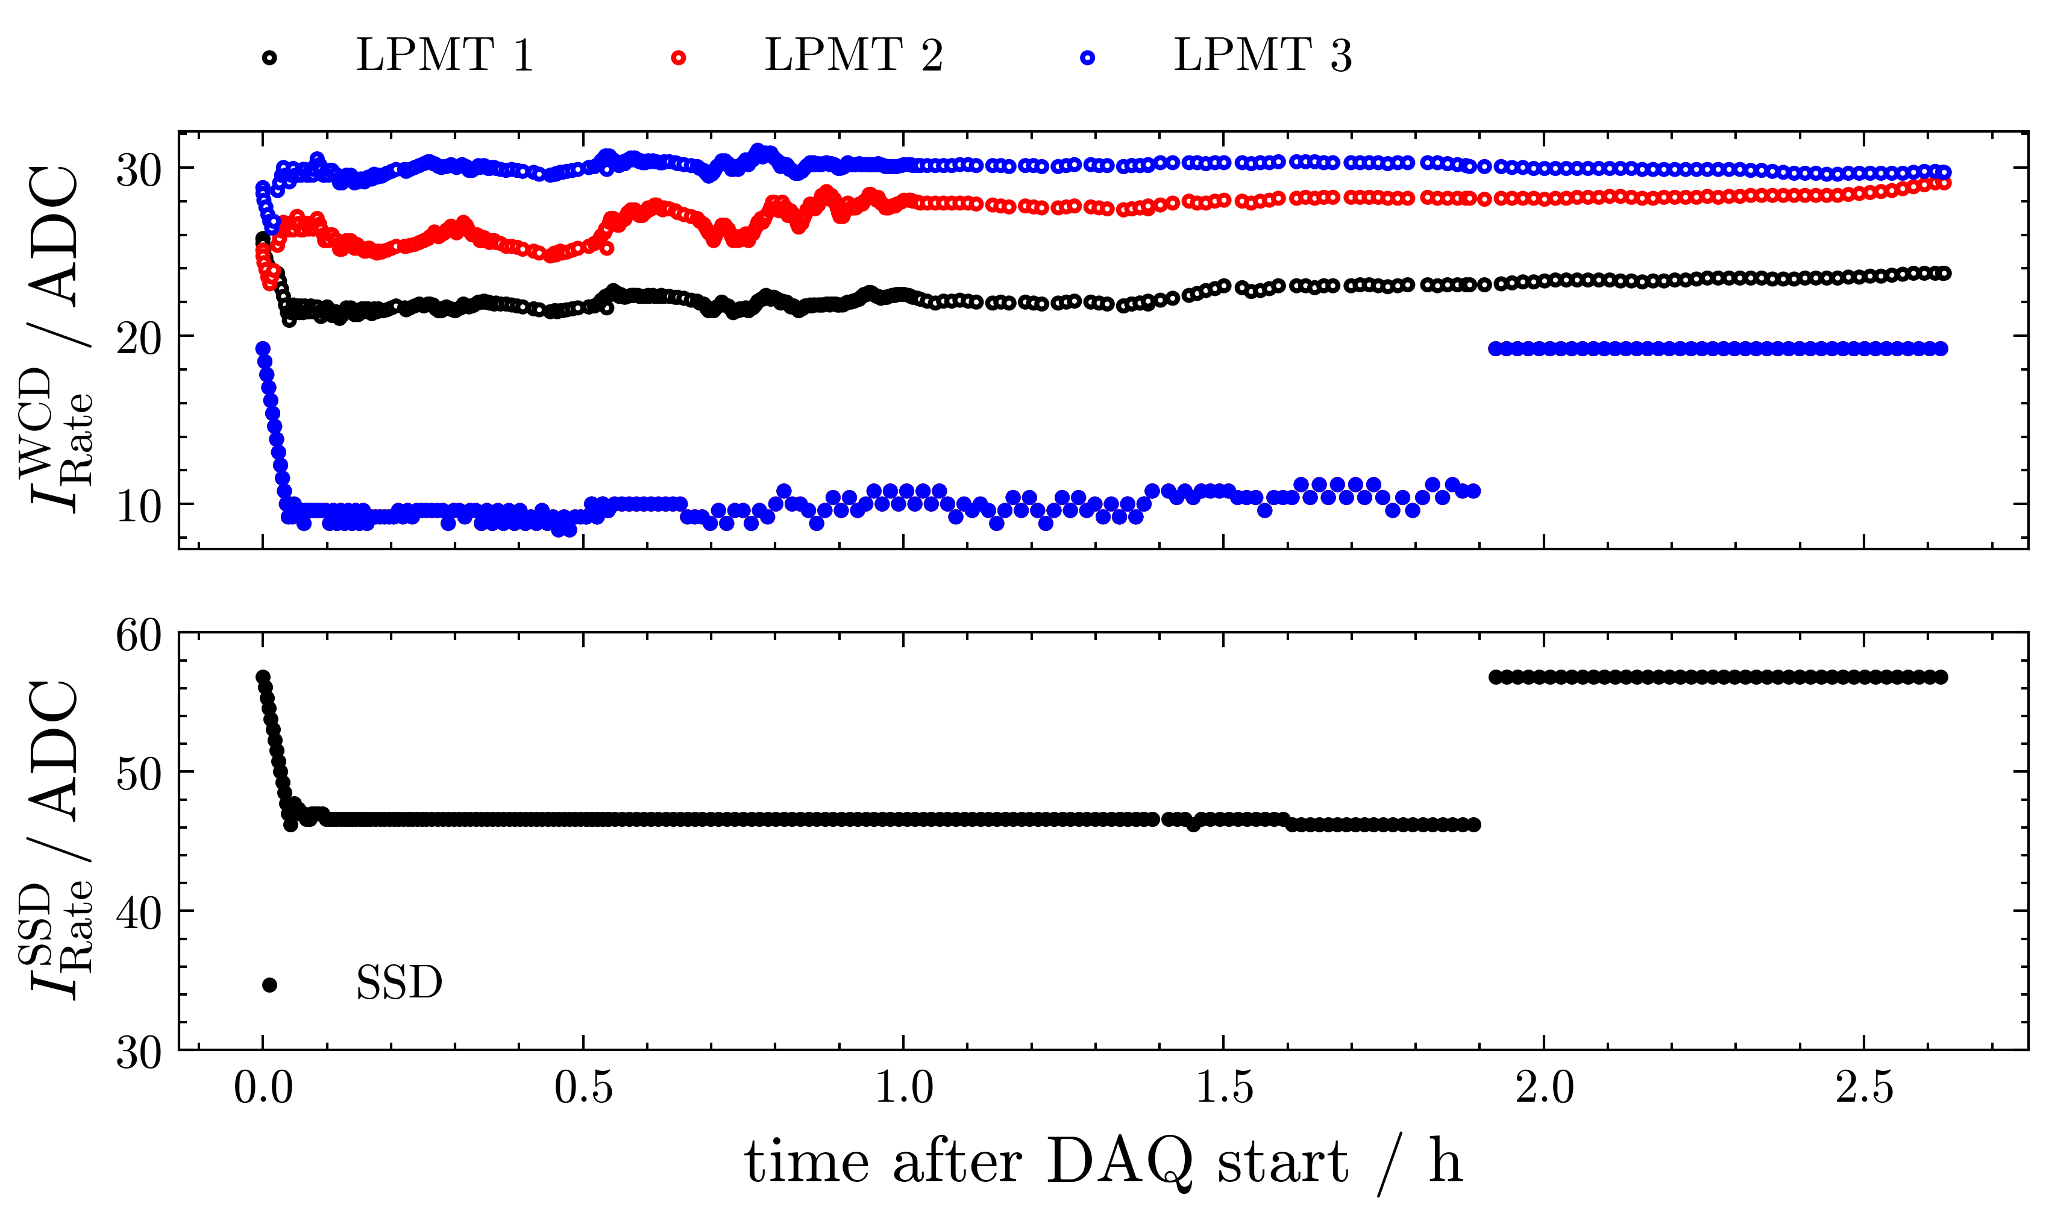
First results of integration test
SSD stable
Realistic?
too stable?
Some issues:
  WCD calib values
  DAQ restarts?

Slide 4
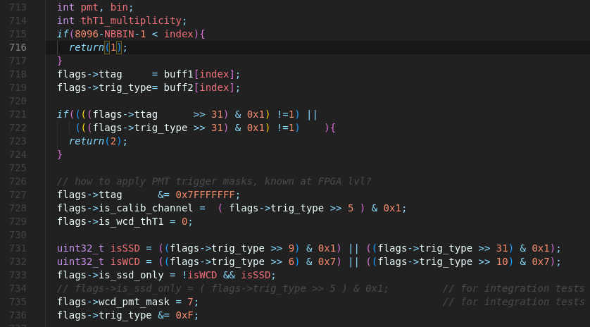
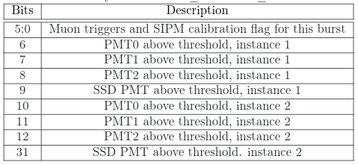
Open questions: trigger bits
Muonbuffer

Slide 5
Open questions: trigger bits
Muonbuffer

Slide 6
Open questions: trigger bits
Muonbuffer

Slide 7
Open questions: trigger bits
Muonbuffer
Showerbuffer
  Tube mask needed
  which bits to read?
  How to access?

Slide 8
Backup

Slide 9
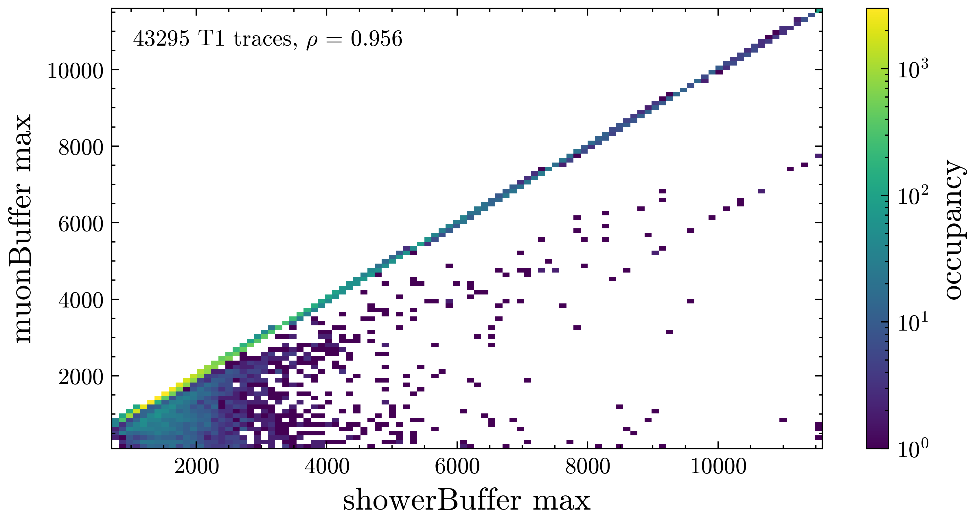

Slide 10
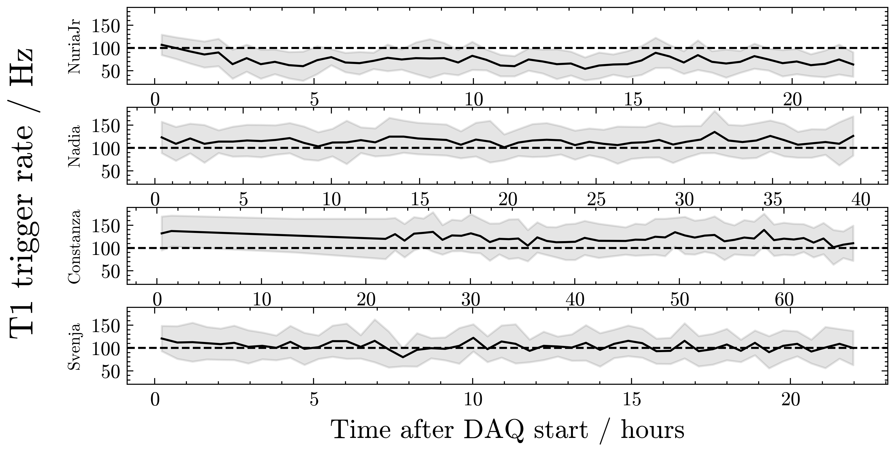

Slide 11
