Slide 1
SSD online calibration

Slide 2
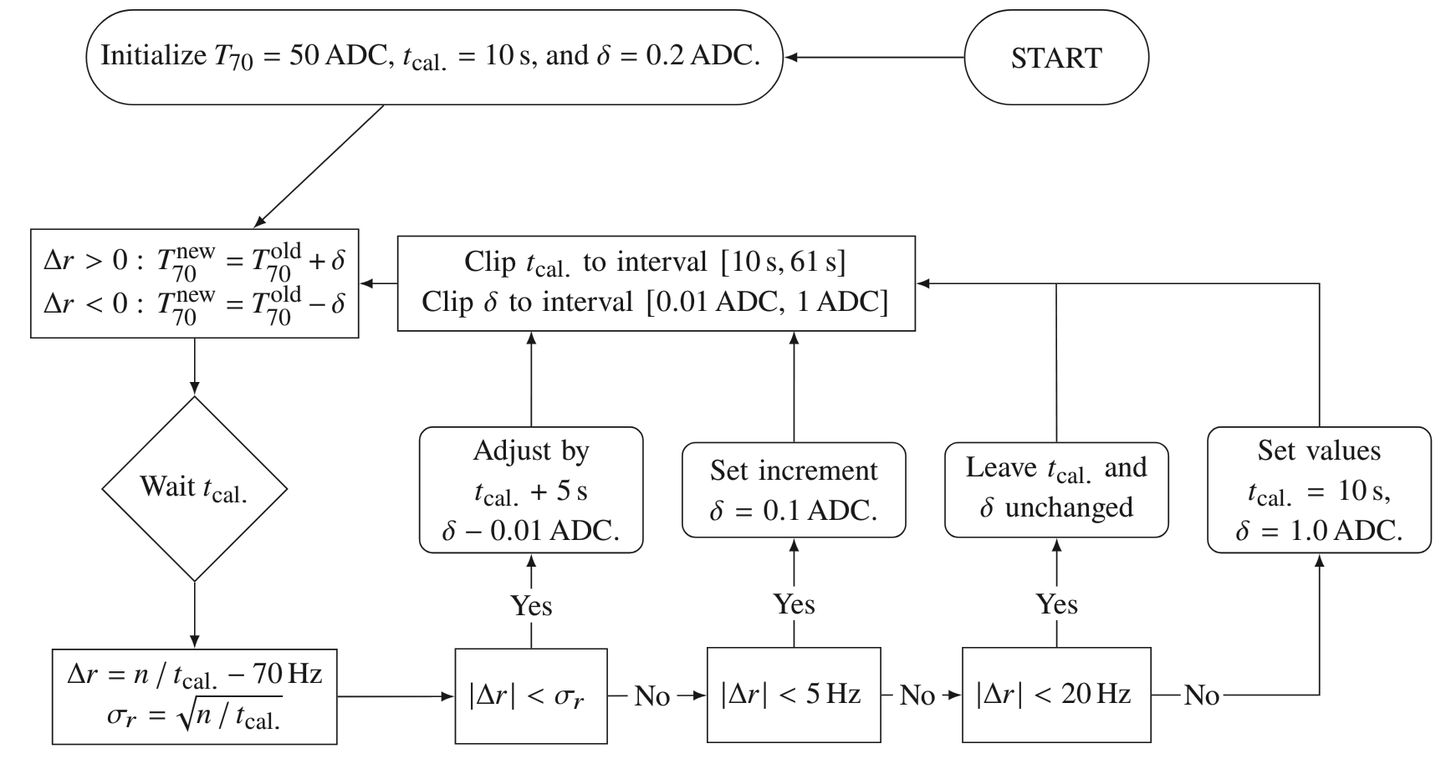
Recap
Estimate MIP peak independently for LS
Monitor SSD performance/exposure, trigger on scintillators
Accurate to ~5% *
GAP2024_023
GAP2024_065
PoS UHECR2025, 085

Slide 3
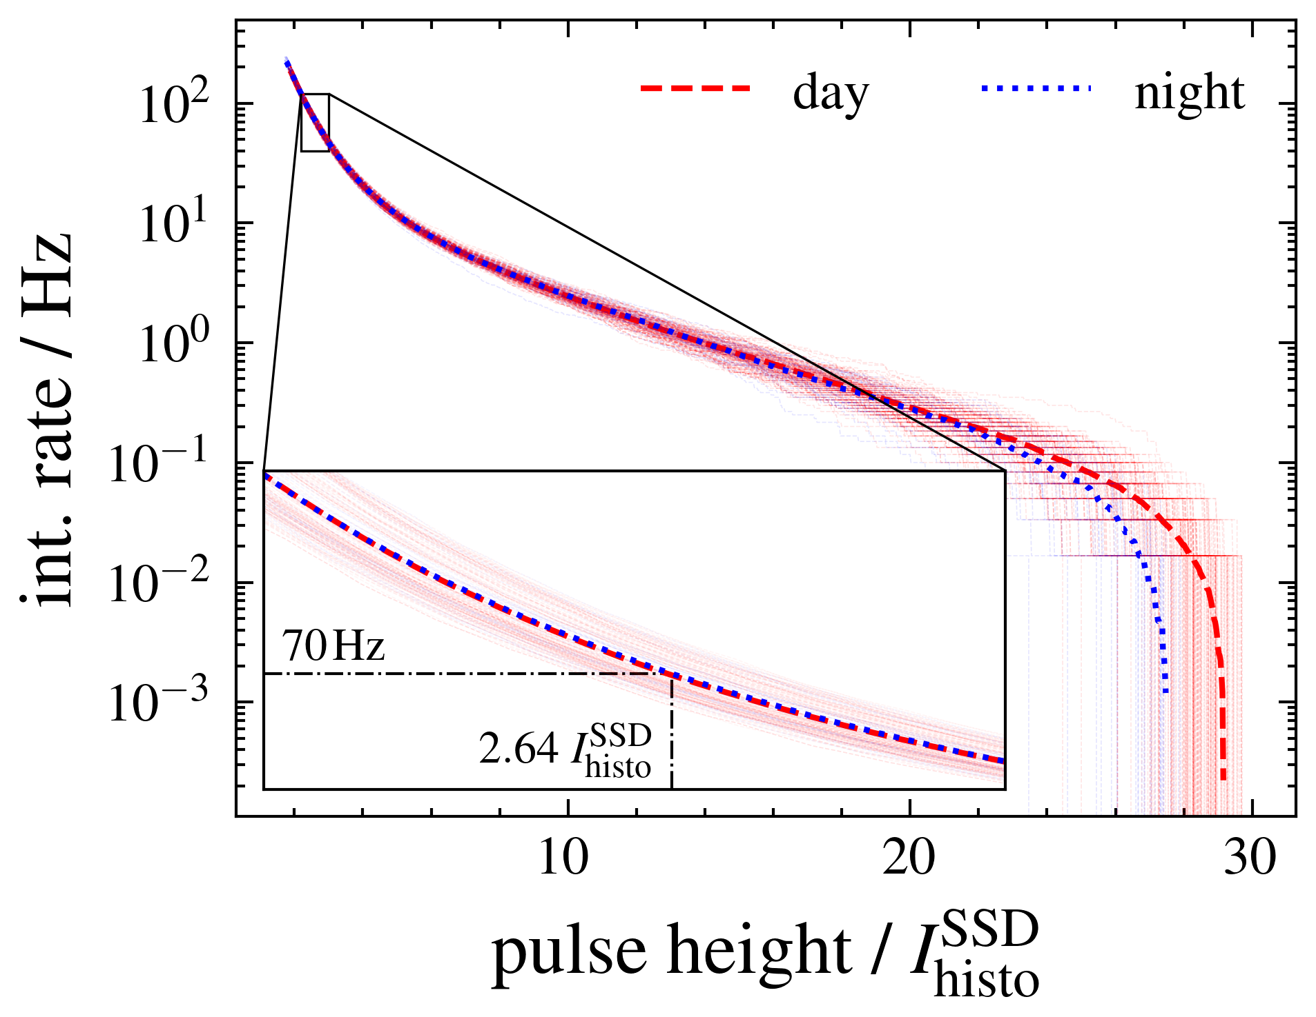
Recap
T70 trigger threshold correlates strongly with MIP peak
Get rate-threshold-relationship
from dedicated acquisition
Very similar to WCD calibration
Different implementation in LS

Slide 4
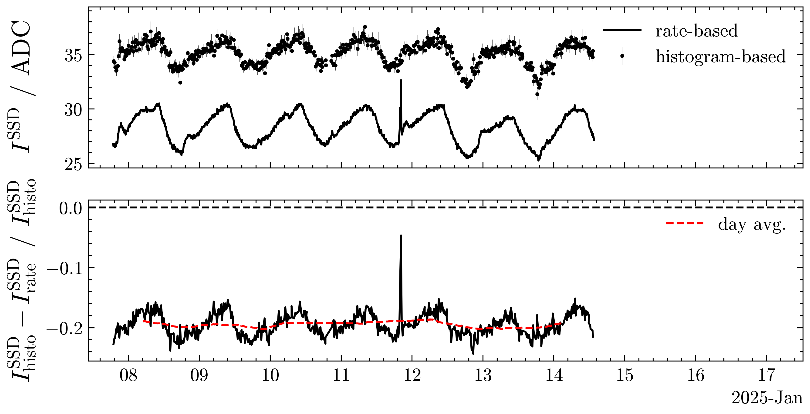
Histogram vs. Rate offset

Slide 5
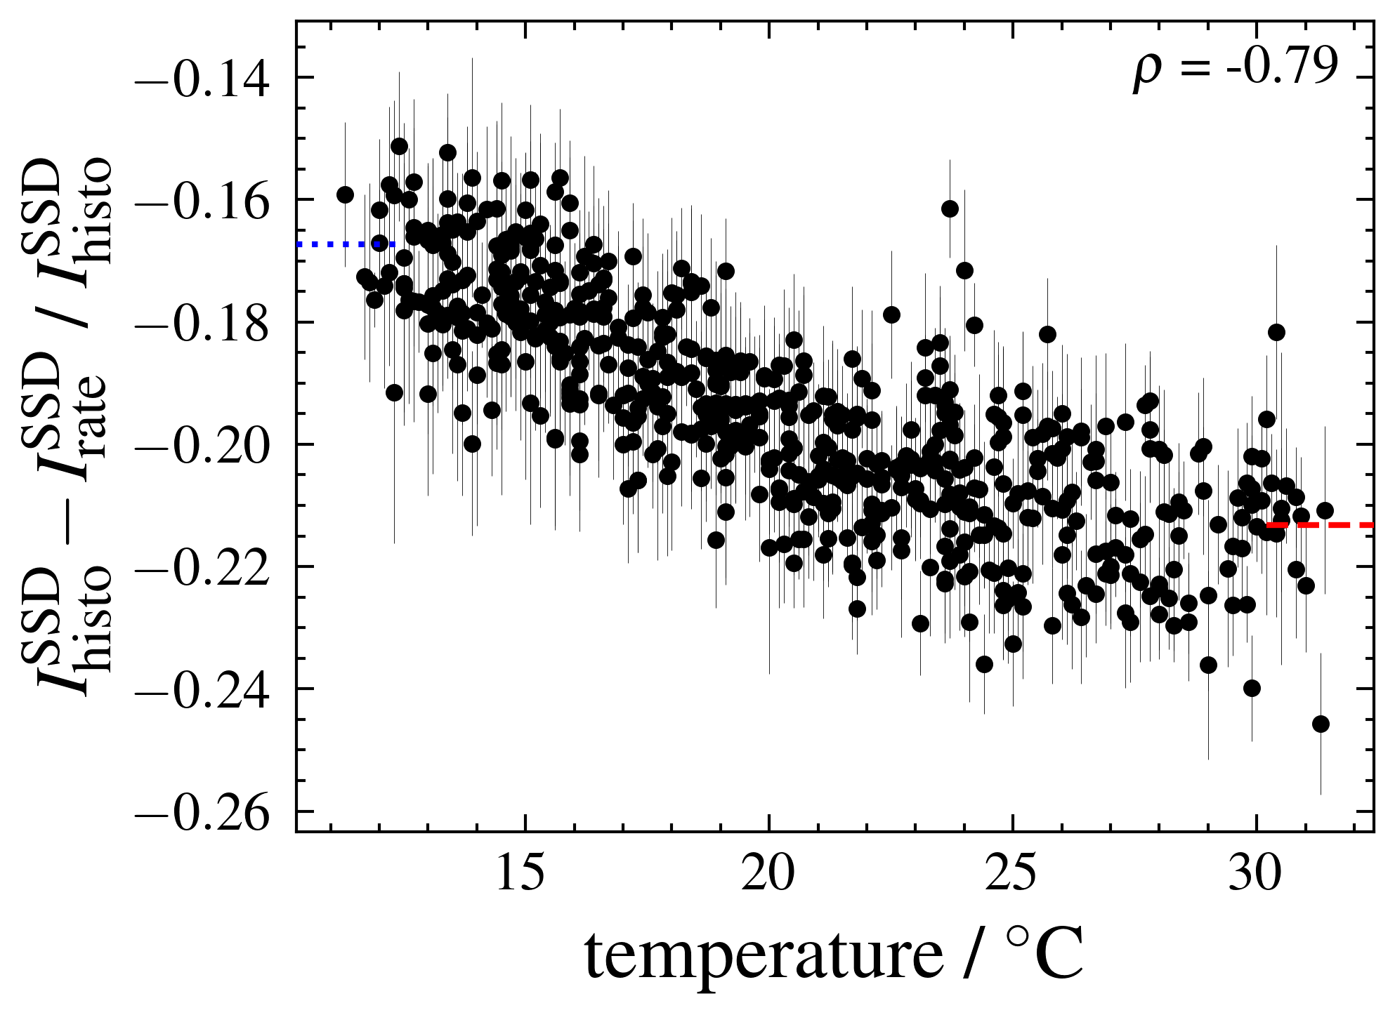
Histogram vs. Rate offset
~15-20% offset when comparing offline/online MIP peak
Temperature modulation ~5% small, but expected
Station (hardware) independent
No (big) seasonal fluctuations
Independent of threshold cut
Different station configuration during dedicated acquisition?

Slide 6
CDAS/LS implementation and performance

Slide 7
Backup

