Slide 1
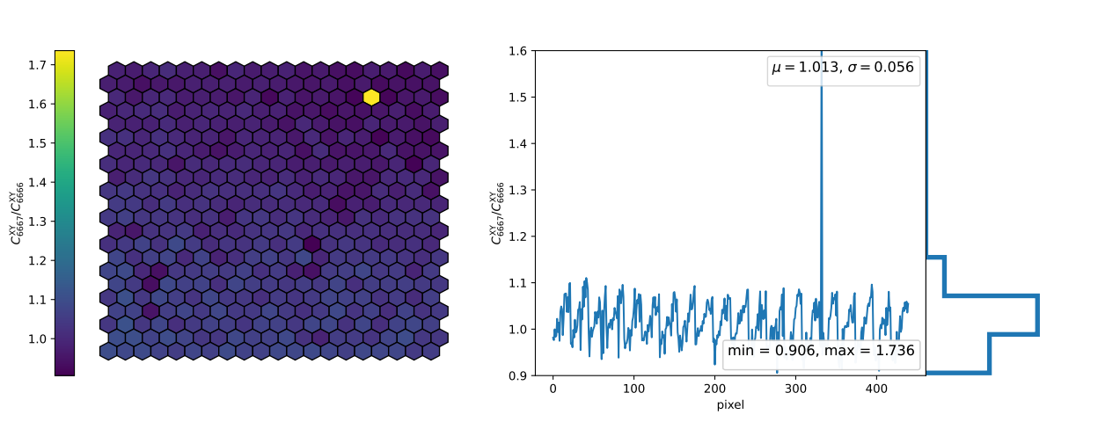
Heat #2 first XY run

Slide 2
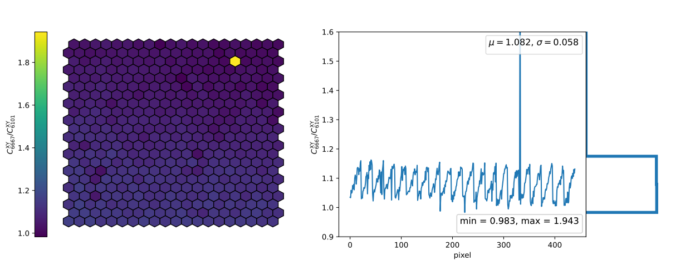
Heat #2 second XY run

Slide 3
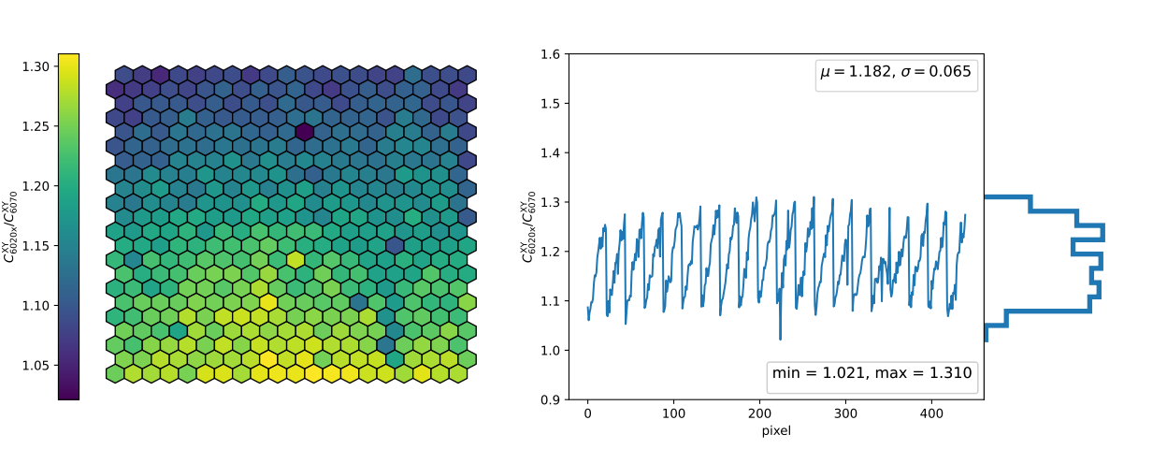
Heat #1 XY run

Slide 4
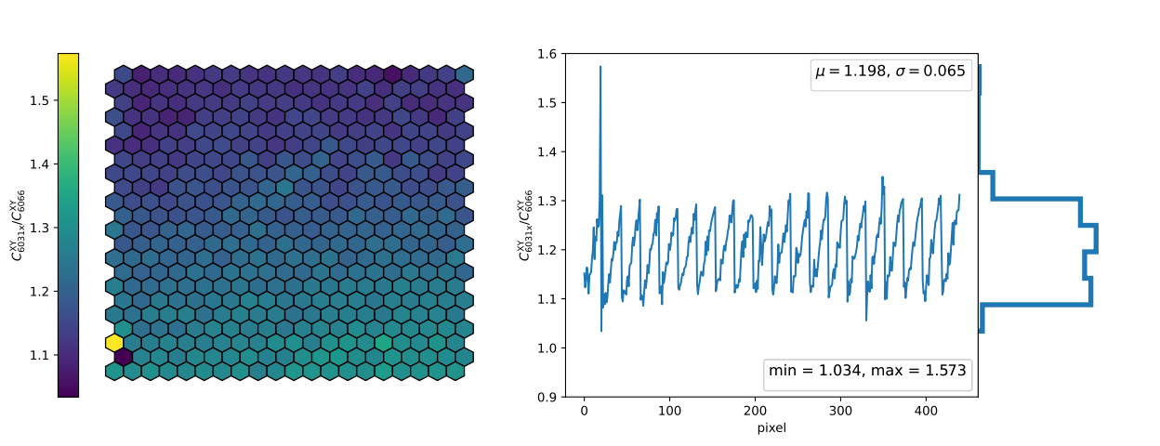
Heat #3 XY run

Slide 5
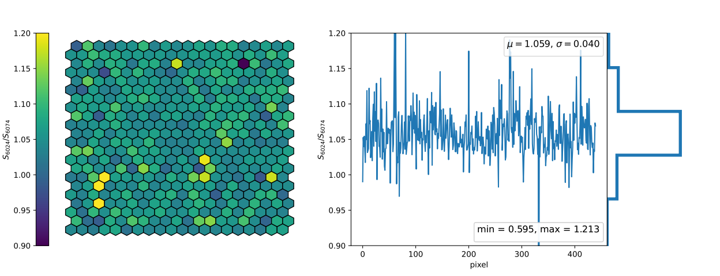
Heat #2 first CalA run

Slide 6
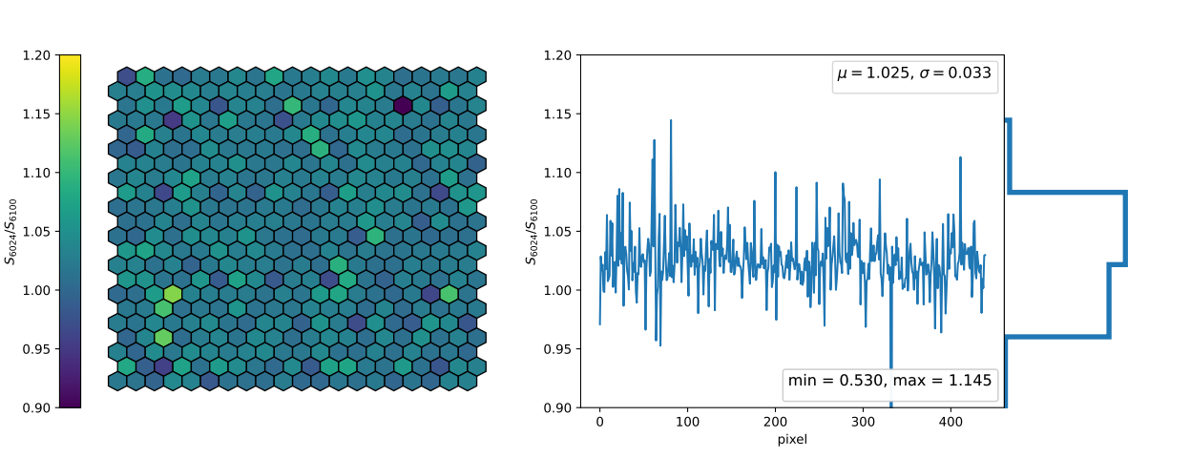
Heat #2 second CalA run

Slide 7
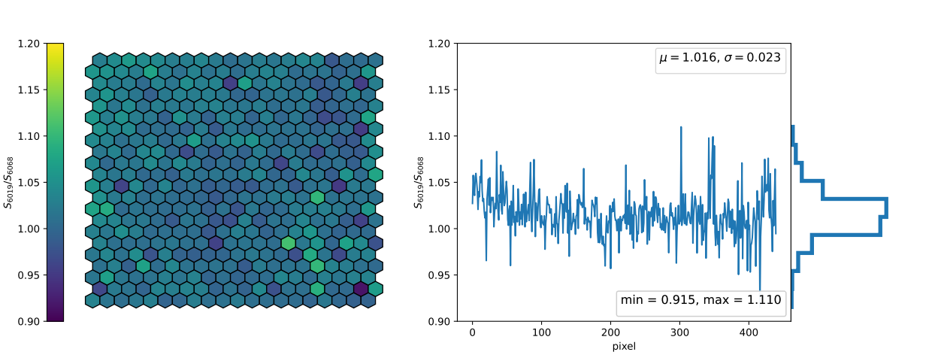
Heat #1 CalA run

Slide 8
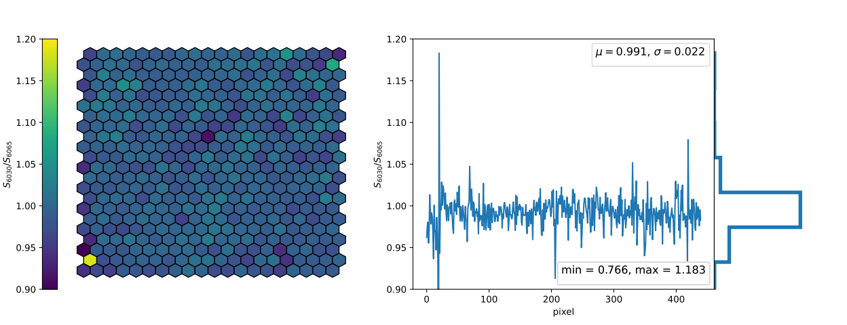
Heat #3 CalA run

