Slide 1
XY quality assurance + potential energy shift

Slide 2
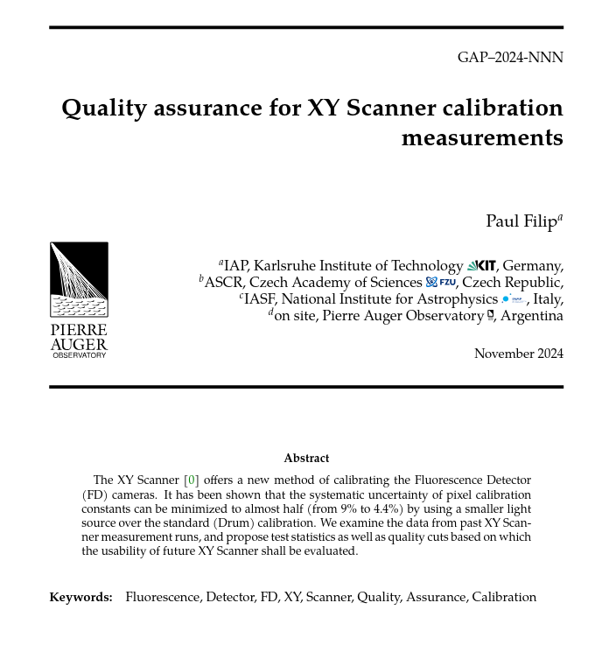
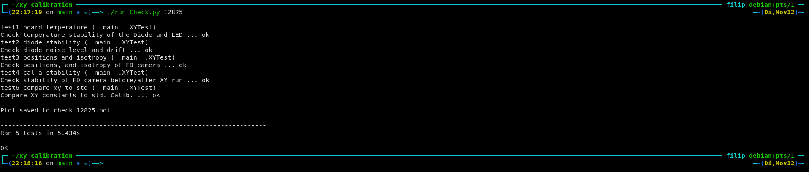
XY quality assurance
Python script for automatic testing
  Unit tests for XY run information
  Replaces plot_scripts code
  One application (= easy to use)
  Hard (TBD) selection criteria

Slide 3
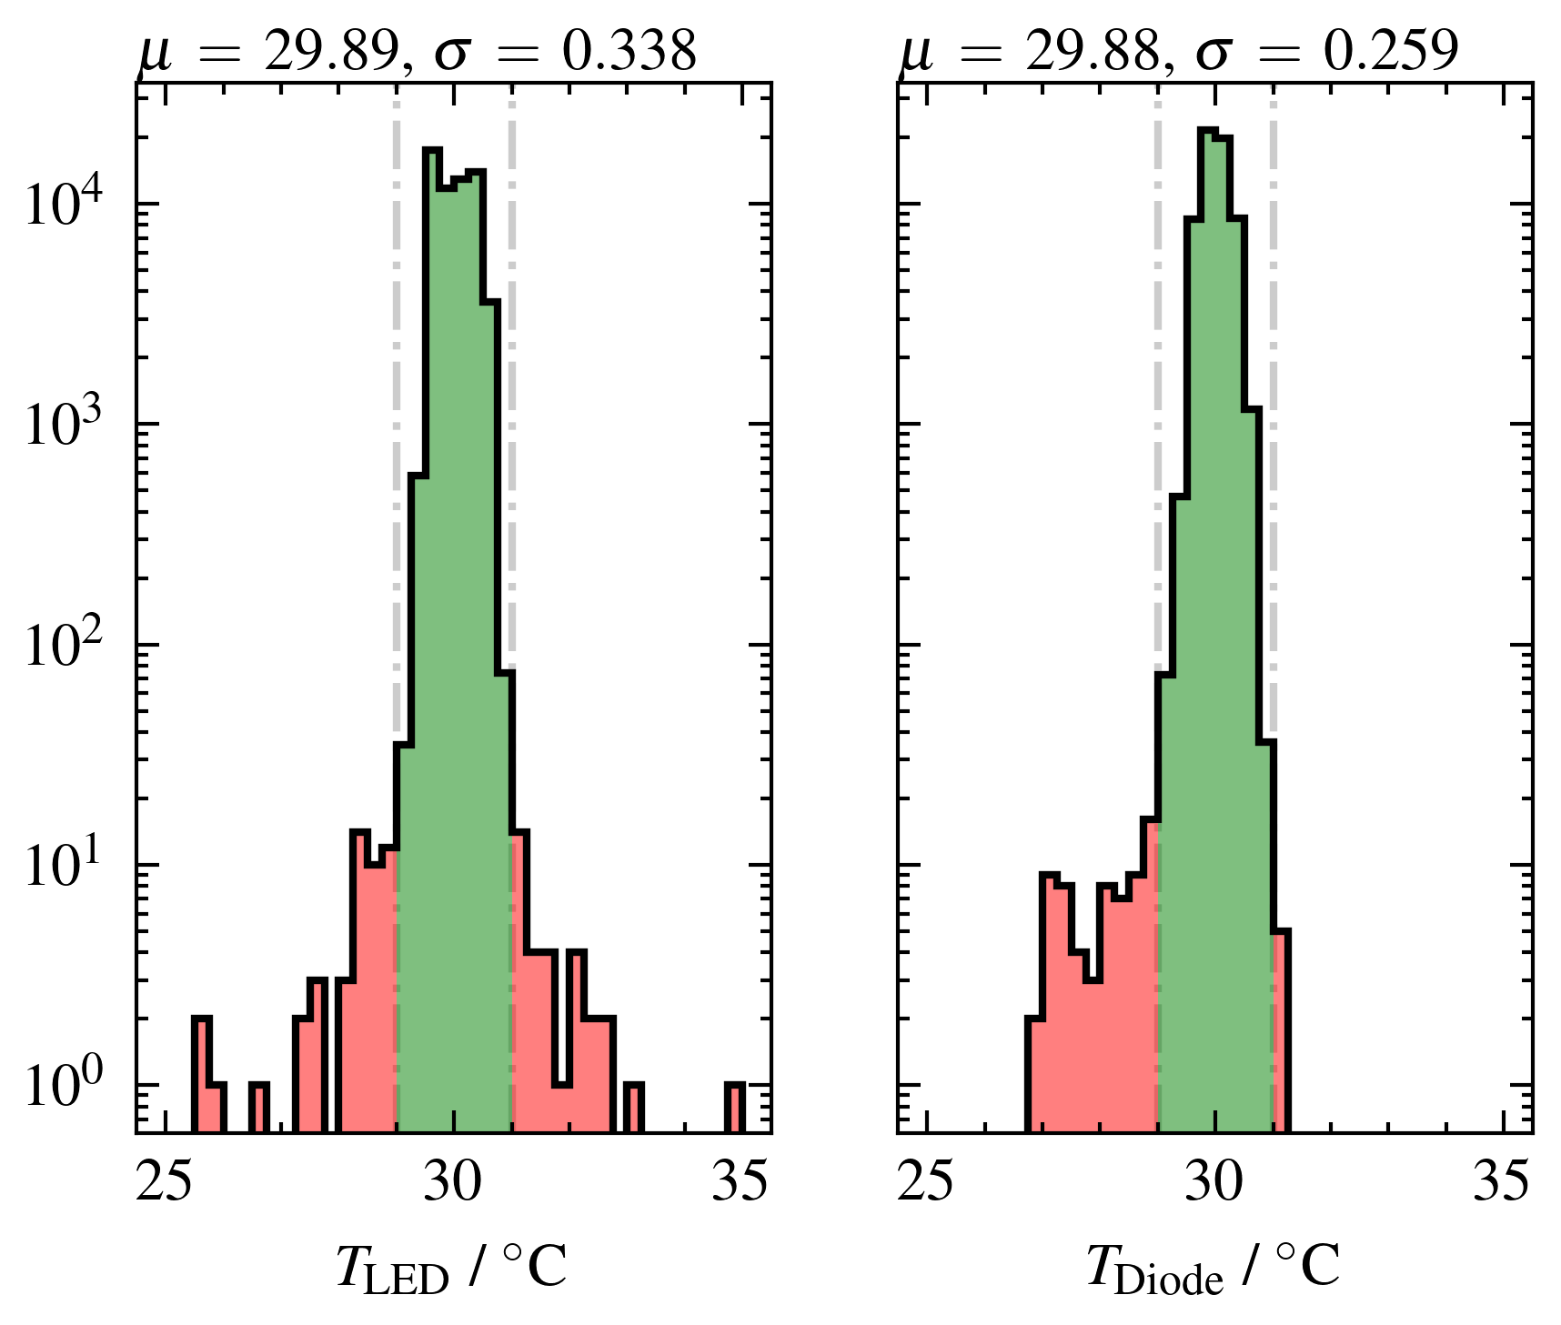
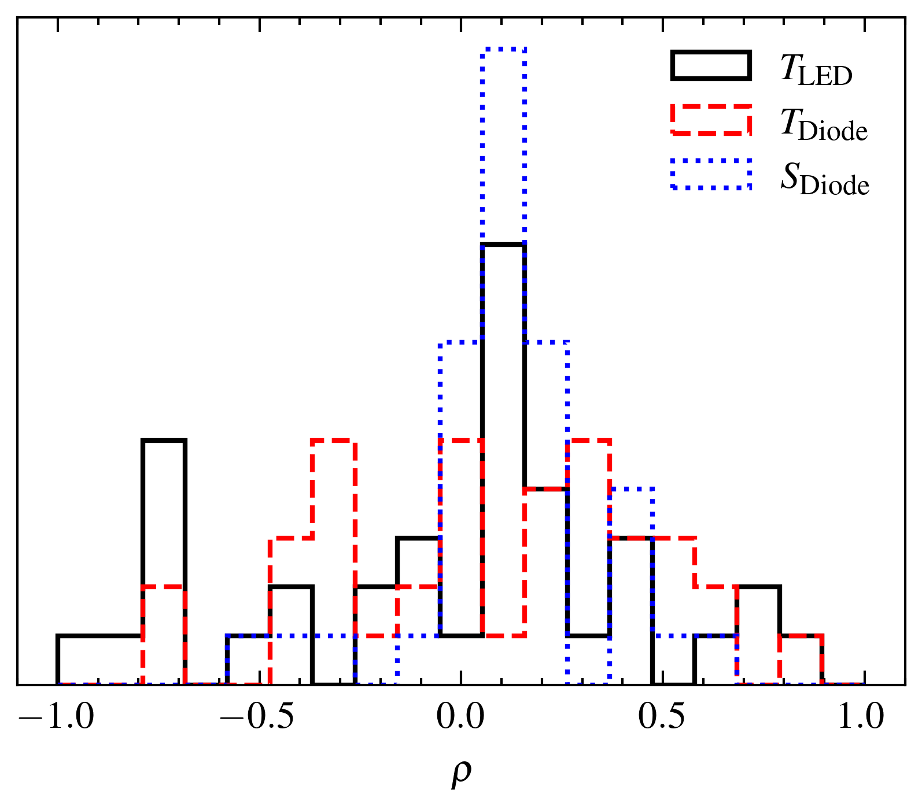
Unit tests – defining limits
Log distribution of all test statistics over all XY runs with:
  OLO sphere, LED up, 6 cm stepsize, d=10 cm, full aperture

Slide 4
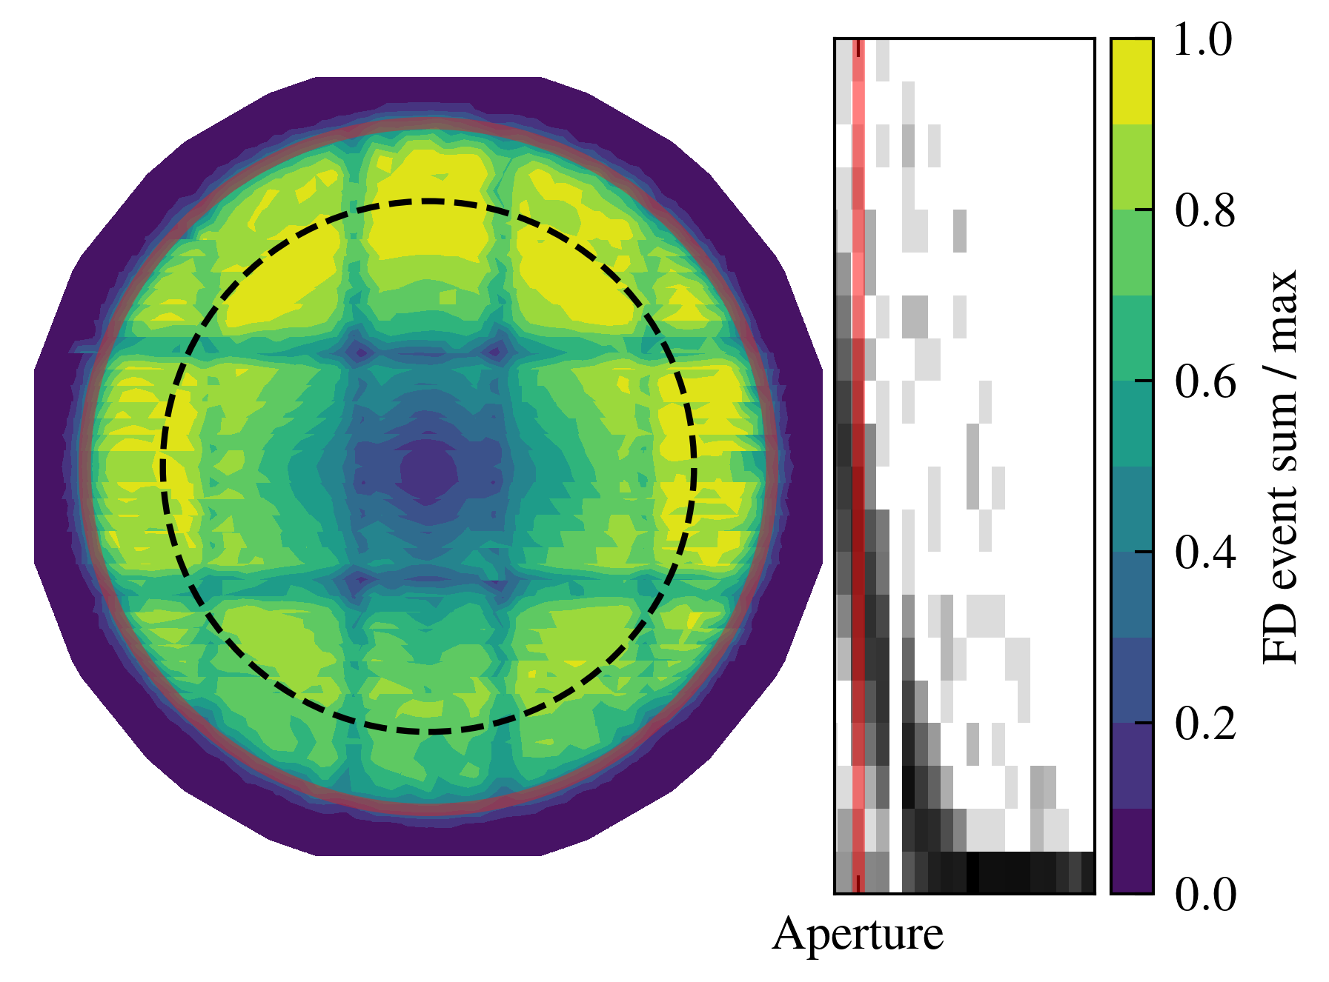
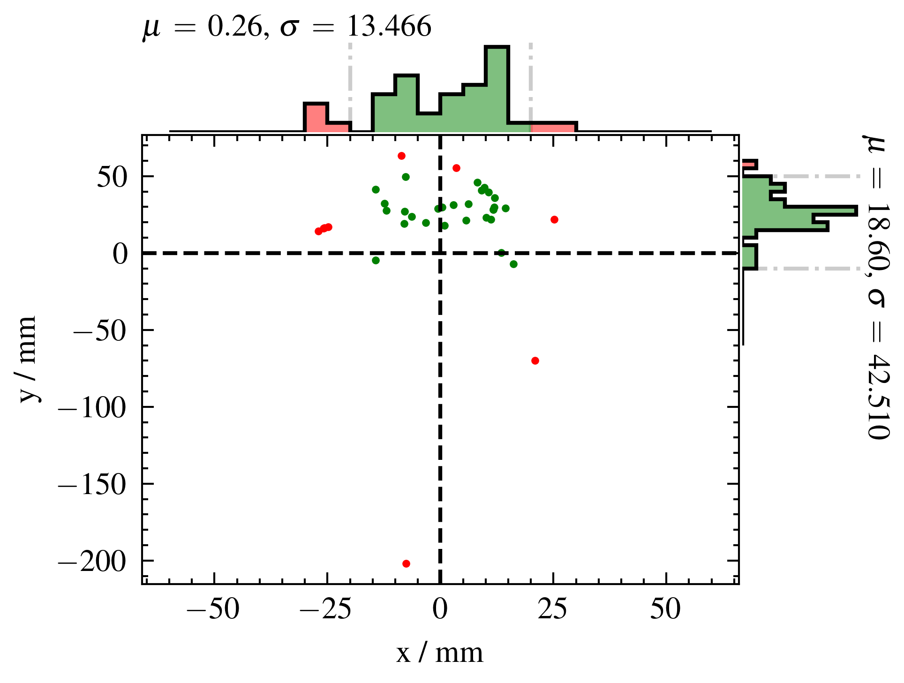
Unit tests – defining limits
Log distribution of all test statistics over all XY runs with:
  OLO sphere, LED up, 6 cm stepsize, d=10 cm, full aperture

Slide 5
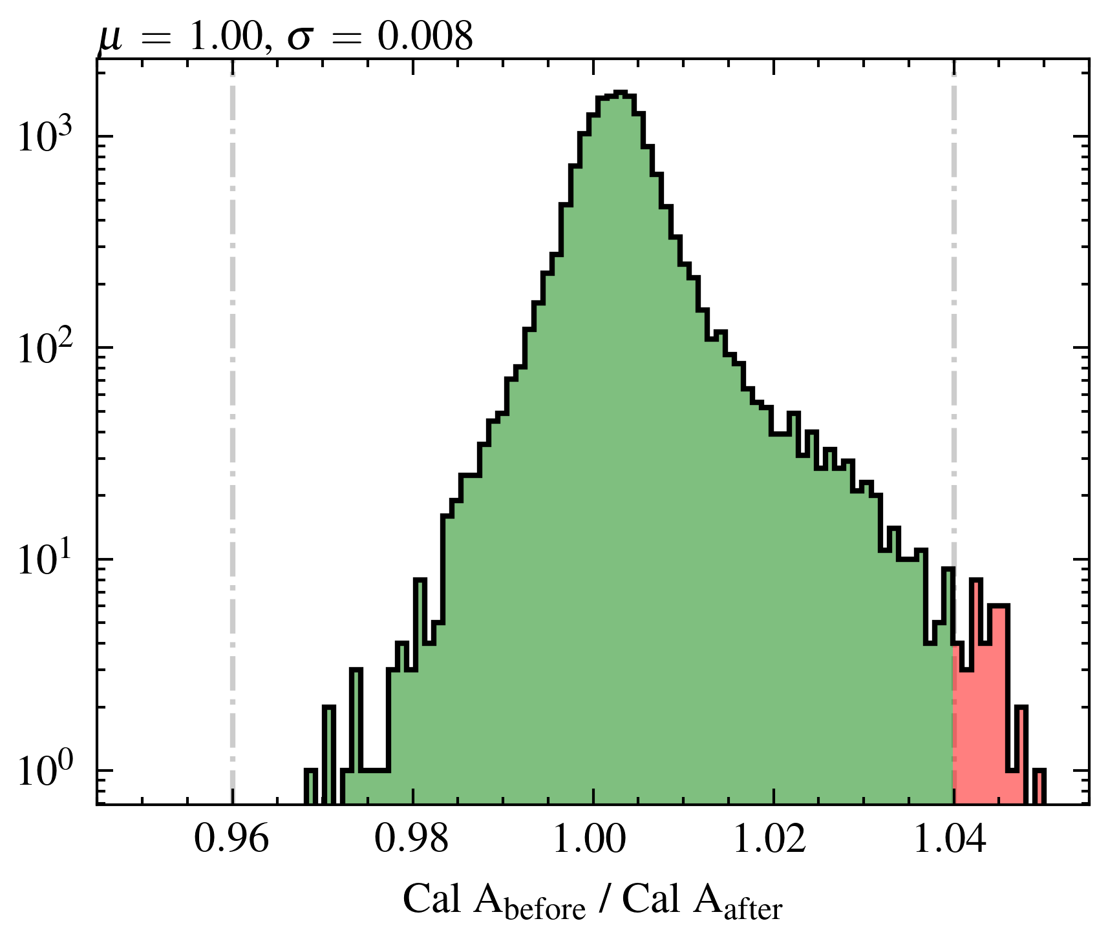
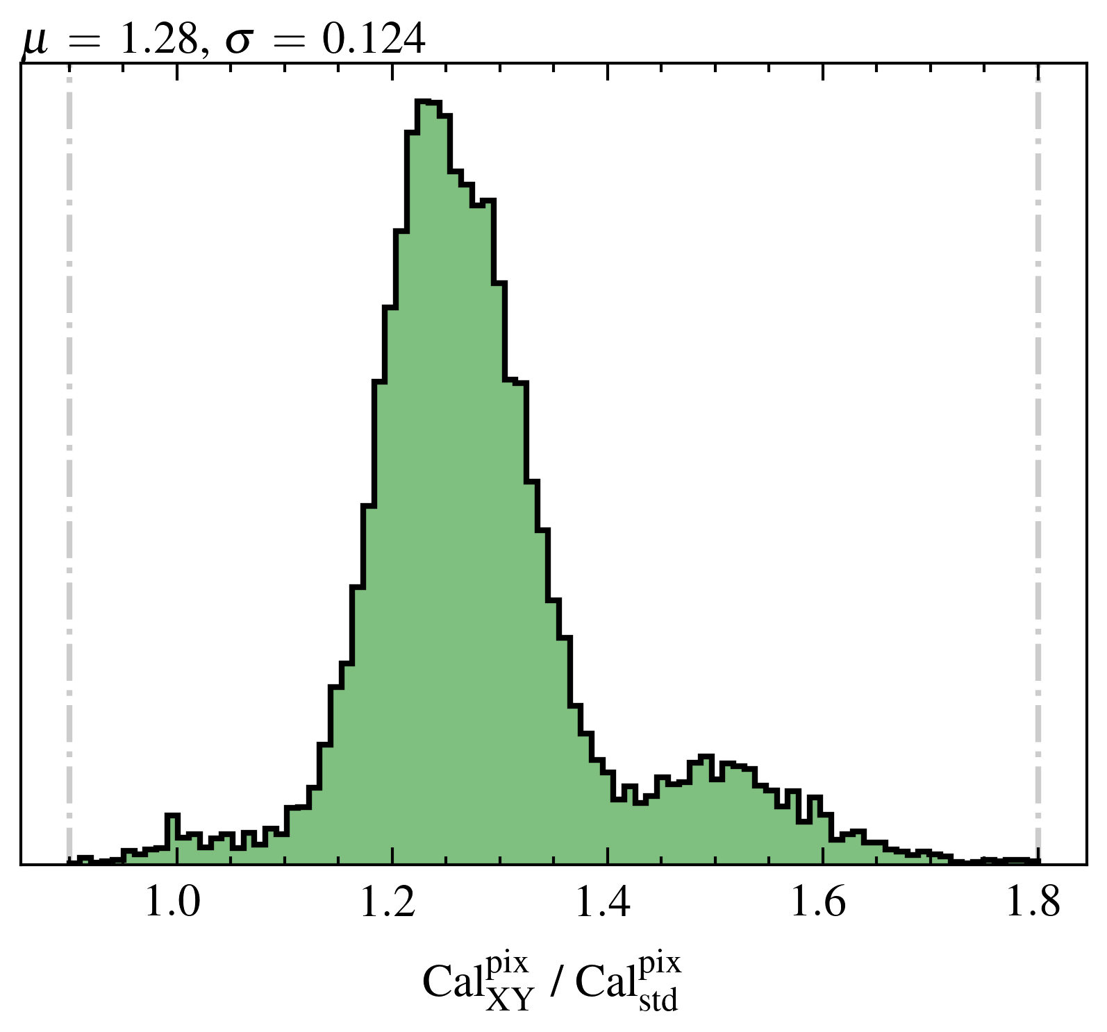
Unit tests – defining limits
Log distribution of all test statistics over all XY runs with:
  OLO sphere, LED up, 6 cm stepsize, d=10 cm, full aperture

Slide 6
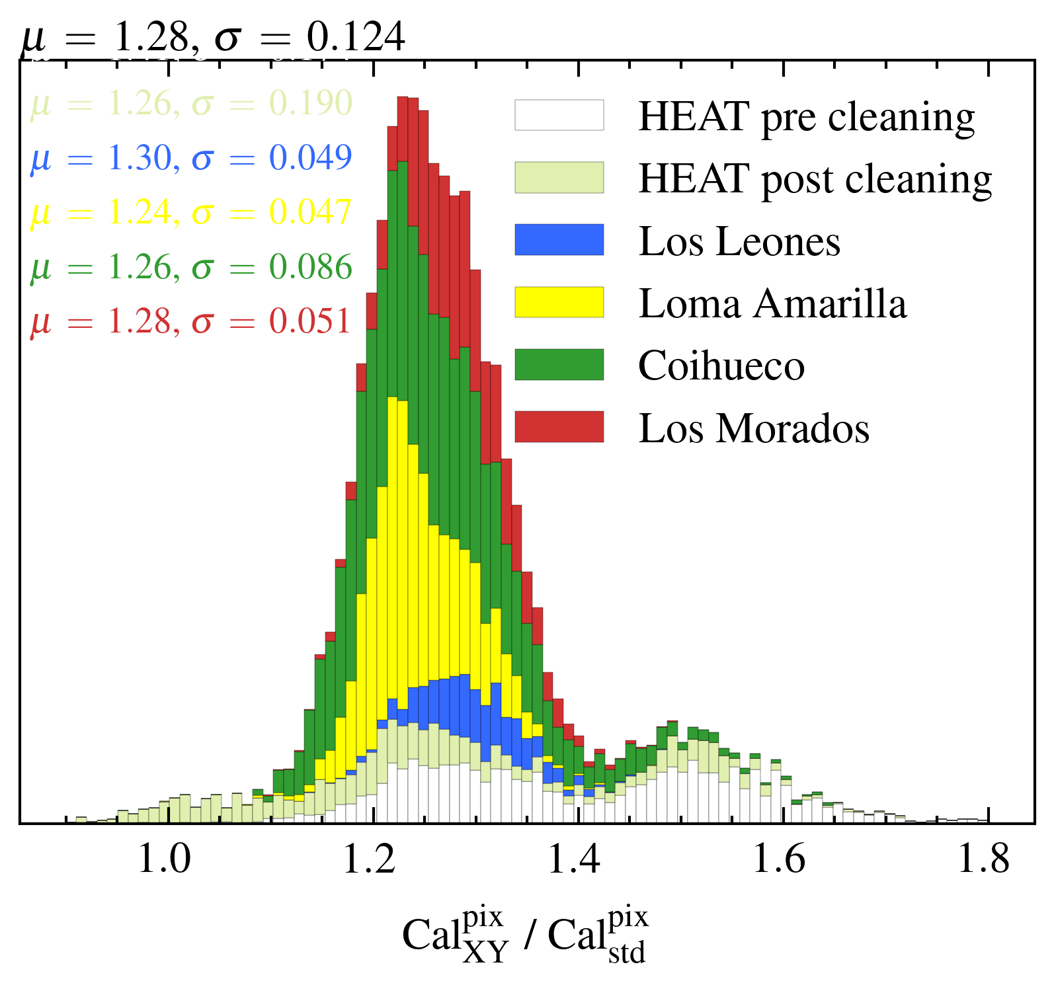
Potential energy shift
Given roughly by Cal XY ratio (corr.) vs. Cal A ratio
Average +25% change!
HE/CO have large spread
Mean driven by outliers
Differs from Christophs results by few percent

Slide 7
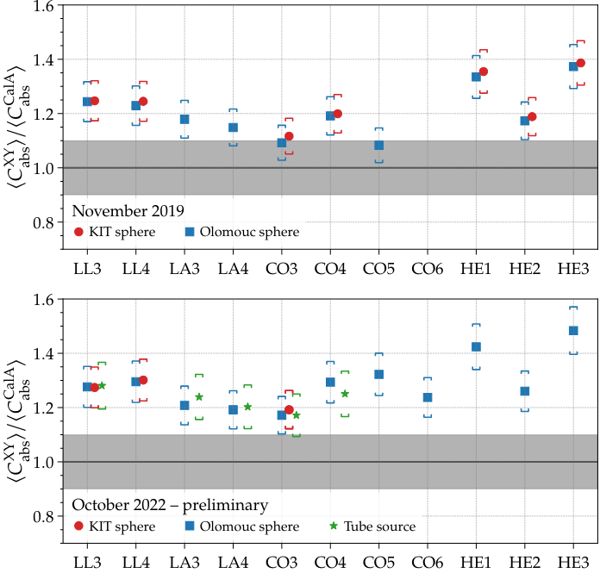
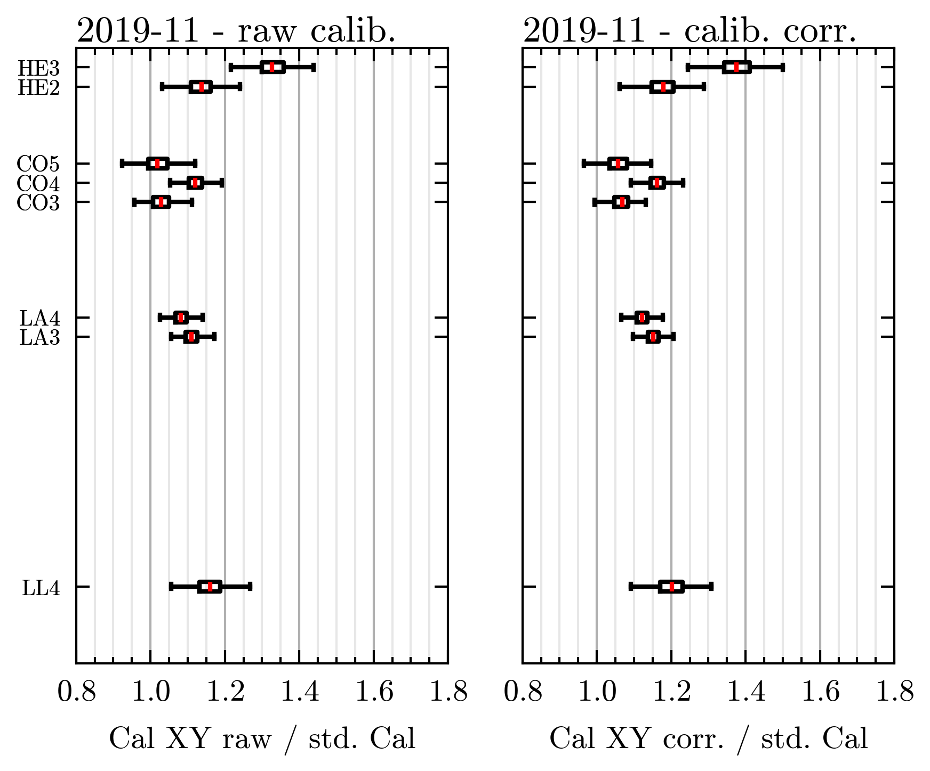
Potential energy shift

Slide 8
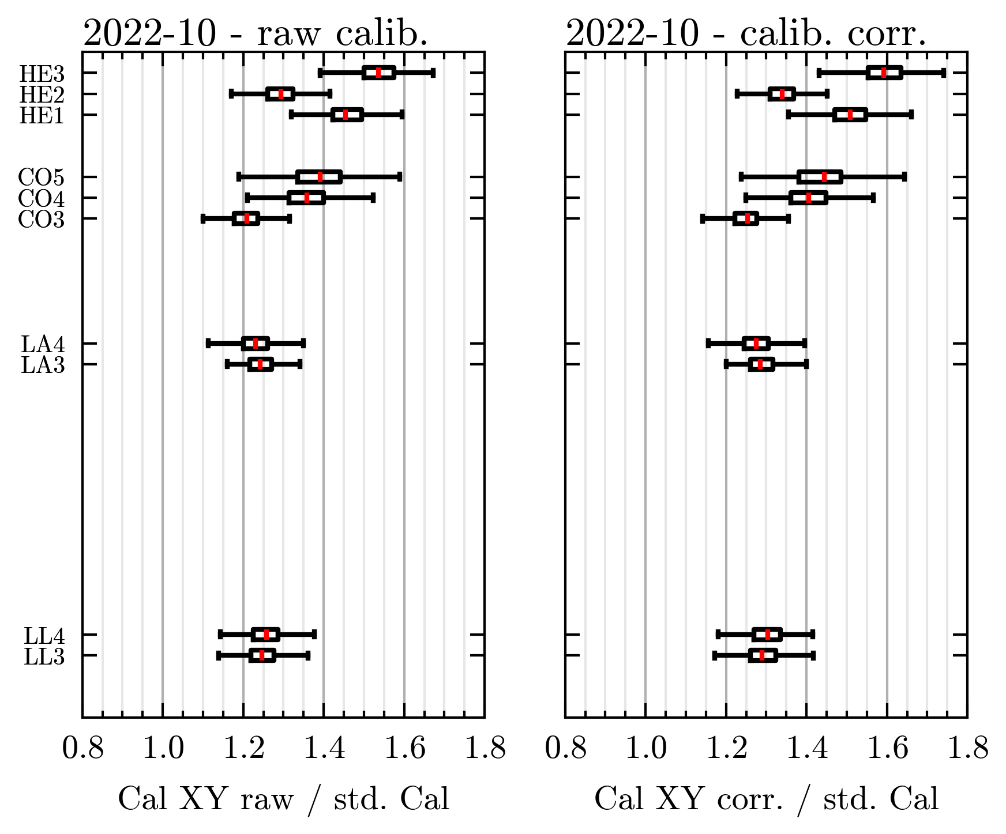
Potential energy shift

Slide 9
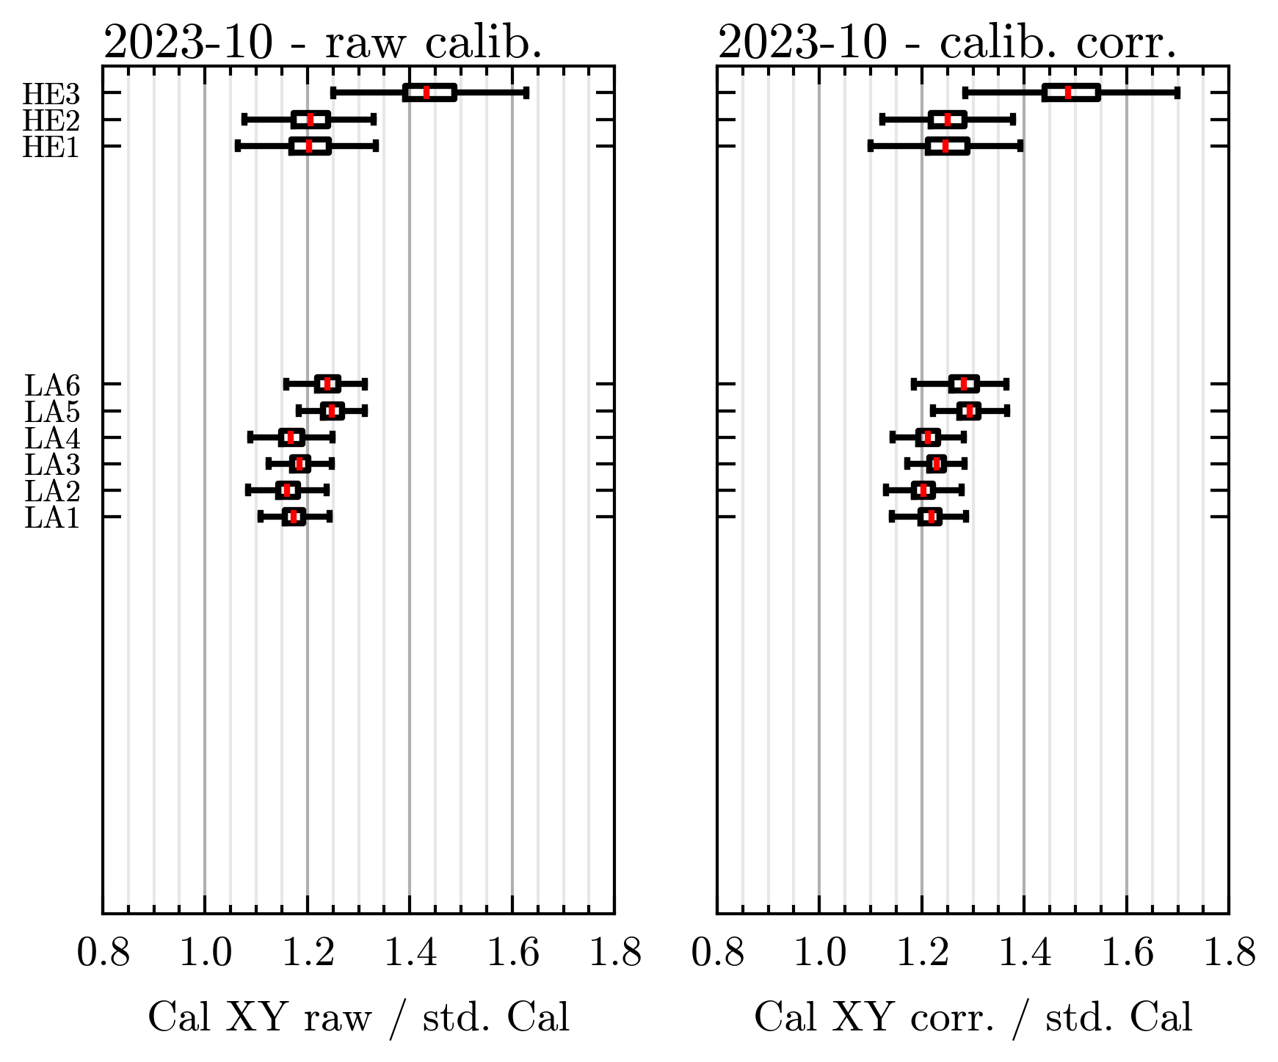
Potential energy shift

Slide 10
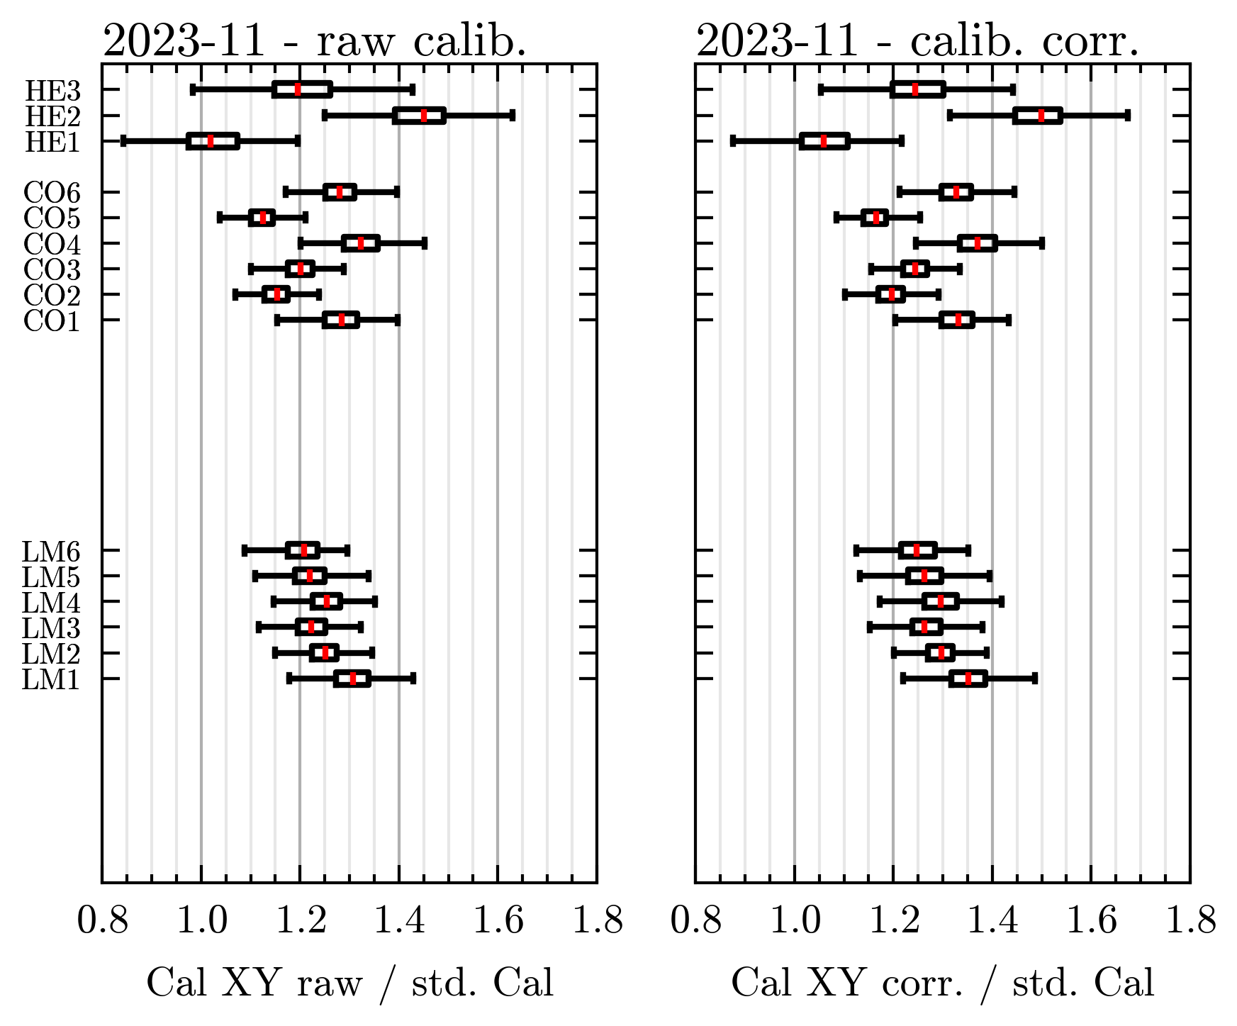
Potential energy shift

Slide 11
Backup

