Slide 1
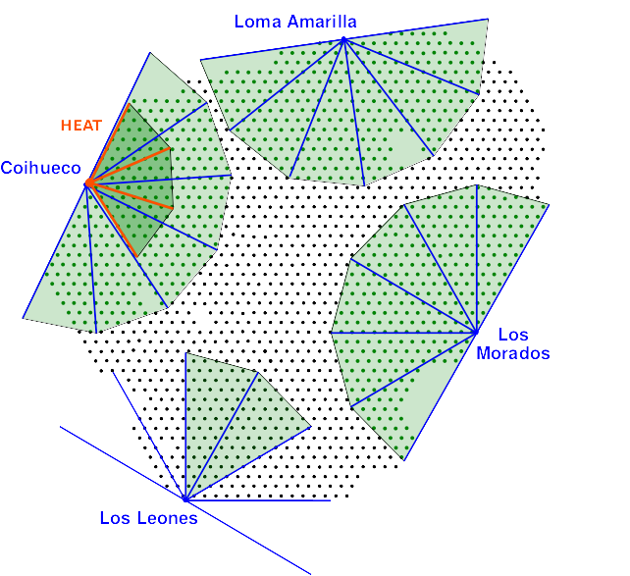
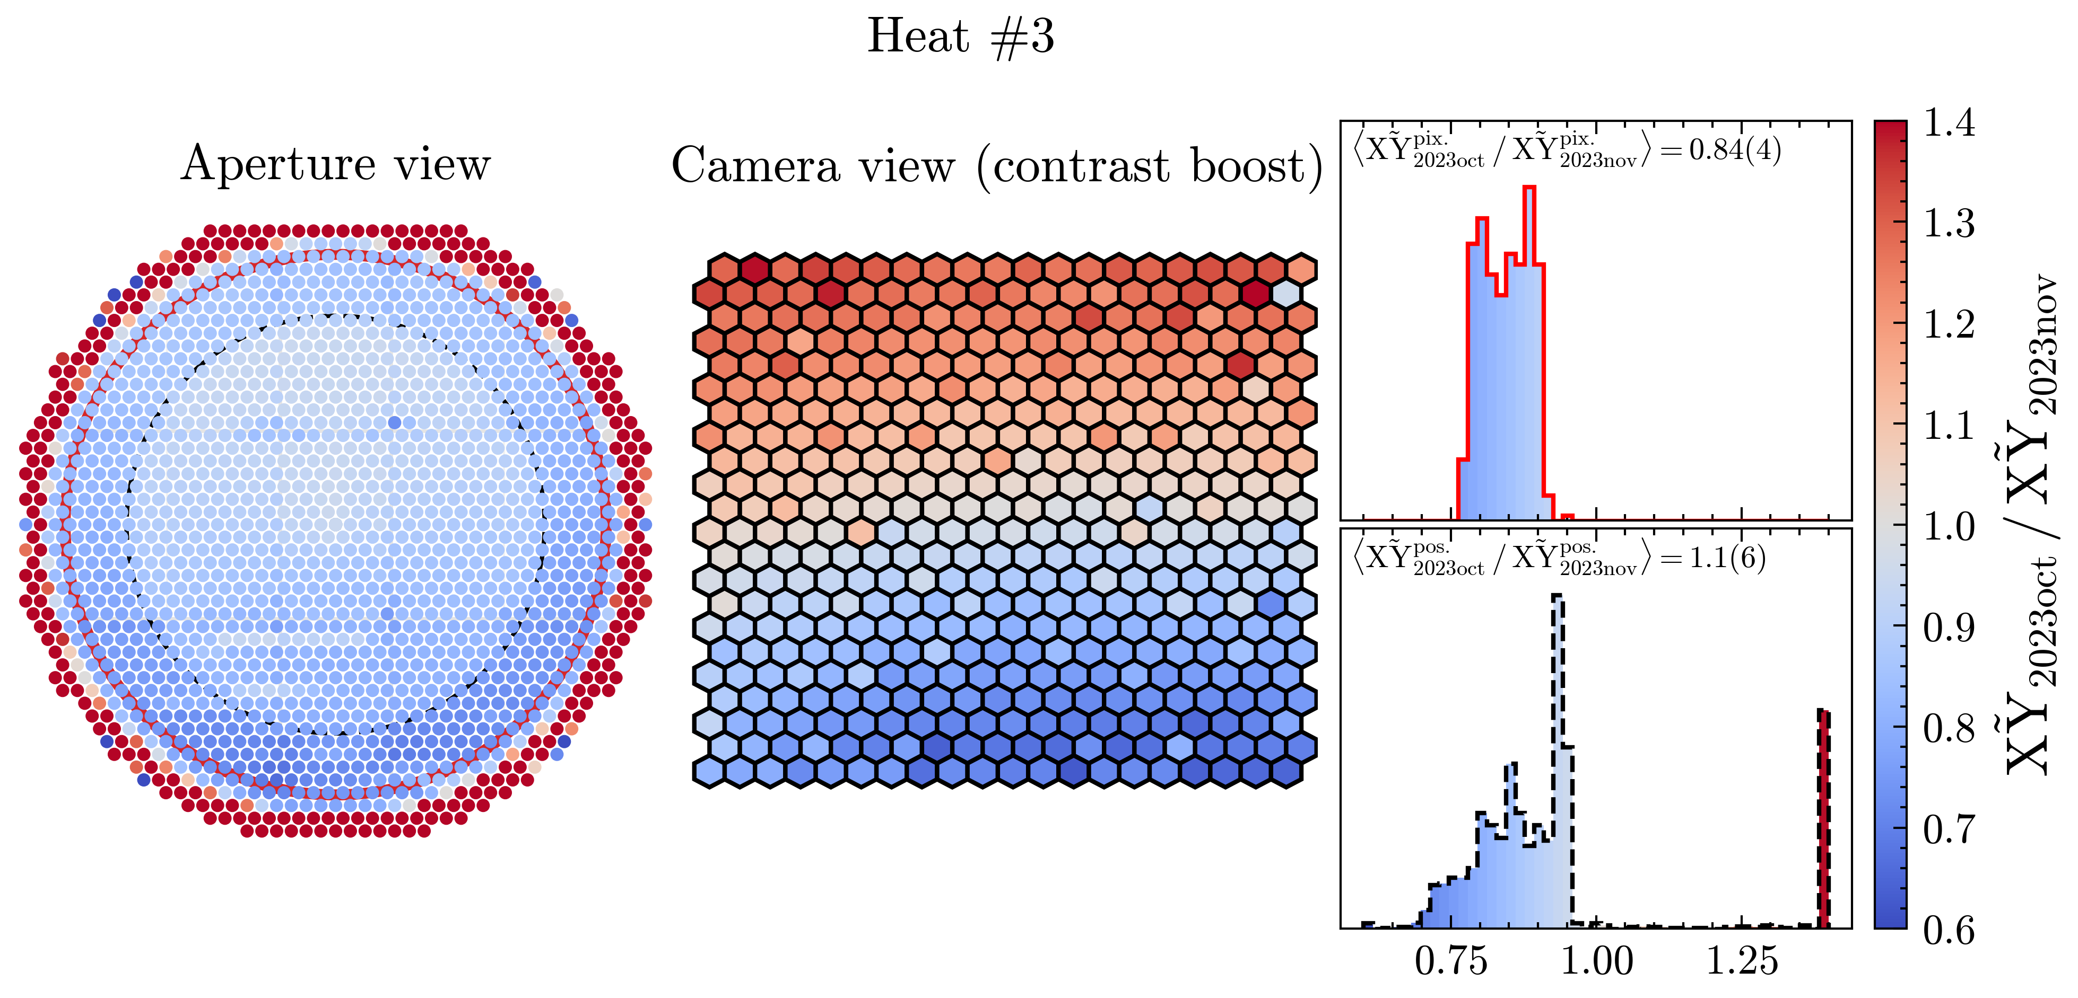
XY Scanner status
Current status:
  23/27 telescopes measured at least once
  Light source calibration in Karlsruhe, Wuppertal
  4.4% uncertainty on absolute FD calib
Open questions
  Effect of mirror cleaning on calib constants → see Calibration session
  Revisit reproducibility – claimed 1% too optimistic for some eyes?
Further plans
  LL mirrors 1, 2, 5, 6 in November 2024
  Add XY calib constants to database
  Calib. of light source at multiple sites
  Transition strategy between XY and Drum
~20% higher light collection after mirror cleaning @ HEAT1!

