Slide 1
Status/Results November XY Scanner Campaign

Slide 2
Review of November XY campaign
FD shift 2024/11/20 – 2024/12/07 (17 nights)
  9 DAQ nights
  31 measurement runs
  27 telescopes
  4 people
Thanks Hermann-Josef, Kai, Pavel, and Martin!

Slide 3
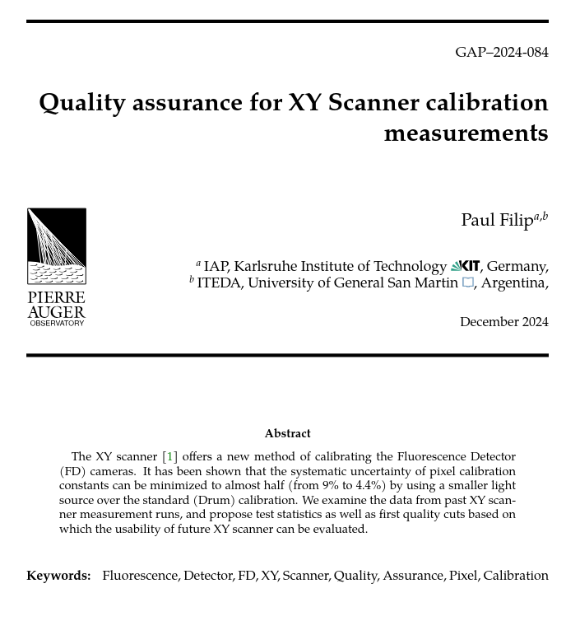
Quality control/cuts for calibration constants
GAP-2024-084
  Analyze past XY runs
  Identify/Explain outliers
  Propose quality cuts
Imposed quality cuts
  Light source stability
  Measurement setup
  FD Camera stability

Slide 4
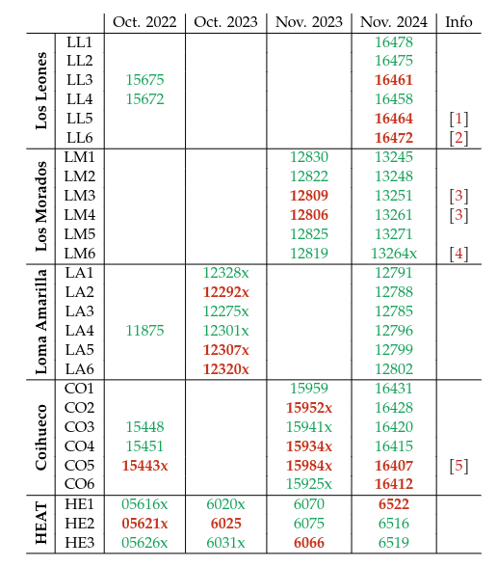
Quality control/cuts for calibration constants
GAP-2024-084
  Analyze past XY runs
  Identify/Explain outliers
  Propose quality cuts
Imposed quality cuts
  Light source stability
  Measurement setup
  FD Camera stability

Slide 5
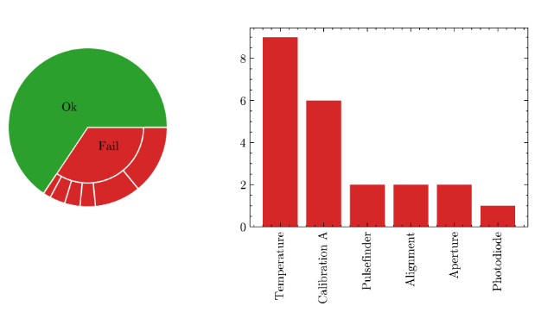
Quality control/cuts for calibration constants
Most rejections stem from environmental influences
  Temperature of LED between 29 and 31 degrees for every flash
  Cal A mean of pixels before/after within 2.5%, max deviation <7.5%
  Selection criteria for Cal A and Temperature too restrictive?
  Single flash contributes <1% to exposed total signal
  Camera drifts unavoidable in the first nights of the FD shift

Slide 6
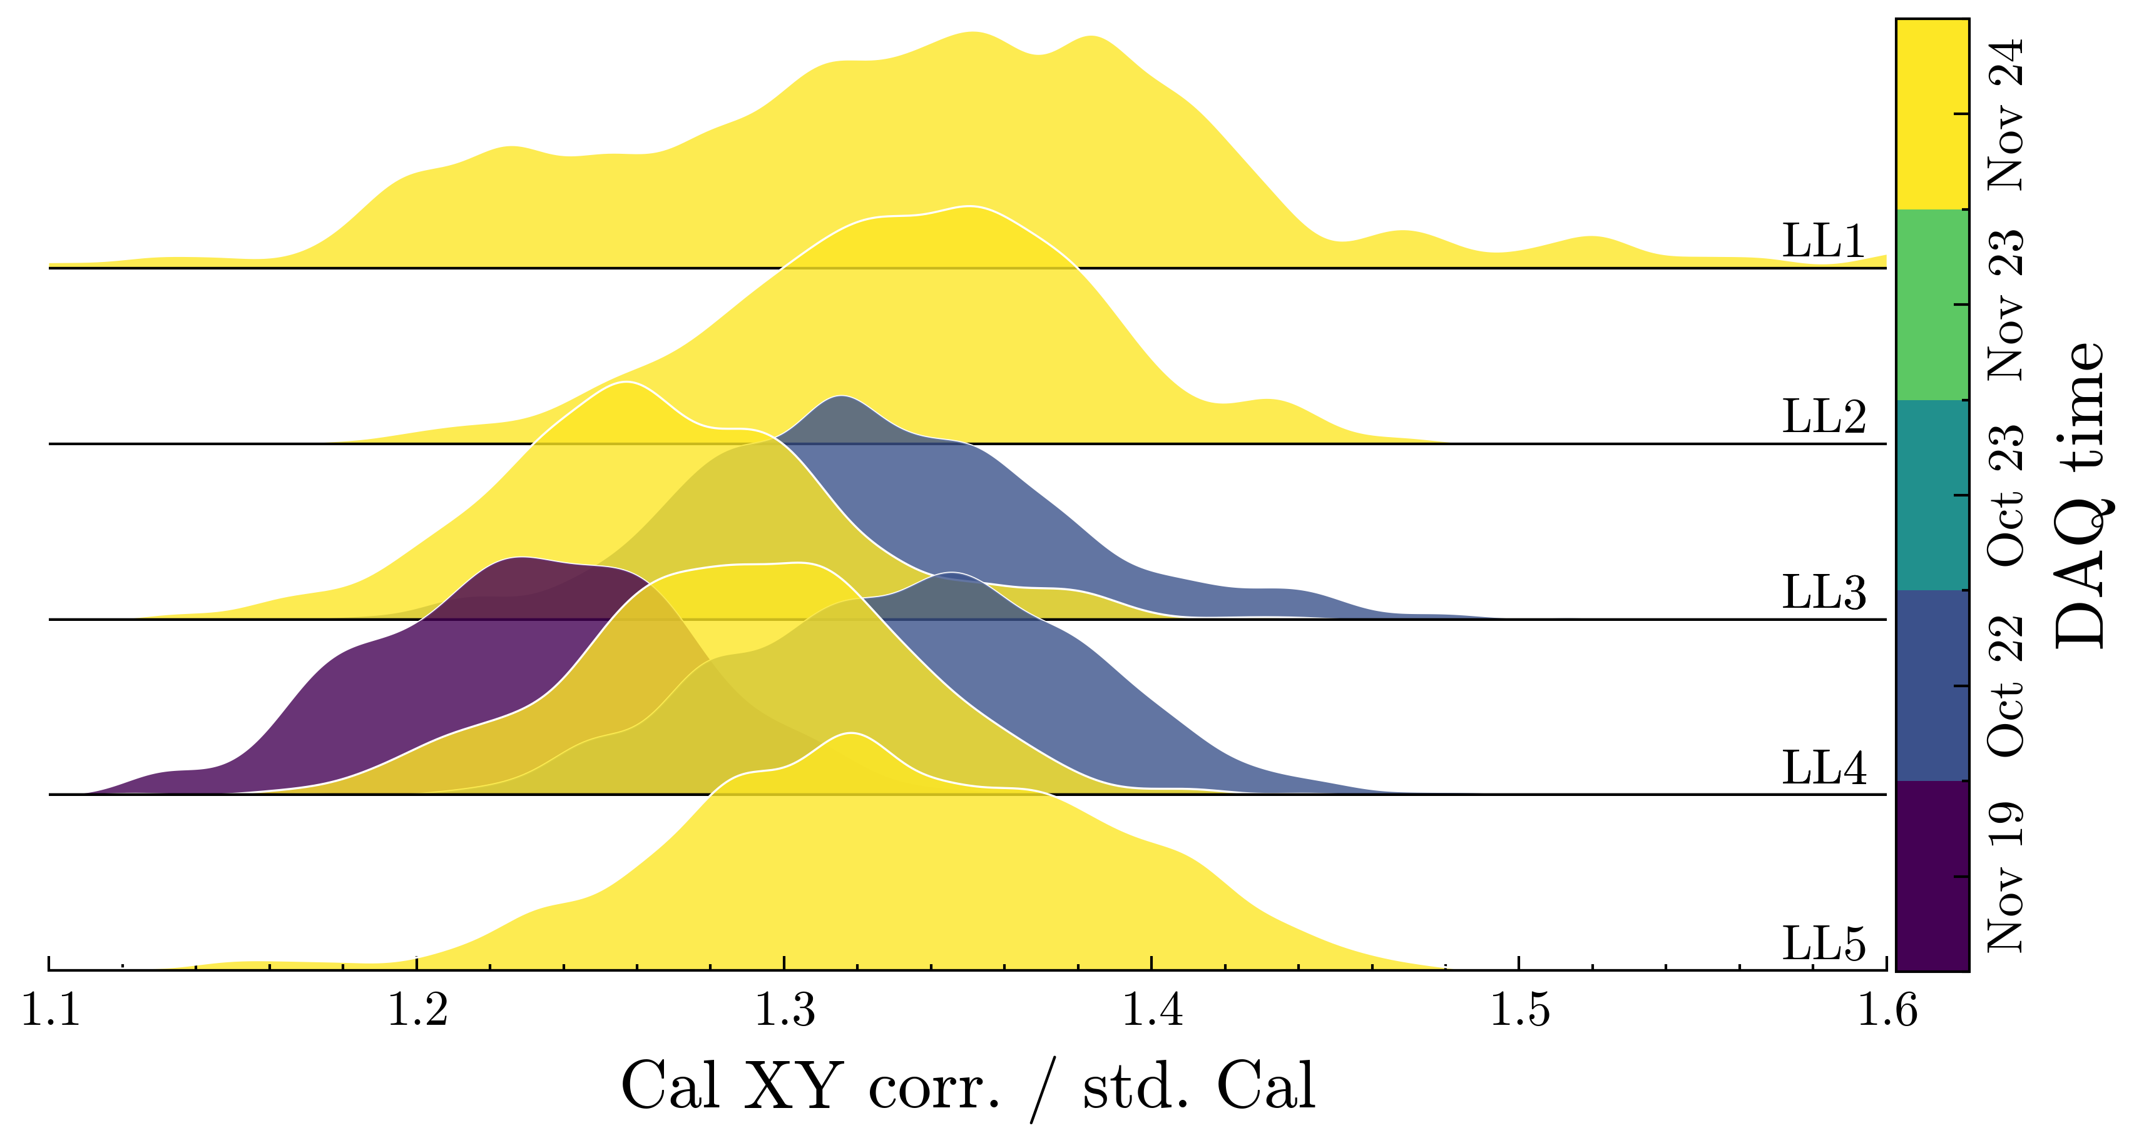
Status/Result of last measurement campaign

Slide 7
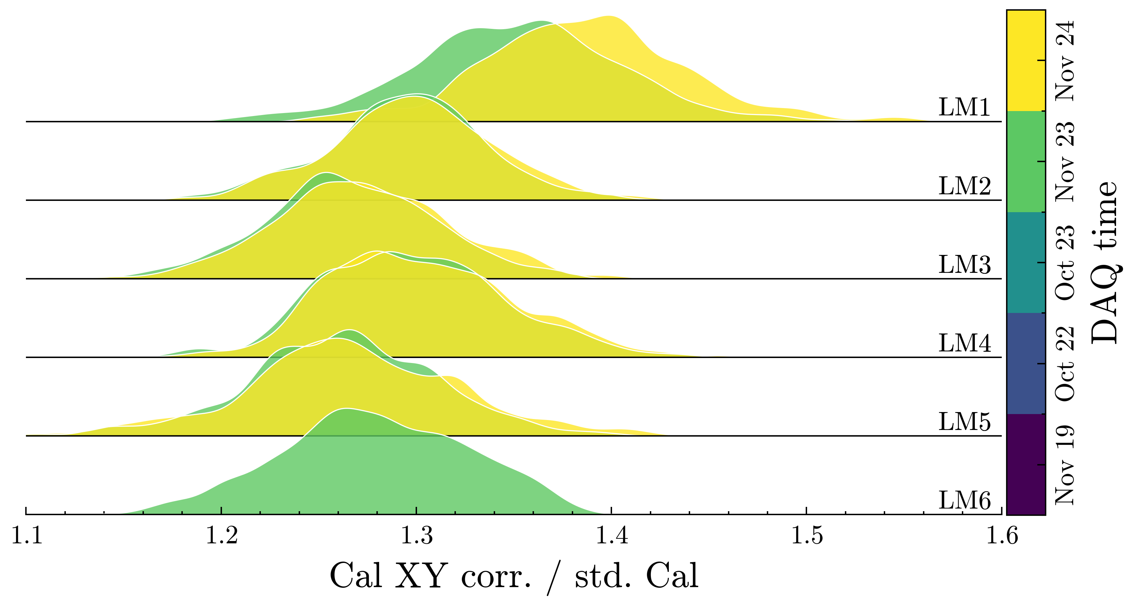
Status/Result of last measurement campaign

Slide 8
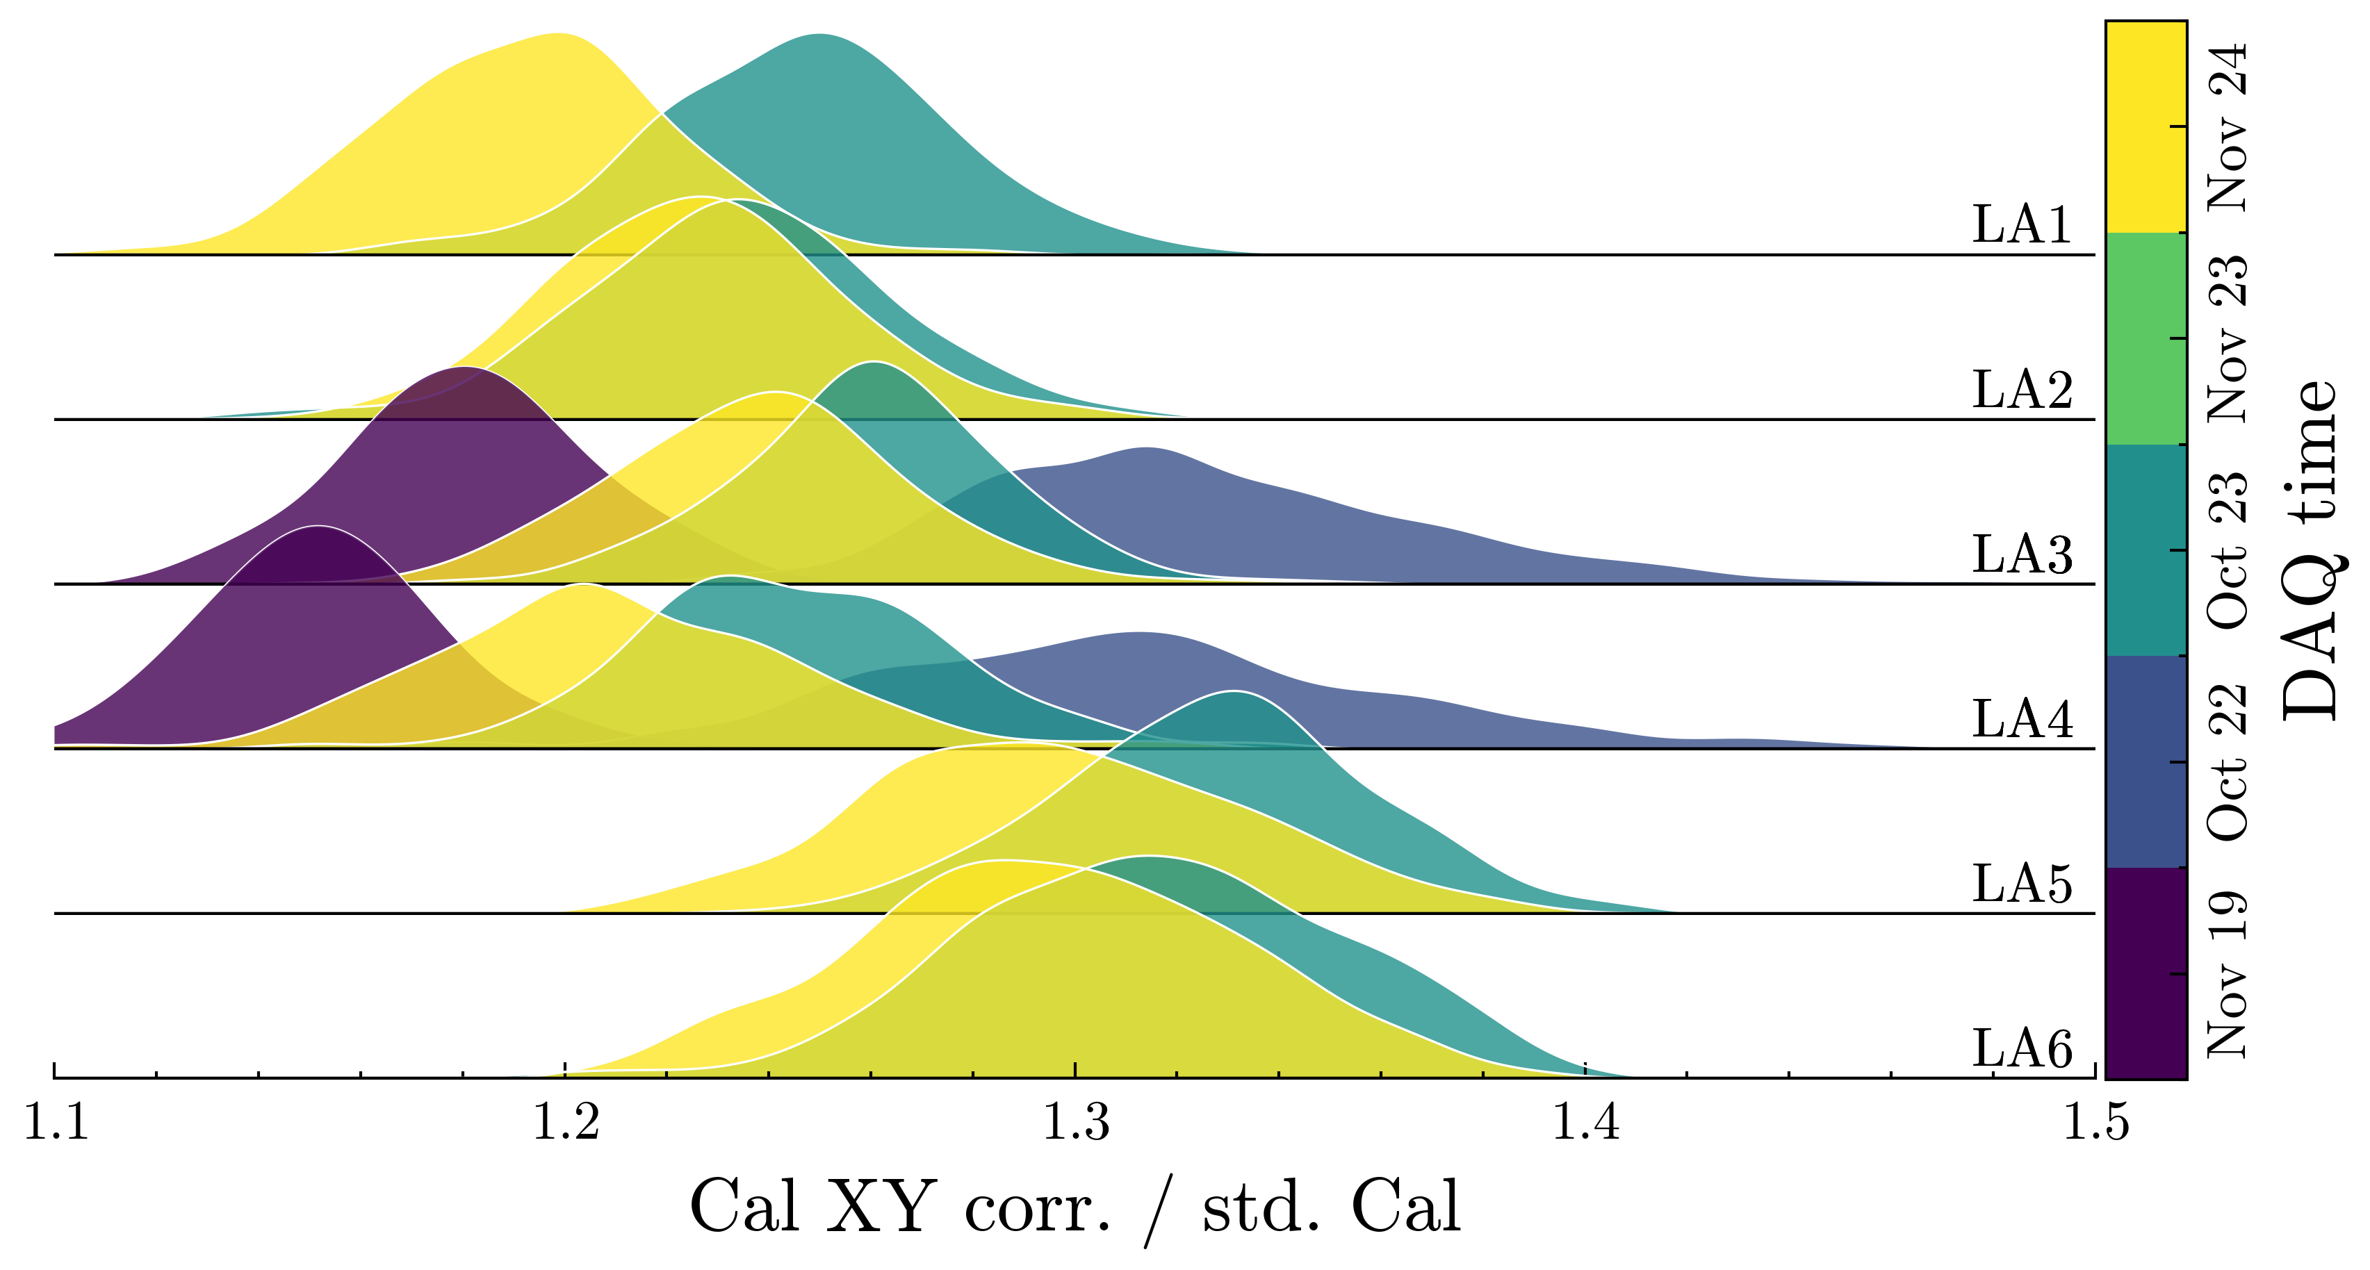
Status/Result of last measurement campaign

Slide 9
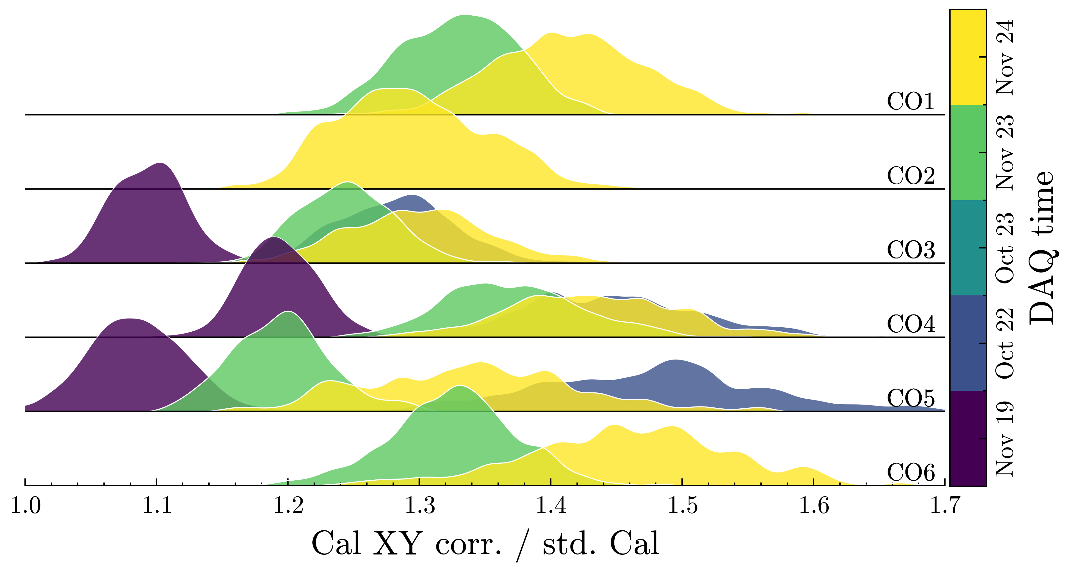
Status/Result of last measurement campaign

Slide 10
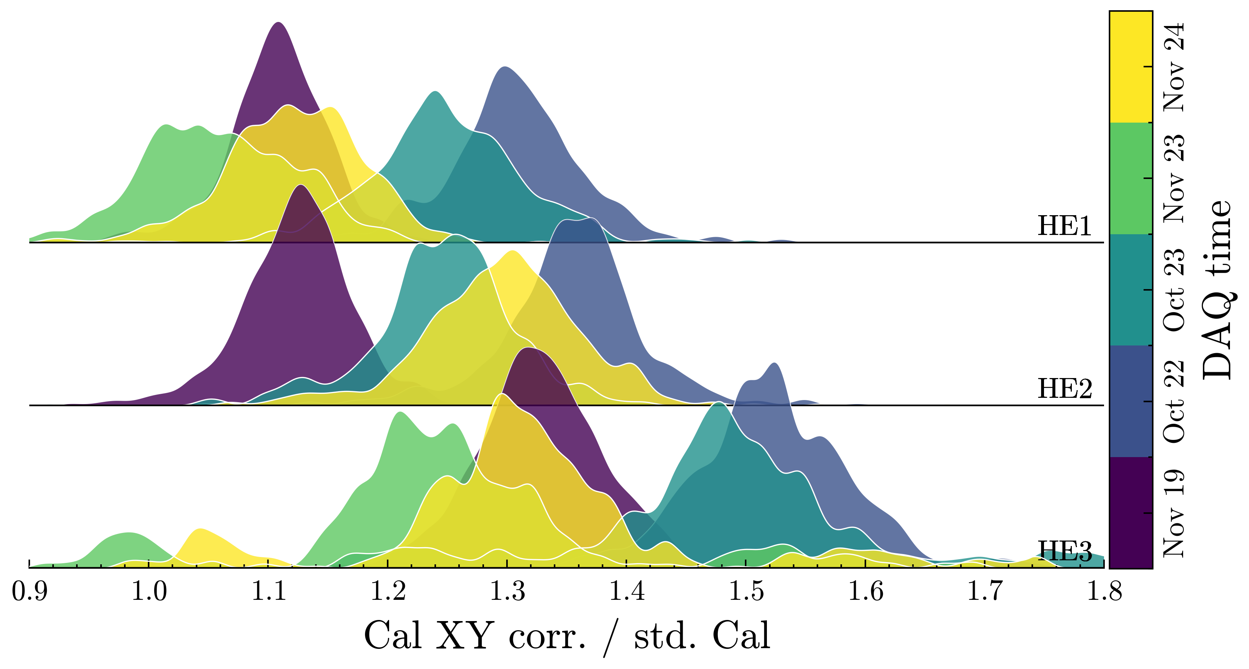
Status/Result of last measurement campaign

Slide 11
Backup

