Slide 1
Introduction

Slide 2
Energy calibration @ FD (and SD by cross calib.)
Number of observed photons
Calibration constant
Signal strength in camera

Slide 3
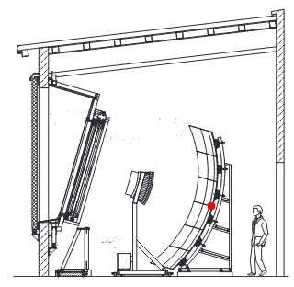
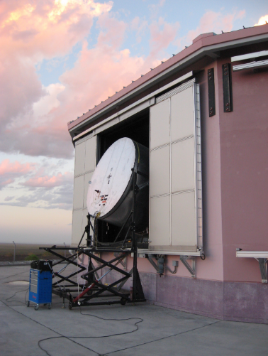
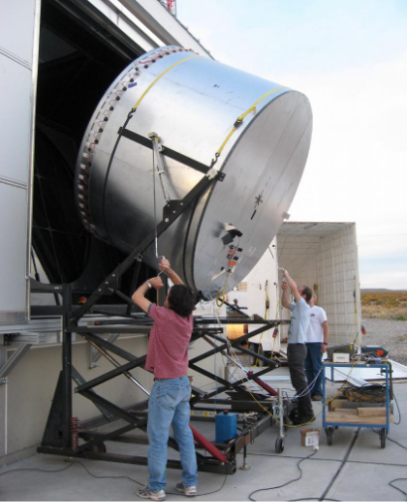
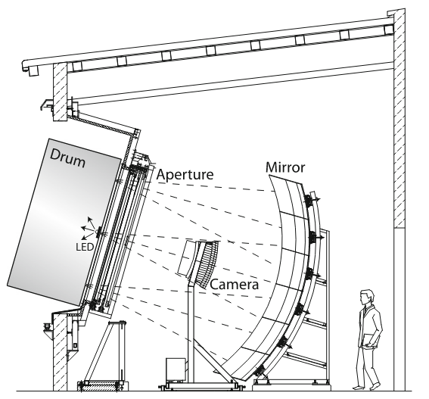
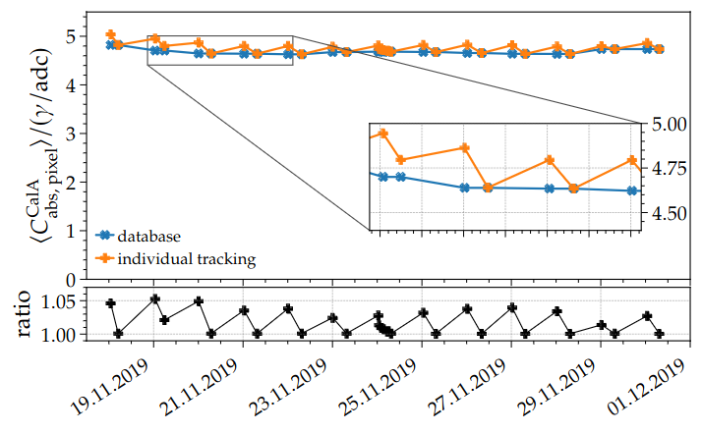
Energy calibration @ FD (and SD by cross calib.)
Track relative drift by exposing camera to known light source
Blind to changes in mirror/filter!
Combined calibration error of ~9%
2013
Expose telescope to lightsource and measure response to (known) signal
Mean pixel calibration constant for 2-week period in november 2022, from Calibration A

Slide 4
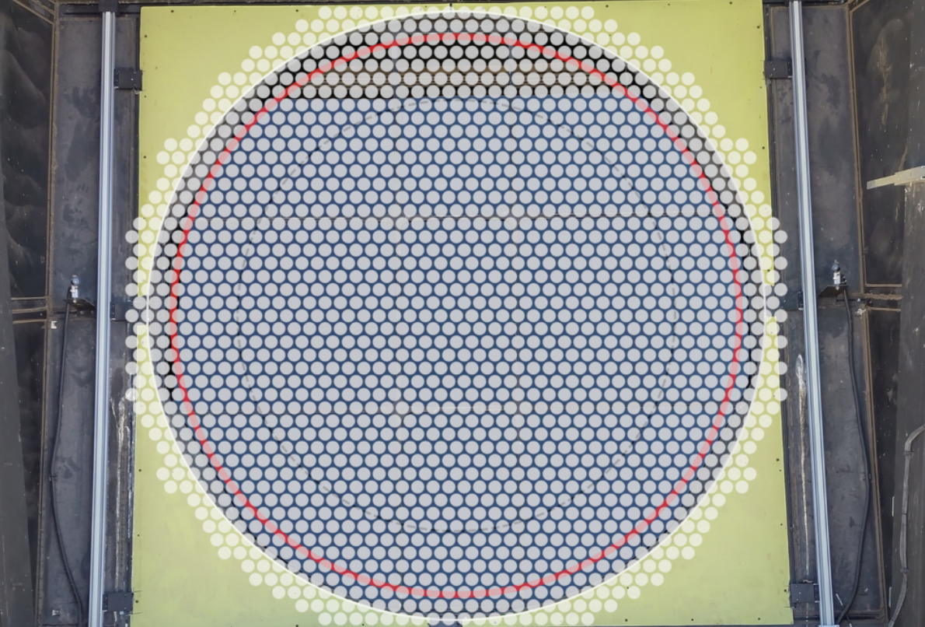
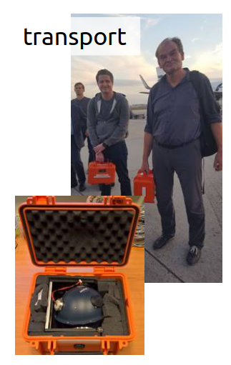
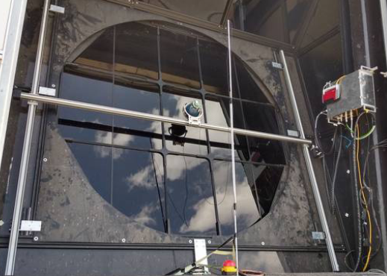
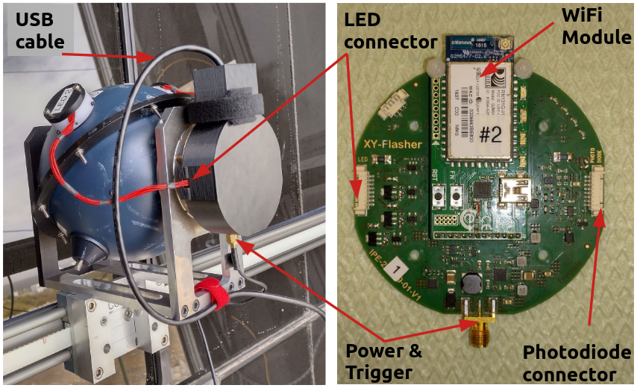
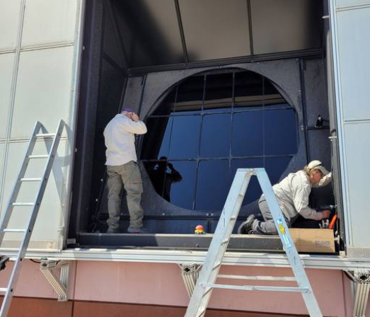
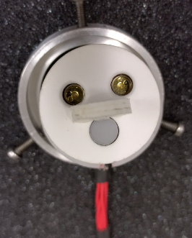

The XY Scanner – size matters
  Sum of many measurements at different positions mimic the drum
  Portable light source
  Absolute calibration is possible on- and off-site
  Scanner control
  Light source
  X stage
  Y stage
LED

Slide 5
Probing the light source

Slide 6
Backup

