Slide 1
SSD online calibration

Slide 2
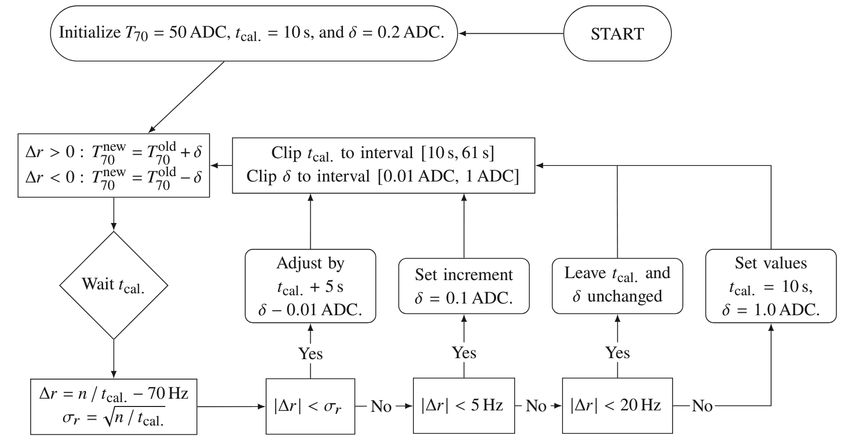
Recap
Estimate MIP peak independently for LS
Monitor SSD performance/exposure, trigger on scintillators
Accurate to ~5% *
GAP2024_023
GAP2024_065
PoS UHECR2025, 085

Slide 3
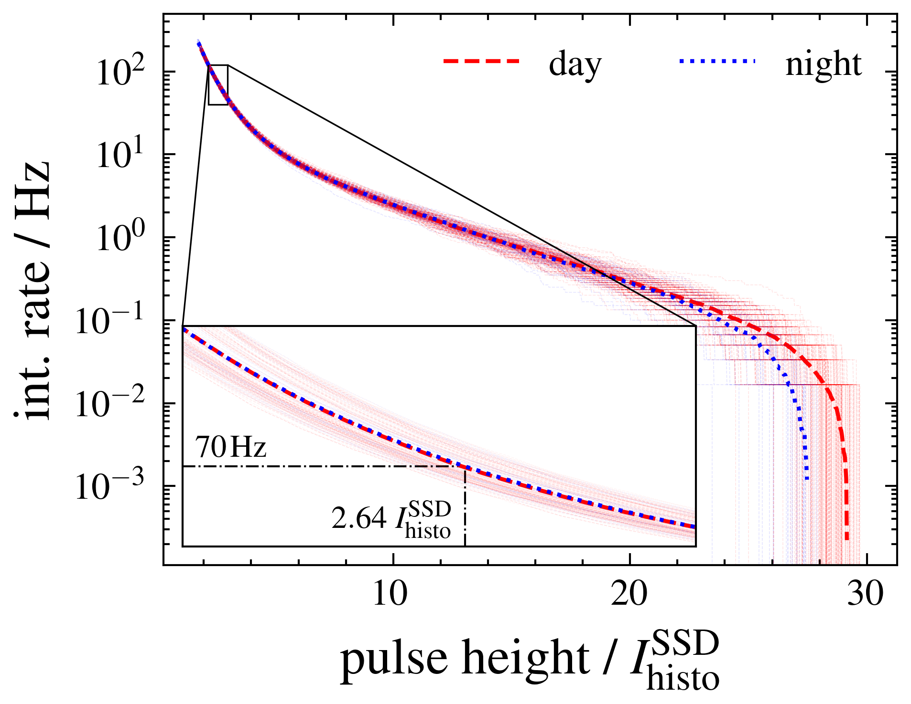
Recap
T70 trigger threshold correlates strongly with MIP peak
Get rate-threshold-relationship
from dedicated acquisition
Very similar to WCD calibration
Different implementation in LS

Slide 4
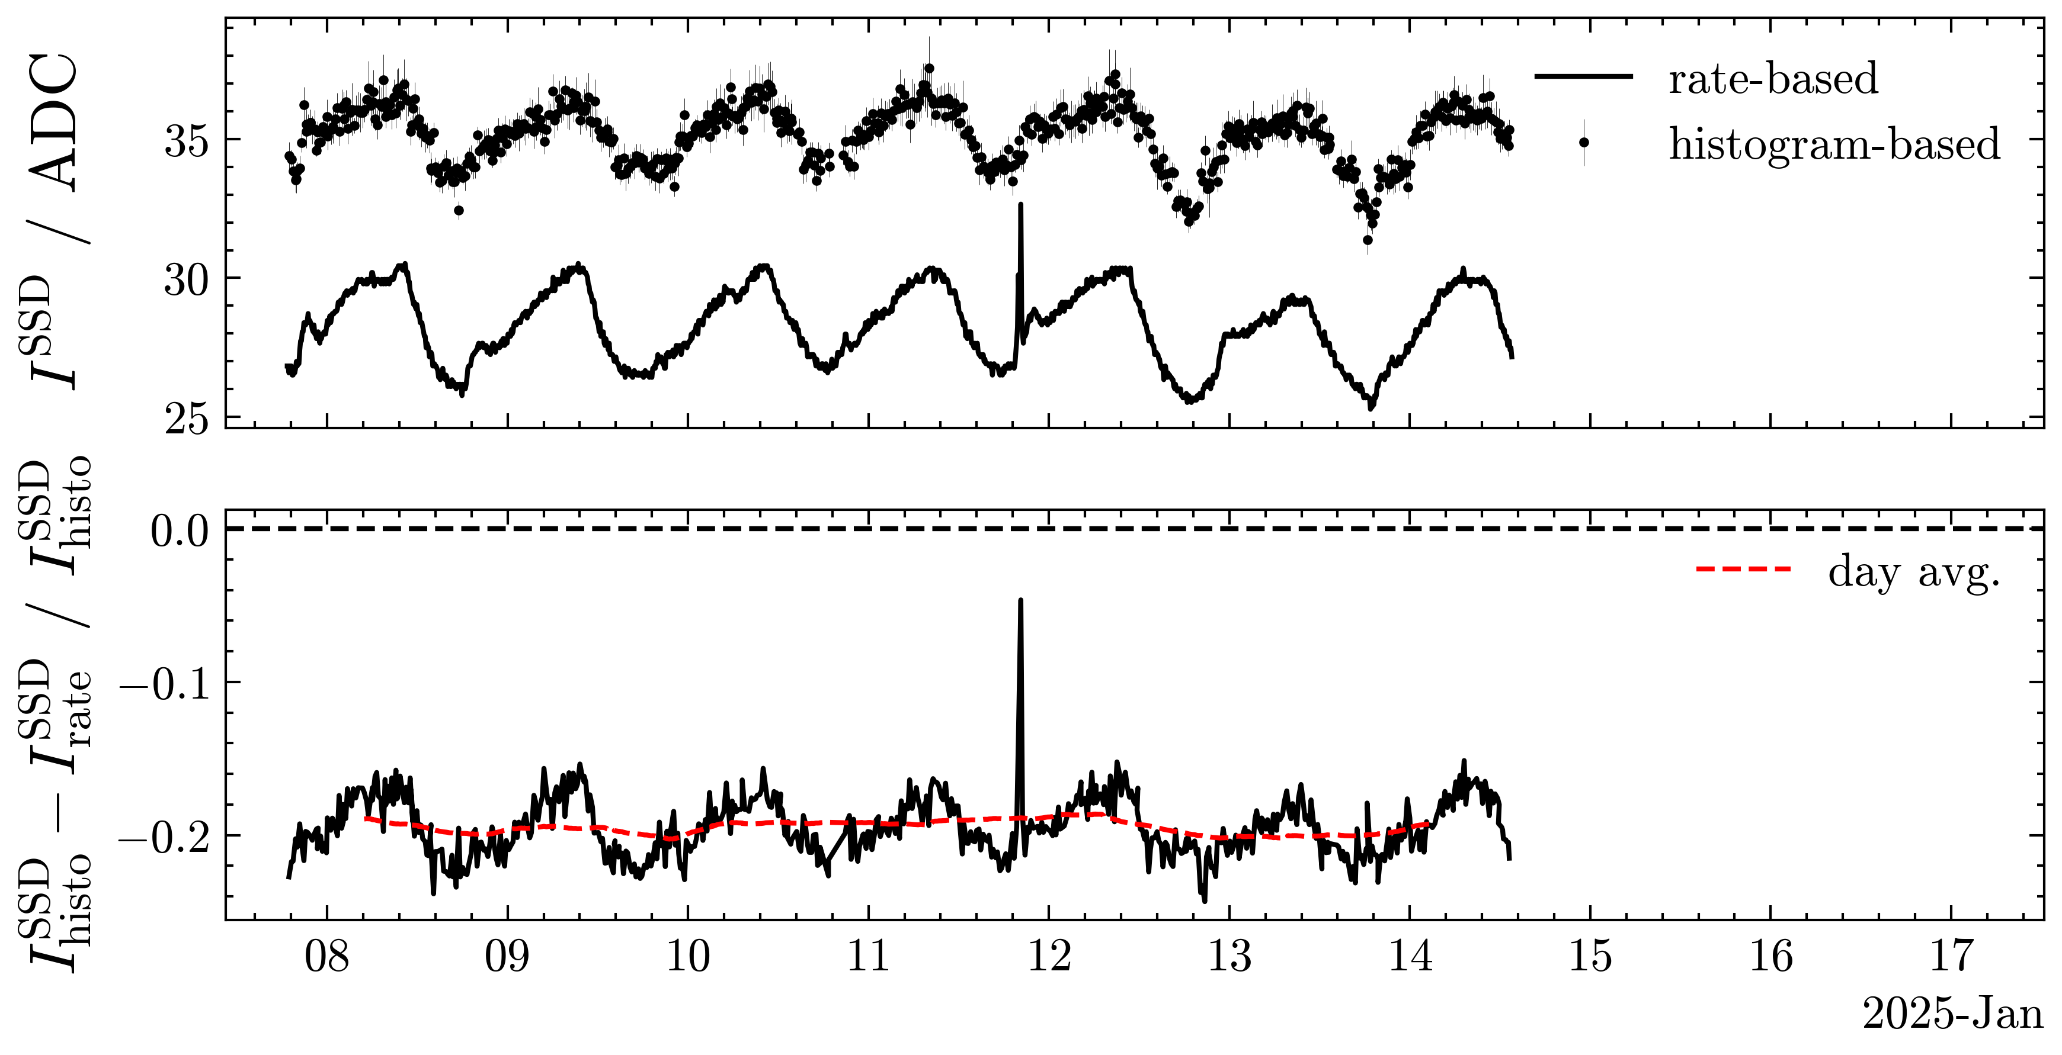
Histogram vs. Rate offset

Slide 5
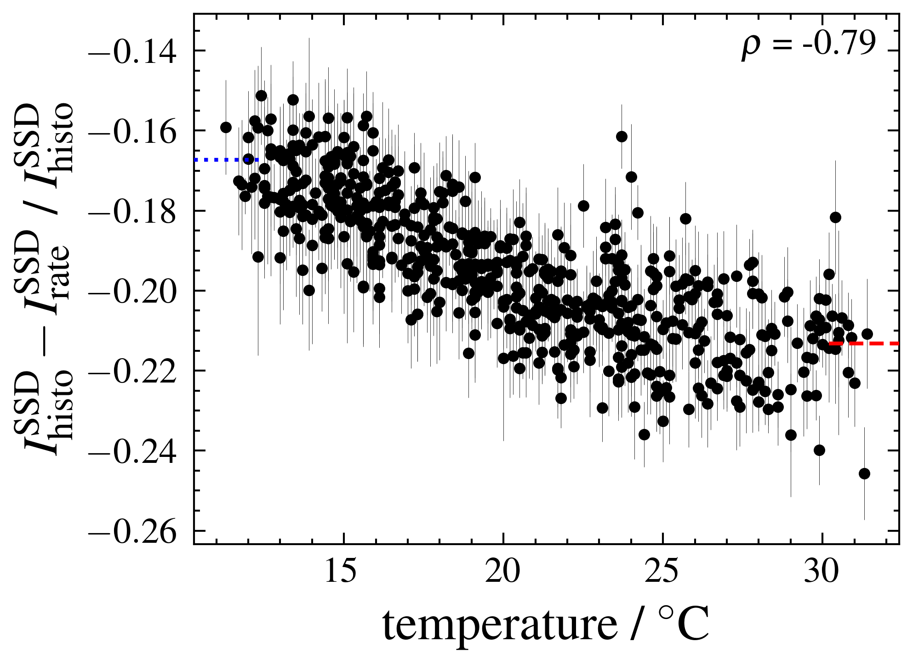
Histogram vs. Rate offset
~15-20% offset when comparing offline/online MIP peak
Temperature modulation ~5% small, but expected
Station (hardware) independent
No (big) seasonal fluctuations
Independent of threshold cut
Different station configuration during dedicated acquisitions?

Slide 6
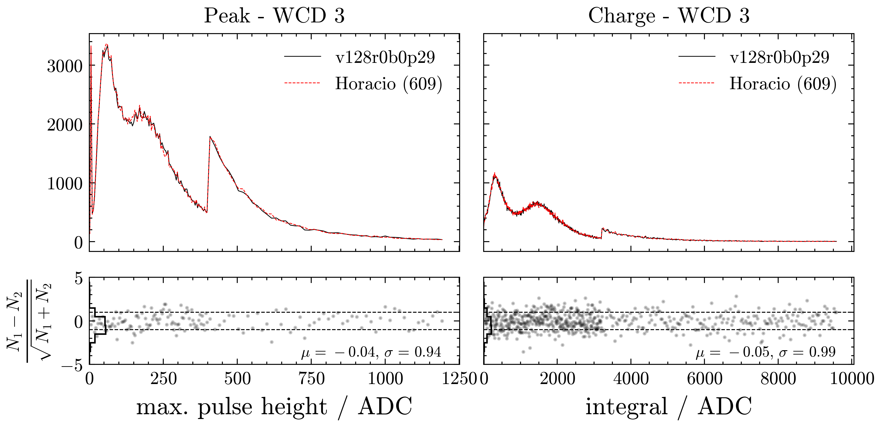
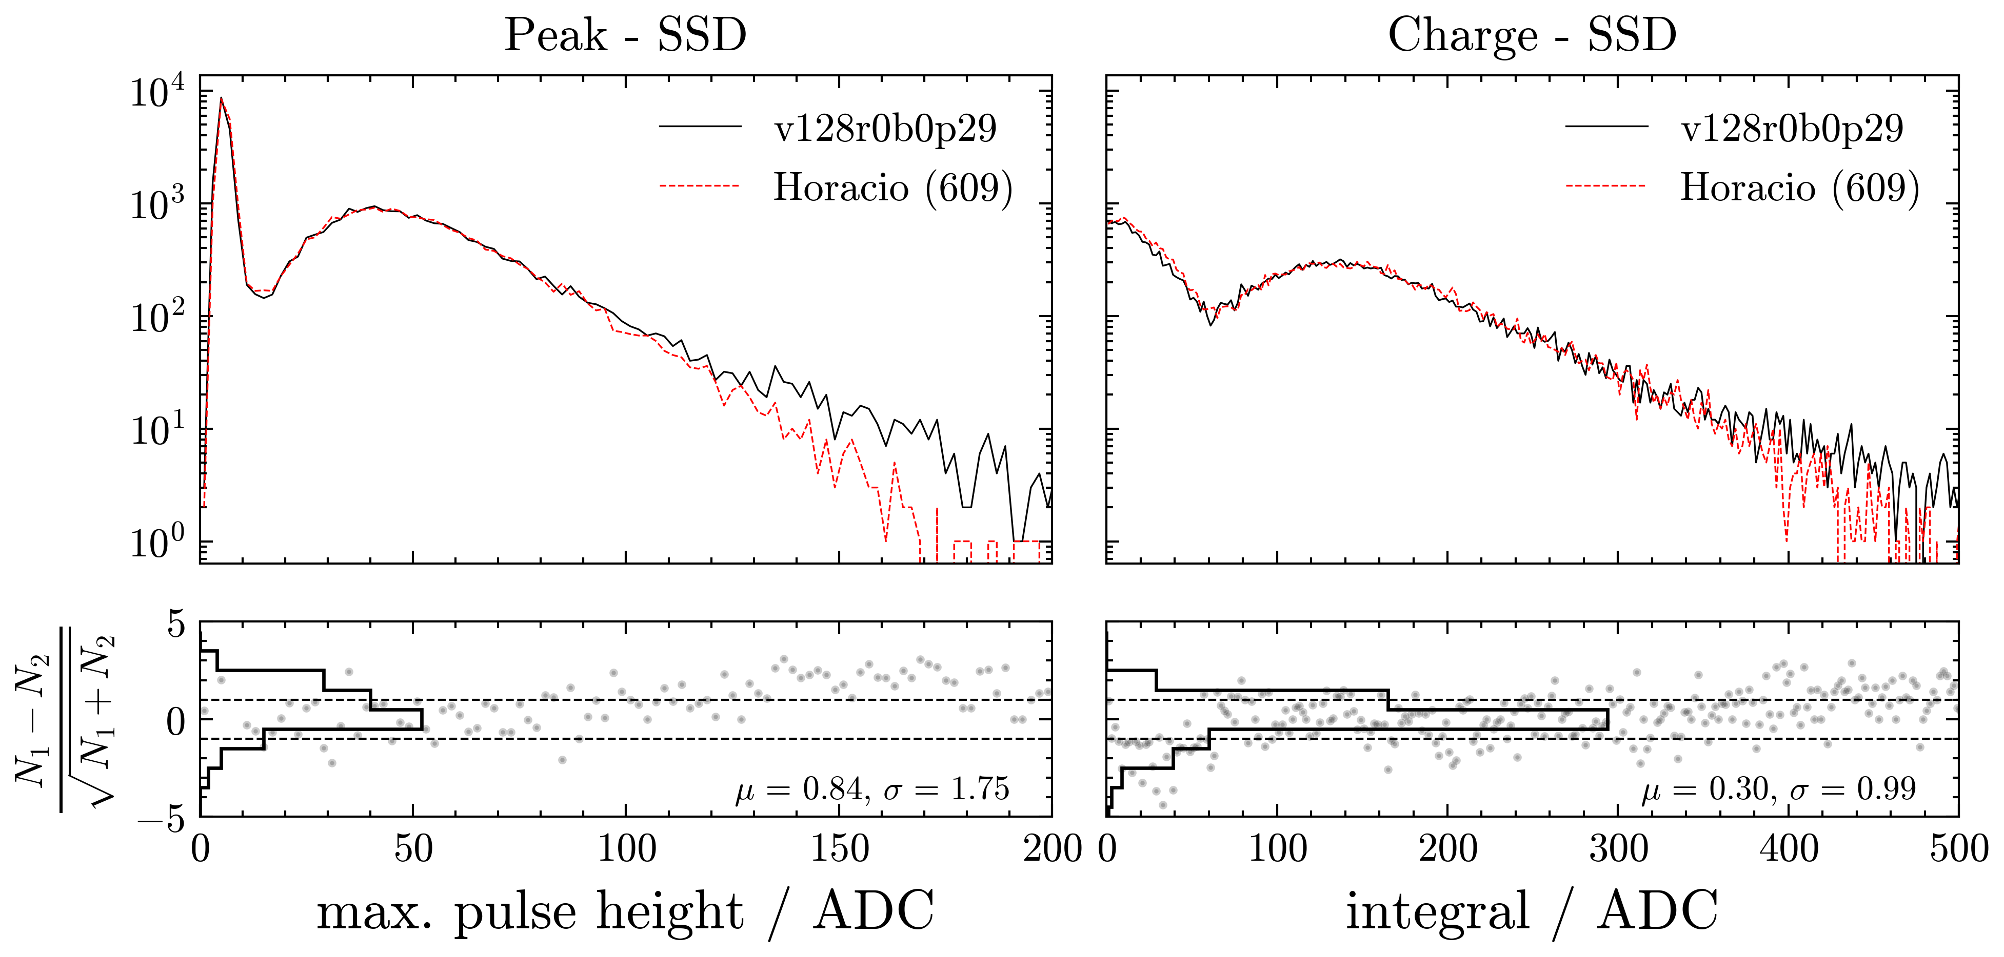
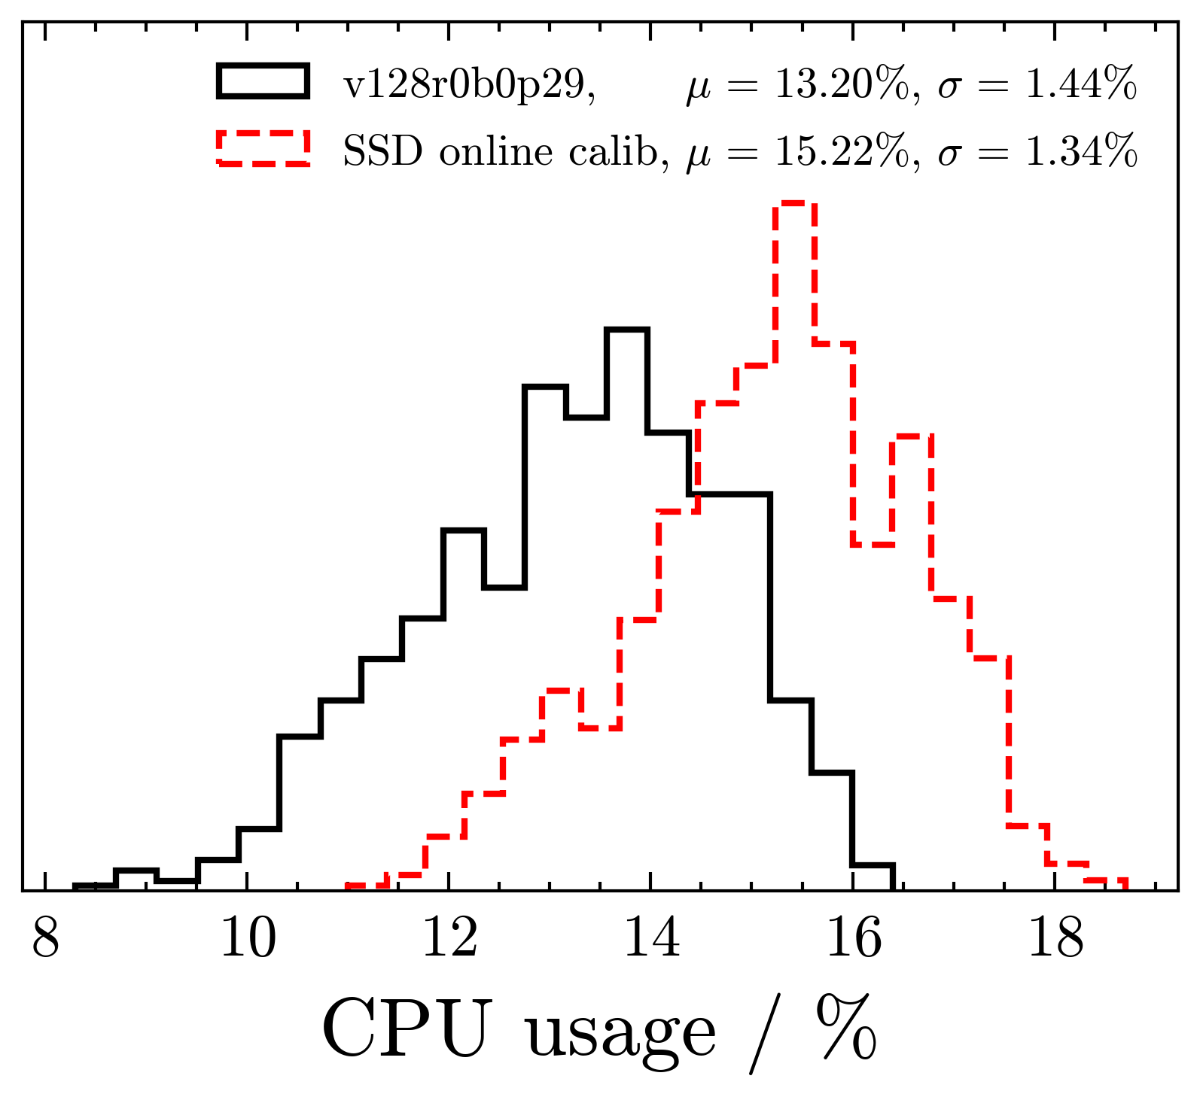
CDAS/LS implementation and performance
Performance in LS DAQ:
  Different trigger settings!
  Muon histograms unaffected
  ~2% overhead in CPU usage
  >5000 hours of stable DAQ

Slide 7
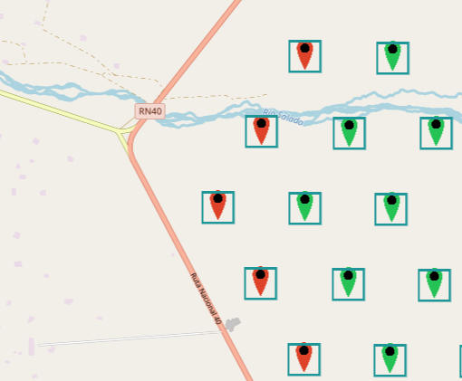
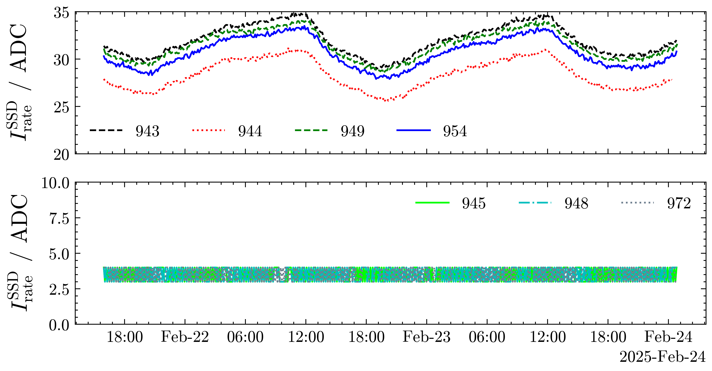
CDAS/LS implementation and performance
Implementation in CDAS
  Online MIP Peak and T70Rate implemented in CalMon & ready to go
  Information not yet passed to sd_* files
HEAT
Las Leñas
Las Leñas

Slide 8
Summary and outlook
SSD online calibration fully implemented in UUB DAQ *
CDAS status: Implemented in Mr (mc files), not yet in Eb (sd files)
Deployment to full array planned once Eb implementation done
Define SSD-ToT like trigger with new SSD online calibration
Analyse trigger efficiency & background trigger rate
  Photon search?

Slide 9
Backup

Slide 10
