Slide 1
Towards an online MIP calibration

Slide 2
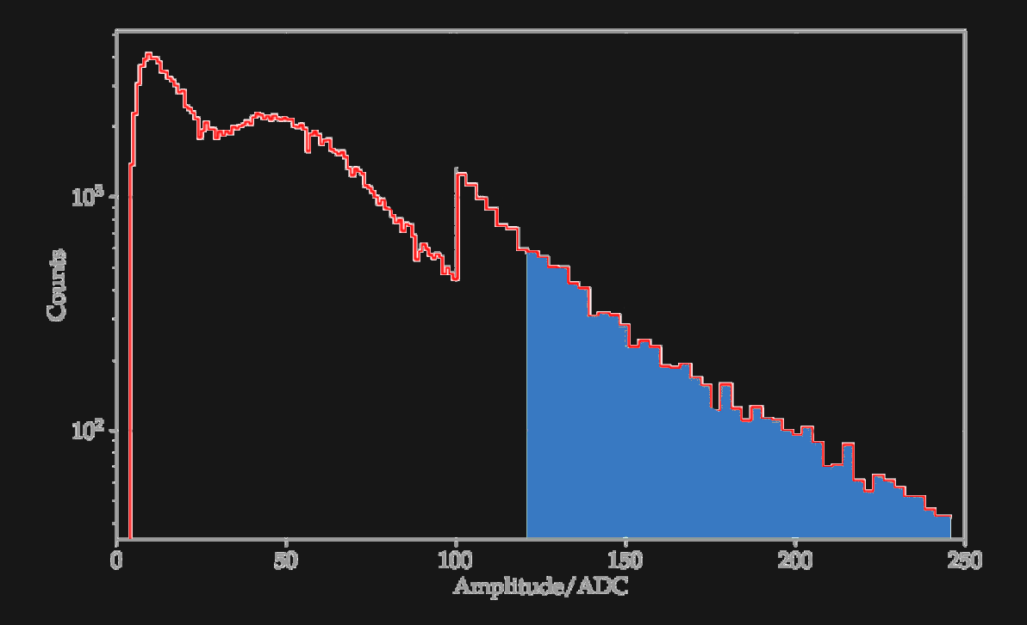
Current (WCD) calibration
WCD offline calibration
  Fit muon hump in histogram
WCD online calibration
  Calibration trigger with threshold , that satisfies:
    Threefold coinc. of
    >1 PMT above
  Iteratively adjust threshold until 70 Hz rate is reached
  Threshold equals
  Accurate to ~2%
  See alsp GAP2023-049
Streich 2022
omnidirectional muon hump
~
change in binning

Slide 3
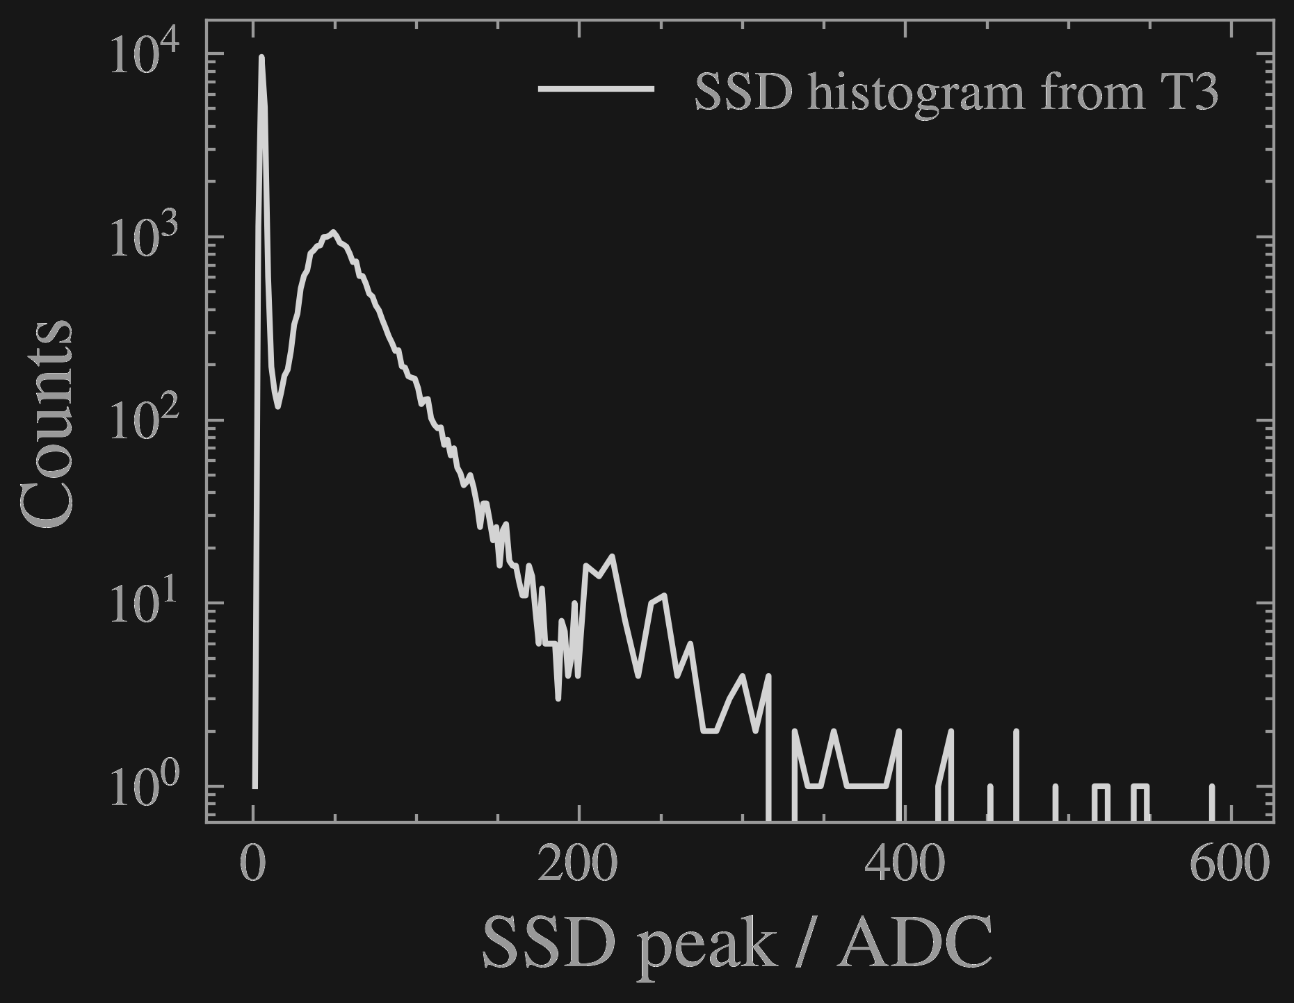
Setting up rate/threshold relationship
870,000 SSD histograms from SD-1500 T3s in Jun/Dec 2023
Bootstrap muon events according to histo to estimate
Characteristic shape
Scale differs due to gain
determined by:
  Weather
  Electronics
  ???
Does there exist a stable rate/threshold relationship?

Slide 4
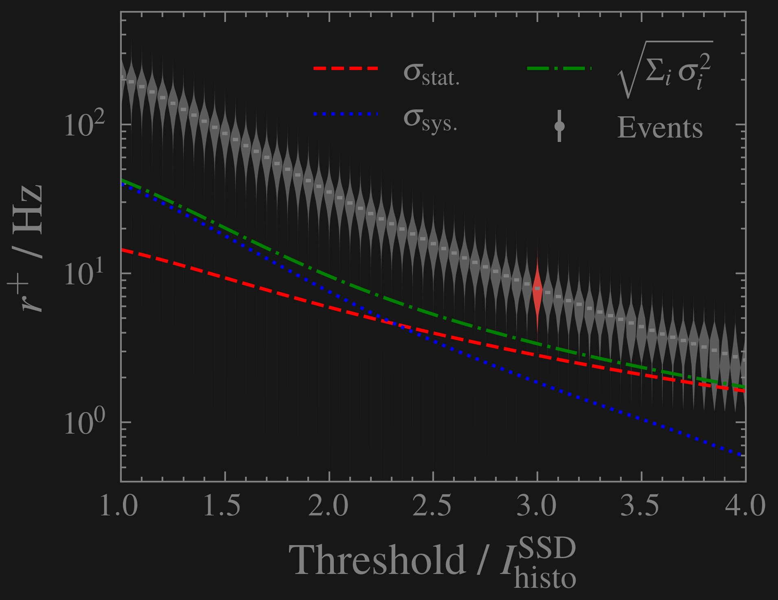
MIP → Rate
Fit parabola to histogram to obtain “true”
For threshold in {1.0, …, 5.0} :
  Count histo entries above
  Per station: remove outliers at 3σ
  Per station: take mean of samples
  Divide by histogram acquisition time (61s)
  Average across all stations
Systematic: station-to-station fluctuations ~20%
Statistical: Poisson error on counts above threshold

Slide 5
MIP ← Rate
Adjust threshold [ADC] of SB trigger until rate converges to Hz
given as (read off , from plot)
Compare and “true”

Slide 6
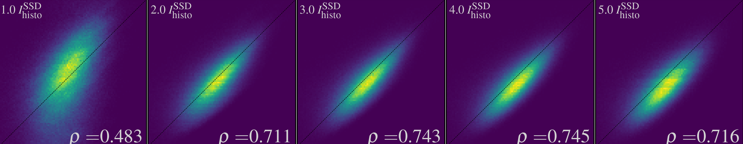
MIP ← Rate
Adjust threshold [ADC] of SB trigger until rate converges to Hz
given as (read off , from plot)
Compare and “true”
Stron EM influence at low thresholds
Best correlation at intermediate values
Large sampling error at very high thresholds

