Slide 1
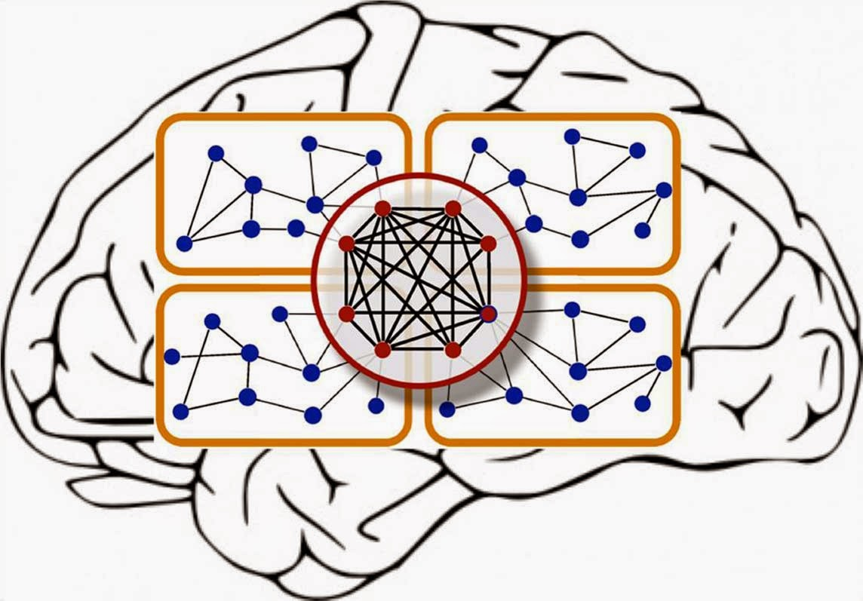
Hands-On Deep Learning
with MatConvNet
www.cvc.uab.es/~gros/index.php/hands-on-deep-learning-with-matconvnet/
15th January of 2015

Slide 2

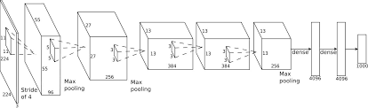


Training
‘antelope’
‘ballet’
‘boat’
Empirical Risk

Slide 3
Training
Stochastic gradient descent:
Minibatch gradient descent: Use groups (called minibatches) of images to update the parameters.

Slide 4
Training
error
General recipe for stochastic gradient descent:
Guess an initial learning rate.
If the error keeps getting worse or oscillates wildly, reduce the learning rate.
If the error is falling fairly consistently but slowly, increase the learning.
Towards the end of mini-batch learning it nearly always helps to turn down the learning rate.
Hinton

Slide 5
Contents
Tips and tricks to make it work
Initialization
Vanishing gradient problem
Overfitting - Drop out
Batch normalization

Slide 6
Initialization
The initialization of the networks is very important for (fast) convergence of the network.
INPUT:
Networks convergence faster if its inputs are whitened (linearly transformed to zero-mean and unit variance and decorrelated)
BIASES: initialized to zero.
It is important to observe that weights cannot be initialized with the same value . You need to break the symmetry.
WEIGHTS:
Glorot & Bengio[2010] aimed to keep the variance of the outputs at each layer to be white and unit variance.
Improvement proposed by He et al [ArXiv 2015] for ReLu
weight_filler { type: "xavier“)

Slide 7
Training Deep Networks
Neural networks with one layer can approximate arbitrarely close any network with multiple layers.
However as the number of layers increase the number of nodes to express the same function decreases exponentially.
Problems
Vanishing gradient problem
Overfitting (number of parameters is often larger then number of training examples)

Slide 8
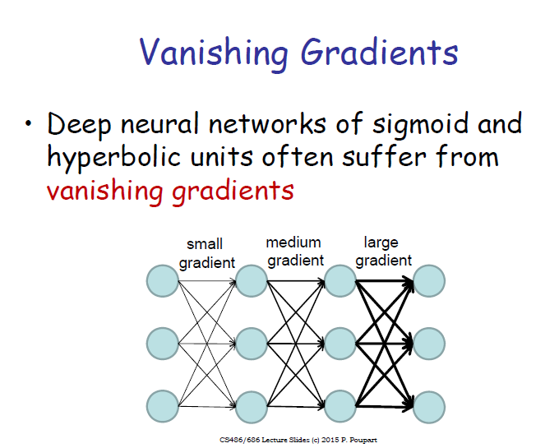
slide credit P.Poupart

Slide 9
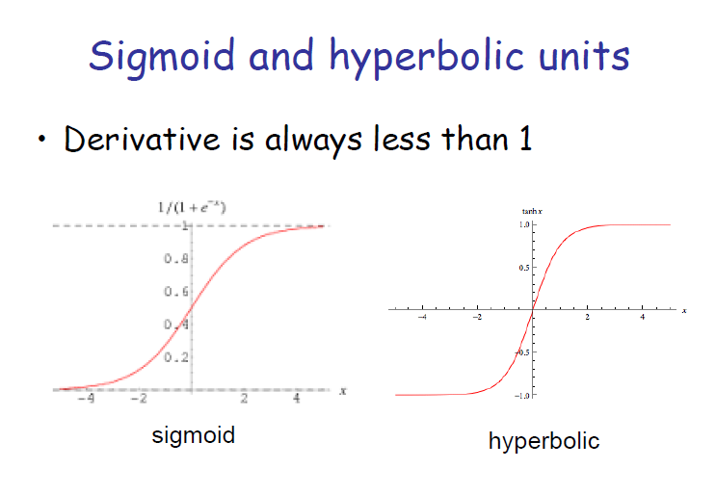
slide credit P.Poupart

Slide 10
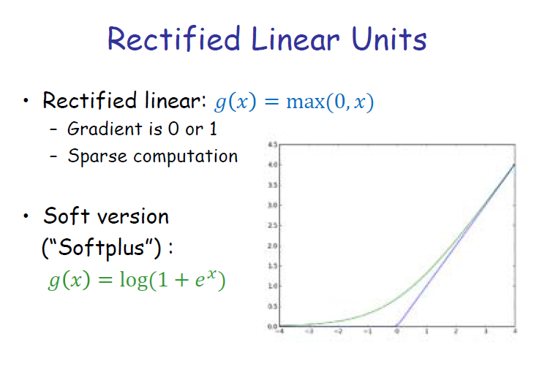
slide credit P.Poupart

Slide 11
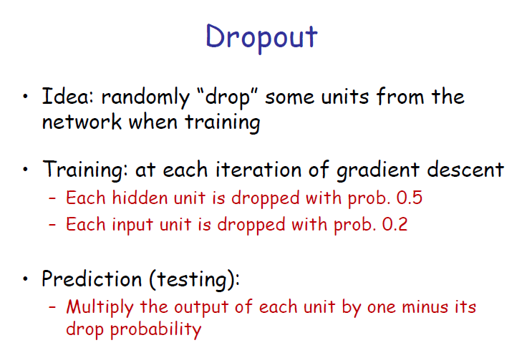
slide credit P.Poupart

Slide 12
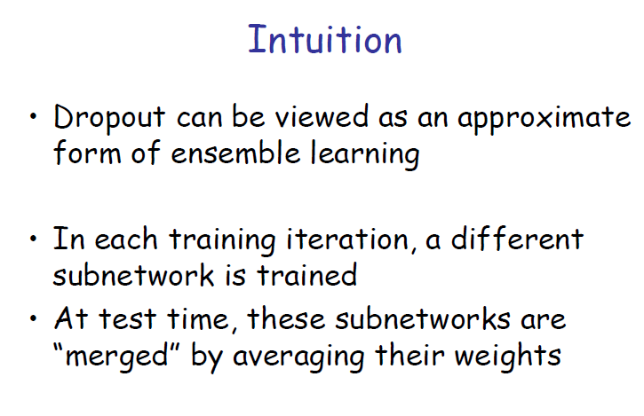
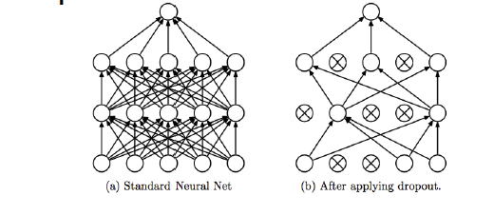
slide credit P.Poupart

Slide 13
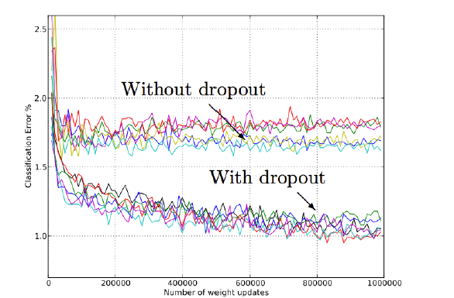
Dropout
You have to play with the best positioning of the dropout (often it is placed in between the fully connected layers).
slide credit R.Fergus

Slide 14
Batch Normalization
Batch normalization is recent work from Sergey Ioffe and Christian Szegedy [ICML2015]
We apply whitening to the input, and choose our initial weights in such a way that the activations in between are close to whitened (‘Xavier’ inialization).
It would be nice to also ensure whitened activations during training for all layers.
Training of networks is complicated because the distribution of layer inputs changes during training (internal covariate shift)
Making normalization at all layers part of the training prevents the internal covariate shift.

Slide 15
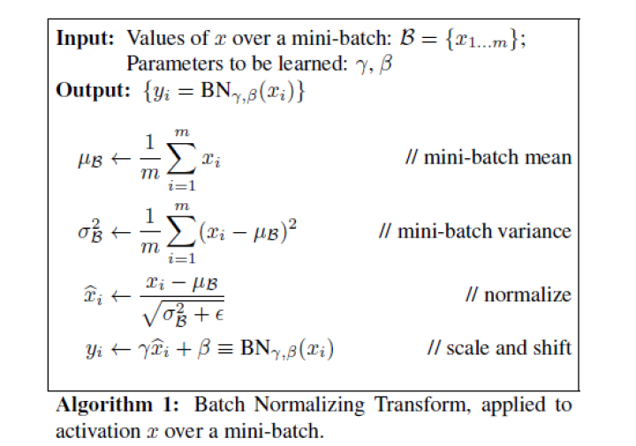
Batch Normalization

Slide 16
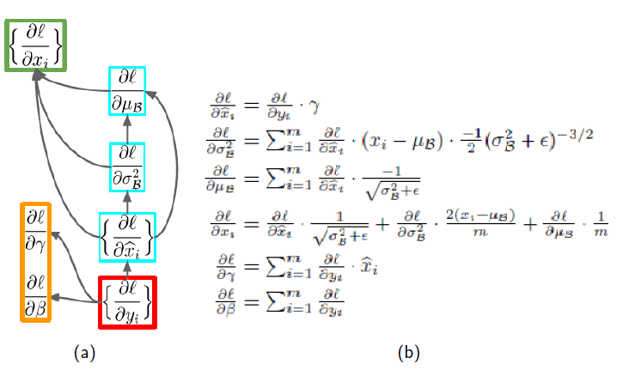
Batch Normalization
Backpropagation with Batch Normalization

Slide 17
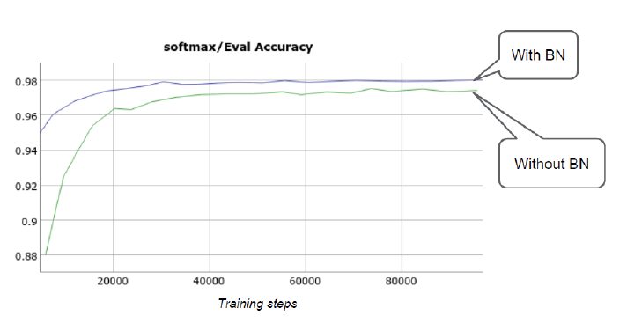
Batch Normalization
Results on MNIST [Ioffe & Szegedy2015]

Slide 18
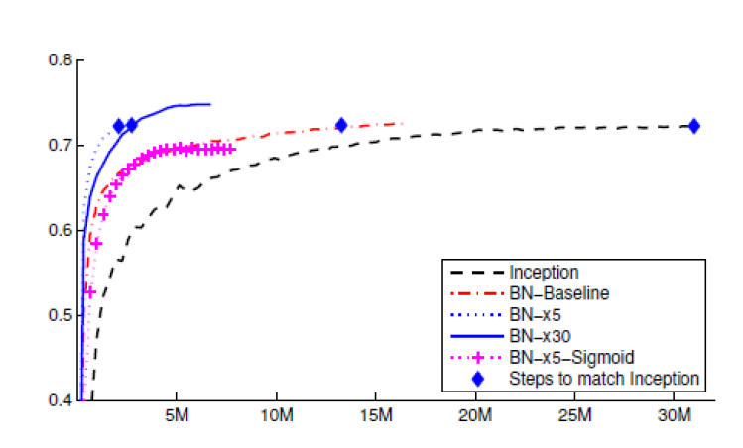
Batch Normalization
14x faster to reach same results
Learning rate multiplied with 5 and 30.
Results on ImageNet [Ioffe & Szegedy2015]

Slide 19
Conclusion
Correct initialization is crucial for the succesfull application of DNNs.
Dropout is an effective method to prevent overfitting.
Batch Normalization prevents the internal covariate shift and therefore allows higher learning rates (It seems that Dropout is not necessary when using Batch Normalization)

Slide 20
Questions!?

