Slide 1
Group Exercise

Slide 2
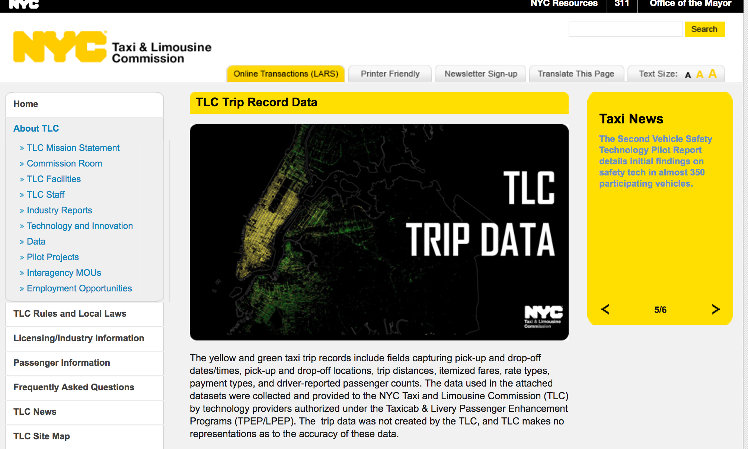
NYC Taxi Trip Data
http://www.nyc.gov/html/tlc/html/about/trip_record_data.shtml

Slide 3
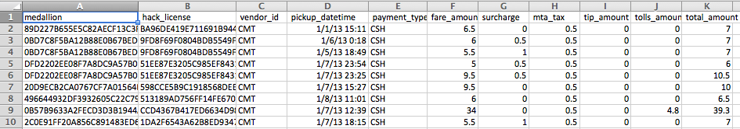
Taxi Data / Fares

Slide 4
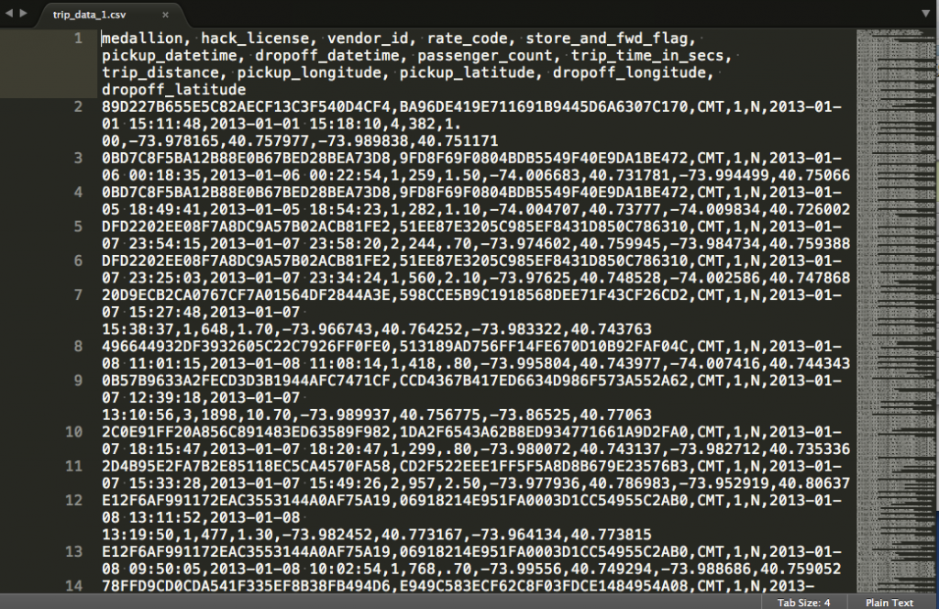
Taxi Data / Trips

Slide 5
Design a system to receive these events in real time
What architecture would you use to handle the data, to support:
Building dashboards for city planners (taxi, traffic, etc) to provide both real-time and historical views
Public graphical views of high-level analysis (e.g. busy times, average fares, average time taken between two points)
Real time analysis of “busy-ness” to give drivers an app allowing them to know about surges
Monitoring of drivers to know if they are driving too long hours
etc

