Slide 1
Cloud Computing and Big Data Recap of the fundamental theories
Oxford University
Software Engineering Programme
Sep 2016

Slide 2
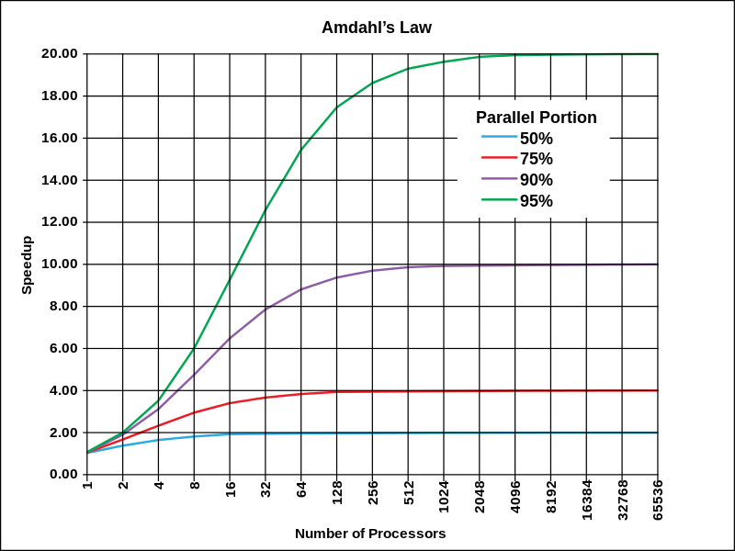
Amdahl’s Law Theoretical speedup given a fixed data size
The speedup of a program using multiple processors in parallel computing is limited by the time needed for the serial fraction of the program, given a fixed size of data

Slide 3
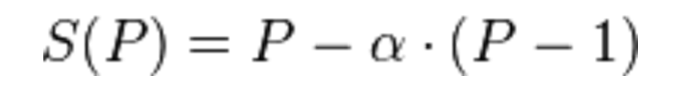
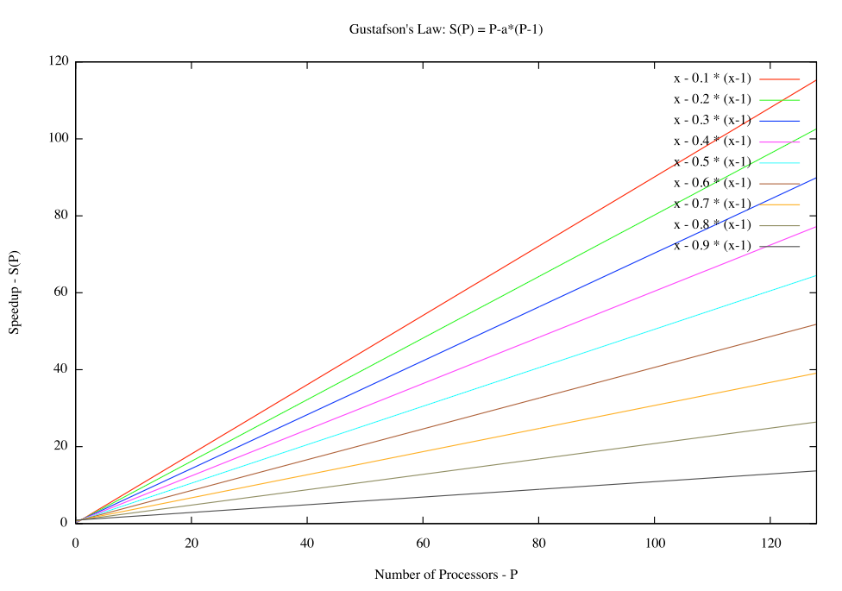
Gustafson’s Law What if the data increases too?
α is the largest
non-parallelizable fraction

Slide 4
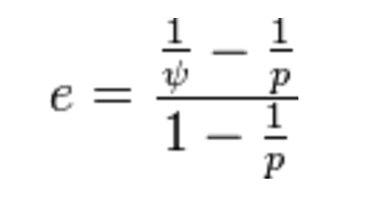
Karp-Flatt Metric
e is the Karp-Flatt Metric
ψ is the speedup
p is the number of processors
e = 0 is the best
e = 1 indicates no speedup
e > 1 indicates adding processors
slows down the system!!!

Slide 5
Karp-Flatt metric
e=0
e=0.3
Performance
e→1 as p increases
1 server
1 server
Number of servers

Slide 6


Shared Nothing Architecture
Server
Disk
Load Balancer
Server
Disk
Server
Disk

Slide 7

Elastic Queue Consumers
Pull
Worker pool
Pull
Job
Queue depth
Elastic Scale
Cloud Controller

Slide 8
Load Balancer-based elastic scaling
Worker pool
Client
Load Balancer
Elastic scale
Cloud Controller
Monitoring
Topology update

Slide 9
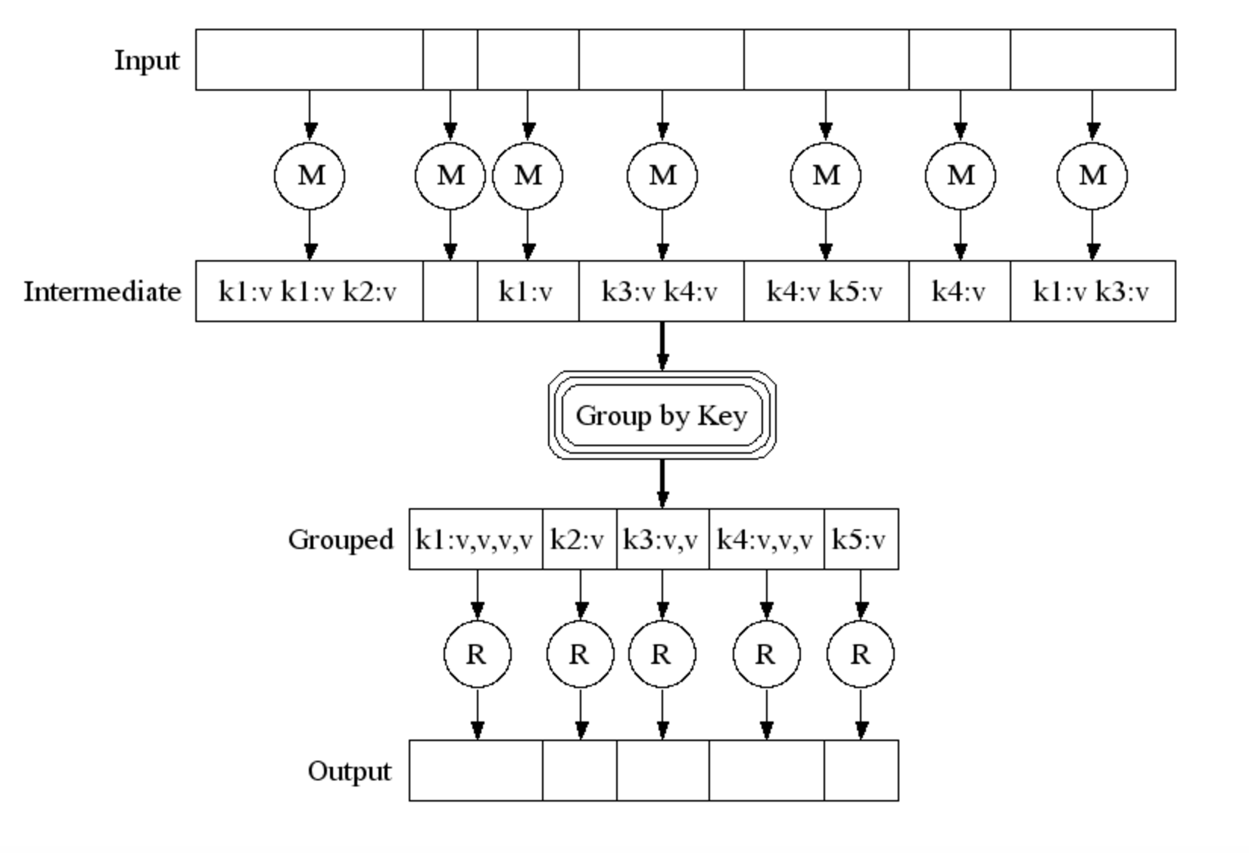
Pictorially

Slide 10
Partitioning / Sharding
A-I
Server
Disk
J-R
Load Balancer
Server
Disk
S-Z
Server
Disk

Slide 11
Efficiency
Reduce phase:
We can theoretically process each word in parallel
How?
Shuffle / Sort the results from the map phase by key (word)
Partition by keys
Parallelize the reduce phase

Slide 12
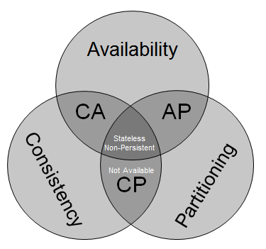
CAP Theorem
Originally proposed by Eric Brewer
Inktomi and Berkeley
Proved in 2002 by Gilbert and Lynch
You can have 2 out of three:
Consistent
ACID
Available
Partitioned
Survive network down between nodes
http://blog.mccrory.me/2010/11/03/cap-theorem-and-the-clouds/

